Slide 1
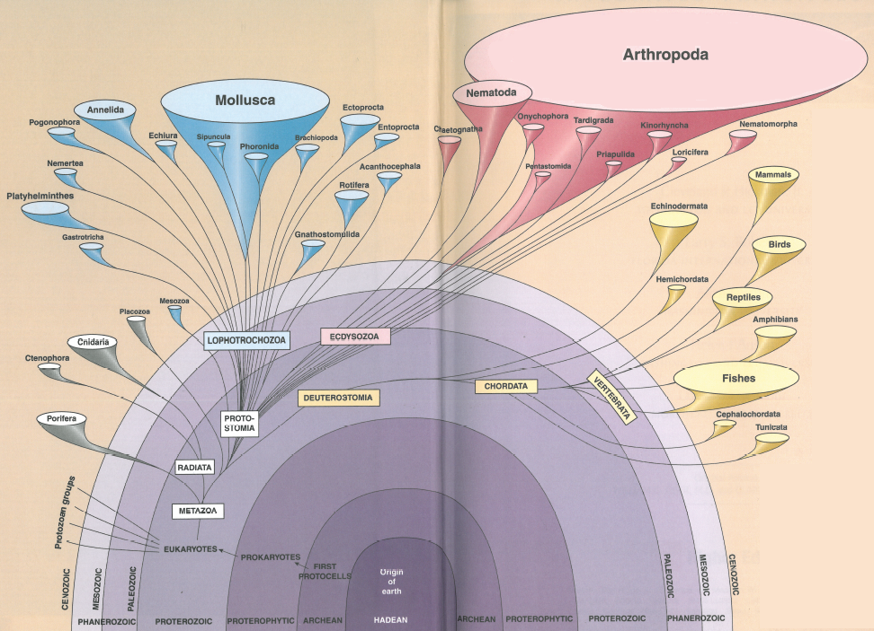

Slide 2
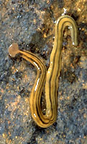
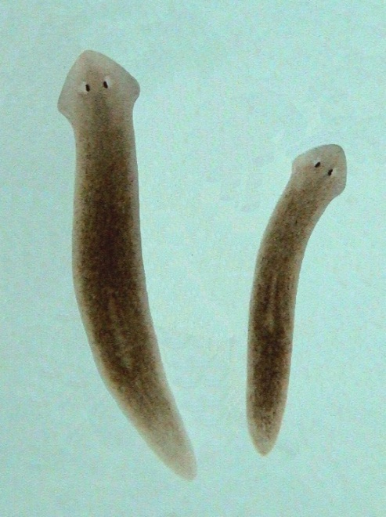
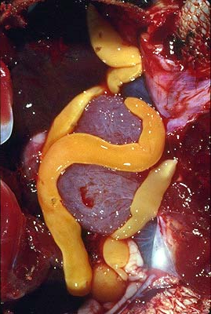
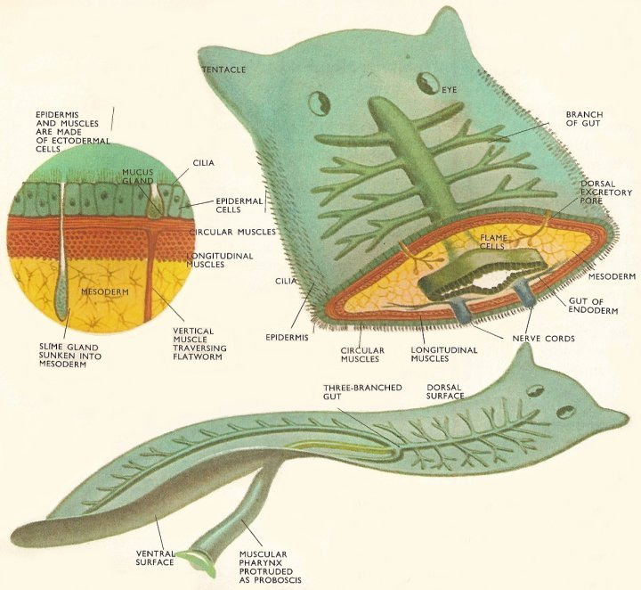
Phylum Platyhelminthes
Flatworms
Simplest bilateral animal
Incomplete digestive tract
No circ sys (gas exchange?)
Synapomorphies:
Hermaphroditic
If free living - move via rows of cilia
25,000 sp.
3 classes
Arthropoda
Mollusca
Chordata
Platyhelminthes
Nematoda
Annelida
Porifera
Echinodermata
Other
Other protozoans
Apicomplexa
Ciliophora

Slide 3
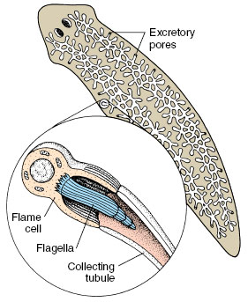
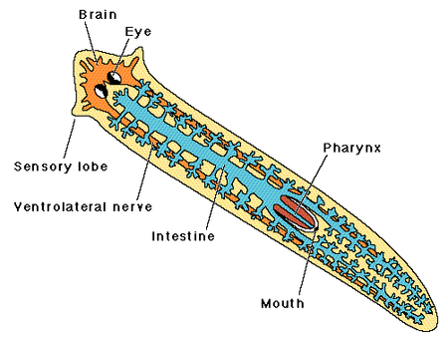

Slide 4
Parenchyma tissue
Parenchyma
Function:
“Skeletal support, nutrient storage, motility, reserves of regenerative cells, transport of materials, interactions between tissues, oxygen storage, perhaps other…”
Conn 1993. The biology of flatworms (Platyhelminthes): parenchyma cells and extracellular matrices

Slide 5
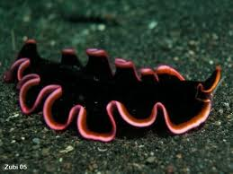
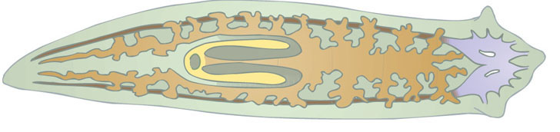
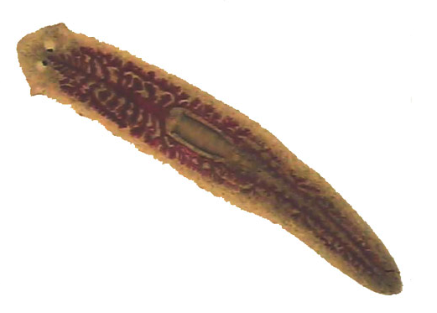
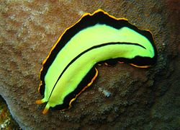
Phylum Platyhelminthes
  Class Turbellaria: Turbellarians
Free-living
Scavengers (most)
Freshwater & marine (toxic)
Eyespots
DRAW: Live Planaria (37.1)
HW: Planaria (w.m.) or (c.s) (pg 413)

Slide 6
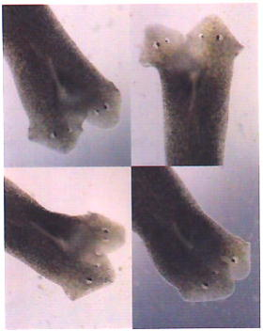
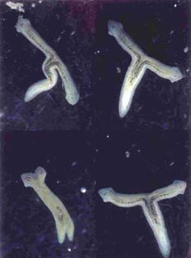
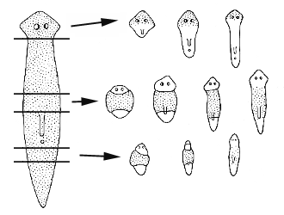
Regeneration

Slide 7
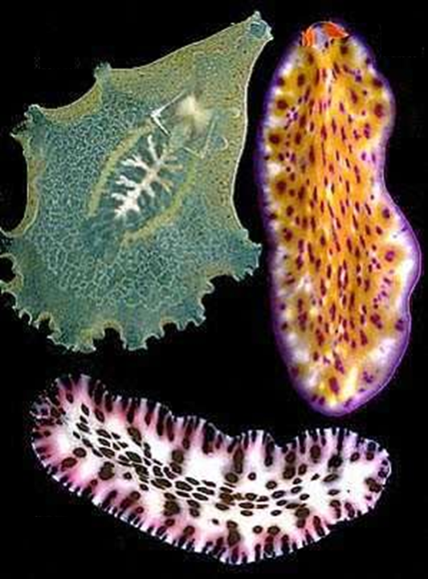
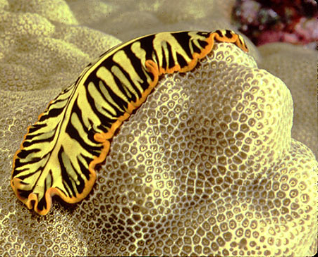
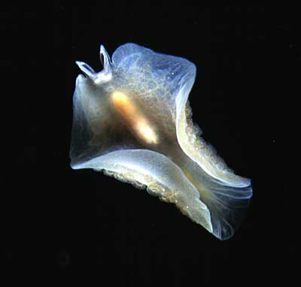
https://www.youtube.com/watch?v=wn3xluIRh1Y&app=desktop
Marine

Slide 8
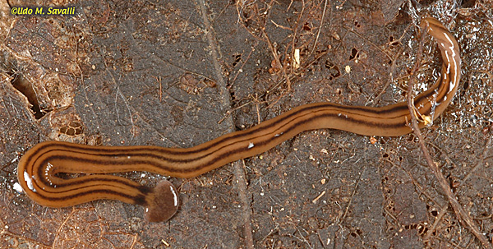
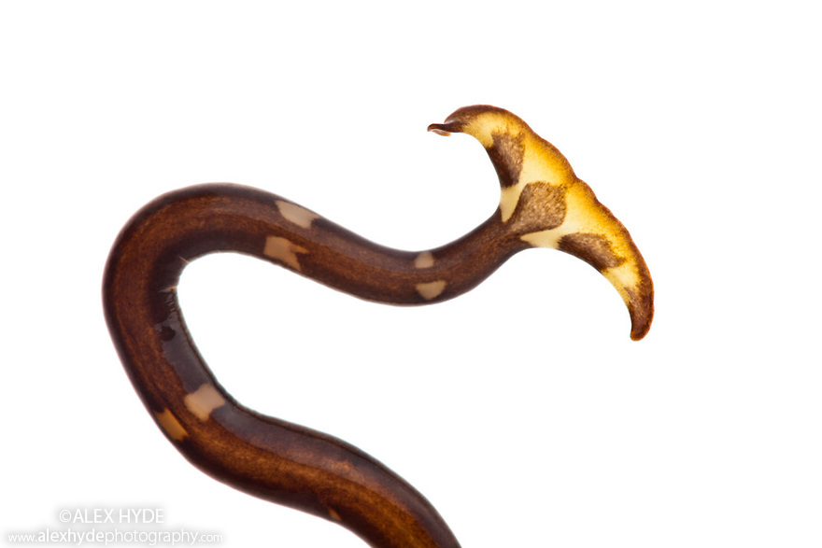
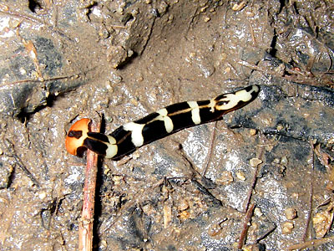
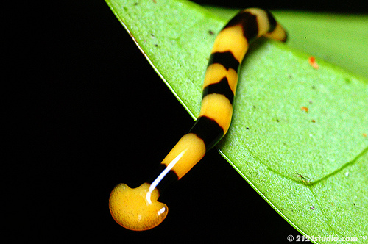
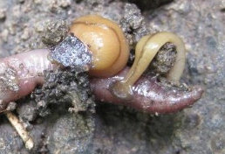
Terrestrial species

Slide 9
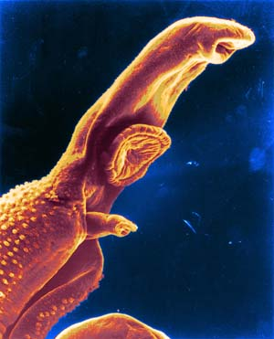
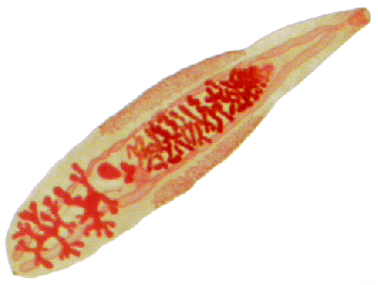
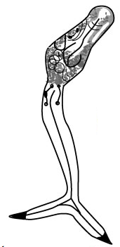
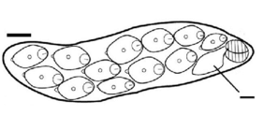
Phylum Platyhelminthes
  Class Trematoda: Flukes
Parasitic – feed with mouth
All host-dependent (verts)
Reduced features (such as?)
Common human parasites – blood and liver
Complex life-cycles
DRAW: Rediae & Cercariae (on same slide), pg 415
Shape variable

Slide 10
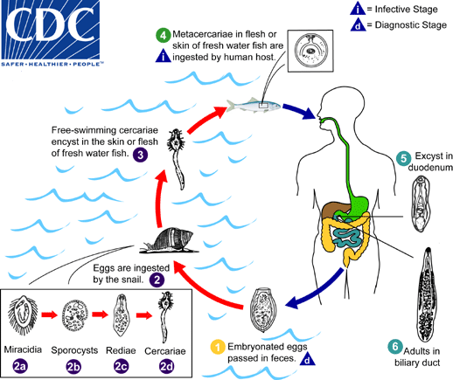
Opisthorchis sp.
&
Clonorchis sp.

Slide 11
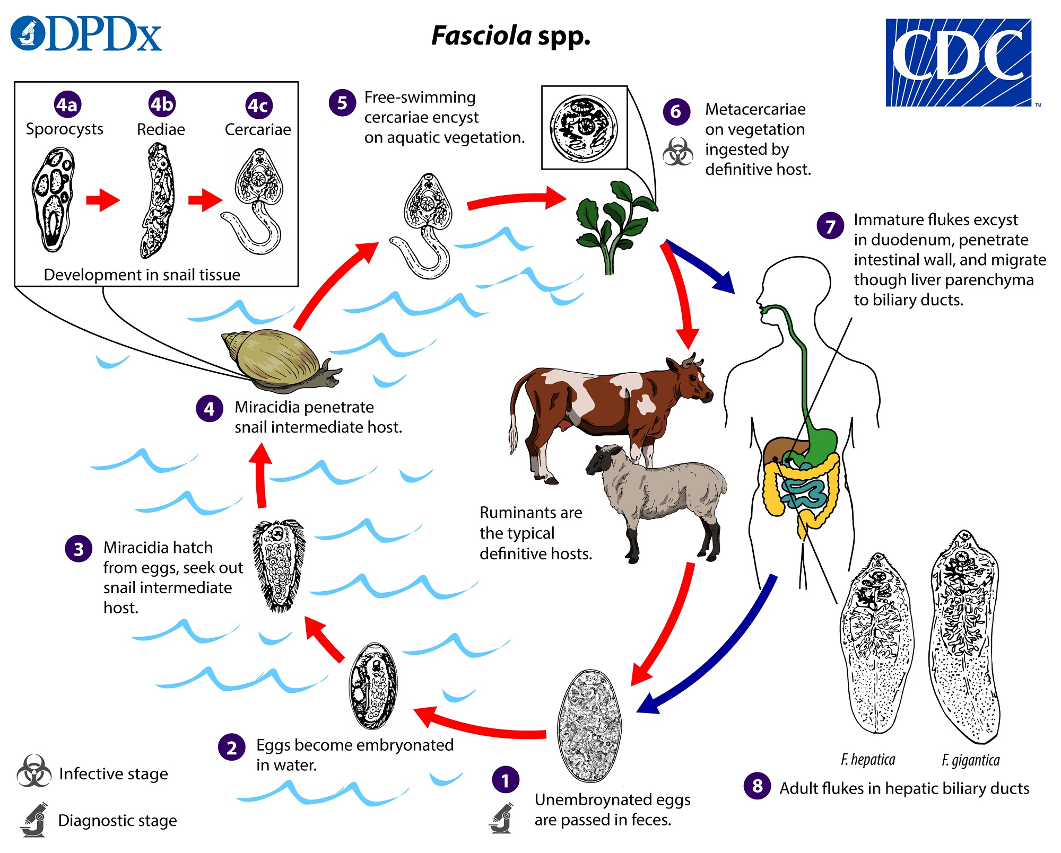
Fasciola sp.
https://www.youtube.com/watch?v=fqUV_FFTQa8
DRAW: Clonorchis (pg 414)
OR Fasciola (pg 415)
Notes:
Common liver fluke
Primarily in domestic and wild ruminants
Larvae migrate to the liver where they mature and produce eggs
gastrointestinal problems such as nausea, vomiting, and abdominal pain/tenderness
Long term blocks bile ducks – gallbladder and pancreas inflammation

Slide 12
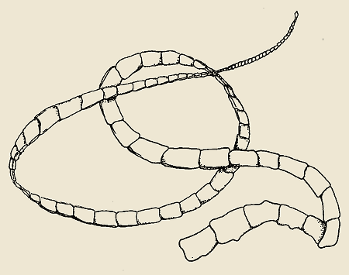
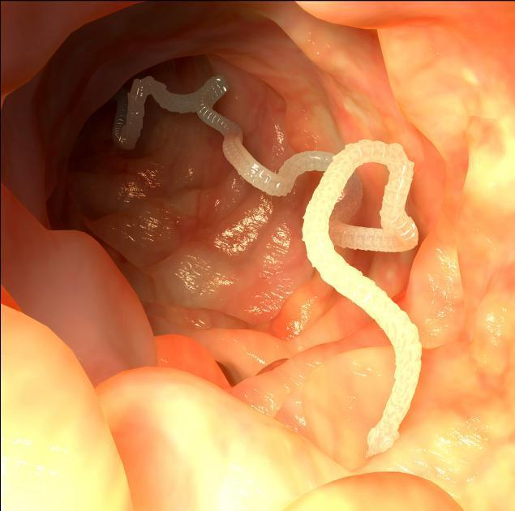
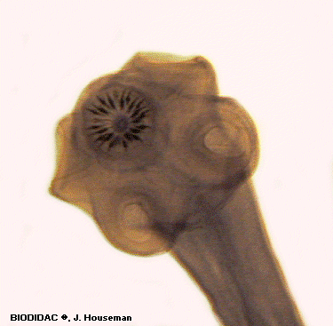
Phylum Platyhelminthes
  Class Cestoda: Tapeworms
Parasitic – no mouth
Most specialized (basic structure)
Attach to wall of digestive tract (how get food?)
Passed via eggs from contact with feces or water, uncooked meat
DRAW: Scolex
HW: Proglottid
DRAW: Preserved Specimen (pg 417-418)
Notes:
May contain up to 1000 proglottids
Each proglottid can produce 30k to 100k eggs

Slide 13
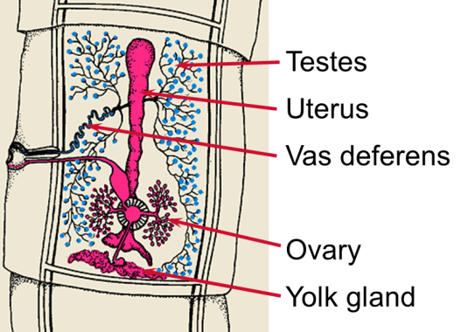
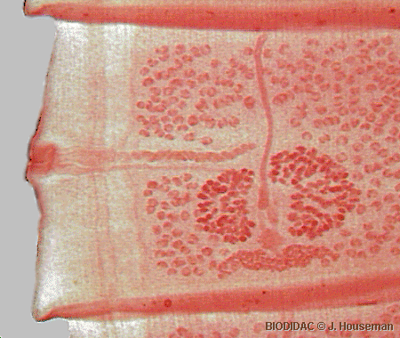
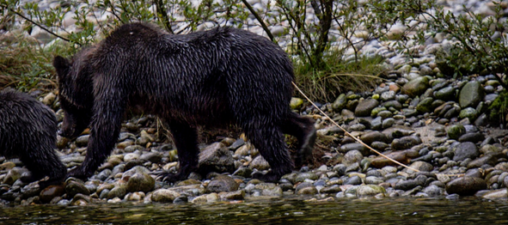
Proglottid Reproduction
Sally Mae Wallace on September 05, 1991

Slide 14
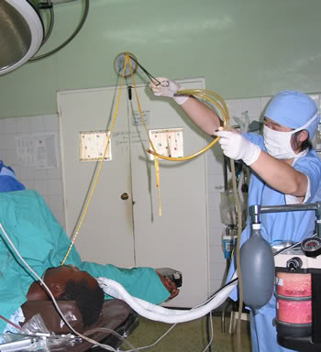

Slide 16
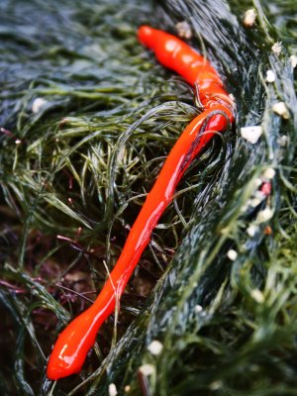
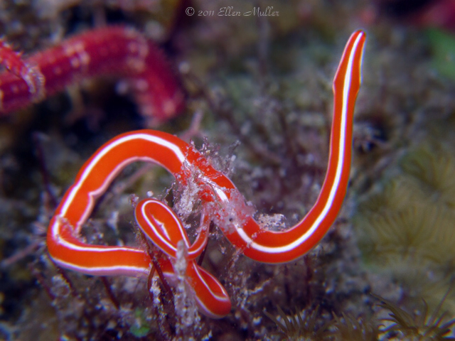
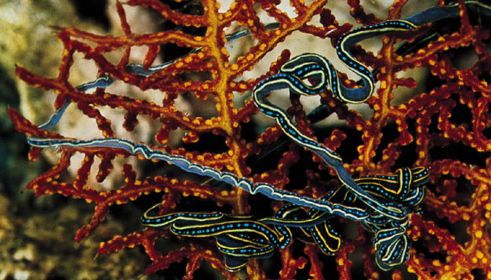
Phylum Nemertea
Ribbon Worms
900 sp.
Simplest animal with complete digestive tract
Marine (most)
Synapomorphy: rhynchocoel + proboscis
https://www.youtube.com/watch?v=2cjMn7AcCq4&ebc=ANyPxKpDo1wEL8O_Ep4-Uuow2QxBgKChw38fkzsoL4-GxYP3UPybcdvdmve5VxiW_0ZifrEXU4hcoYNi9lhT1li2ztl5NU8lrA
Copyright © McGraw-Hill Companies Permission required for reproduction or display

Slide 17
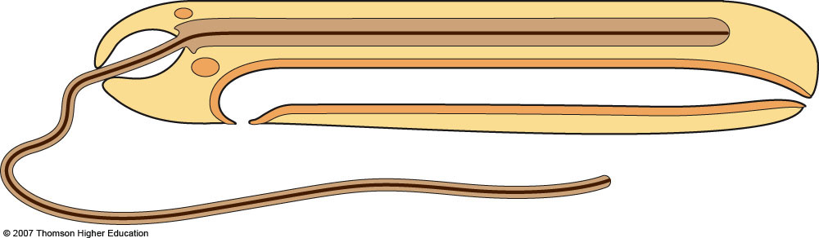
Ribbonworm Anatomy
Rhynchocoel
Cerebral ganglion
Retractor muscle
Anus
Mouth
Digestive tract
Extended proboscis
Notes:
Figure 30.5: Nemerteans (proboscis worms).

Slide 19
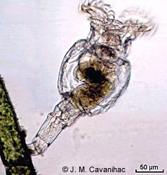
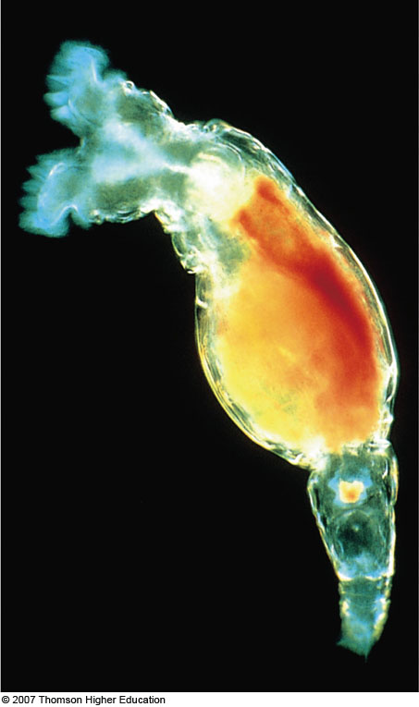
Phylum Rotifera
Rotifers
1800 sp.
“wheel animals”
Two bands of cilia on head
Filter feeders
Most attach to substrate, but can move
DRAW: Live rotifer (not in book)

Slide 20
Phylum Nematomorpha
Hairworms
https://www.youtube.com/watch?v=YB6O7jS_VBM
HW: Preserved horsehair worm (not in book)

Slide 21
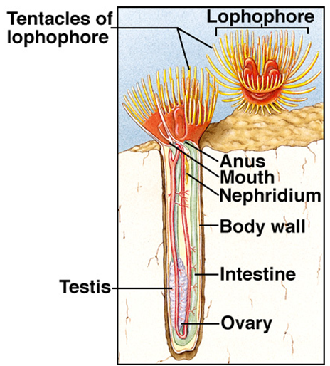
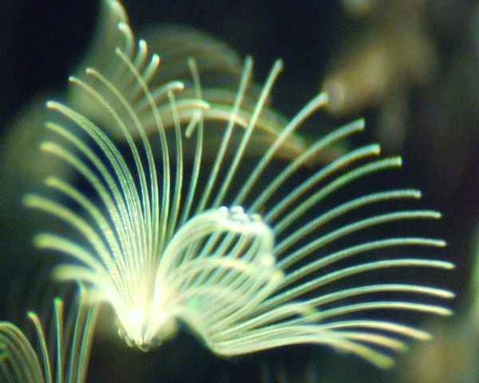
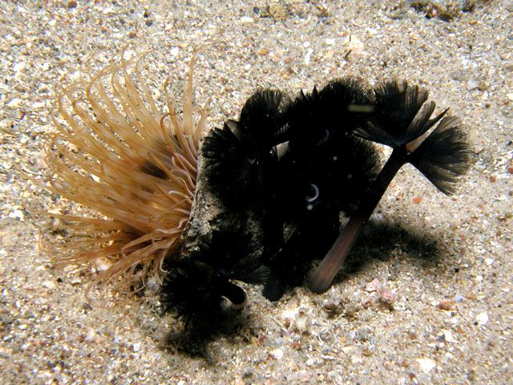
Phyla Phoronida
20 species
Marine, costal areas only
All filter-feeders
Secrete a leathery tube
Bulk of animal stays below substrate
Never move

Slide 22
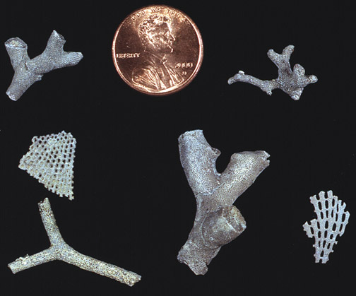
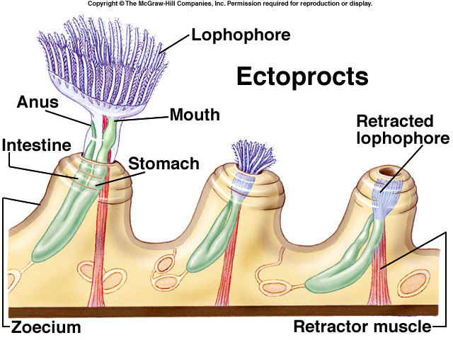
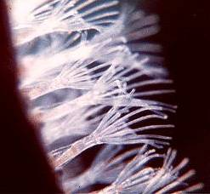
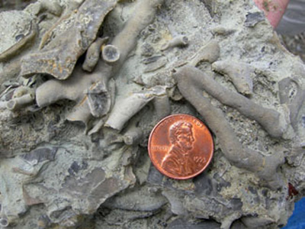
Phyla Ectoprocta (Bryozoans)
4500 sp.
Freshwater and marine
Colonial filter feeders
Each individual secretes a chamber
Fossil Bryozoa

Slide 23
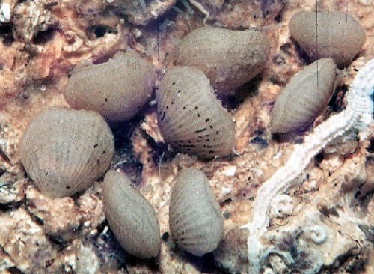
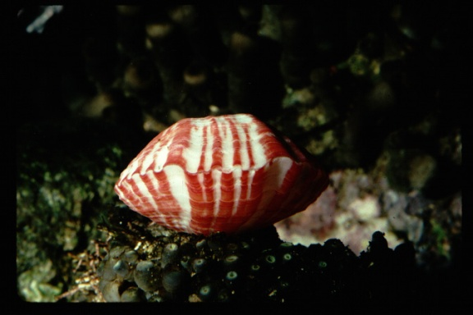


Phyla Brachiopoda (Brachiopods)
350 sp.
Marine filter feeders
Look like bivalves
Attachment and feeding:

Slide 24
HW:
Sort through the fossil collections and find and draw (same circle) a representative of:
Ectoprocta
Brachiopoda

Slide 26




Phylum Annelida
15,000 sp.
2 synapomorphies
Hydrostatic skeleton to move
Each segment contains setae
Coelom and closed circ system
3 classes:

Slide 27

Basic Body Plan

Slide 28

Movement
Contracted longitudinal muscle
Contracted circular muscle
OBSERVE: Live earthworm (38.3)

Slide 29



Phylum Annelida
Polychaeta: Marine Worms
10,000 sp.
Well-differentiated head
Paired appendages with each segment (parapodia)
Lots and lots of setae
Burrow, under rocks and coral, abandoned shells
All depths
Body form:
DRAW: Nereis (38.2)
OBSERVE: Misc. polychaeta

Slide 30

Everted pharynx of Nereis

Slide 31




Diverse feeding and respiration modes
http://www.youtube.com/watch?v=_VNep2mh7yU
http://www.youtube.com/watch?v=8mBo0sfum0E

Slide 32


Phylum Annelida
Oligochaeta: Earthworms
3,000 sp.
Hermaphroditic
Terrestrial (most) or freshwater
No clear head, no eyes
Few setae
Important in soil aeration
DRAW: Earthworm dissection (38.4 & 38.5)

Slide 33



Reproduction

Slide 34



Phylum Annelida
Hirudinea: Leeches
Abundant freshwater, some marine, very few terrestrial
Parasites, predators, scavengers
All fluid feeders
Synapomorphy: Lost setae, lack internal segmentation, two suckers
Develop a clitellum during breeding season
DRAW: Preserved leech (38.6)

Slide 35



Hirudinida feeding

Slide 36



Leech locomotion & medical use
Why can’t they use a hydrostatics skeleton?

