Slide 1
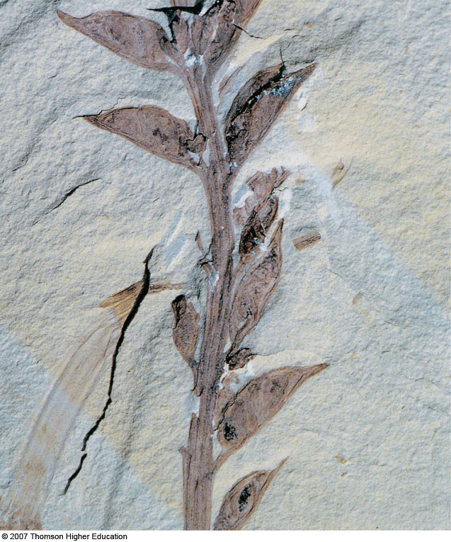
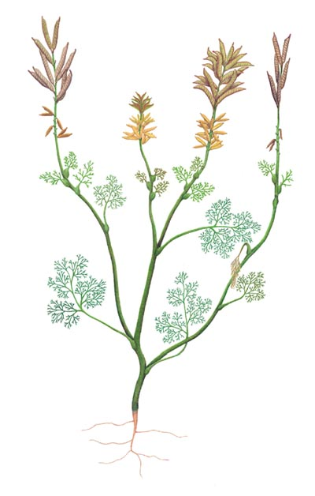
What habitat are gymnosperms in?
How successful?
What’s the next major plant innovation?
Carpel
Ovule
Has male and female repro. structures – What is it missing?
Archaefructus
Notes:
Figure 28.17: The oldest known fossil angiosperm.
This fossil of Archaefructus shows a carpel-bearing stem. Discovered in northeastern China, it is about 125 million years old.

Slide 2
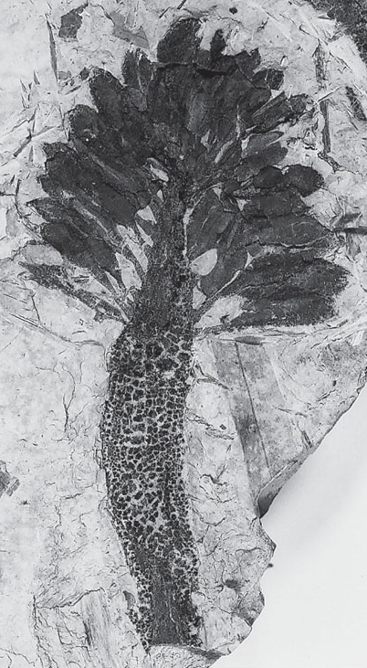
Archaeanthus
Fossil Flower
100 MYA
Carpel
Scars on reproductive axis
7 mm
Notes:
Figure 28.18: Fossil flower.
The fossilized flower of the extinct plant Archaeanthus linnenbergeri, which lived about 100 mya. The scars on the reproductive axis (receptacle) may show where stamens, petals, and sepals were originally attached but abscised (fell off). Many spirally arranged pistils were still attached at the time this flower was fossilized.

Slide 3
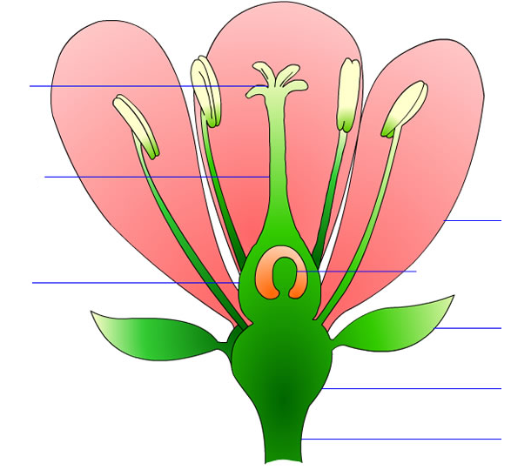
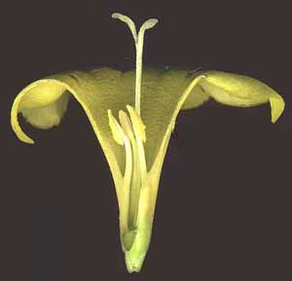
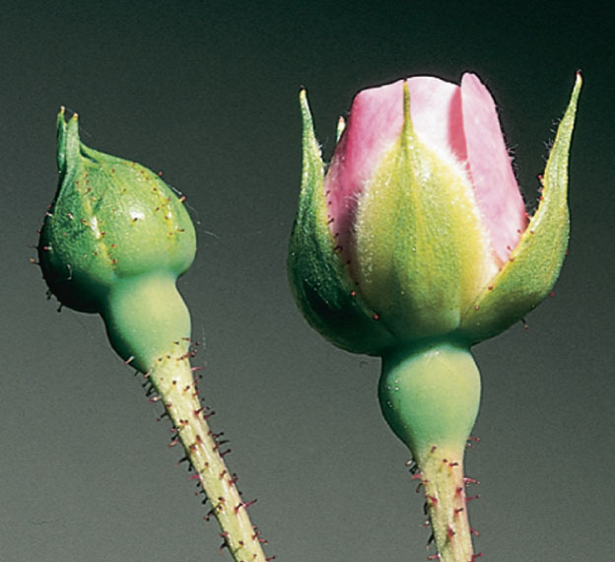
Flower Structure
Modified stems and leaves
Houses male and female structures
DISSECT and DRAW: Flower (pg 340 & 31.1)

Slide 4
Flower Structure
What’s the function of petals?
What’s the function of sepals?
How many eggs inside the ovule?
How many ovules per flower?

Slide 5
Additional Flower Terms
Complete
Incomplete
Perfect
Imperfect

Slide 6
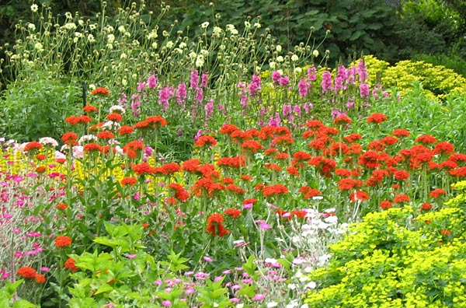
Angiosperms
Phylum Anthophyta
Meaning
Most dominant land plants
300,000 sp.
Synapomorphies?
Appeared?

Slide 7
Angiosperm Phylogenetics
Notes:
Figure 28.19: Evolution of flowering plants.

Slide 8
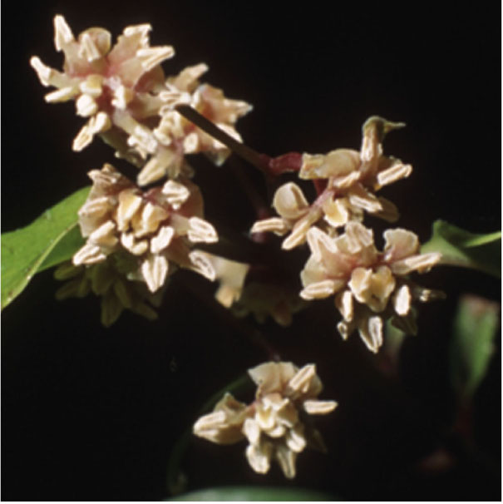
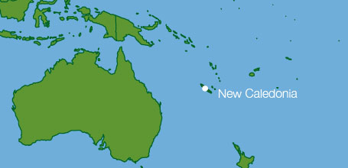
Amborella sp.
Single species
Most basial flowering plant
Found only on 1 island in S. Pacific
No vessels
Shrub with small cream flowers
Notes:
Figure 28.19: Evolution of flowering plants.

Slide 9
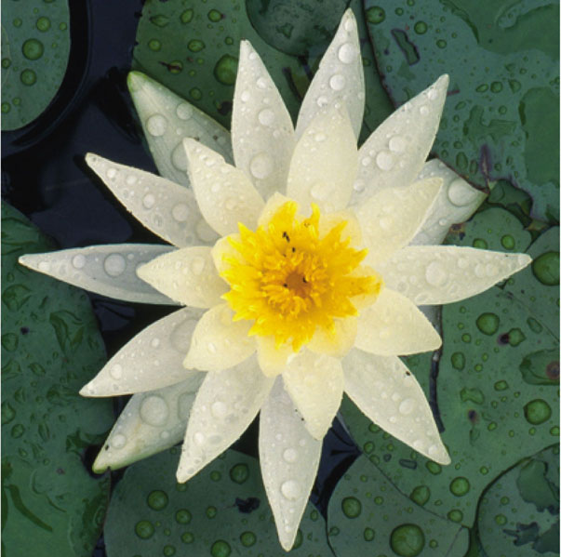
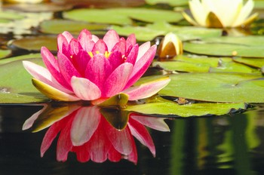
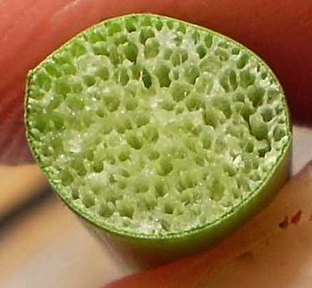
Water Lilies
70 sp.
Freshwater
Rooted in soil at bottom of shallow ponds or rivers
Leaves and flowers have adaptations to help them float
Notes:
Figure 28.19: Evolution of flowering plants.

Slide 10
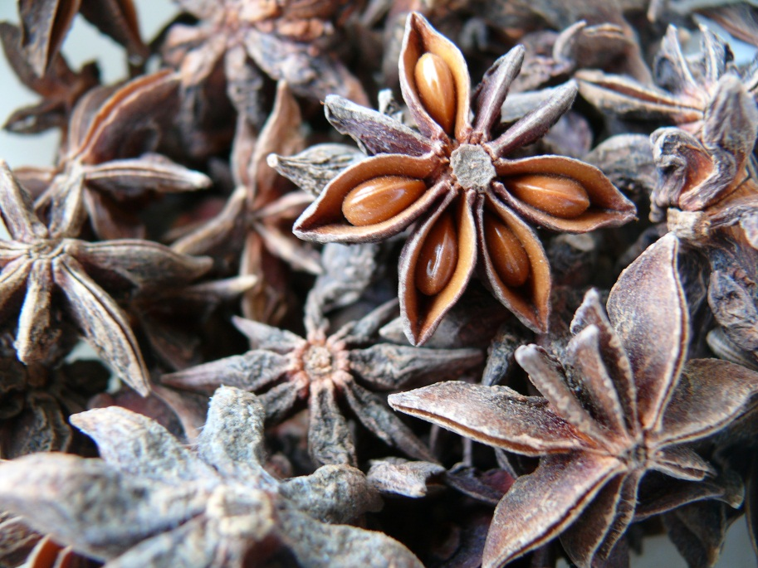
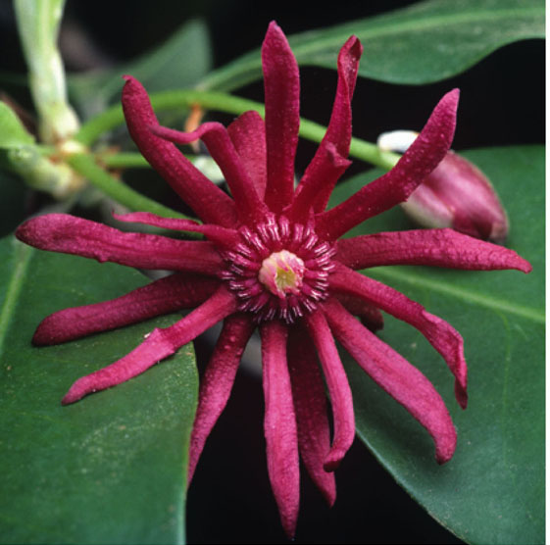
Star Anise
90 sp.
Small tree from SE Asia
Flowers star shaped
Important spice
Notes:
Figure 28.19: Evolution of flowering plants.

Slide 11
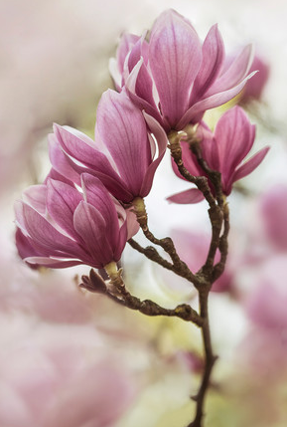
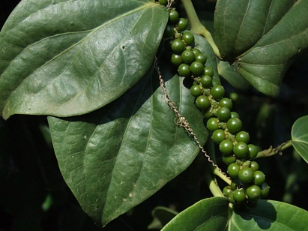
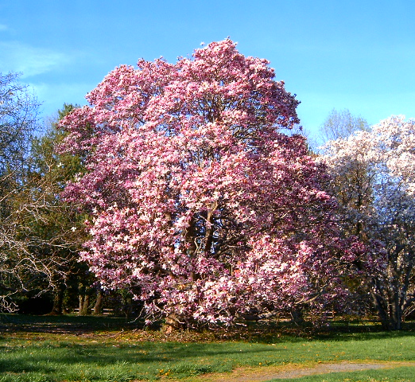
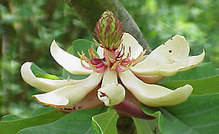
Magnoliids
10,000 sp.
Probably paraphyletic
All morphologies
Large fragrant flowers

Slide 12
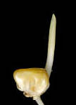
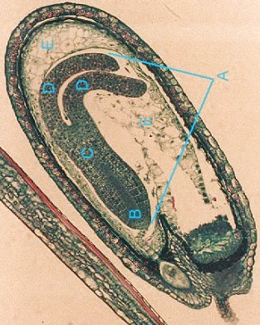

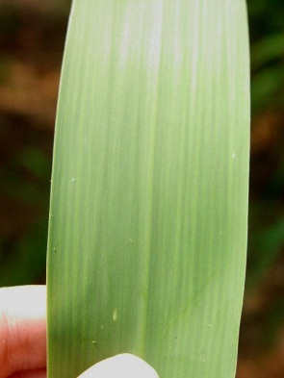
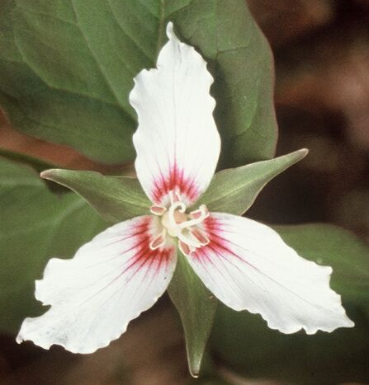
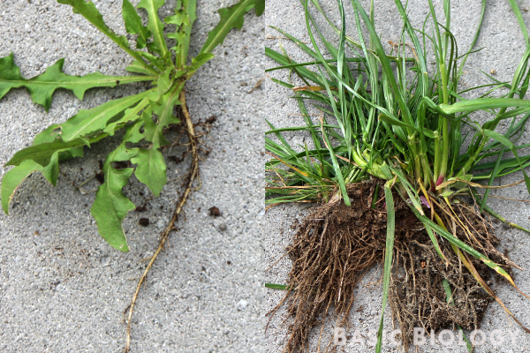
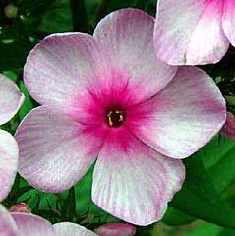
Characteristics of Monocots and Eudicots

Slide 13
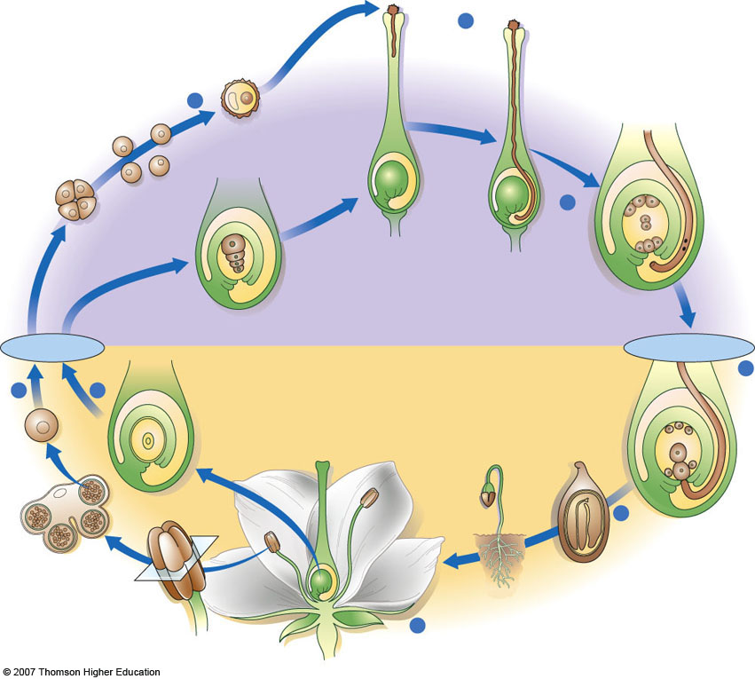
Pollination
Developing pollen tube of mature male gametophyte
Angiosperm
Reproduction
(whole page…
maybe 2)
Each microspore develops into a pollen grain
6
Embryo sac (mature female gametophyte)
5
Pollen grain (immature male gametophyte)
Microspore
Tetrad of microspores
Pollen tube
3
Megaspore
Polar nuclei
Two sperm cells
HAPLOID (n) GAMETOPHYTE GENERATION
Egg nucleus
Meiosis
Double fertilization
DIPLOID (2n) SPOROPHYTE GENERATION
7
Ovary
4
2
Endosperm (3n)
Megasporangium (ovule)
Zygote (2n)
Fruit
8
Embryo
Seed
Seed coat
microsporangia
Anther
Seedling
1
Flower of mature sporophyte
Notes:
Figure 28.13: Life cycle of flowering plants.
A significant feature of the flowering plant life cycle is double fertilization, in which one sperm cell unites with the egg, forming a zygote, and the other sperm cell unites with the two polar nuclei, forming a triploid cell that gives rise to endosperm. See text for a detailed description.

Slide 14
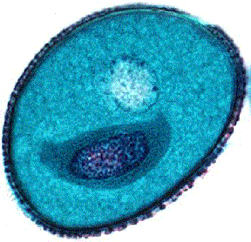
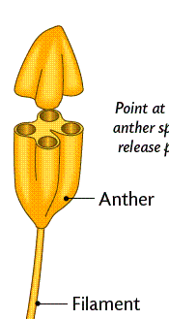
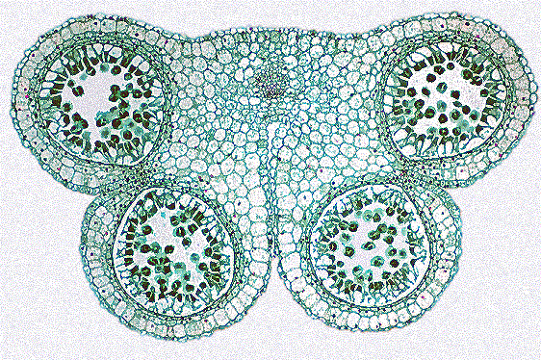
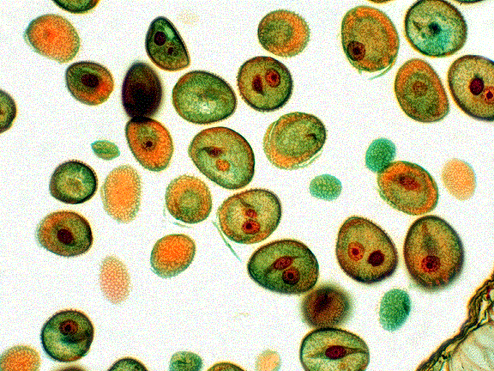
Male Reproduction
DRAW: Fresh anther (31.2)
DRAW: Mature anther slide (31.2)
HW: Mixed pollen grains (31.2)
https://rumble.com/vunog8-people-who-have-pollen-allergies-beware.html

Slide 15
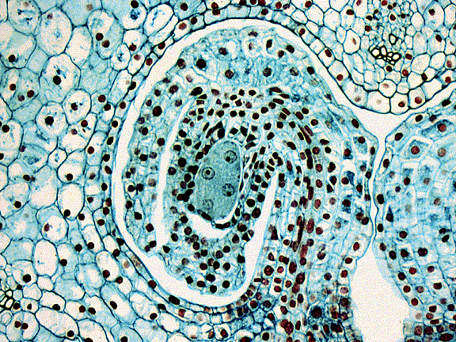
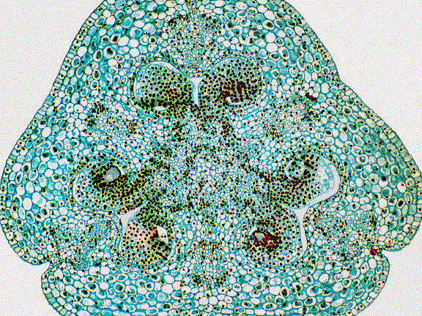
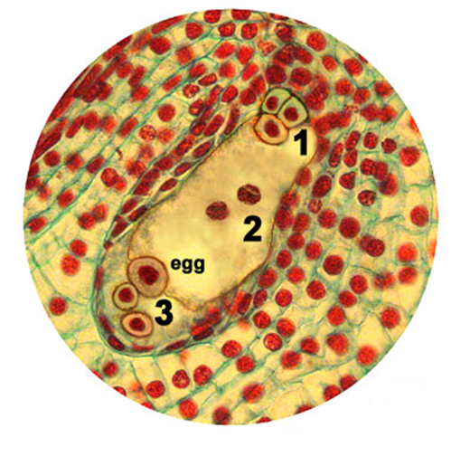
Female Reproduction
DRAW: mature embryo sac (31.4)

Slide 16
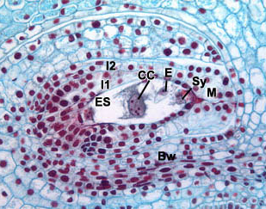
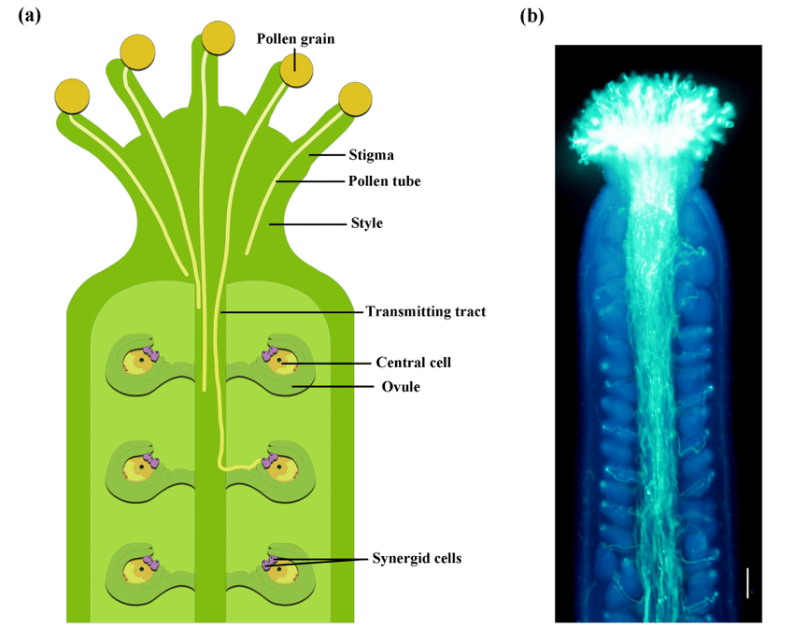
Pollination, Fertilization, & Seed Development
HW: Pollen tubes (31.4)
DRAW: Lily Seed or Corn Seed (31.7)
DISSECT & DRAW: Bean Seed (31.6)
What does the stuff around the ovule become?

Slide 17
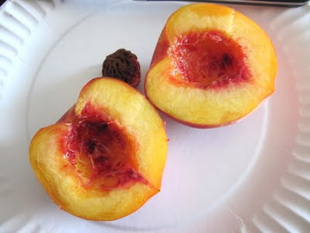
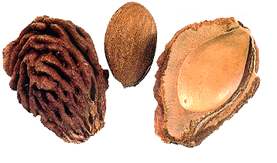
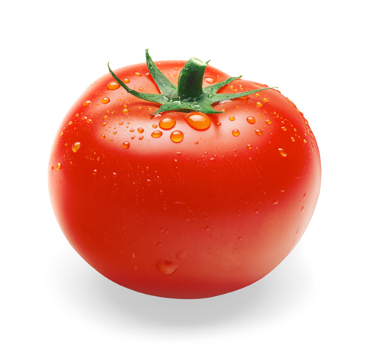
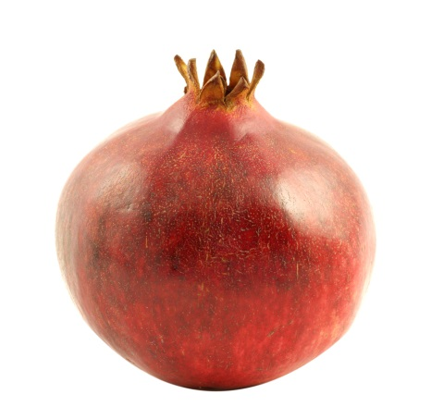
Fruit Parts & Terminology
Dissect: Peach
IDENTIFY: Fruit types

Slide 18
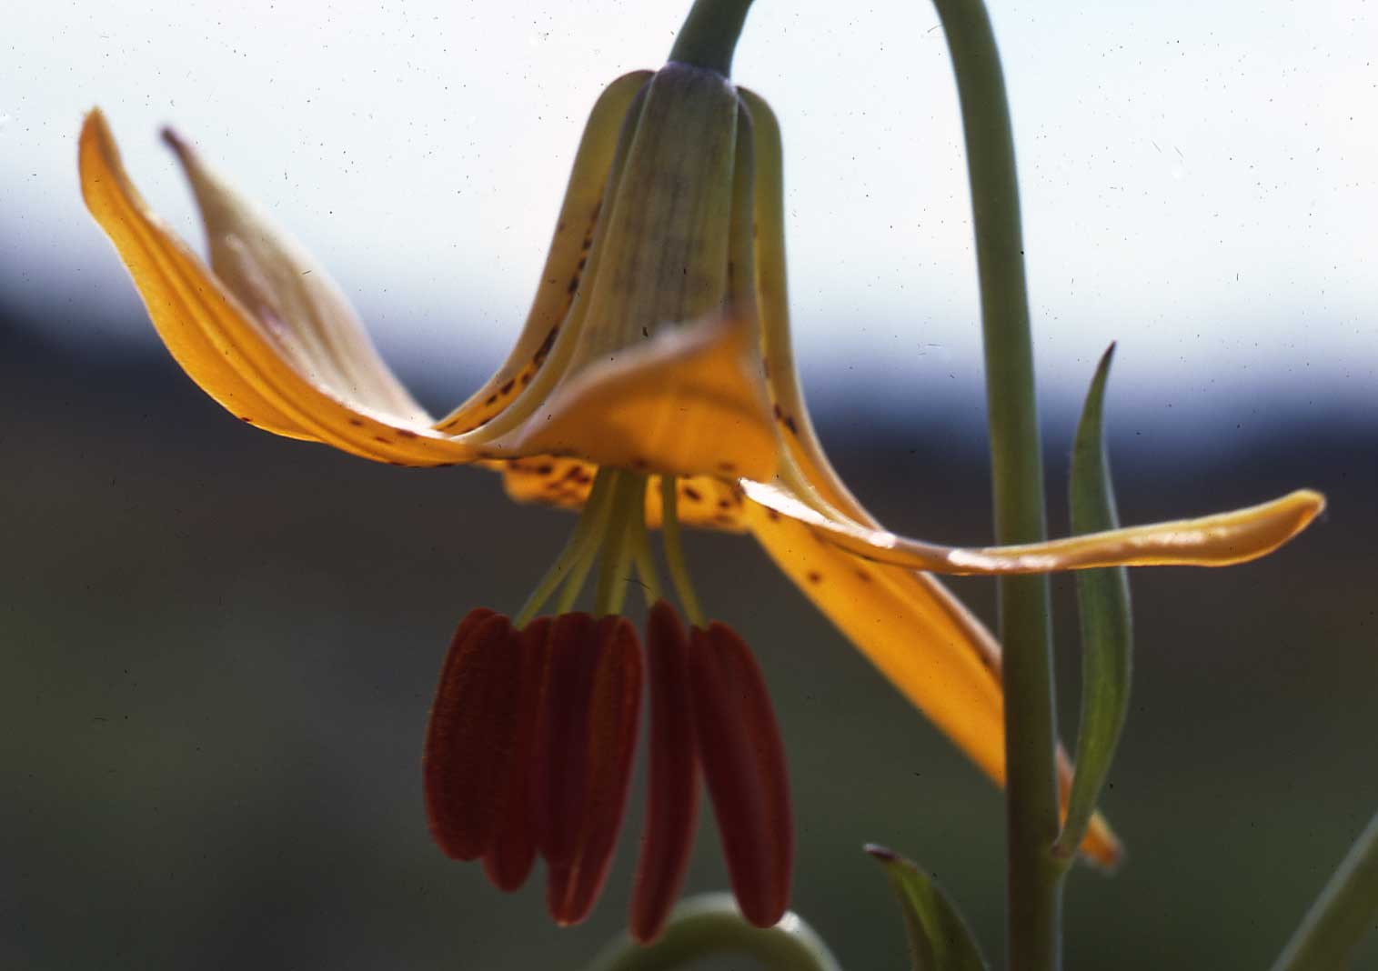
The Angiosperm Success Story
Angiosperms dominate in < 5MY
Why such a rapid transition?

Slide 19
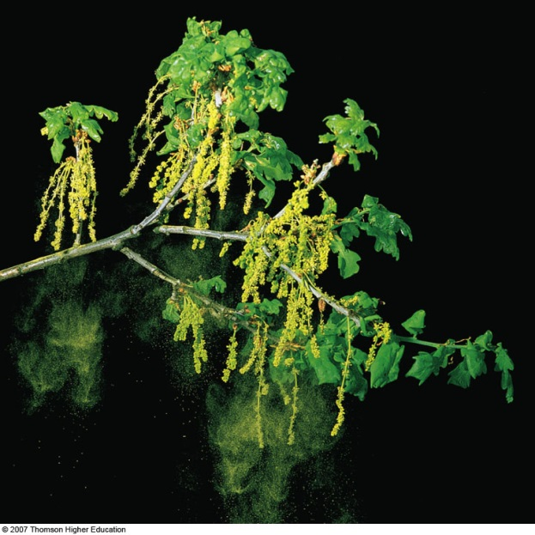
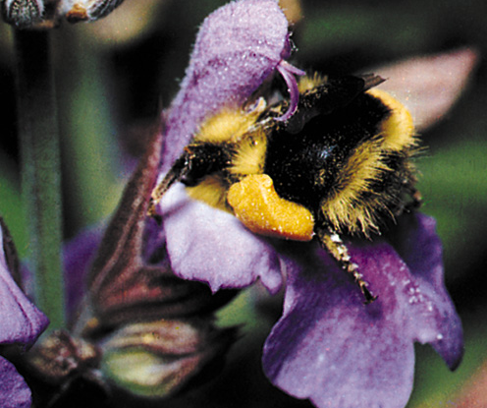
The Angiosperm Advantage is…
Flowers
Especially animal association
Pollination was wind first
  What are flowers like?
Why animal pollination?
Notes:
Small, green or yellow flowers
Odorless
Why?

Slide 20
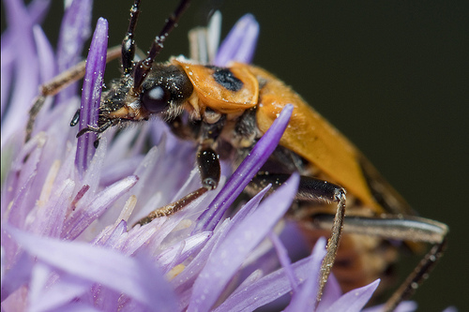
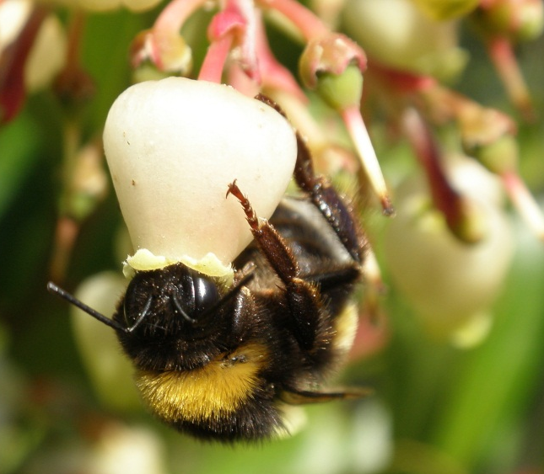
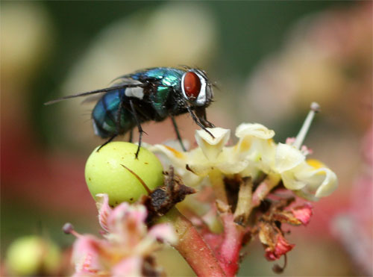
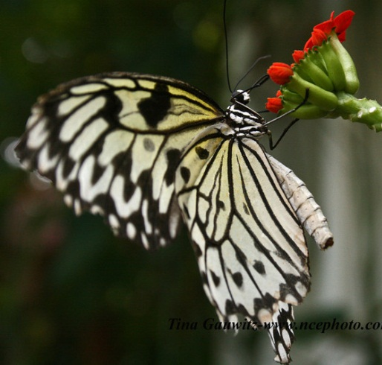
Animal Pollination
INSECTS!!!
  Bees
    Initially odor
    Then shape & color
    Flower usually blue or yellow
    Bees see UV light – flowers usually UV reflective
    Pollen important
  Other insects?
    Carotenoids
    Strongly scented
    Some - landing platforms
    Some - long floral tubes

Slide 21
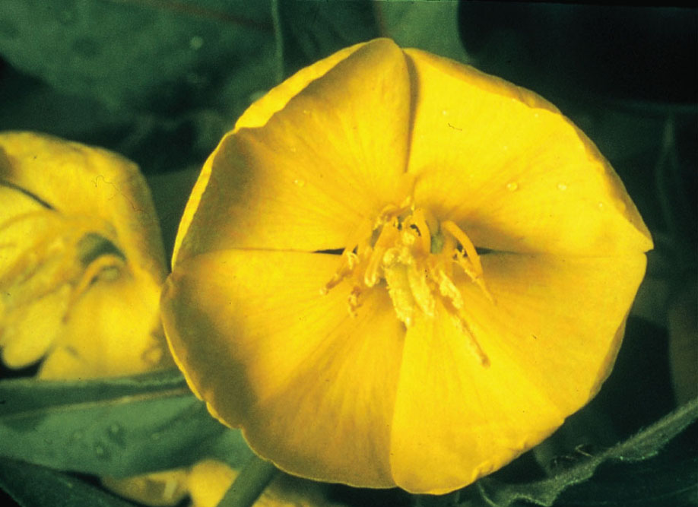
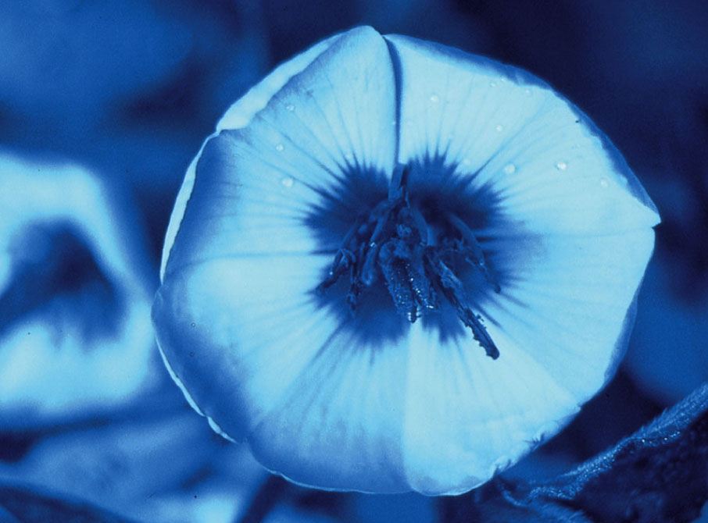

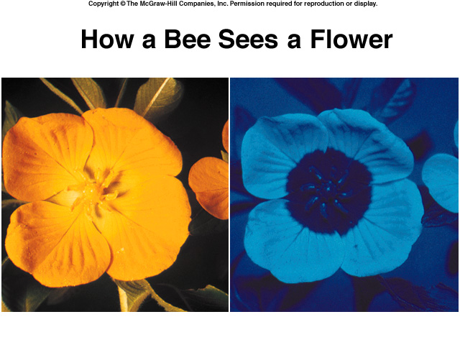
What we see vs. what a bee sees
Notes:
Figure 36.5: Ultraviolet markings on insect-pollinated flowers.
These markings draw attention to the center of the flower, where the pollen grains and nectar are located.

Slide 22
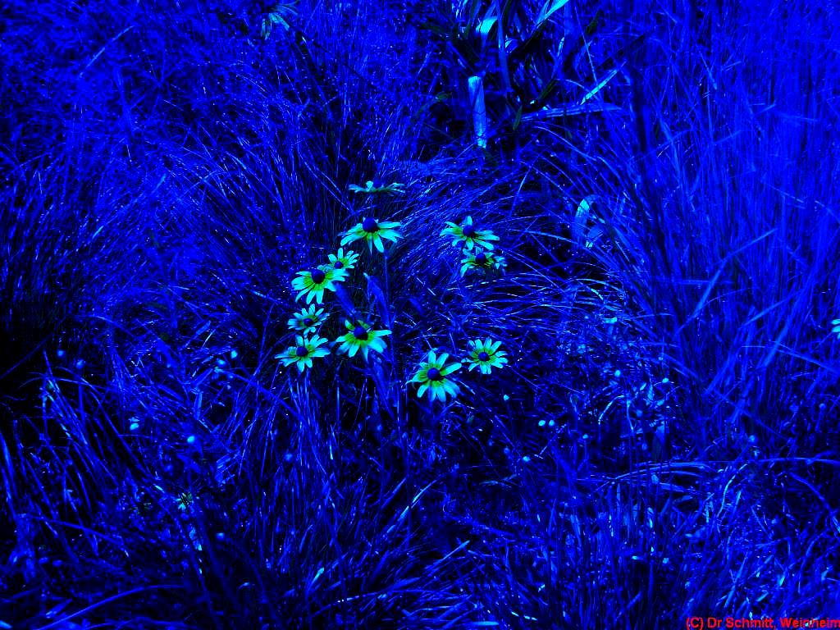
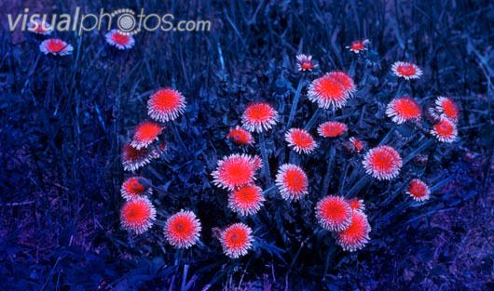

Slide 23


Animal Pollination
  Birds
    Large amount of nectar
    Red and pink flowers – why?
    Little or no scent

Slide 24

Animal Pollination
Anyone else?
  FEW: Bats, rodents
Notes:
Passive or active dispersal???

Slide 25




The Angiosperm Advantage:
Part II
Fruits
What’s the advantage of fruit?
Mechanisms of dispersal?

Slide 26



Asexual Reproduction
Vegetative Reproduction – clones
Apomixis

Slide 27





Carnivorous Plants
Species
  Venus Flytrap
  Sundew
  Butterwort
  Pitcher Plant
  Bladderwort
Photosynthetic?
What habitats?
https://www.youtube.com/watch?v=vqVL92uq1OE

Slide 28
Plant Life Span
  Annual
    Grow, flower, and form fruits & seeds, die
    All within one growing season
    Examples?
  Biennial
    Grow, collect nutrients, store it
    Flower, set seed, die second year
    Examples?
  Perennial
    Grow continuously
    Flower, set seed each year
    Examples?

