Slide 1
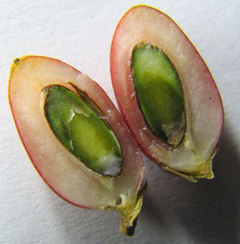
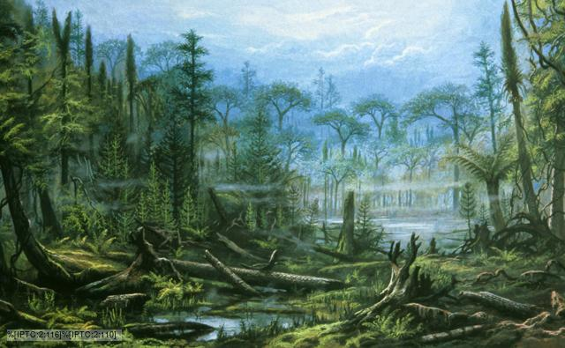
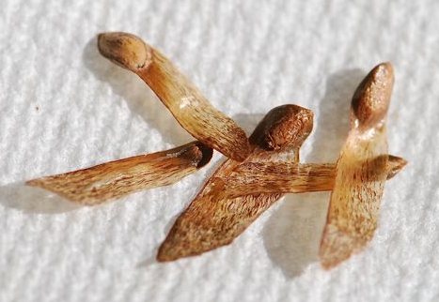
What habitat are plants in? How old?
What’s the next major plant innovation?
What are the functions of seeds?

Slide 2
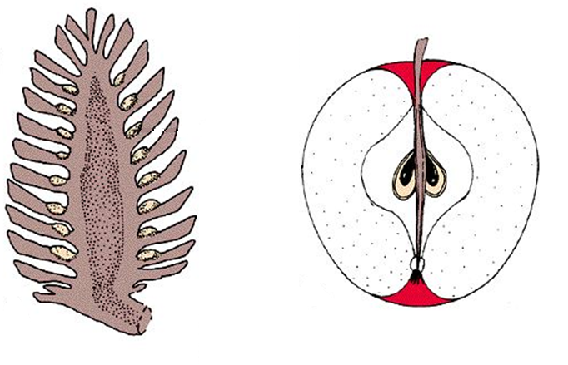
Gymnosperm – “naked” seed (?)
Seed rests (exposed) on female scales
Embryo not surrounded by layers of protective tissue (?)

Slide 3
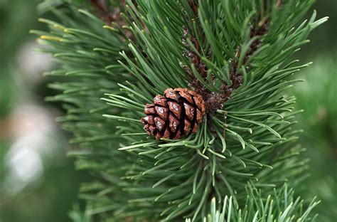
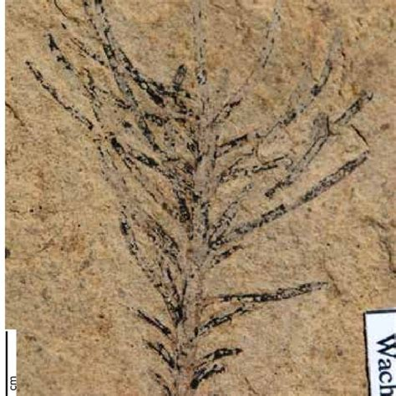
Gymnosperms
4 phyla
More complex repro (seeds!)
Lack flower/fruit
All heterosporous
Sperm motile?
Which stage dominant?

Slide 4
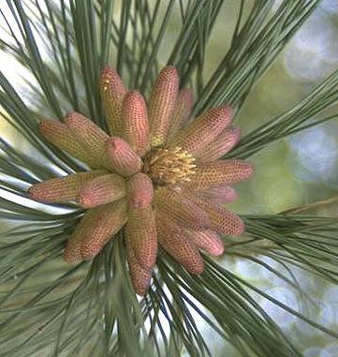
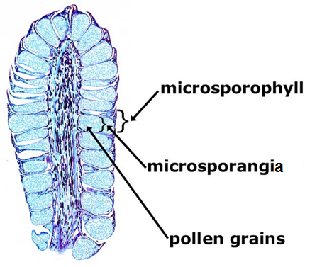
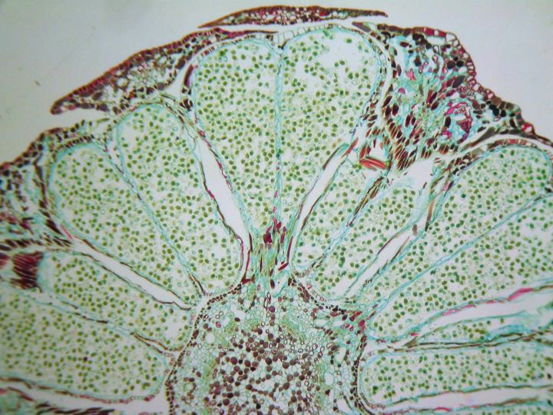
Gymnosperm Reproduction
(Whole Page)
DRAW: Male Cone Cross Section (30.2)

Slide 5
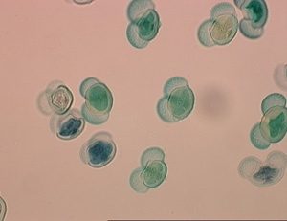
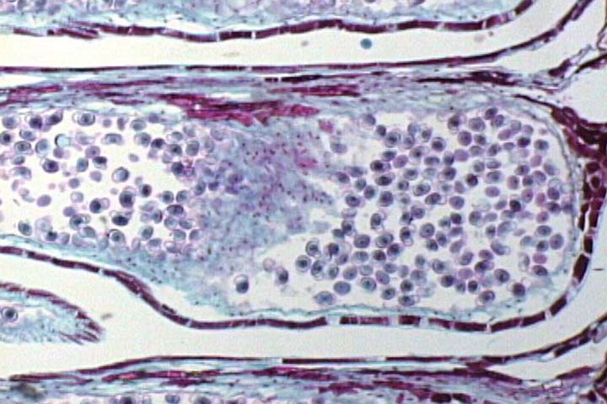
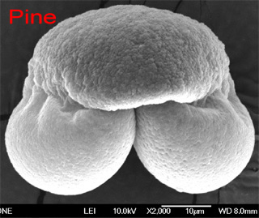
DRAW: Pine Pollen Grain (30.2)

Slide 6
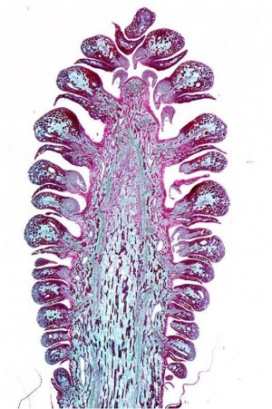
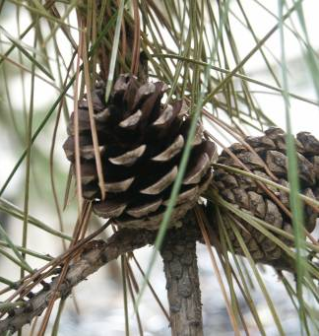
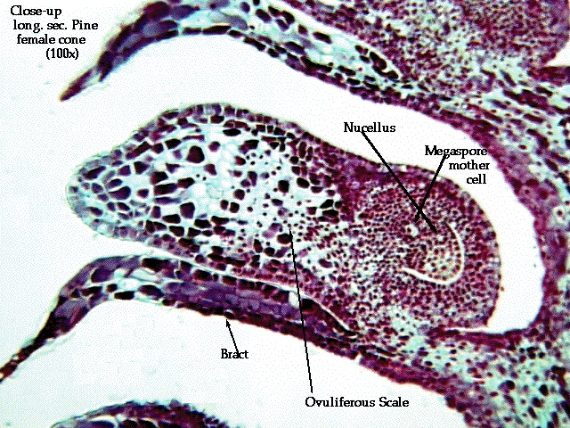
DRAW: Female Cone Cross Section (30.3)

Slide 7
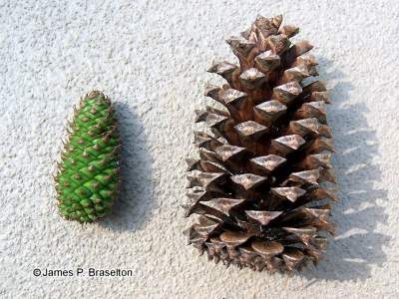
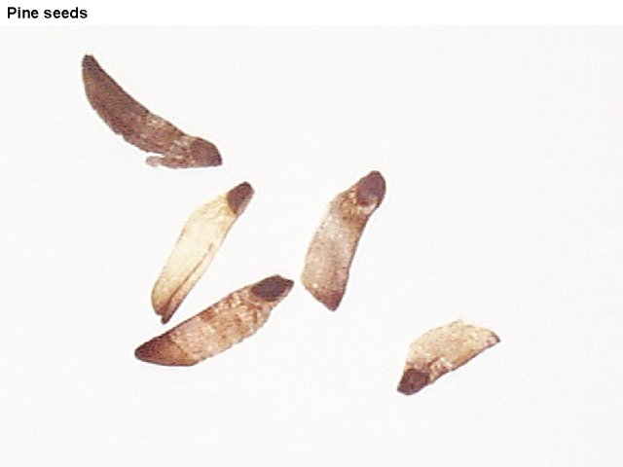
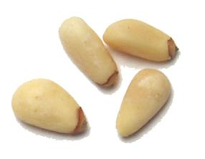
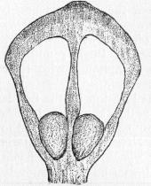
OBSERVE:
Immature female cone
Mature female cone
Pine seeds

Slide 8
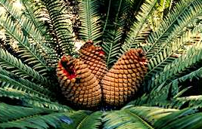
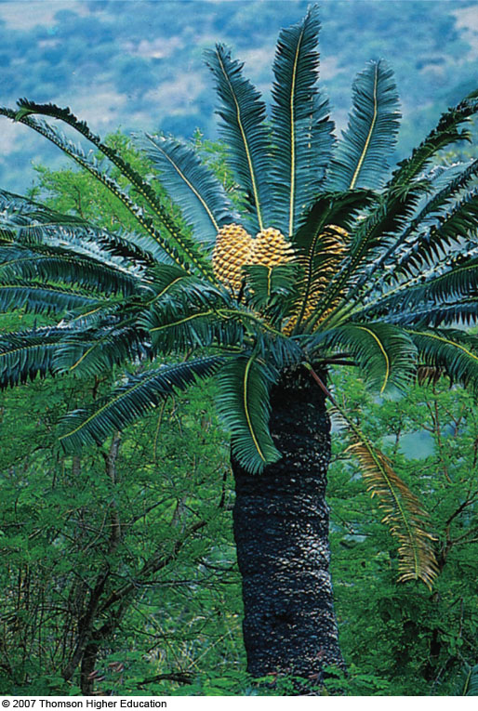
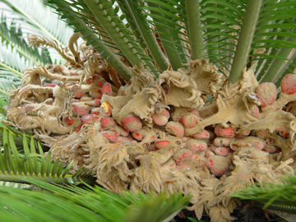
Phylum Cycadophyta
Tropical and subtropical
Slow growing
Resemble palm trees
All Dioecious
Heterosporous with motile sperm
Tracheids only
Common 200MYA
Sperm neurotoxic
HW: Live cycad (30.3)

Slide 9
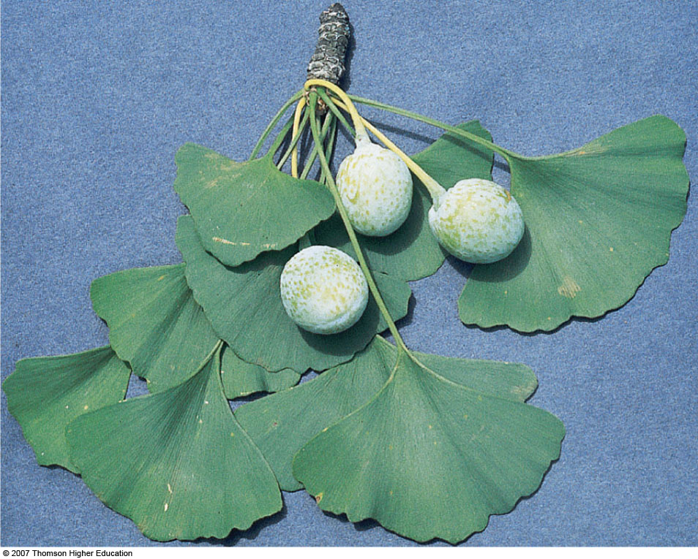

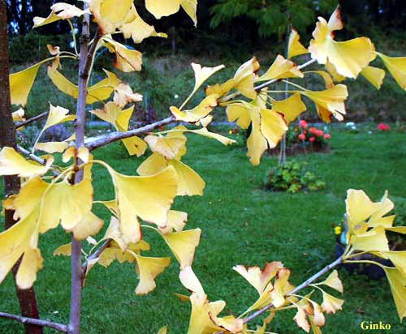
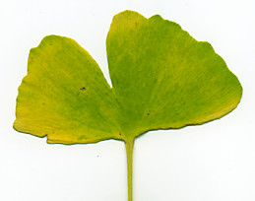
Phylum Ginkgophyta
One species
Heterosporous, motile sperm
Dioecious
Secondarily lost cones
Tracheids only
Supplement for memory loss
Campus?

Slide 10
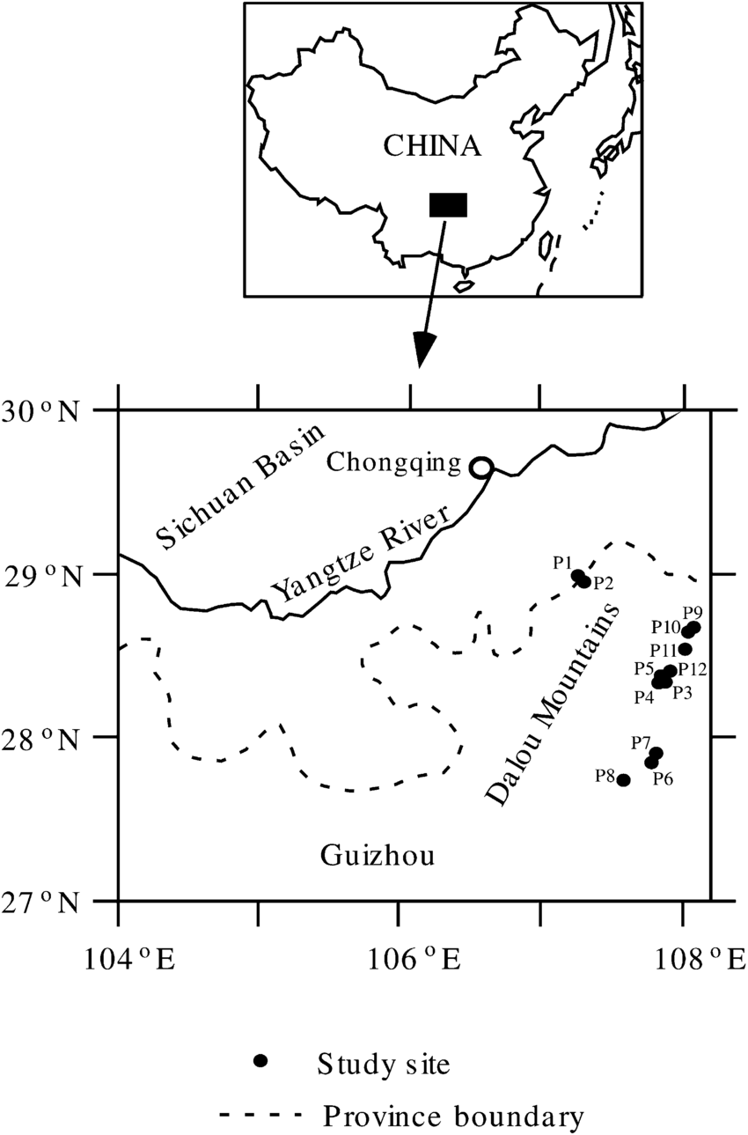
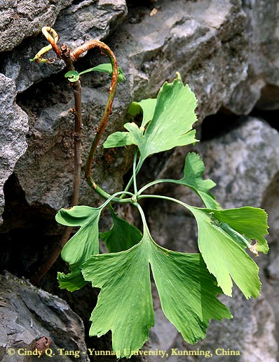
Tang et al. 2012 – American Journal of Botany

Slide 11
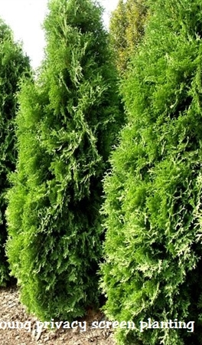
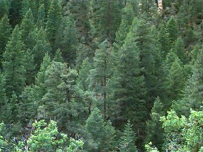
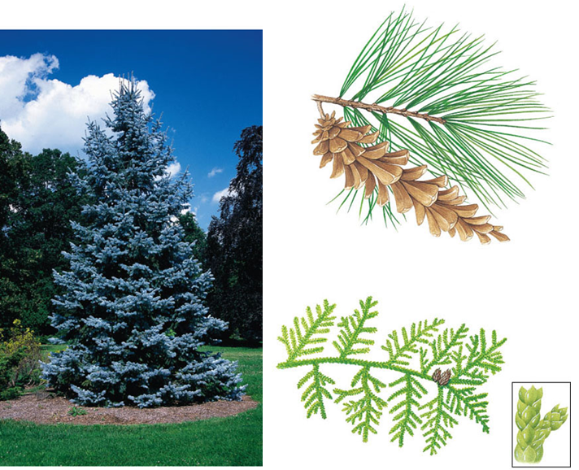
Phylum Coniferophyta
Approx. 600 species
Leaves – thick cuticle and few stomata
  Well adapted to what climates?
Nonmotile sperm
Tracheids only
80% of all paper and wood products
Variable leaf structure

Slide 12
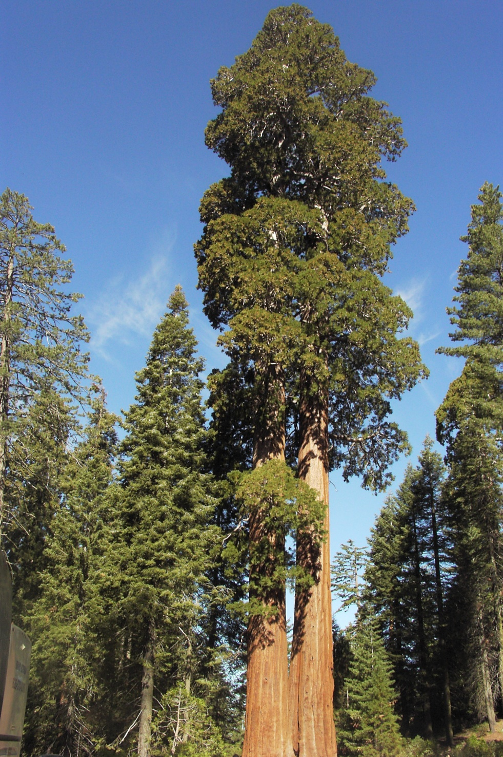
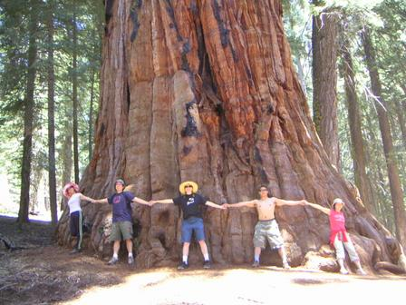
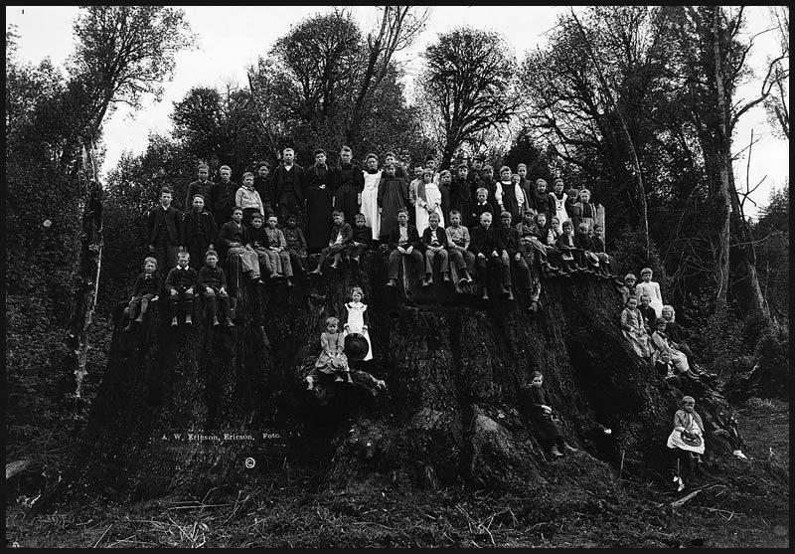

Slide 13
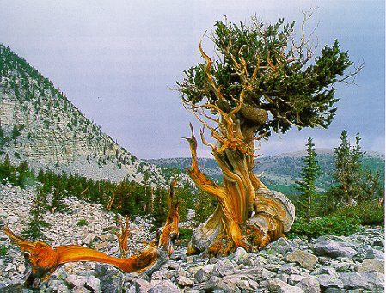

Slide 14
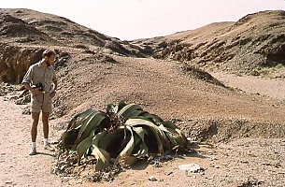
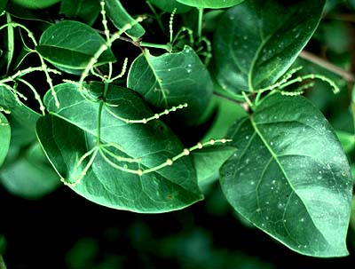

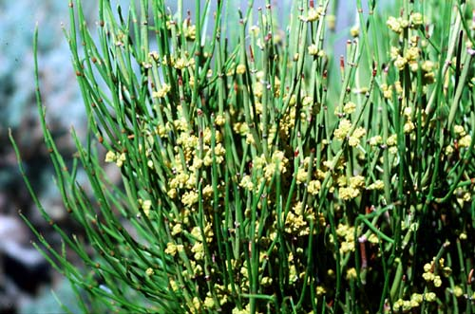
Welwitschia sp.
Phylum Gnetophyta
Gnetum sp.
Approx 70 sp.
Dioecious
Non-motile sperm
Vessel-elements!
Flower-like structure
Double fertilization (some)
(1 species)
(35 species)
What do the last 3 traits suggest?
Ephedra sp.
(40 species)

