Slide 1
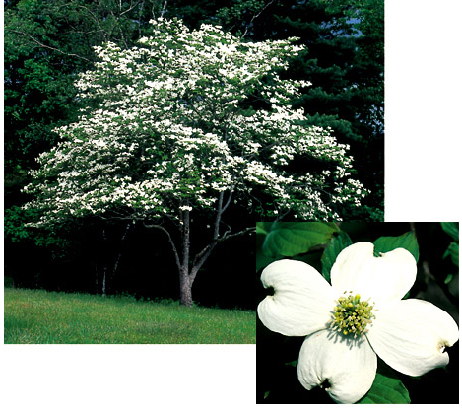
Plantae
Major transition in history of life
Why?

Slide 2
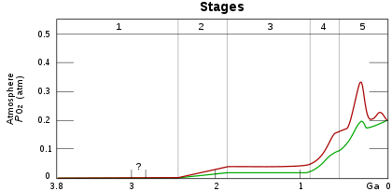
What do you notice about oxygen concentrations over time?
Notes:
Red and green are the confidence interval
O2 critical for aerobic life
Almost every O2 molecule was originally coupled with water

Slide 3
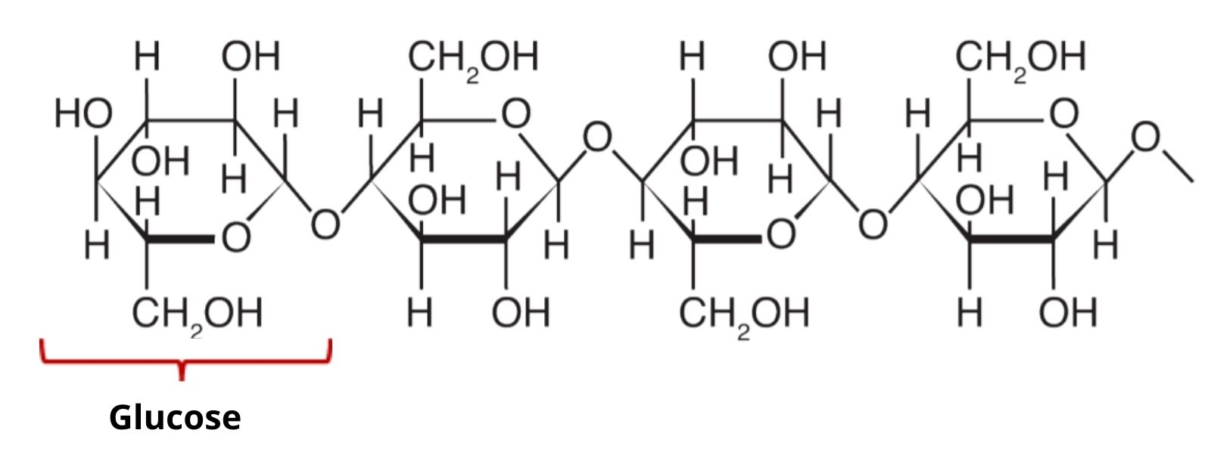
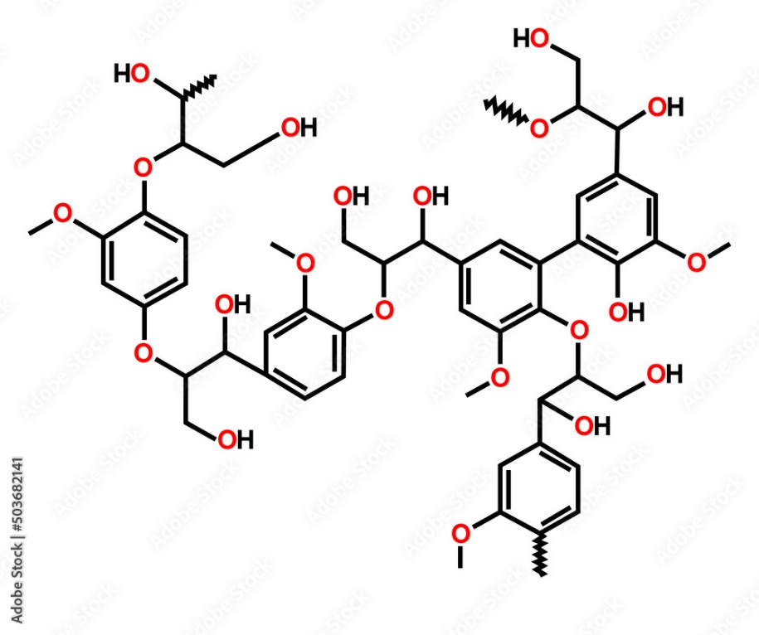
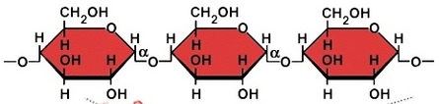
Major Characteristics of Plantae
Evolved from green algae (Chlorophyta)
Single, multicellular, or both?
All photosynthesize?
What chlorophyll?
What accessory pigment?
Three unique/important molecules
Notes:
Starch is bottom right
Lignin is left side
Cellulose is top right

Slide 4
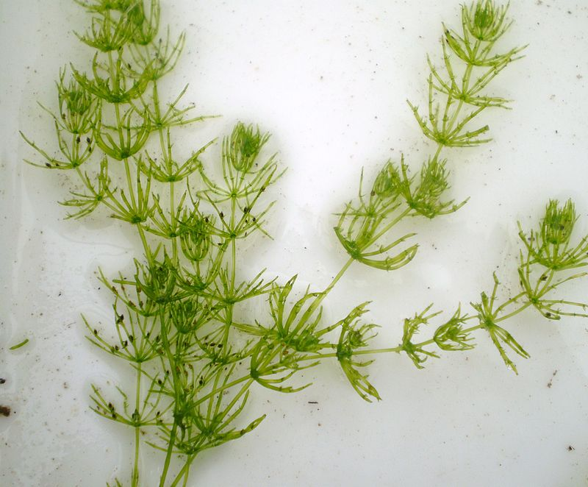
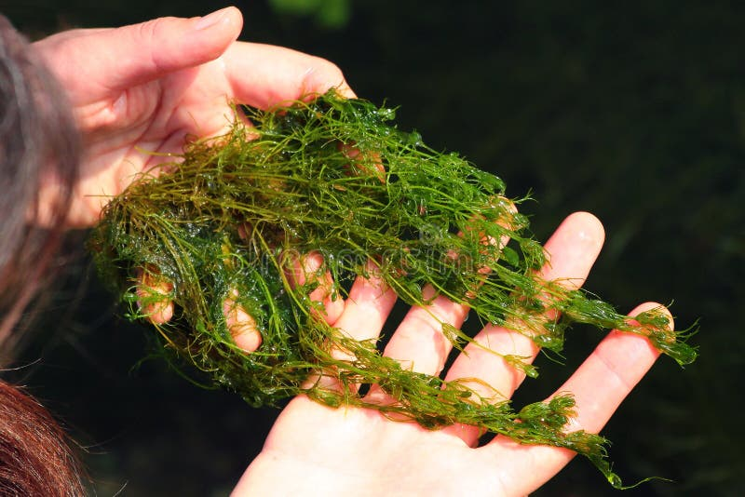
Major changes within Plantae
Evolved from green algae
Marine → fresh water → land
Two lineages of algae
Viridiplantae

Slide 5
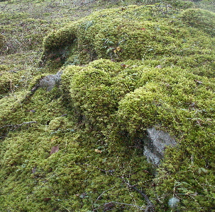
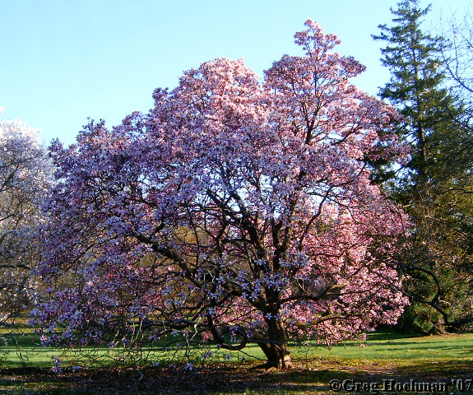
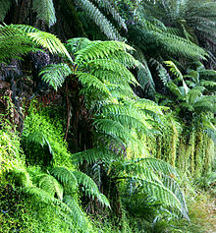
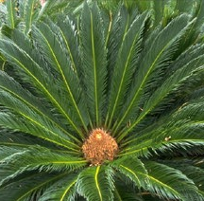
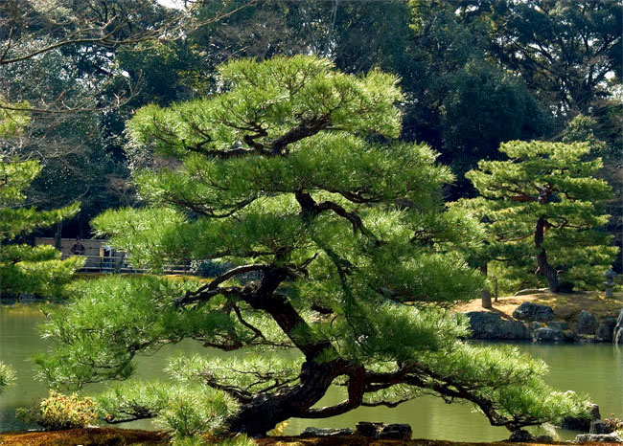
Modern Plant Groups (and 10 phyla)

Slide 6
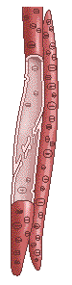
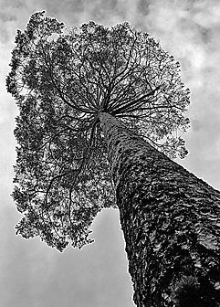
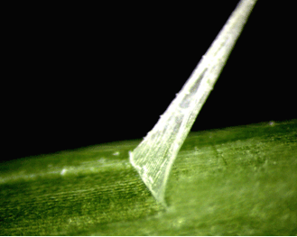
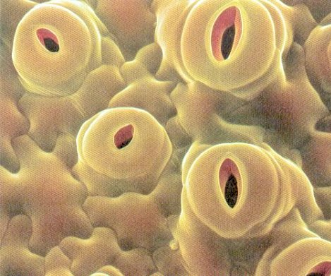
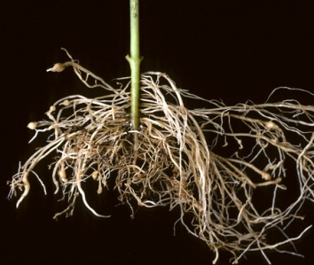
Problems with Living on Land &
Associated Adaptations
Desiccation
Gravity stronger
Extreme temp changes
Obtaining H₂0 & nutrients
UV stronger
Reproduction harder?

Slide 7
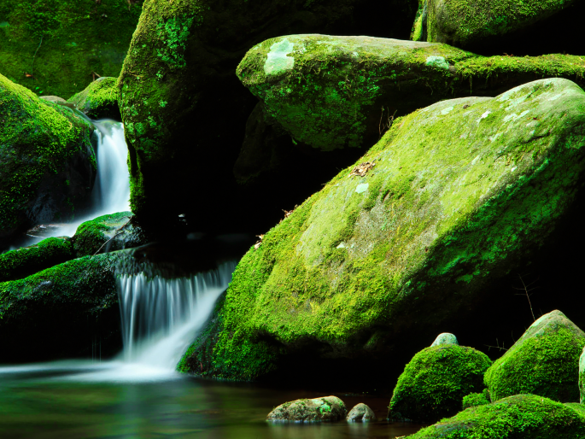
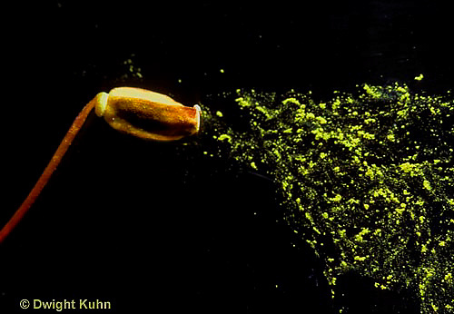
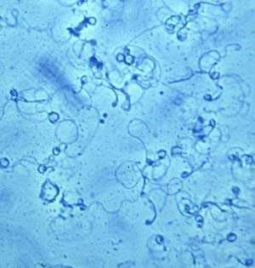
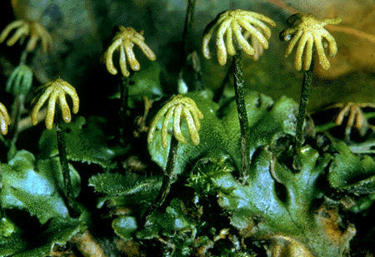
Non-Vascular Plants
Key characteristics:
Gametophyte is dominant phase of life cycle
Require water for sexual repro
Homosporous
No vascular tissue – small size and what environment?
Three phyla
Moss sperm

Slide 8
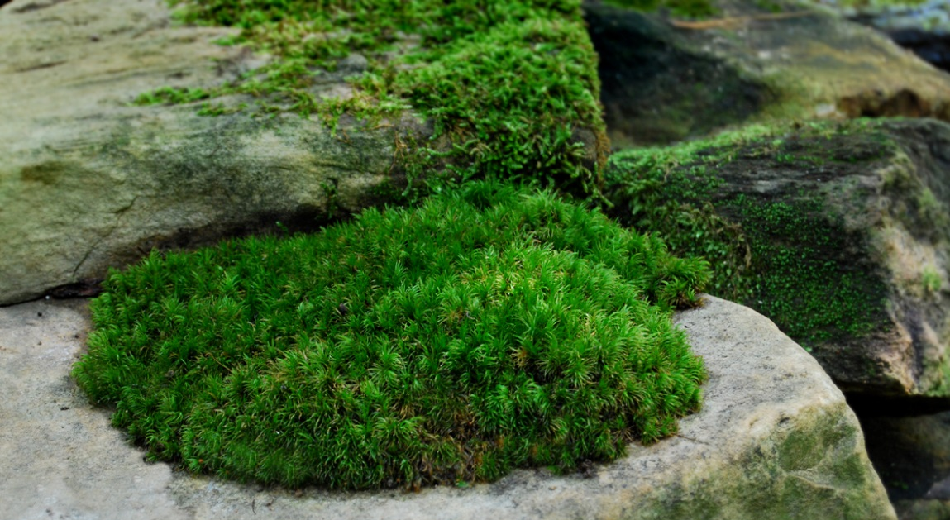
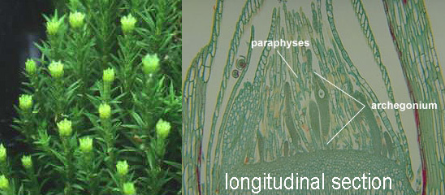
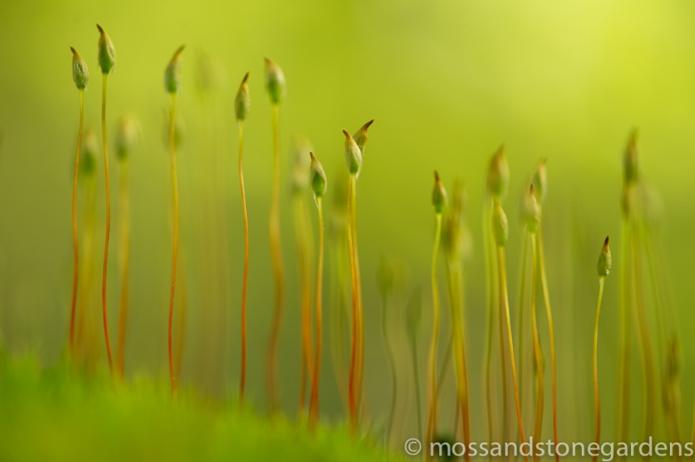
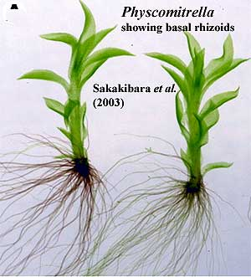
Phylum Bryophyta (mosses)
10,000 sp.
Gametophytes leafy and spiral
Anchored to substrate with Rhizoid
How obtain water?
Wet environments, but drought resistant

Slide 9
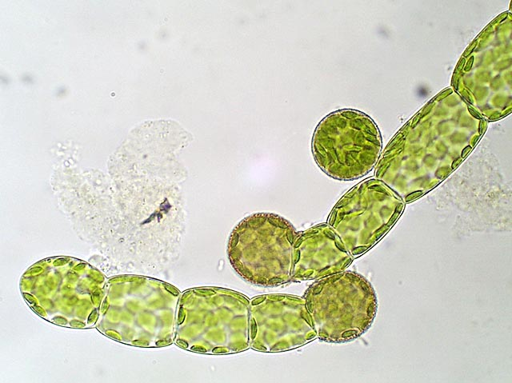
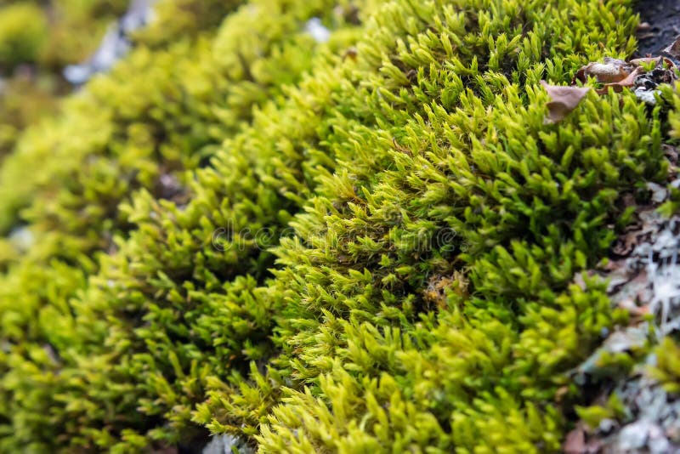
Protonema
Moss Life Cycle
Gametophyte
OBSERVE
Protonema
Gametophyte (break piece off)

Slide 10
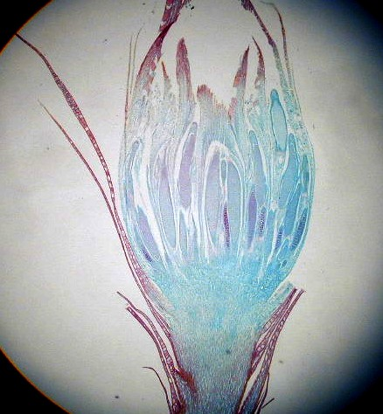
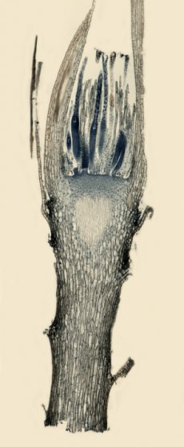
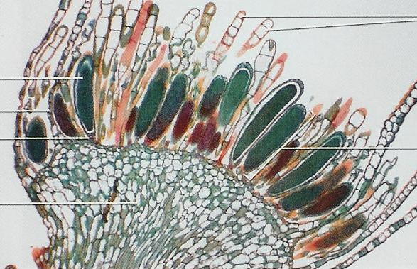
DRAW One, HW other (28.6):
Archegoniophore & archegonia (slide)
Antheridiophore & Antheridia (slide)

Slide 11
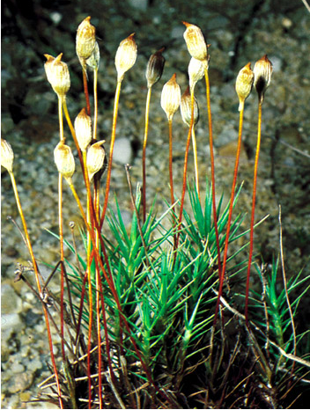
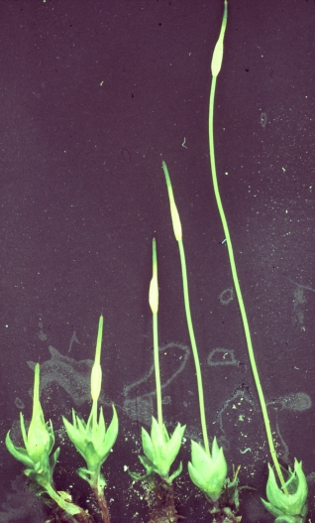
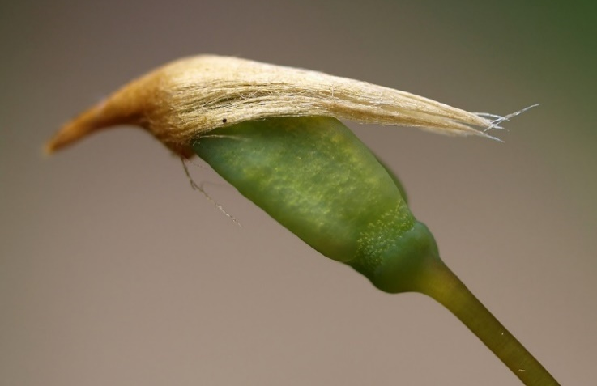
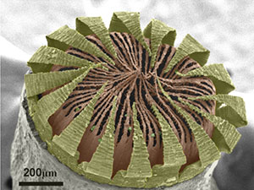
DRAW: Developing sporophyte (28.3)
HW: Sporophyte capsule (slide)

Slide 12
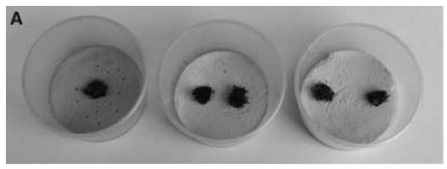
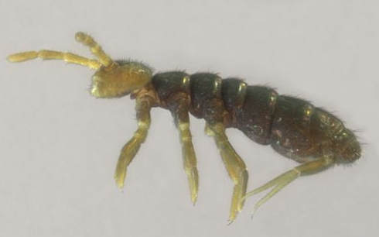
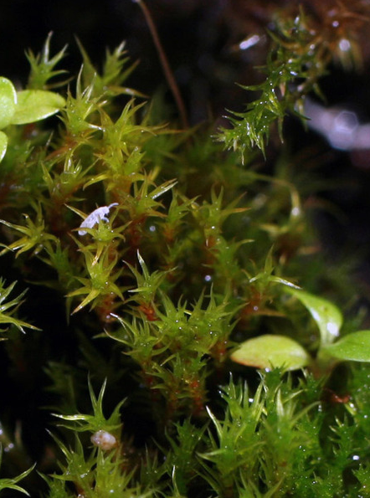
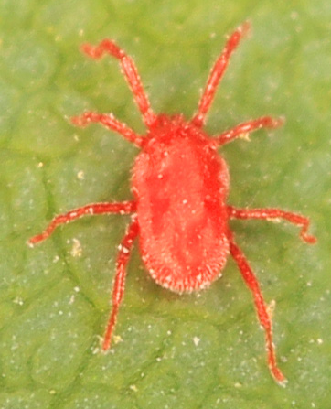
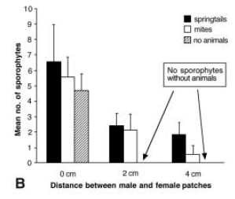
How does the sperm get to the archegonia?
Cronberg et al. 2006. Science.

Slide 13
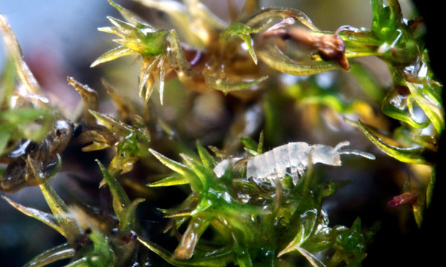
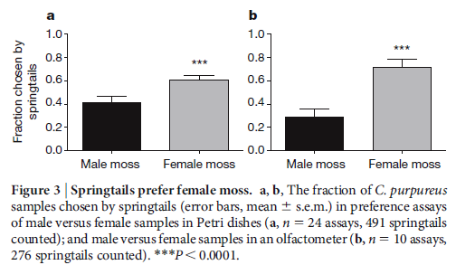
Why would “bugs” visit the archegonia / antheridia?
Rosenstiel et al. 2010. Nature.

Slide 14
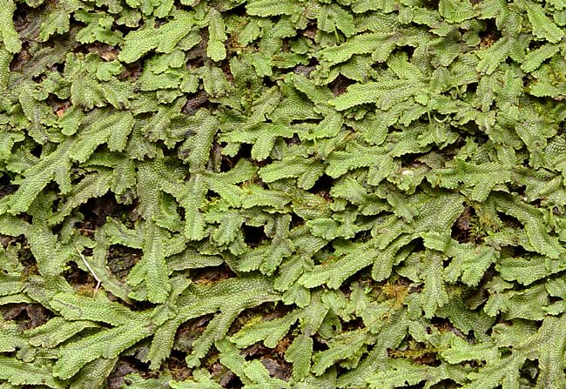
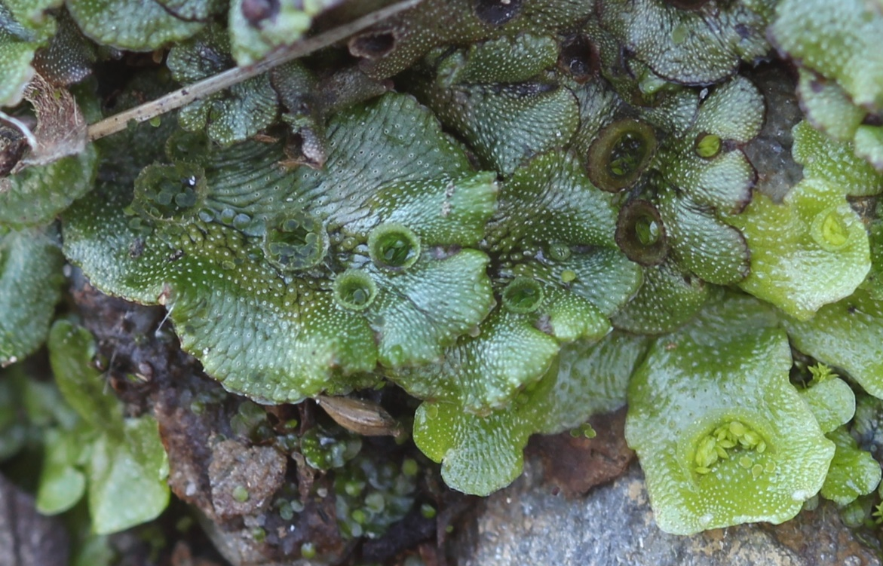
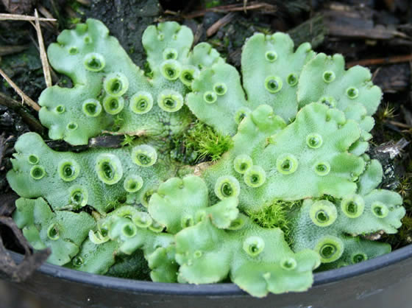
Hepaticophyta (liverworts)
9,000 species
Gametophyte flat & leaf-like (most)
Not drought resistant
Gametangia raised and photosynthetic
Asexual reproduction – gemmae cup
OBSERVE: Gametopyte & Gemmae cups (28.1)

Slide 15
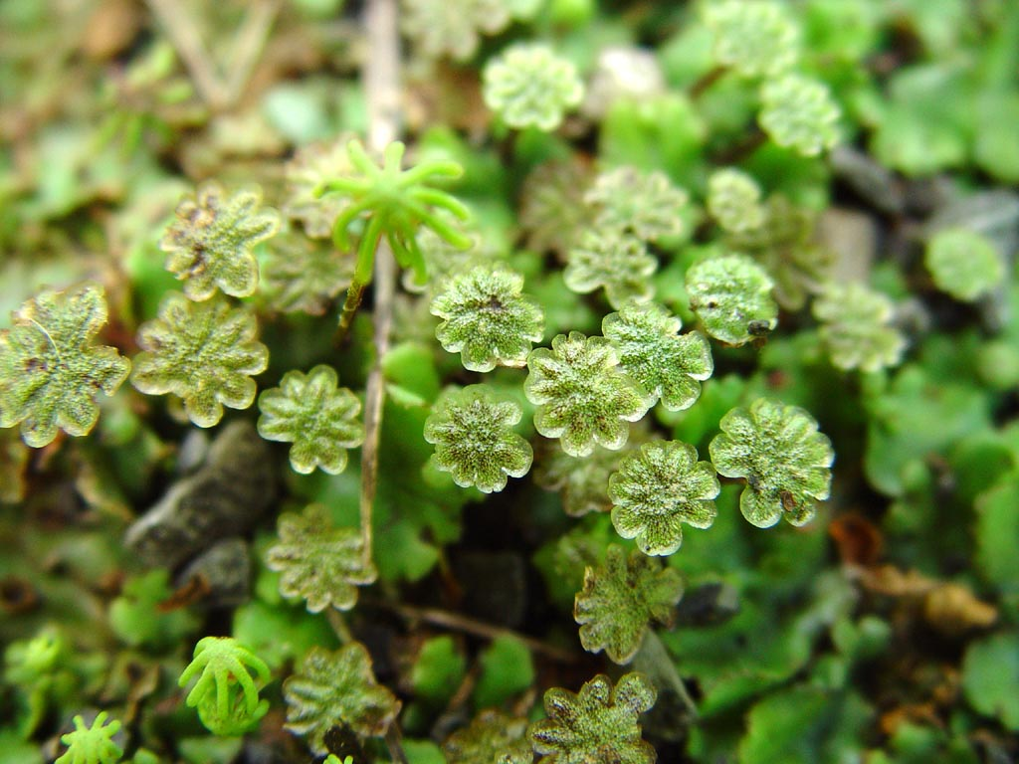
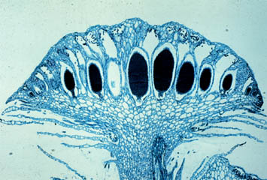
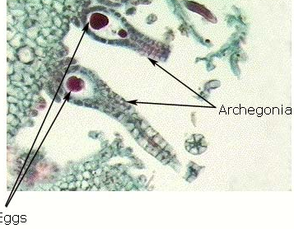
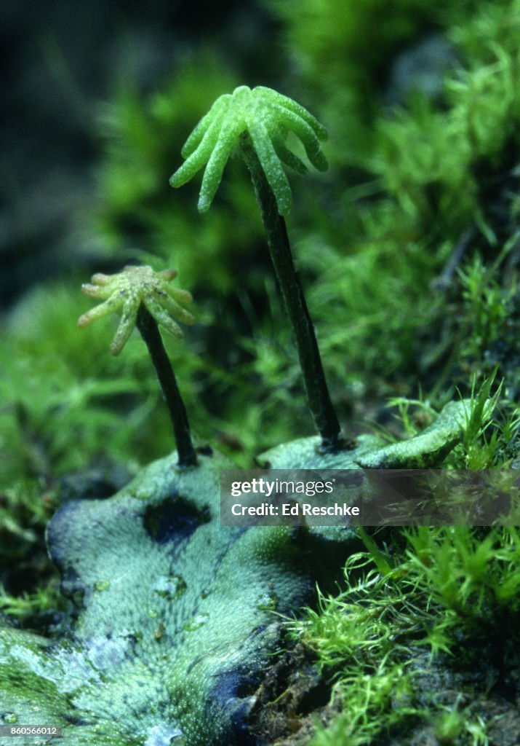
Liverwort Life Cycle
DRAW 2, HW other (28.2)
Archegoniophore & Antheridiophore (plastic block)
Antheridiophore & Antheridia (slide)
Archegoniophore & Archegonia (slide)

Slide 16
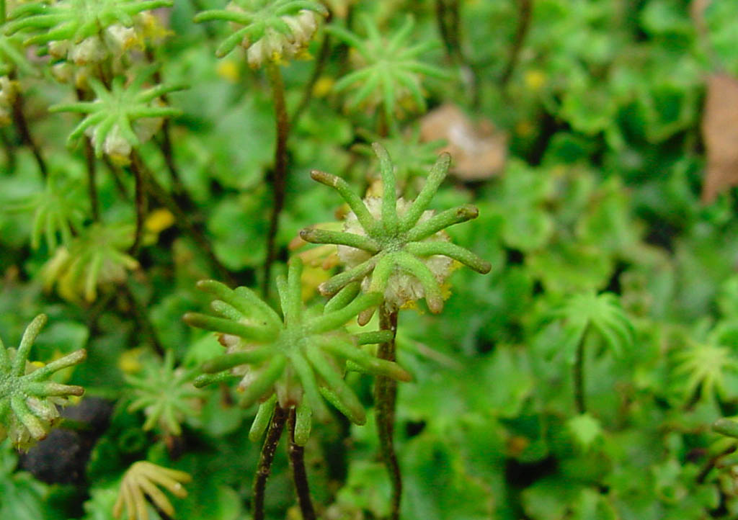
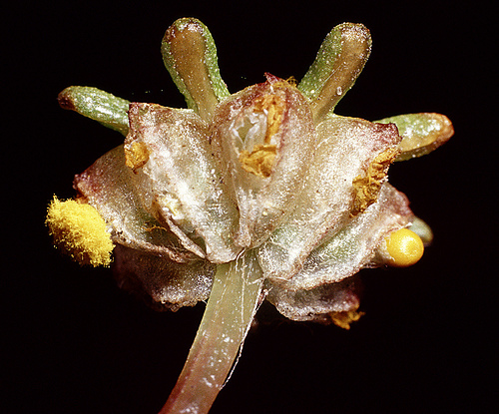
Liverwort Life Cycle
DRAW: Developing sporophyte (slide) 28.3

Slide 17

Anthocerophyta
(hornworts)
~100 sp.
Flat and leafy gametophyte
Single chloroplast (per cell)
Sporophyte horn-like
Sporophyte photosynthetic and possesses stomata

Slide 18

When did the first plants appear?
What habitats are bryophytes in at this time?
What plant innovation is next?
The 1st known vascular plant

Slide 19

Sporangium
Evolution of Vascular Plants
Stems first
Habitat without roots?
Surprising stems first?
Upright stem
Edwards et al. 1992. Nature
Rhizome
Rhizoids
Notes:
Figure 27.19: Reconstruction of Aglaophyton major.
Recent evidence indicates that this plant, although superficially similar to other early vascular plants, lacked conducting tissues that are characteristic of vascular plants. For this reason, it has been reclassified into a new genus and is no longer considered a rhyniophyte. (Redrawn from J. D. Mauseth, Botany: An Introduction to Plant Biology, 2nd ed., Saunders College Publishing, Philadelphia, 1995.)

Slide 20

What’s next roots or leaves?
What do roots provide?

Slide 21


Leaf Evolution
What’s the function of leaves?
Two leaf morphologies
Notes:
Figure 27.10: Evolution of microphylls and megaphylls.
Dichotomous branching (in b) is branching into two equal halves. Webbing (in b) is the evolutionary process in which the spaces between close branches become filled with chlorophyll-containing cells.

Slide 22


Where does photosynthesis happen?
Photosynthesis requires the cells to pull in ? and give off ?
Why aren’t openings on top?

Slide 23

How does water get up to the top of a tree?

Slide 24

Dilemma:
Need CO2 (and release O)
Do not want to lose water
How do plants solve this problem?
Work as a table, list the conditions that are going to cause changes in stomata regulation (think both in and out of the cell)

Slide 25


Vascular Tissue
No heart
How do the solutions move?
Two types of vascular tissue
DRAW: Xylem (not in book)

Slide 26



Phloem: 2 types
DRAW: Phloem (NIB)

Slide 27



Phylum Pterophyta (Ferns and allies)
12,000 sp.
Most species tropical
Reproduce with ?
Sporophyte is dominant
Horizontal underground stem
Frond – developing leaf
Most homosporous
Motile sperm

Slide 28


Fern Reproduction
Fern gametophyte

Slide 29


DRAW: Gametophyte with dev. sporophyte (use forceps and put on slide)

Slide 30



Sori
DRAW: Sori and sporangia (29.1; rip a piece off, dissecting scope)

Slide 31


Odd Ferns and fern allies
OBSERVE
Aquatic ferns Azolla & Salvinia
Whisk fern
Horsetail
Notes:
Figure 27.8: The life cycle of the common liverwort (Marchantia polymorpha).
The dominant generation is the gametophyte, represented by separate male and female thalli. The stalked, umbrella-shaped structures are the antheridiophores, with antheridia that produce sperm cells, and the archegoniophores, with archegonia that each bear an egg cell. See text for a detailed description.

Slide 32


Phylum Lycophyta
Club mosses, ground pine, quillworts, spike moss
Homosporous or heterosporous
Sperm flagellated and motile, swim to the egg
Lycophyll leaves
Selaginella (spike moss)
Isoetes (quill wort)

Slide 33


Lycopodium
(ground pine)
OBSERVE:
Sellegenella
Isoetes
Quillworts

Slide 34



Growth and Development
Do all plants have both types of growth?

