Slide 1
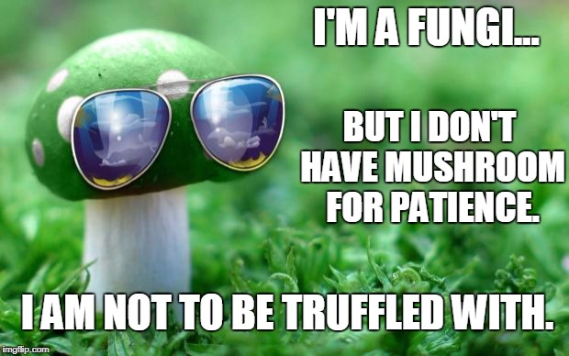
Kingdom Fungi

Slide 2
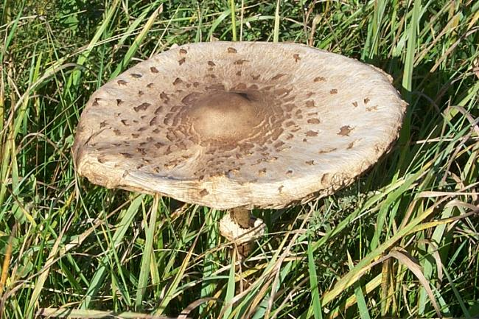

Slide 3
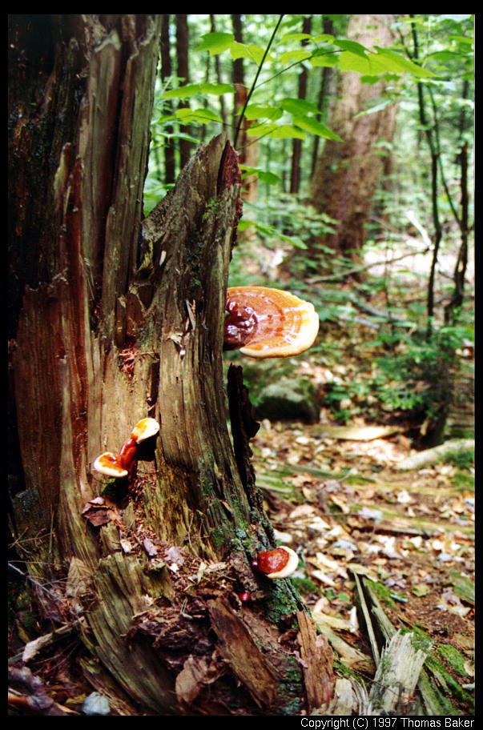
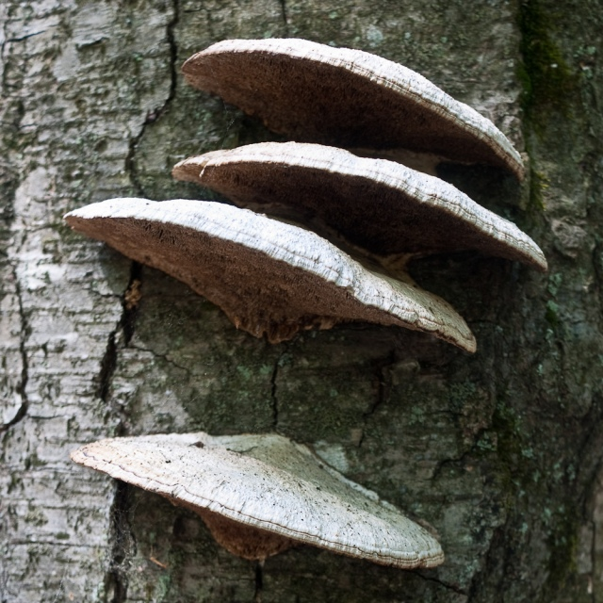

Slide 4
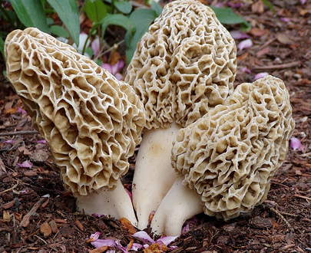

Slide 5
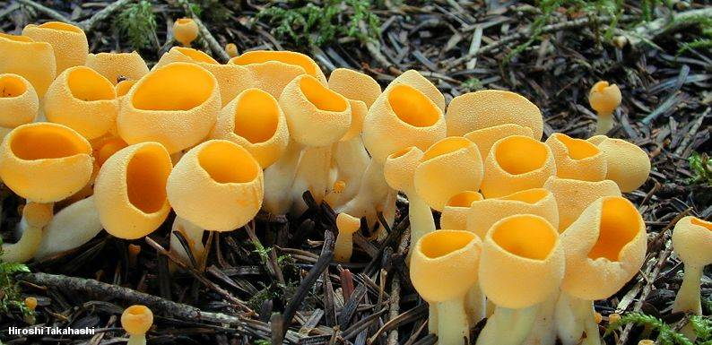

Slide 6
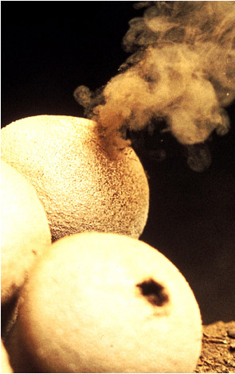
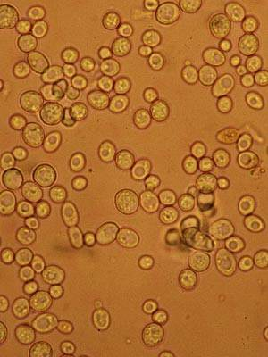
Diverse Kingdom

Slide 7
“The fungi are a cursed tribe, invention of the devil, devised by him to disturb the harmony of the rest of nature created by God.”
Linnaeus, 1758
If you were Linnaeus, where would you put them?

Slide 8
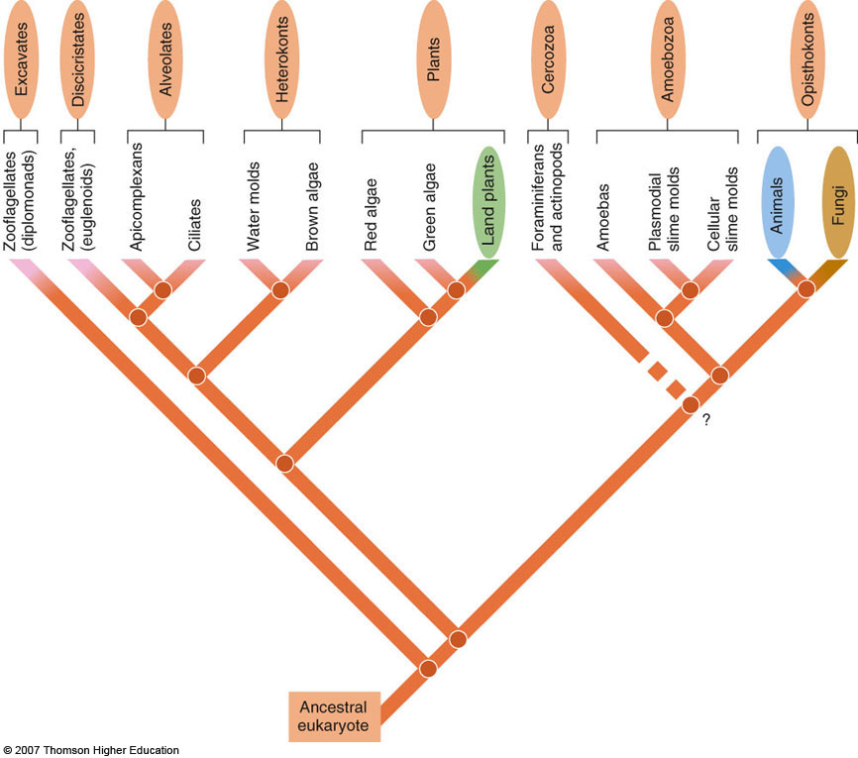
History & Phylogeny
Sister group to animals
When do they evolve?
Ancestor?
When did they colonize land?

Slide 9
Evolutionary Relationships
Kingdom divided into 5 phyla
Cladogram:
Notes:
Figure 26.5: Fungal evolution: cladogram of major phyla of fungi.
This cladogram shows phylogenetic relationships among living fungi, based on comparisons of ribosomal and nuclear gene sequence data for many species. The chytrids were the lineage that branched off first during fungal evolution. Note that ascomycetes and basidiomycetes are sister clades. Remember that the phylogeny of fungi is a work in process.

Slide 10
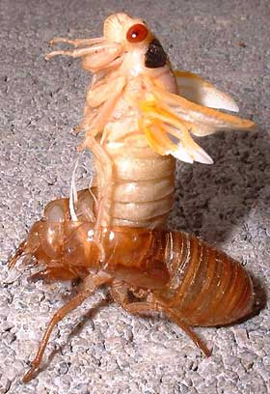
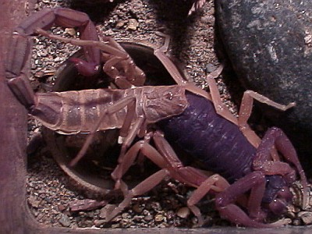
Fungus Synapomorphies
Cell walls made of unique polysaccharide
What’s does chitin do for fungus?
Who else has chitin in their cells?

Slide 11
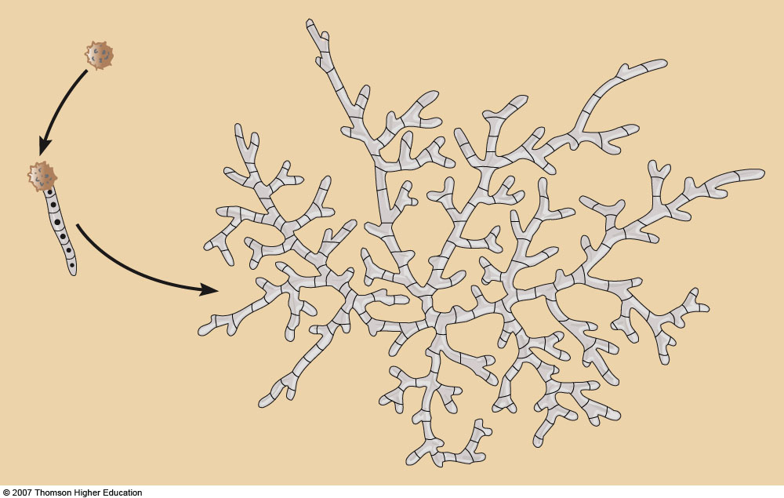
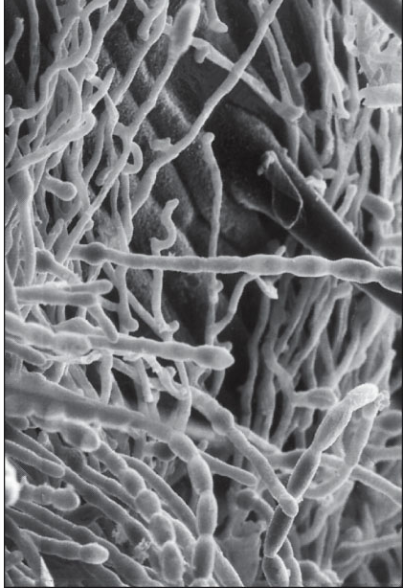
Fungus Synapomorphies
Mass of interconnected hyphae?
Fungus life cycle starts as?
Grow into filaments called?
Notes:
Figure 26.2: Germination of a spore to form a mycelium.

Slide 12
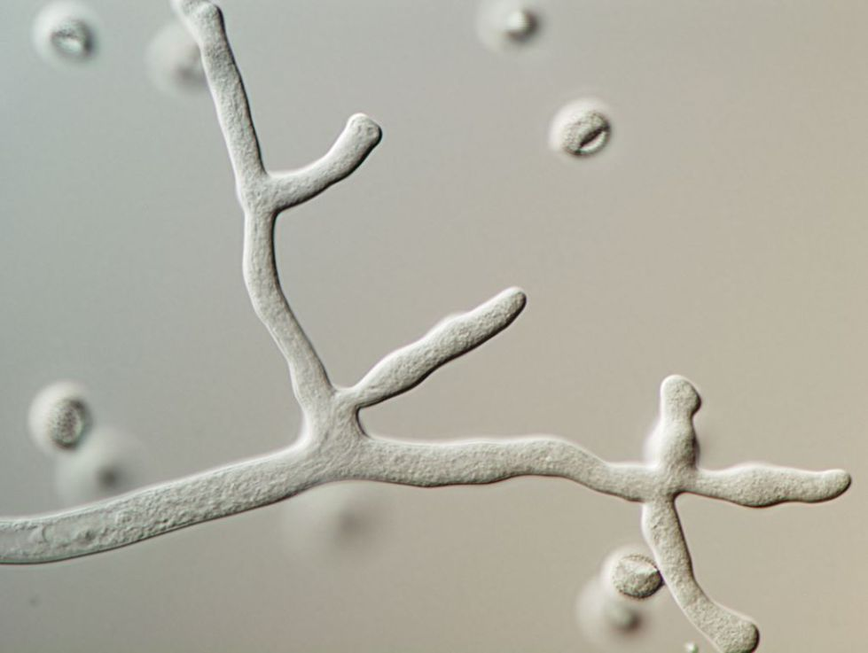

Slide 13
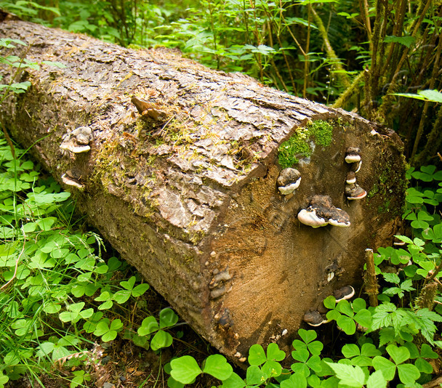
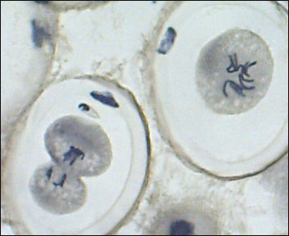
General Fungus Characteristics
Single or multicellular?
Heterotrophs (specifically what type?)
How do they obtain nutrients?
3 important enzymes
Evolved to maximize surface area
Asex and Sex reproduction
Do they have males and females?

Slide 14
Asexual Replication
Strange form of mitosis

Slide 15
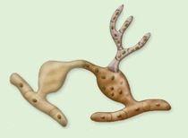
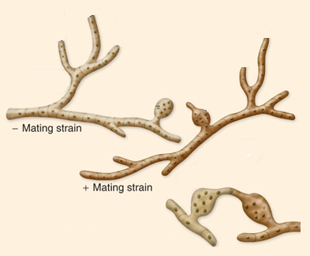
Generalized Fungal Reproduction

Slide 16
General Fungal Reproduction
Work with the person next to you and review/draw the general reproductive life-cycle for all fungus
Where is asexual reproduction happening?
Where are they n, n+n, and 2n?

Slide 17
Important Terms
Monokaryotic – single nucleus in a cell
Dikaryotic – two distinct nuclei within a cell
Plasmogamy – union of cytoplasm of two parent mycelia
Karyogamy – fusion of haploid nuclei

Slide 18
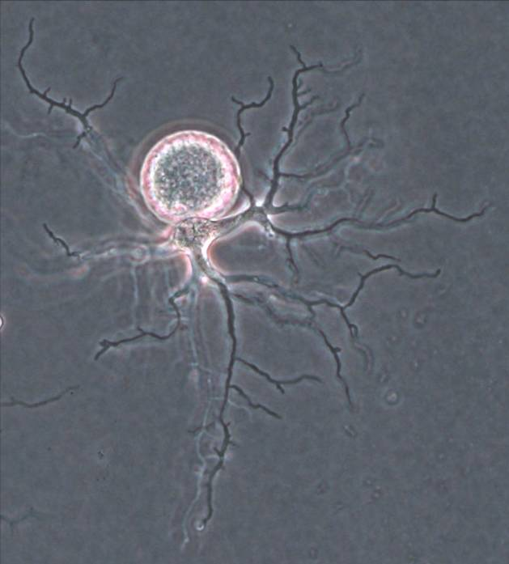
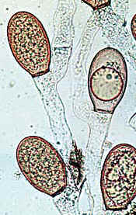

Chytridiomycota - a “new” phylum
Most basal fungus
Aquatic and damp soil
Flagellated spore
Saprobes and parasites
Degrade chitin and keratin

Slide 19
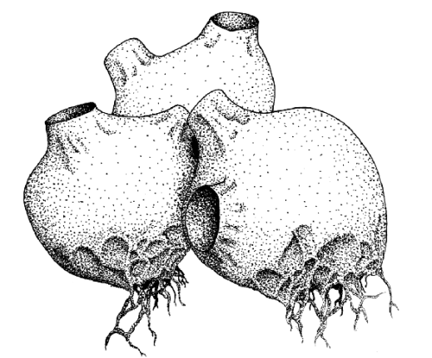
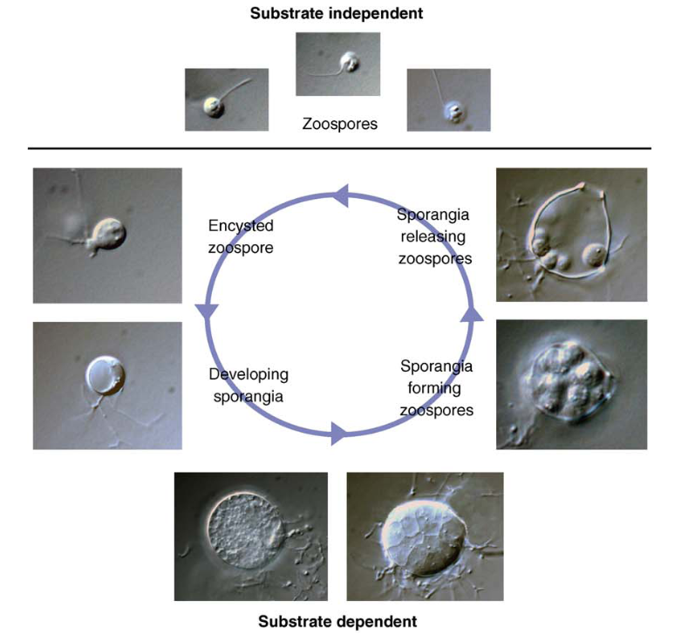
Life-Cycle

Slide 20
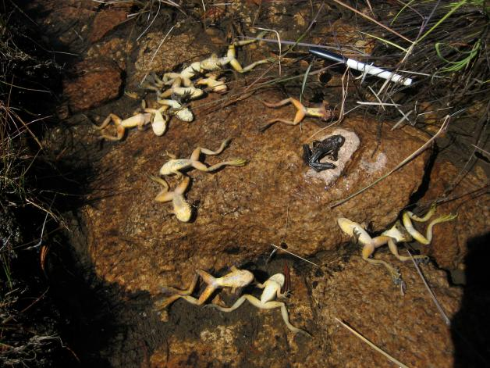
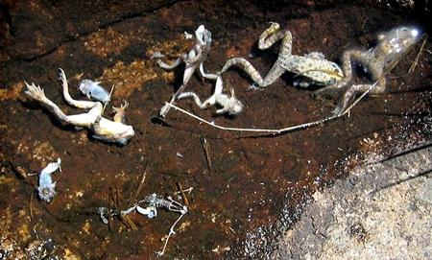
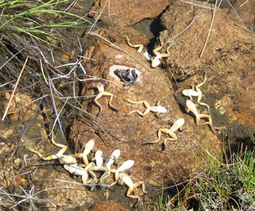
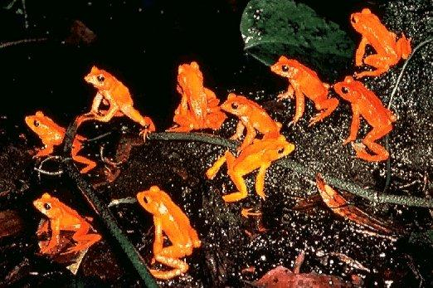
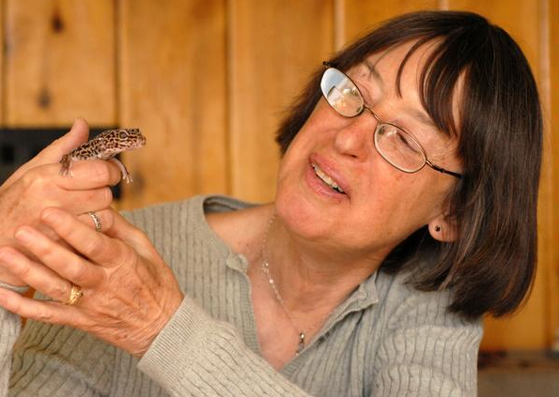
Don’t have any to show
  “Chytrid”
Story of the Golden Toad

Slide 21
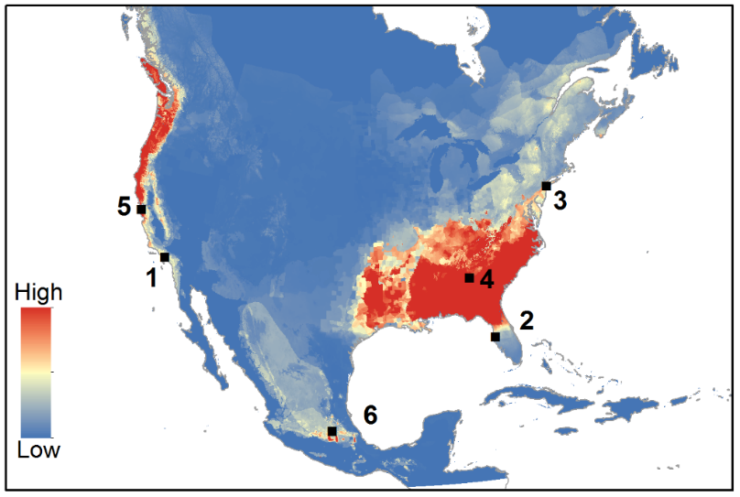
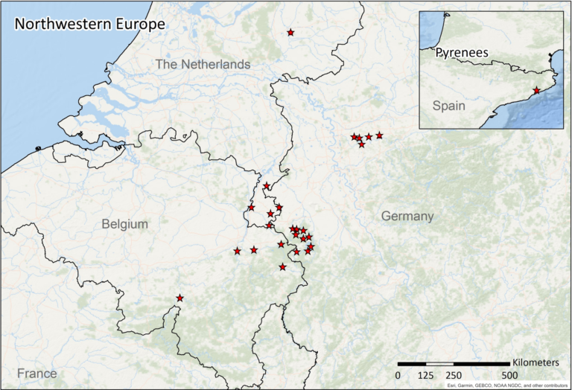
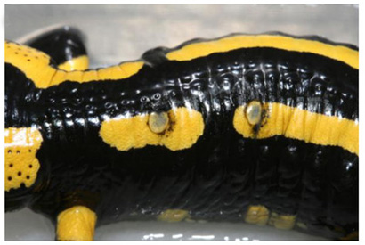
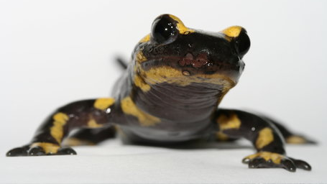
http://amphibiaweb.org/chytrid/Bsal.html

Slide 22
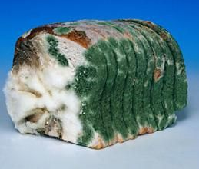
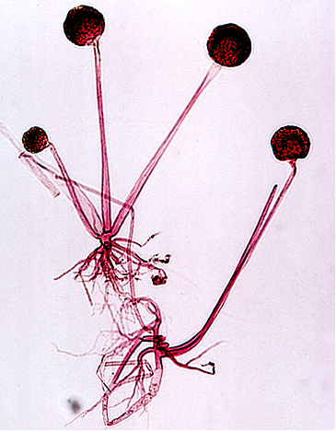
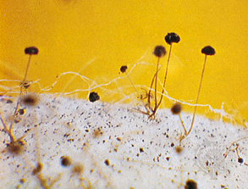
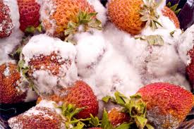
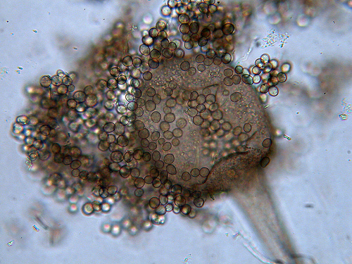
Zygomycota
(Bread molds)
1000 species
All hyphae coenocytic
Asexual reproduction super common
Weird sexual structures (draw)
DRAW: Live bread mold (27.3)
DRAW: Rhizopus zygosporangium (27.3)

Slide 23
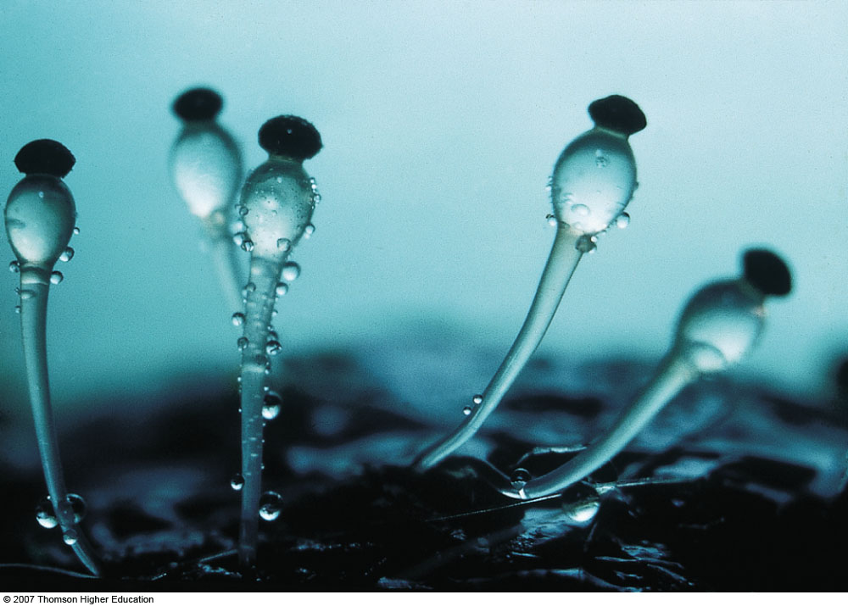
http://www.youtube.com/watch?v=TrKJAojmB1Y
http://www.youtube.com/watch?v=T8OAmcUnm4g
Notes:
Figure 26.8: Pilobolus, a zygomycete that grows in animal dung.
Stalked sporangia of Pilobolus protruding from a pile of dung, which contains an extensive mycelium of the fungus. The stalked sporangia, which are 5 to 10 mm tall, act like shotguns and forcefully discharge sporangia (the black tips) away from the dung onto nearby grass. When animals such as cattle or horses eat the grass, the spores pass unharmed through the animal’s digestive tract and are deposited in a fresh pile of dung.

Slide 24
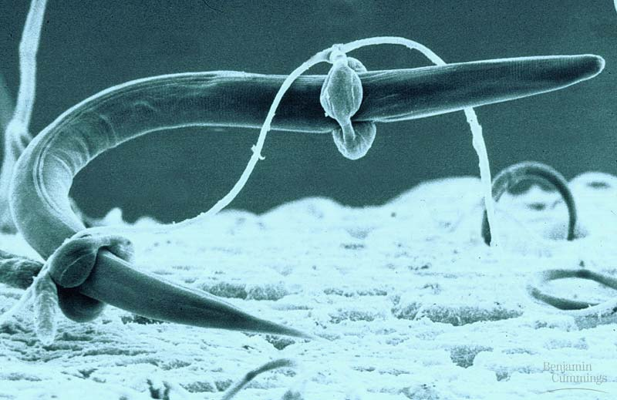
Predatory Zygomycetes
https://www.youtube.com/watch?v=xFhE9empvj4

Slide 25
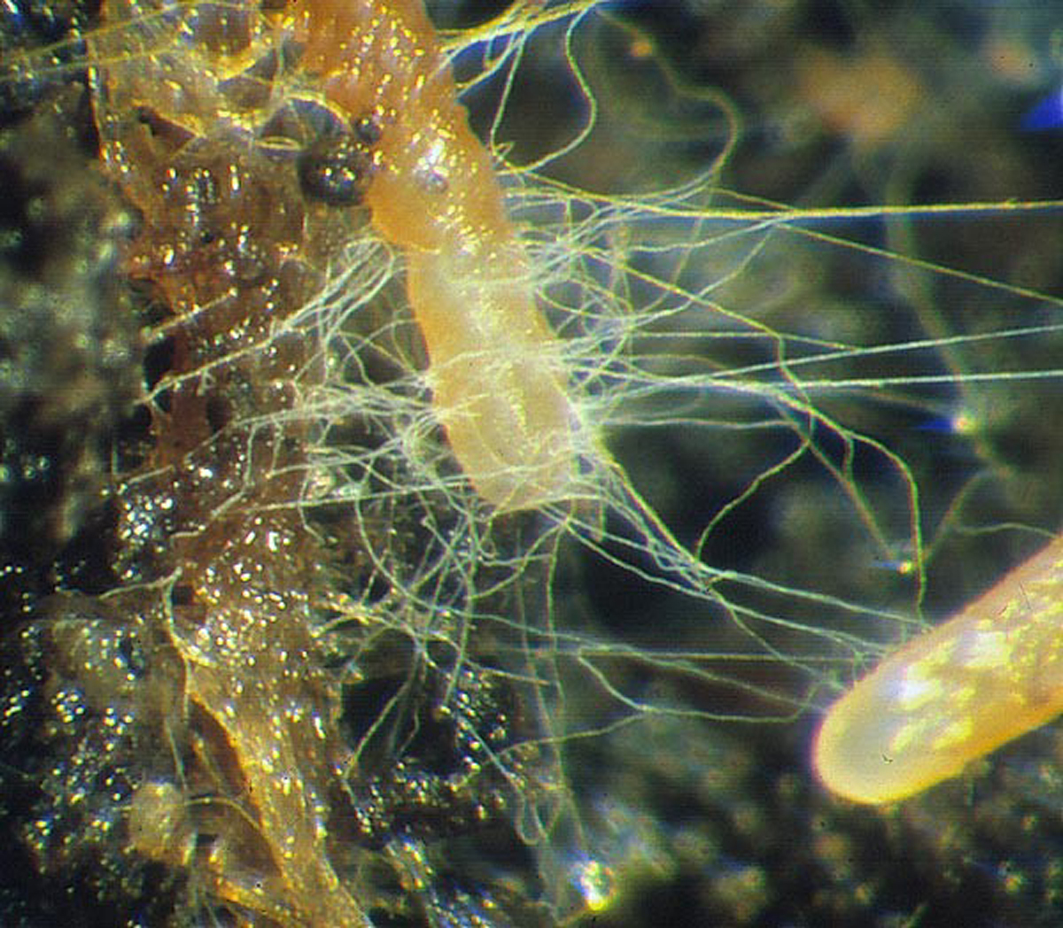
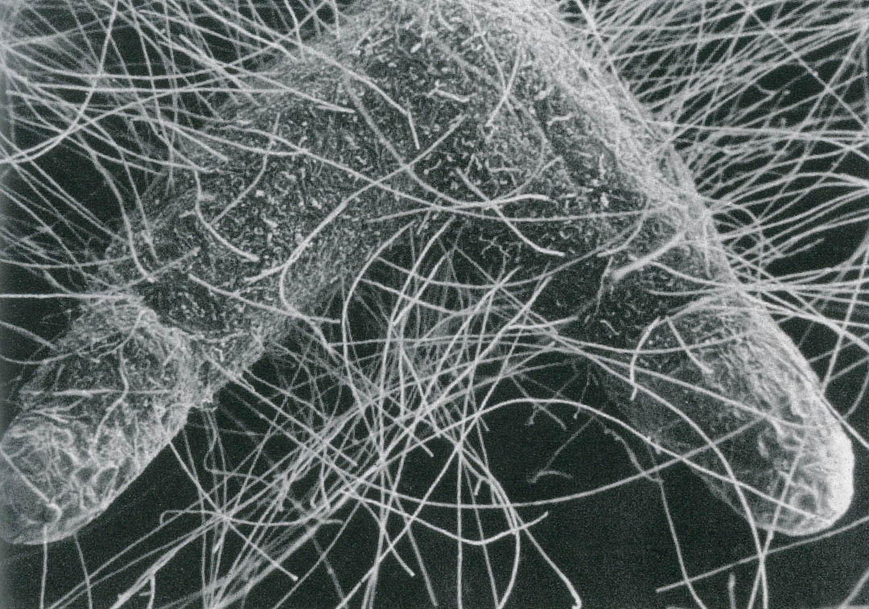
Glomeromycota
150 species
Known as Mycorrhizae
Symbiosis with plant roots
Found in 90% plants
Two different types

Slide 26
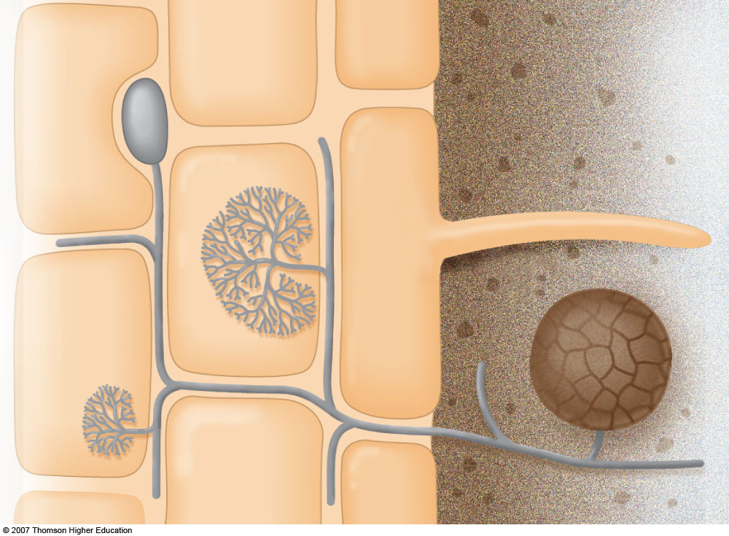
Cells of root cortex
Root epidermis
Soil
Root hair
Spore
Cortex cell
Hyphae of fungus
Notes:
Figure 26.11: Arbuscular mycorrhizae.
This mycelium has grown into the root. Its hyphae branch between the cells of the root. Hyphae have penetrated through the cell walls of two root cells and have branched extensively to form arbuscules. The tip of one hypha between root cells has enlarged and serves as a vesicle that stores food. The tip of a hypha in the soil has enlarged, forming a spore. The spaces between the root cells have been magnified.

Slide 27
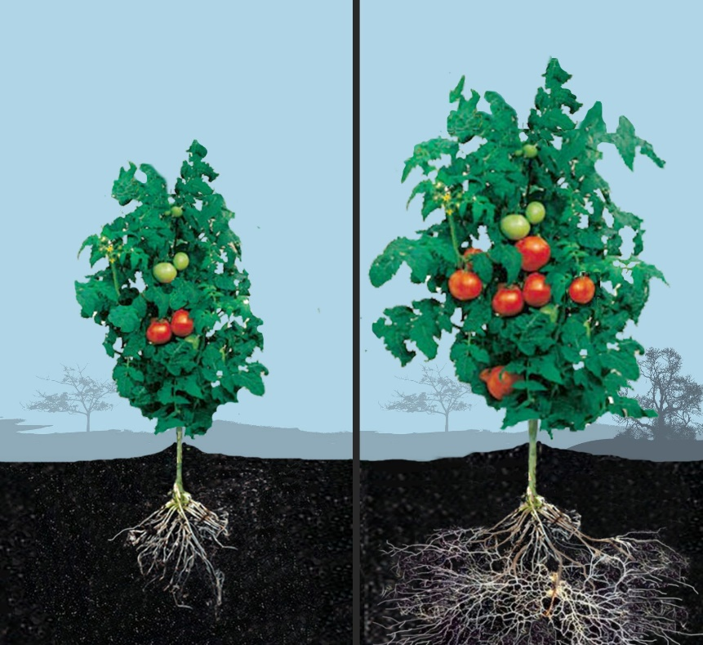
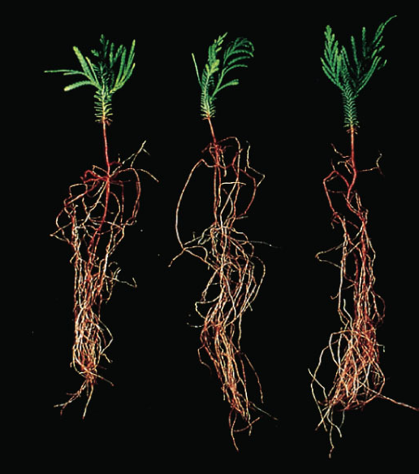
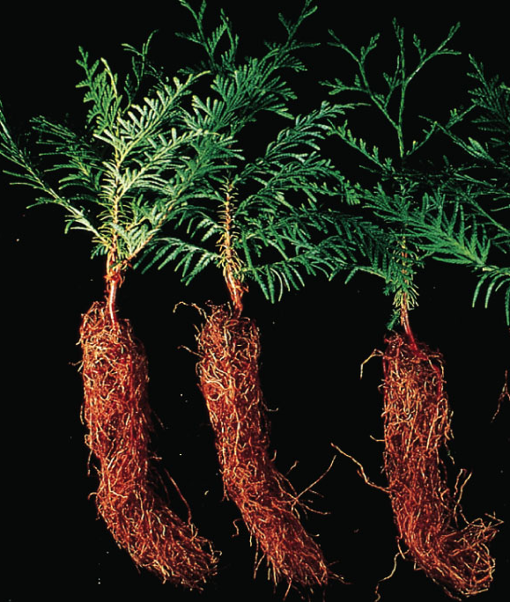
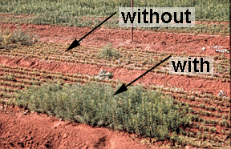
Without
Without
With
Examples of plant growth with and without mycorrhizae
With

Slide 28

Benefits derived from mycorrhizal fungus
Improved soil structure
  Increases resistance to soil pathogens
  Beneficial effect on other soil microbes
Better competitiveness against weed species
Greater water transport from soil to plant**
Greater nutrient transport from soil to plant**
What are the benefits to the fungus?

Slide 29
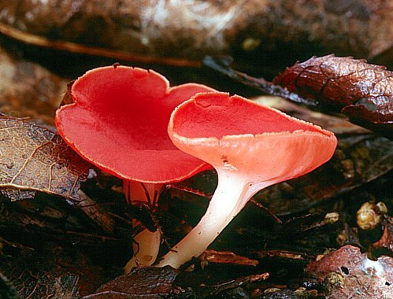
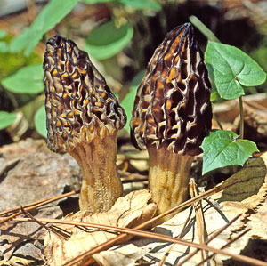
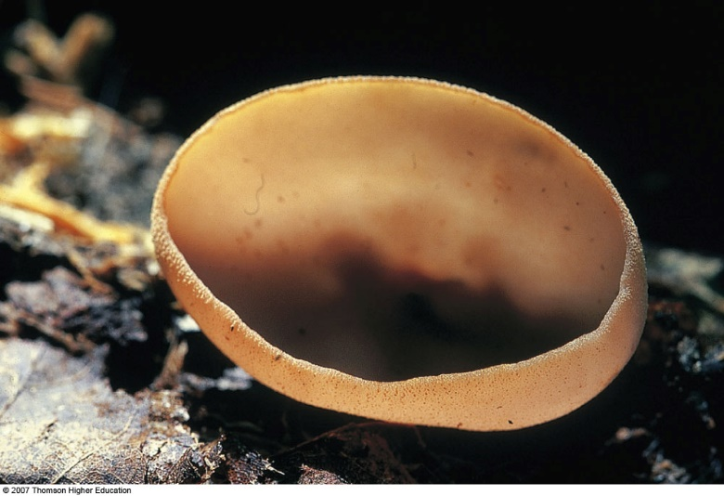
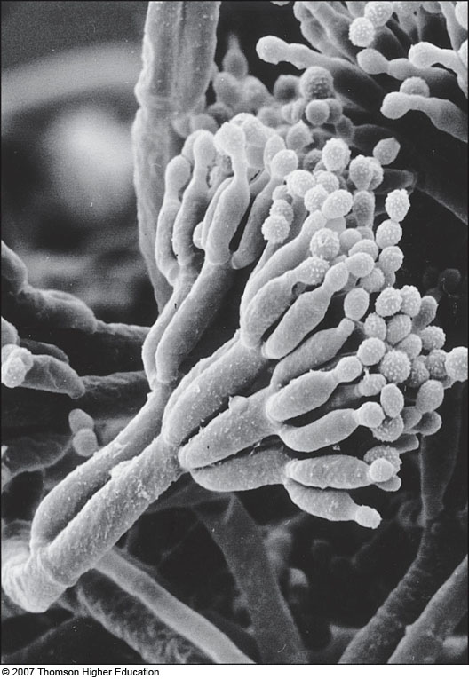
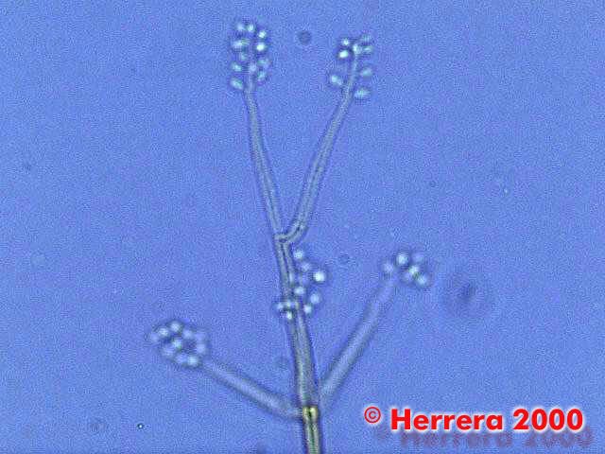
Phylum Ascomycota
60,000 species
Many well-known species
Asexual reproduction (draw)
DRAW: Slide of conidia and conidiophores, dark pink one (27.5)

Slide 30

Sexual Reproduction
Apply n, n+n, 2n, plasmogamy & karyogamy to the cycle
DRAW: slide of asci and ascospores (27.6)

Slide 31







Miscellaneous Ascomycetes
HW
DRAW TWO:
Yeast (27.6)
Morels
Hypoxilon
Scarlet cup
Notes:
https://www.youtube.com/watch?v=Fe4G9tTzeW0

Slide 32

Basidiomycota
30,000 species
Mushrooms, toadstools, shelf fungi, puffballs
Many important plant pathogens (grains)
No asexual phase

Slide 33



Sexual Reproduction
Basidia bearing surfaces
DRAW 2: Miscellaneous basidiomycete fungus (27.7)
HW DRAW 2: Miscellaneous basidiomycete fungus (27.7)

Slide 34


DRAW: slide of basidia and basidiospores (27.8)
Notes:
Figure 26.16: SEM of a basidium.
Each basidium produces four basidiospores.

Slide 35

https://www.youtube.com/watch?v=ADrBo7u3tR4
Notes:
Figure 26.15: Basidiomycete fruiting bodies.

Slide 36


https://www.youtube.com/watch?v=Lg9-HTtgFOk
Notes:
Figure 26.24: Fungi that cause plant diseases.

Slide 37




Fungal Economics
  Human products
    Bread
    Cheese
    Alcohol
    Antibiotics
  Paper processing
How does yeast produce bread?
How is alcohol produced?
https://www.youtube.com/watch?v=GvD-8ZfxfOY

Slide 38


Lichens
Symbiosis between who?

Slide 39


DRAW: lichen cross section (27.9)

Slide 40



Lichen Growth-Forms
DRAW 2: lichen growth forms (27.9)

Slide 41




Lichen Reproduction
Surface
layer
(fungal hyphae)
Fungal hyphae interwoven with photoautotroph
Fungal hyphae
Rock or other surface to which lichen is attached
Notes:
Figure 26.20: Lichens.

Slide 42
What does each partner get?
Fungus
Carbs
Algae
Support
Mechanical protection
Protection from UV
Water

Slide 43

Other Fungal Mutualisms
Leafcutter Ants & Fungus

Slide 44


Slide 45




Fungus Factoids

Slide 46



Largest Basidiocarp: 2 m across, 625 pounds

Slide 47

Largest mycelium: 1500 acres
Several thousand years old
Why are parasitic fungi more problematic than other parasites?

Slide 48


Fairy Rings

Slide 49

Mycoses: fungal infection
Dermatomycoses: jock itch, athlete's foot, ringworm
Candidiasis: yeast infections (Candida albicans)
Histoplasmosis: respiratory infection due to exposure to bird feces (Histoplasmosis capsulatum)
Coccidiomycoses: Valley Fever (Coccidiomyces immitis)
What is the problem with treating fungal infections?

