Slide 1
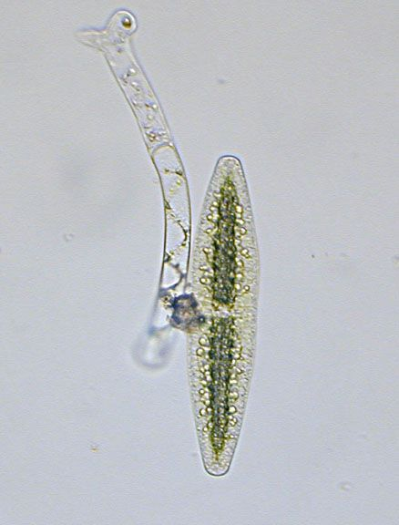
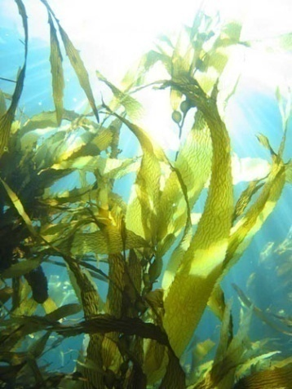
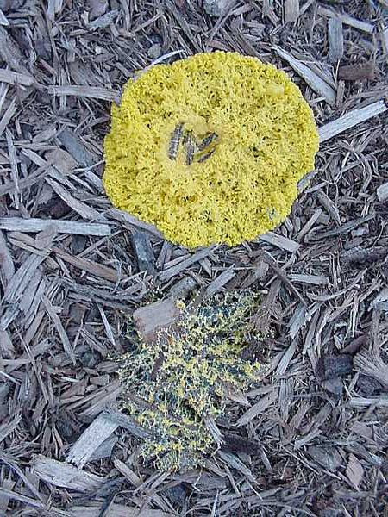
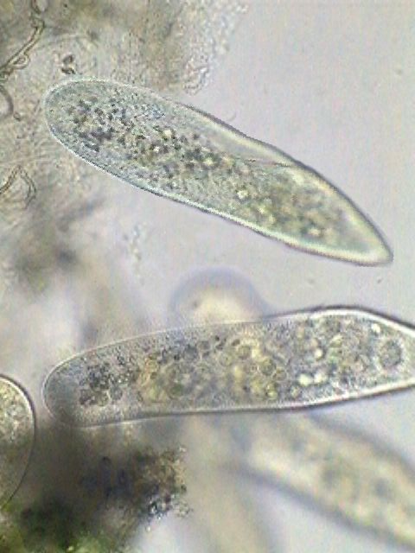
Domain Eukarya
When do they appear?
What’s the first kingdom?
Characteristics that unite the clade
What do you think of this list?

Slide 2
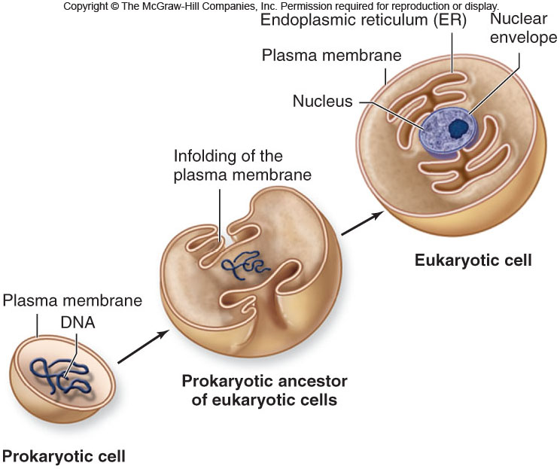
Review: Evolution of Compartmentalization
Stage 1?
Why?

Slide 3
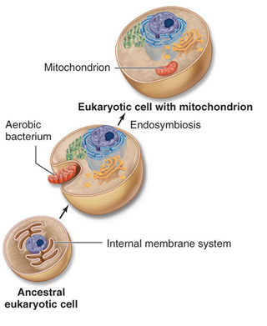
Review: Evolution of Compartmentalization
Stage 2?
Engulfed (phagocytosis)
Initially symbiosis
Dependence
Gene transfer
Work with the person next to you and try and determine what “benefits” each organism is getting during the symbiotic event

Slide 4
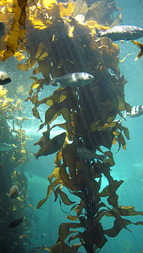
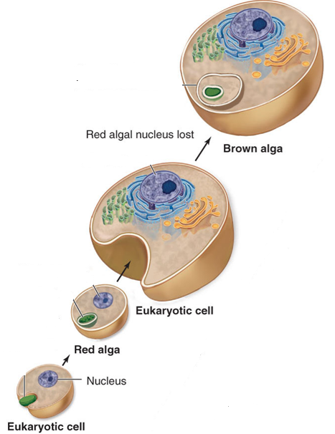
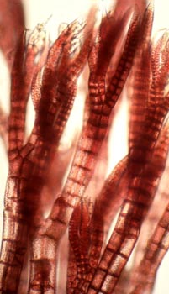
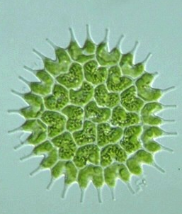
Review: Evolution of Compartmentalization
Stage 3?
Work with the person next to you and identify the “benefits” for each organism during this symbiotic event

Slide 5
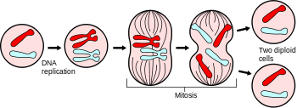
Reproduction (in Protista)
Asexual reproduction is the dominant mechanism
What is the mechanism?

Slide 6
Sexual Reproduction (in Eukarya)
Super important – why evolve?
Three types of sexual reproduction

Slide 7
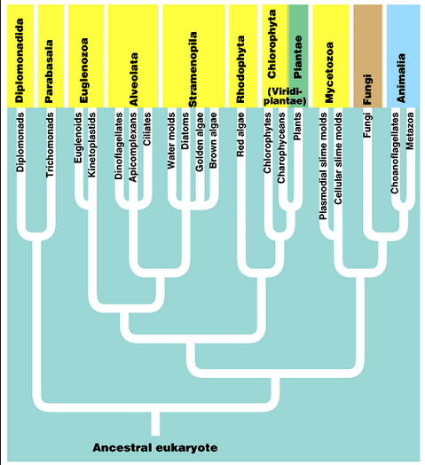
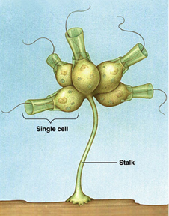
Protista is Polyphyletic
Animals
Evo relationships are a mess
6-8 major “lineages” of protists
Our approach:
  We will discuss groups in a rough evolutionary “order”
  Will present superphyla to help with organization
  The lab manual is not the most up-to-date and will differ

Slide 8
THE KEY!
Eukarya
Domain
Protista
Kingdom
Euglenozoa
Super Phylum
Euglenida
Phylum

Slide 9
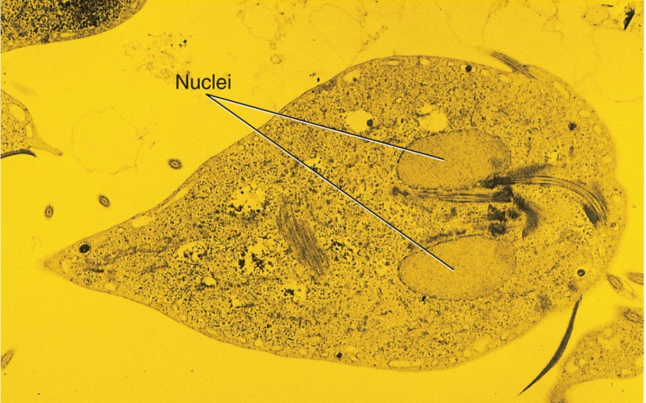
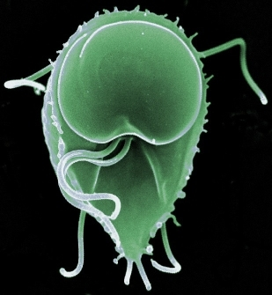
Phylum: Metamonada
Class: Diplomonadida
Eukaryota
Protista
Metamonada
Most ancestral / primitive – lack mitochondria
2 haploid nuclei
Multiple flagella (often clustered)

Slide 10
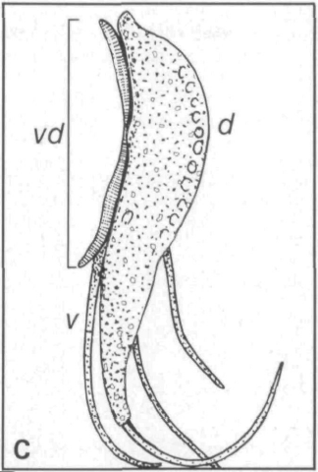
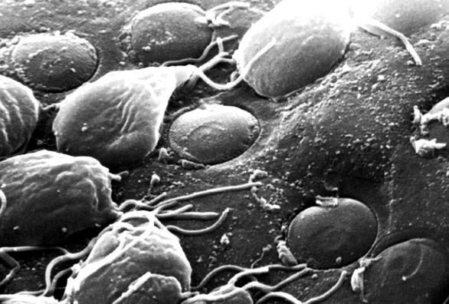
Eukaryota
Giardia lamblia
Protista
Metamonada
Hitchhiker’s diarrhea
Large sucker disk?
flagella

Slide 11
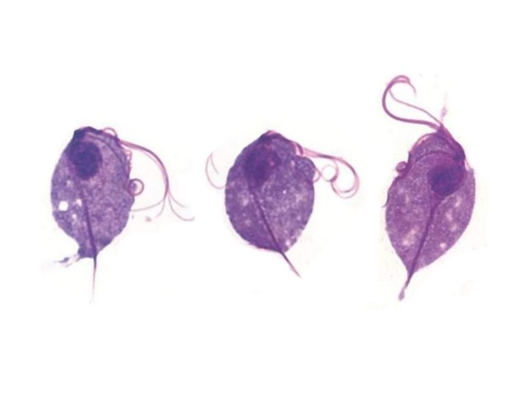
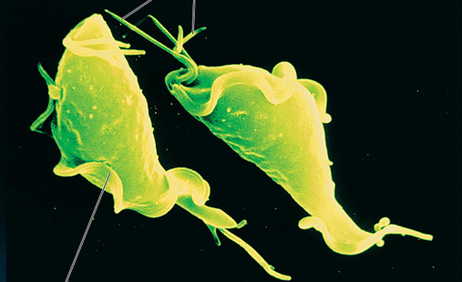
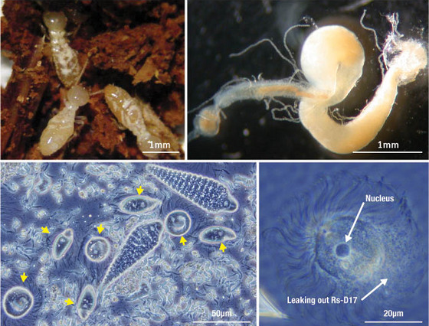
Eukaryota
Phylum: Metamonada
Class: Parabasalia
Protista
Metamonada
Trichomonas vaginalis
Anaerobic – symbionts & parasites
Lack mitochondria
Single cluster of flagella
Undulating membrane
Trichonympha
Notes:
Top left – termite species Reticulitermes speratus
Top right – the gut of a termite
Lower right – protist found inside the gut of the termite
Lower left – lots of bacteria species inside the guts of the protist

Slide 12
Make a phylogeny with the following organisms
Bacteria
Metamonada
“other protists”
Plants
Fungi
Animalia
Now add the following synapomorphies to the phylogeny
Nucleus
Mitochondria
Chloroplast
Notes:
Figure 25.5: The excavates.

Slide 13
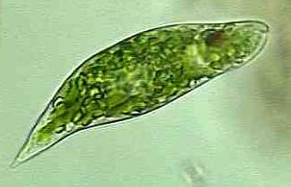
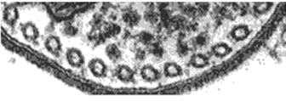
Superphylum:
Euglenozoa
Eukaryota
Protista
Euglenozoa
Two phyla
Characteristics

Slide 14
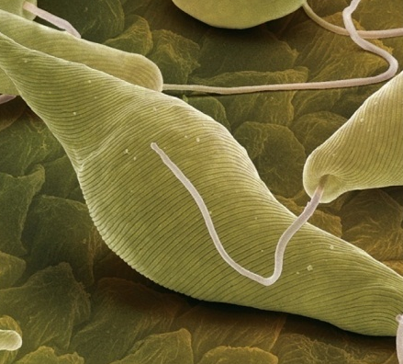
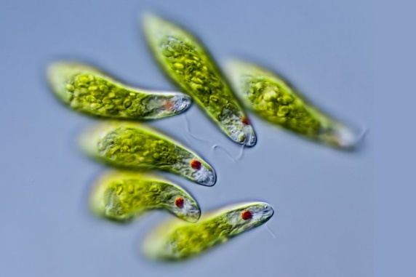
Eukaryota
Protista
Phylum Euglenida
Euglenozoa
Euglenida
Unicellular
Freshwater
Photosynthetic
  Chlorophyl a & c
  Numerous small chloroplasts
Unique carbohydrate
Single flagella
DRAW: Euglena sp. (25.10)

Slide 15
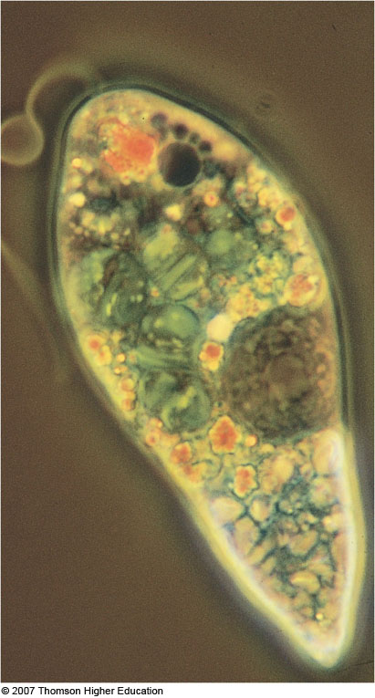
Flagella
Eukaryota
Protista
Euglenozoa
Stigma (Eyespot)
Euglenida
Contractile vacuole
Chloroplast
Nucleus
Paramylon body (stored food)
Pellicle
DRAW: Euglena sp. (25.10)

Slide 16
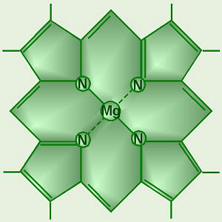
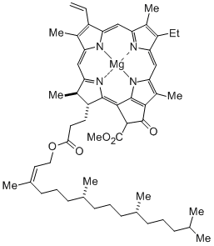
Chlorophyll
Pigment that absorbs light
Found in all autotrophs
Several structurally different pigments

Slide 17
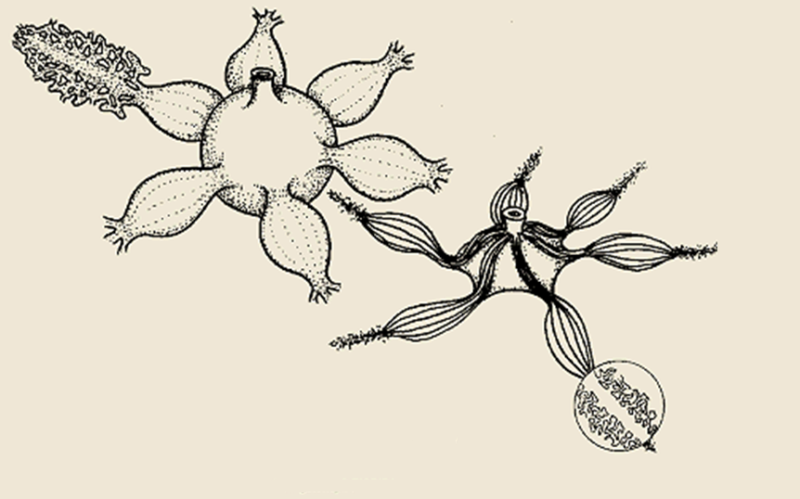
Full
Endoplasmic
reticulum
Empty
https://www.youtube.com/watch?v=pahUt0RCKYc

Slide 18
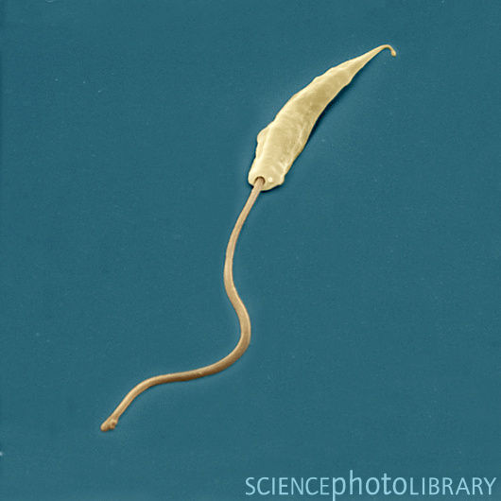
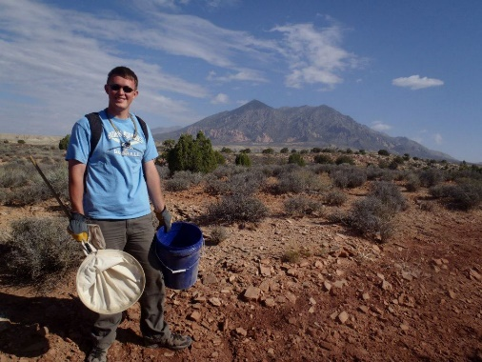
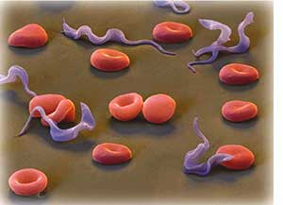
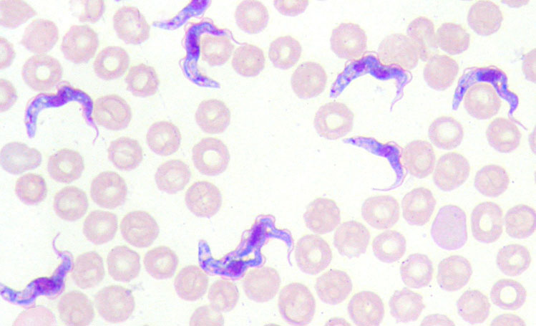
Phylum Kinetoplastea
Eukaryota
Protista
Euglenozoa
Kinetoplastea
Single large mitochondria
Undulating flap/membrane
Large flagella posterior
Many parasitic and disease agents
Leishmaniasis
DRAW: Trypanosoma (26.3)

Slide 19
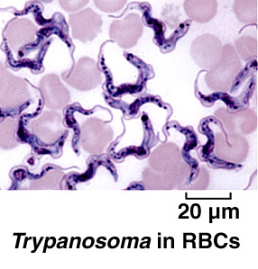
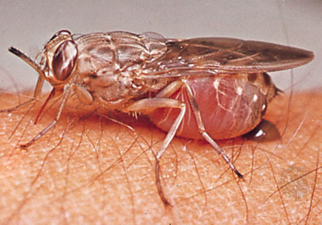
Eukaryota
Protista
African Sleeping Sickness
Euglenozoa
Kinetoplastea

Slide 20
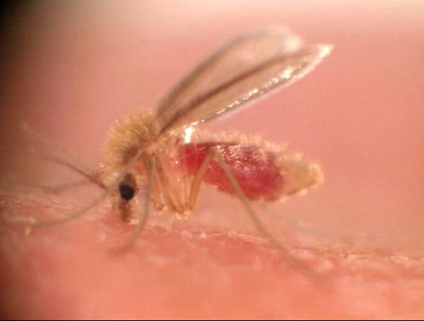
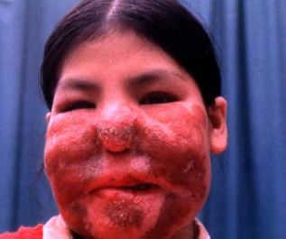
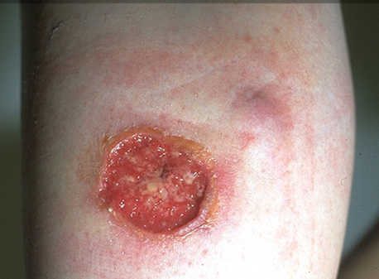
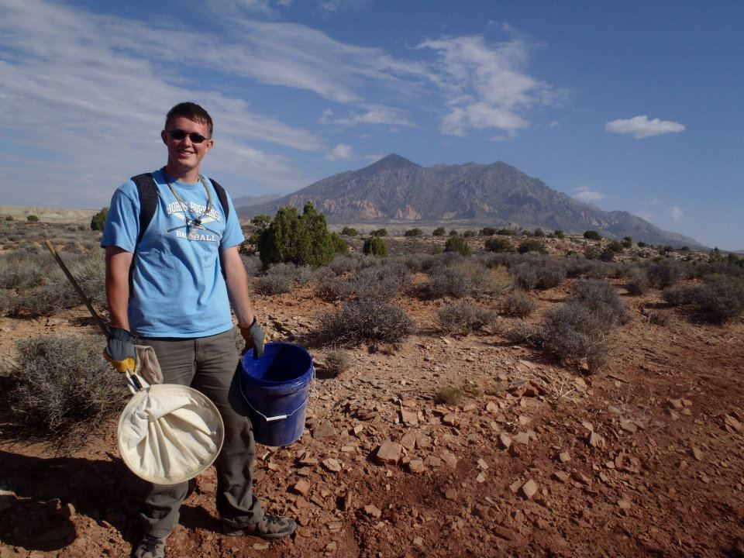
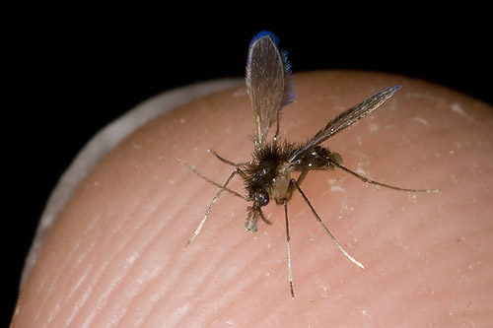
Eukaryota
Leishmaniasis
Protista
Euglenozoa
Kinetoplastea

Slide 21
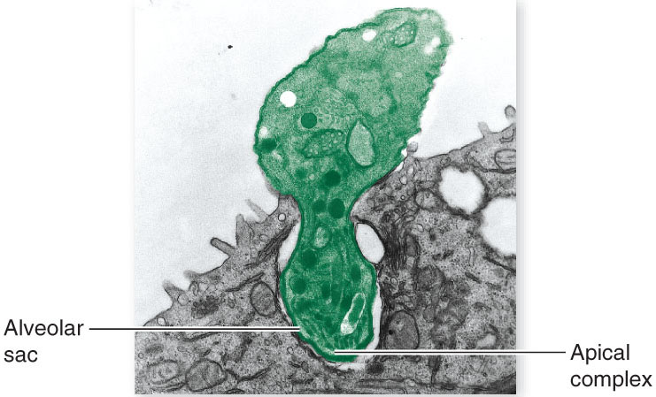
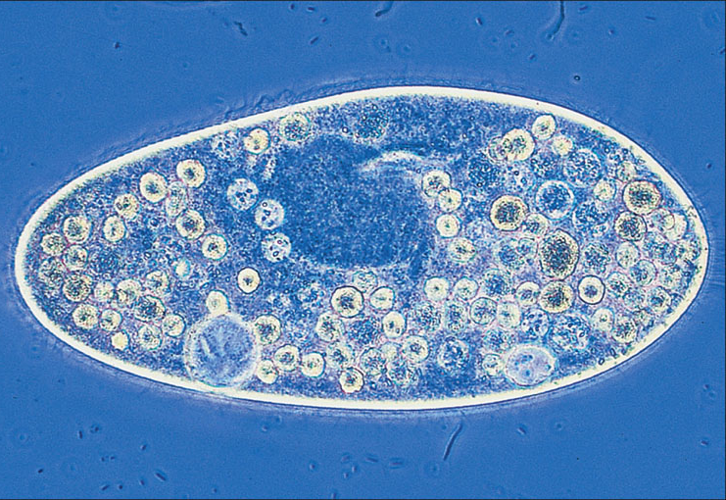
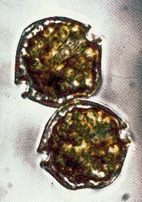
Alveolata
Eukaryota
Protista
Alveolata
Three phyla
Single unique character
Highly divergent locomotion and reproduction

Slide 22
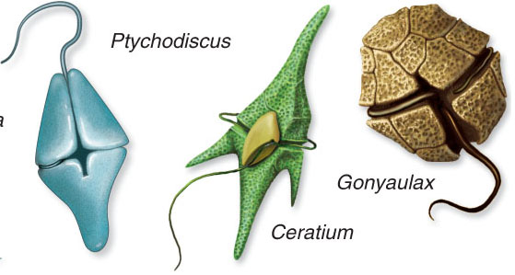
Phylum Dinozoa
(Dinoflagellates)
Eukaryota
Protista
Alveolata
Dinozoa
Marine & freshwater
Single celled
Structure:
Alveoli + cellulose-like compound form armor plates
Photosynthetic & pathogenic
Bioluminescence
DRAW: Dinoflagellate Peridinium sp. (25.9)
HOMEWORK: Live dinoflagellate
http://www.youtube.com/watch?v=foWeRavzuEs

Slide 23
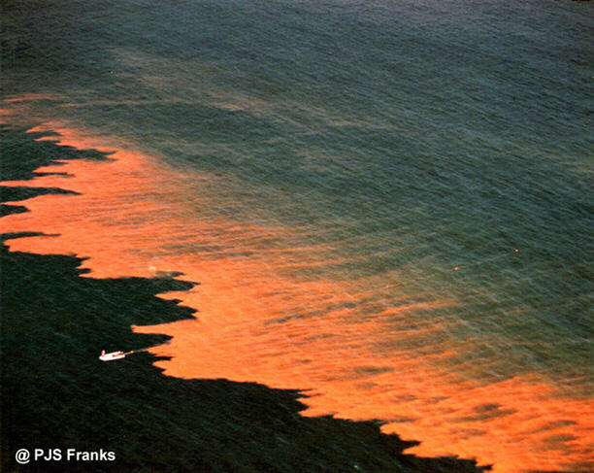
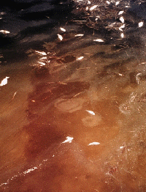

Slide 24
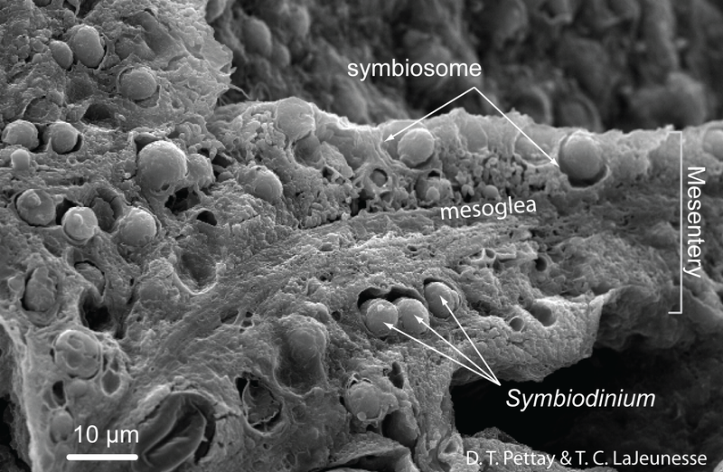
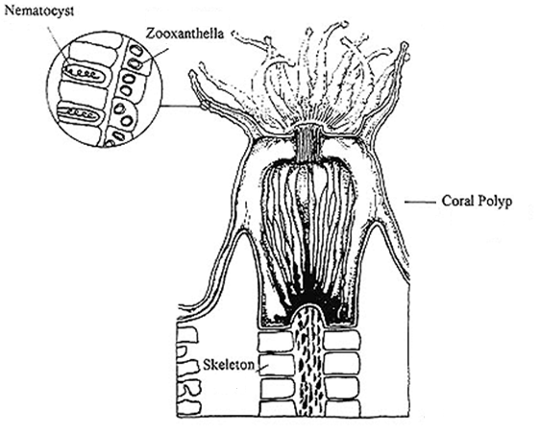
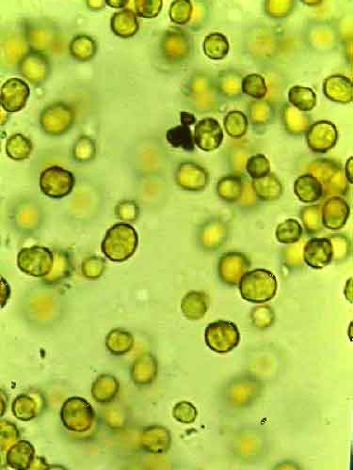
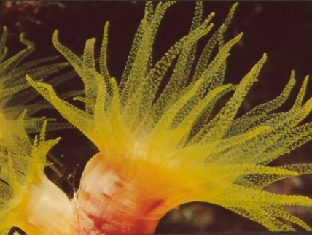
Eukaryota
Protista
What does each get out of the symbiosis?
Alveolata
Dinozoa

Slide 25
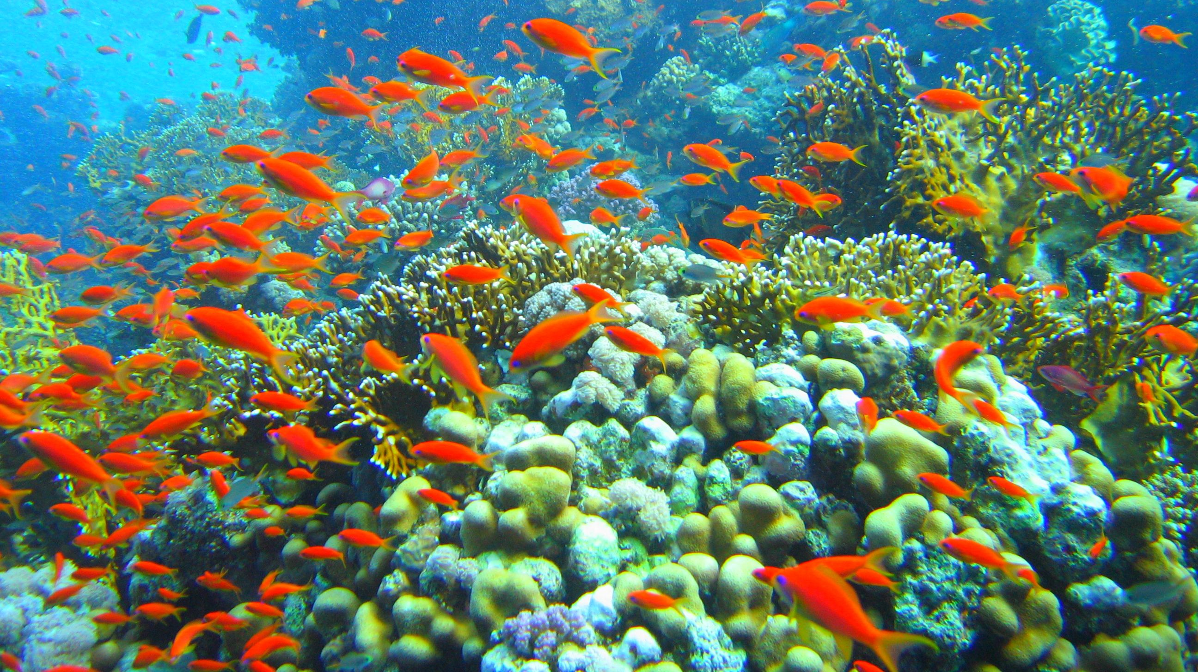
Where do coral reefs occur?
Are they productive ecosystems?

Slide 26

Think back to BIO161…
Where are the most productive ocean zones?

Slide 27


Eukaryota
Protista
Alveolata
Dinozoa
Heard of coral bleaching?
What’s going on?

Slide 28


Slide 29


Eukaryota
Protista
Phylum Apicomplexa
Alveolata
Apicomplexa
Non-motile parasites
Infect animals
Alveoli →
Very complex life cycles
Important human diseases
  Malaria (Plasmodium)
  toxoplasmosis
Notes:
Bottom right: toxoplasma invading a human fibroblast

Slide 30

Eukaryota
Plasmodium life-cycle
Protista
Alveolata
Apicomplexa
HW: Draw Plasmodium (26.7)

Slide 31


Eukaryota
Protista
Phylum Ciliophora
Alveolata
Ciliophora
Unicellular
3 synapomorphies
DRAW: live Paramecium (26.5)
HW: Paramecium in conjugation (26.4)

Slide 32


The eukaryotic flagella (and cilia)

Slide 33




Superphylum Stramenopila
Eukaryota
Protista
Stramenopila
3 clades
1 uniting synapomorphy

Slide 34


Phylum: Gyrista
Class: Bacillariophyceae
Eukaryota
Protista
Stramenopila
Ochrophyta
Unicellular
Marine & freshwater
Chlorophylls a & c
2-part silica shell
Movement
Asexual except when?
Environmentally and economically important
HW: Wet Mount of Diatomaceous earth (25.8)

Slide 35


Eukaryota
Radial & Bilaterally Symmetrical
Protista
Stramenopila
Bacillariophyta
DRAW: Marine diatoms (25.8)

Slide 36


Eukaryota
Phylum: Gyrista
Class: Phaeophyta (Brown Algae)
Protista
Stramenopila
Phaeophyta
Marine (what habitats?)
Multicellular but no differentiation
Chlorophyll a & c + accessory pigment
Environmentally and economically very important – Why?

Slide 37


Slide 38




Eukaryota
Protista
Stramenopila
Phaeophyta
Structure
Laminaria
Nereocystis
HW: draw brown algae, observe food products (25.5)

Slide 39


Commercial Uses?
https://www.youtube.com/watch?v=xenNqCbTMbI

Slide 40



Eukaryota
Phylum: Oomycota (Water Molds)
Protista
Stramenopila
Oomycota
Formerly fungus
Parasites or saprobes?
Characteristics:
Complex life-cycle – M & F structures
Aquatic or damp terrestrial

Slide 41




Slide 42
Potato Blight: Phytophthora infestans
https://www.youtube.com/watch?v=0nOAQAZqvsw

Slide 43




Phylum Rhodophyta (red algae)
Eukaryota
Protista
Rhodophtya
Warm marine
Multicellular but no differentiation
Chlorophyll a & d + carotenoids
Environmentally and economically important – Why?
Why is it red?
EAT: Nori
DRAW: Polysiphiona (25.7)

Slide 44



Chlorophyta
Eukaryota
Protista
Chlorophyta
Freshwater > Marine > Terrestrial
Unicellular & multicellular
Chlorophyll a & b + carotenoids (who else?)
Model organism for the evolution of multicellularity

Slide 45
Chlorophyta
Eukaryota
Protista
Chlorophyta
DRAW ONE, HW ONE:
  Chlamydomonas (25.1)
  Spirogyra (25.3)

Slide 46




Phylum Foraminifera
Eukaryota
Protista
?
Foraminifera
Marine and freshwater (few) heterotrophs
Planktonic and seafloor
Internal shell
  organic + calcium carbonate
Projections used for feeding and swimming
Complex life cycle
HW: Foraminifera tests (26.2)

Slide 47

Eukaryota
Protista
?
Foraminifera
Notes:
Figure 25.20: Foraminiferans.
(b) The White Cliffs of Dover, England, consist largely of the tests of foraminiferans.

Slide 48




Phylum Actinopoda (Radiolarians)
Eukaryota
Protista
?
Actinopoda
Marine planktonic heterotrophs
Superficially resemble foraminiferans
Silica shell
  Also have microtubule extensions
  Pseudopods move along rods
Projections used for feeding

Slide 49



Phylum Amoebozoa
Eukaryota
Protista
?
Amoebozoa
Active heterotrophs (Phagocytic?)
All aquatic environments
1 major synapomorphy
https://www.youtube.com/watch?v=mv6Ehv06mXY
DRAW: Amoeba sp. (26.1)

Slide 50



Phylum Dictyostelia (slime molds)
Eukaryota
Protista
?
Dictyostelia
Important decomposers (saprobes)
Damp terrestrial environments
Previously fungus
Two morphologies:
HW: Plasmodial slime mold (26.8) – plasmodial streaming!

Slide 51

Plasmodial Slime Mold
http://www.youtube.com/watch?v=GScyw3ammmk
http://www.youtube.com/watch?v=czk4xgdhdY4
Notes:
Figure 25.23: The plasmodial slime mold Physarum polycephalum.

Slide 52

Eukaryota
Protista
Cellular Slime Molds
?
Dictyostelia
http://www.youtube.com/watch?v=bkVhLJLG7ug

Slide 53



Eukaryota
Phylum Choanoflagellida
Ancestor of the animals
Protista
Choanoflagellida
Sister-group to animals
Aquatic heterotrophs (filter feeders)
Basic structure:
“transitional” example species

Slide 54




