Slide 1
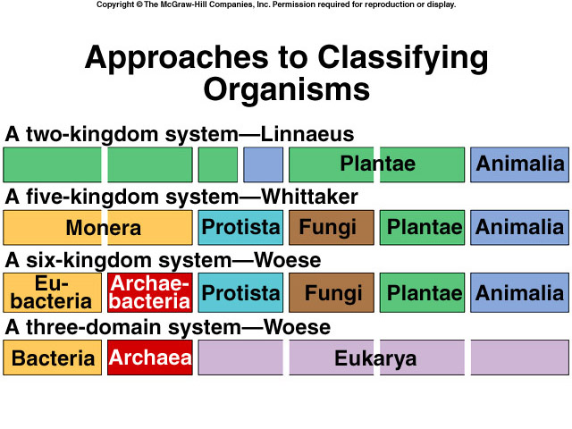
The need for a filing system

Slide 2
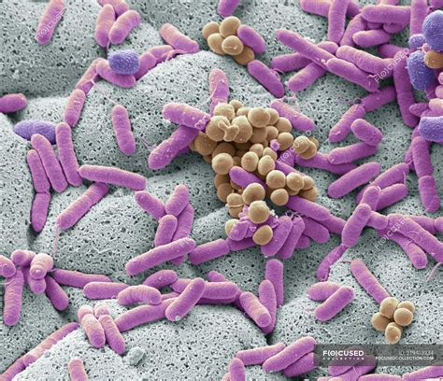
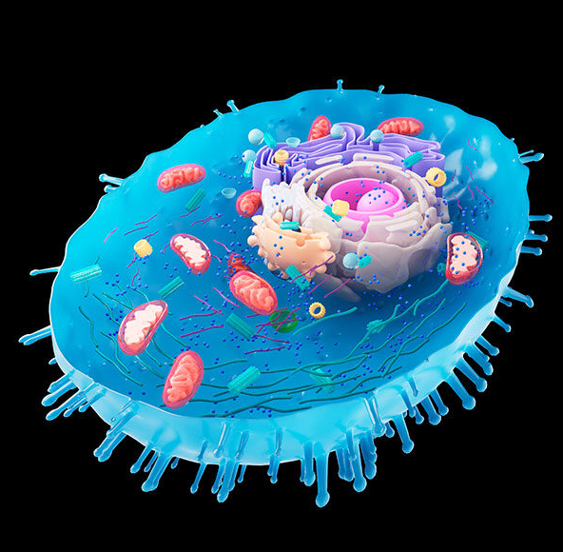
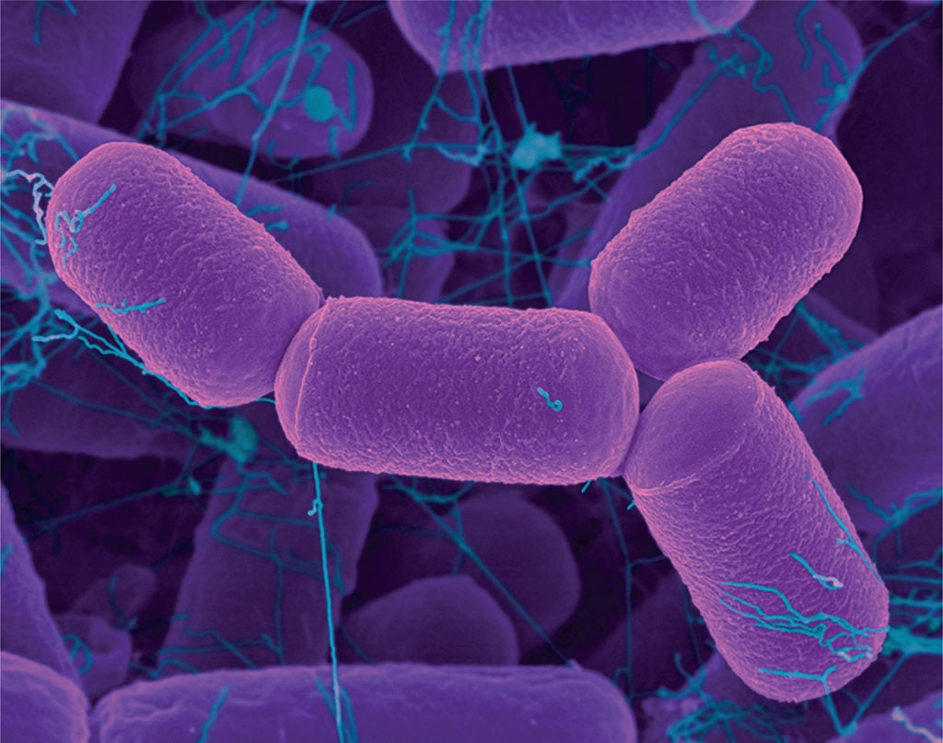
Highest Level Classification
Highest level classification?
Recognize 3
What are they?

Slide 3
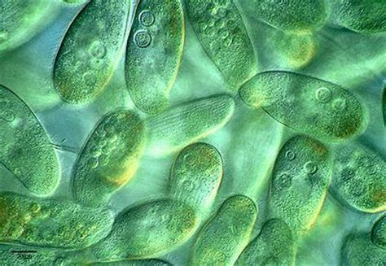
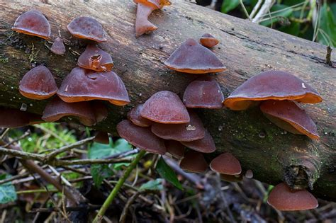
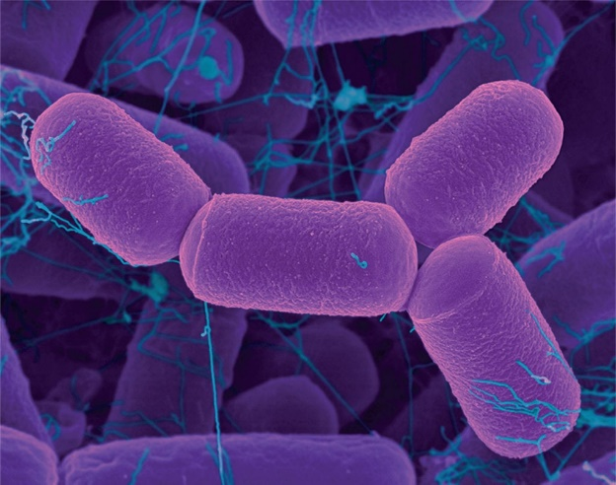
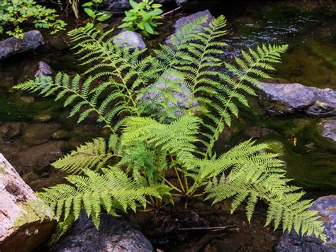
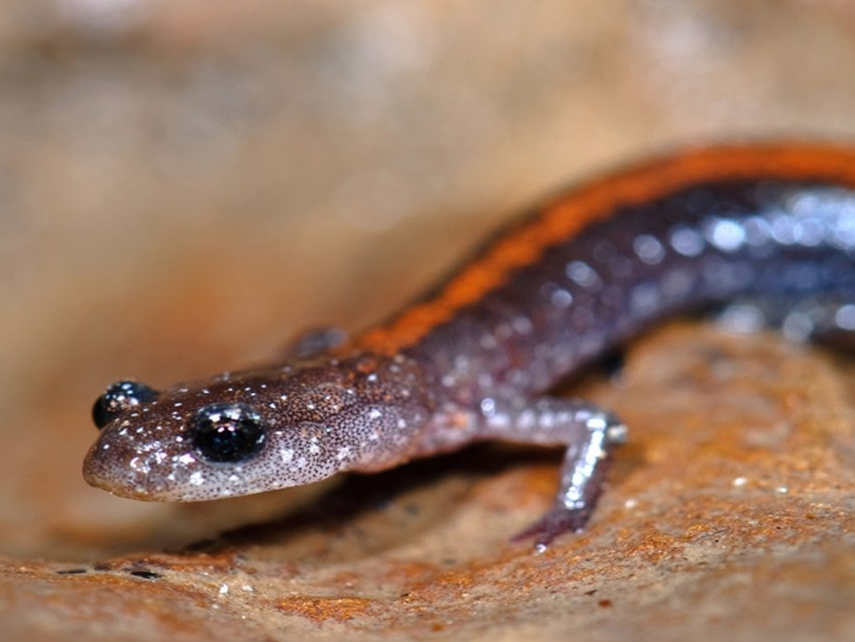
Further subdivide domains – What’s the next rank?
Recognize 6
What are they?

Slide 4
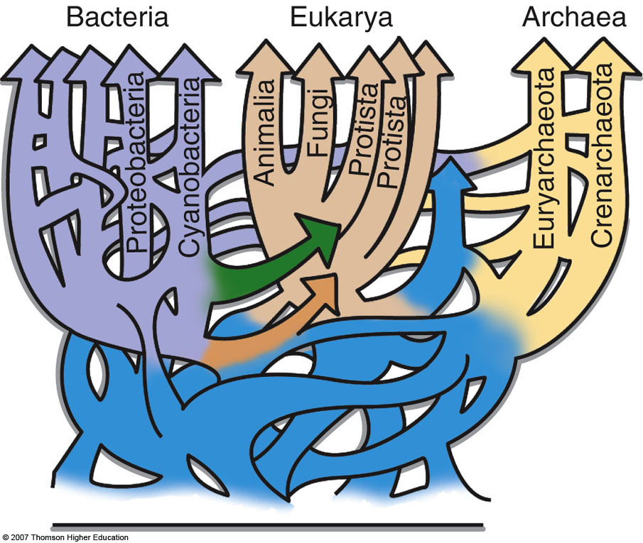
Work with those around you to build a cladogram
Notes:
Figure 23.4: Other ways to represent the tree of life.
[(a) based on W. F. Doolittle, Science, Vol. 284, pp. 2124– 2128, 1999; (b) based on M. C. Rivera and J. A. Lake, Nature, Vol. 431, pp. 152– 155, Sept. 9, 2004.]

Slide 5
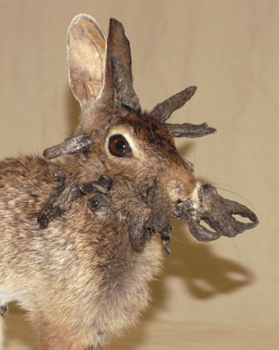
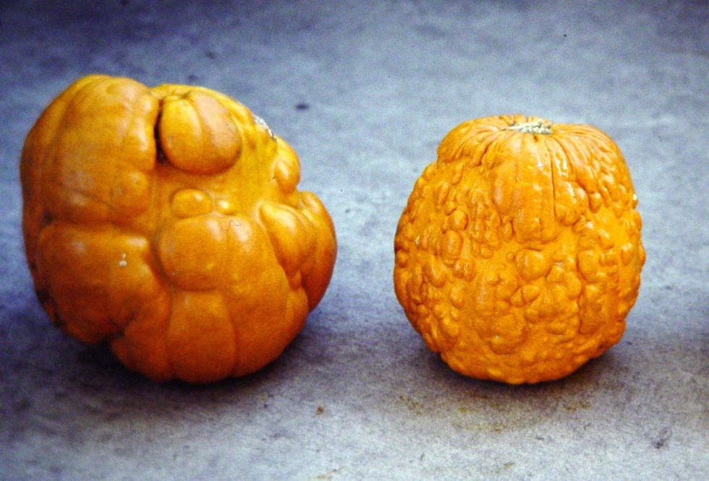
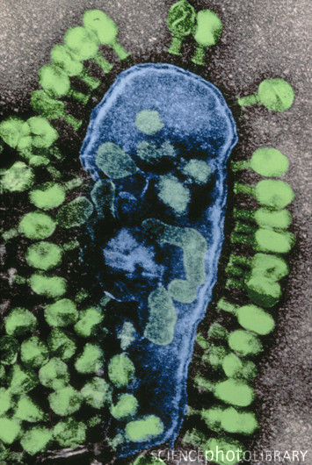
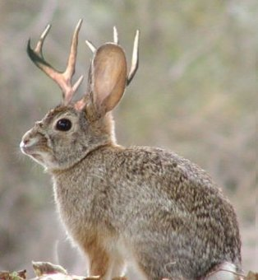
Viruses
Papilloma virus
Dependent on living organisms
Highly specific to a host and/or cells
# viruses?
Economic impact
bacteriophage
Zucchini mosaic virus

Slide 6
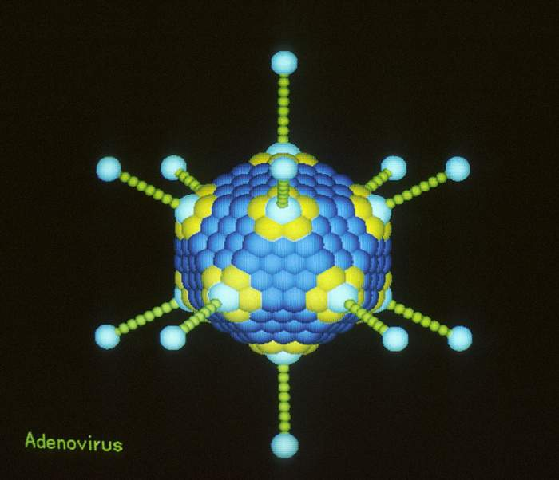
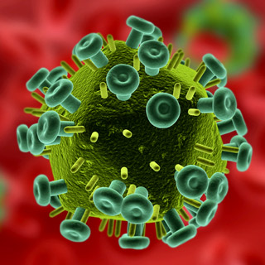
Viral Structure
Simple
All similar structure
Cytoplasm?

Slide 7
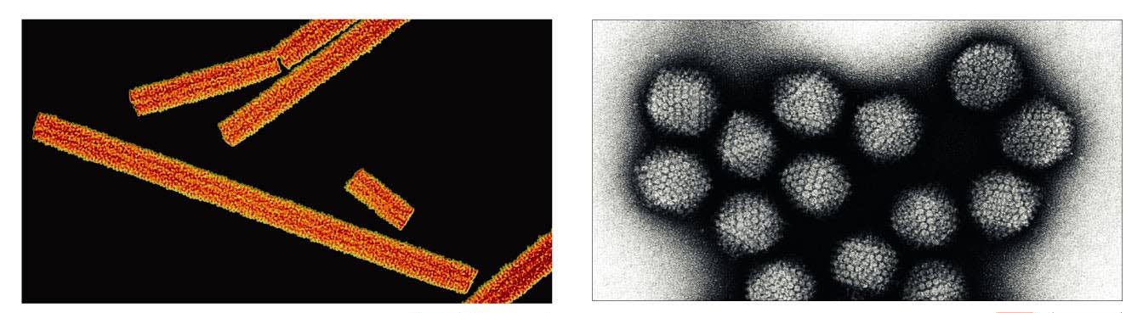
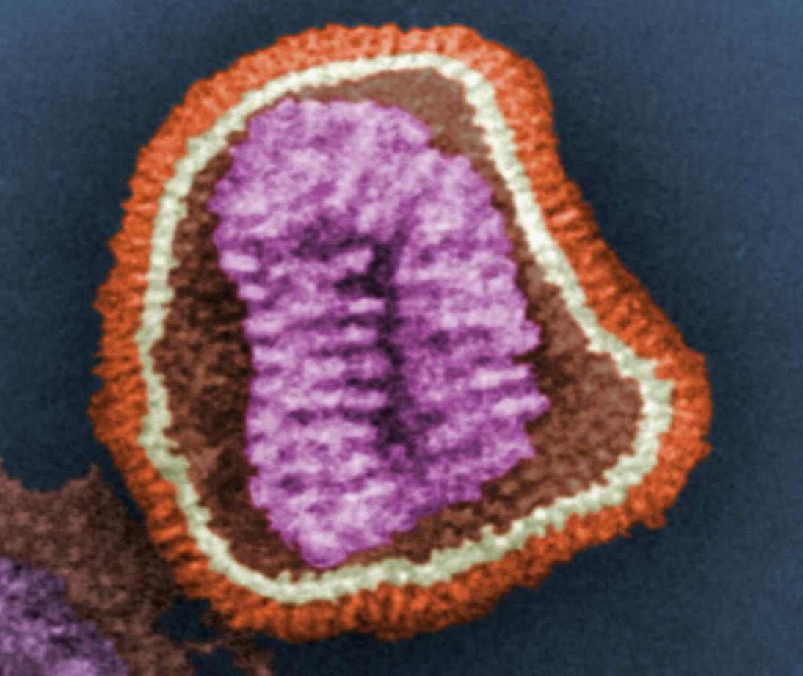
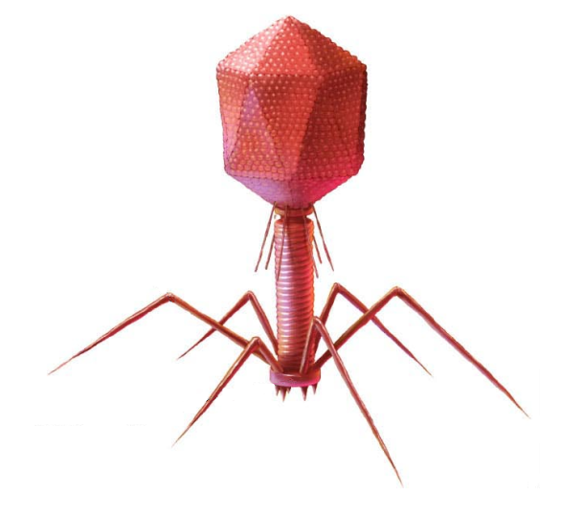
2 basic shapes

Slide 8
What characteristics make something living?
Which do viruses possess?
Cell organization
Response to stimuli
Homeostasis/Metabolism
Growth
Development
Reproduction
Heredity

Slide 9
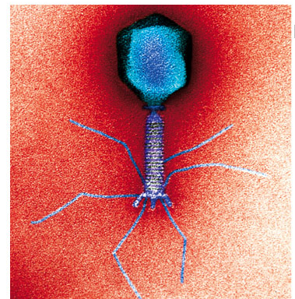
Replication
Bacteriophage
(virus that attacks bacteria)

Slide 10
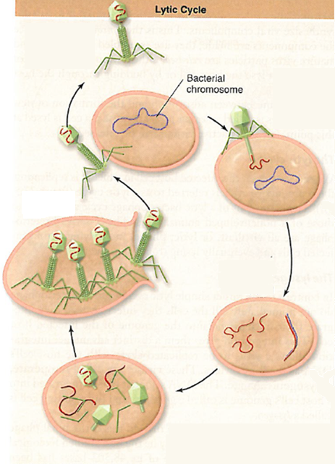
https://vimeo.com/10701736
Lytic Cycle
From an evolutionary perspective is this a “smart” strategy?

Slide 11
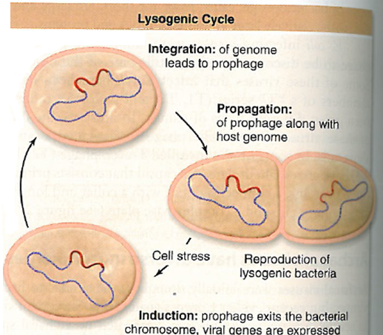
Lysogenic Cycle
Attachment
Penetration
Synthesis
Assembly
Release

Slide 12
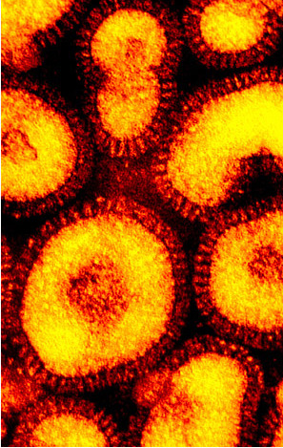
What are some deadly human viral diseases?
Influenza
Historically lethal
High mutation rate
Infects many animals
What makes Influenza so deadly?

Slide 13
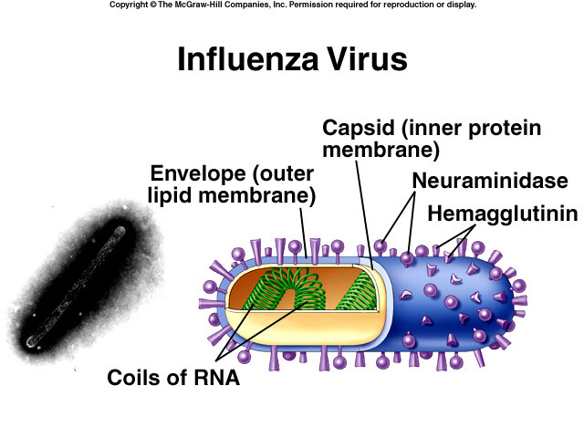
What’s in a flu vaccine?

Slide 14
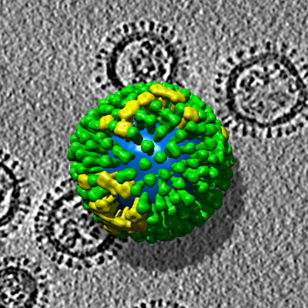
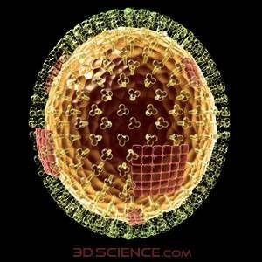
Influenza Strains
Classified by protein type
Dangerous, but not because of mutation rate
Example: Hong Kong Flu (1968)

Slide 15
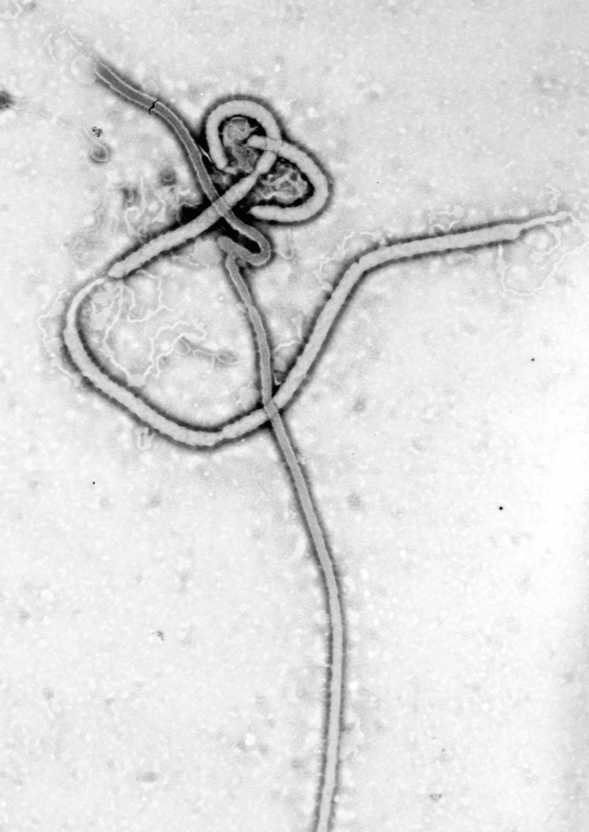
Scariest virus?
Ebola
5 different viruses
Discovered in mid 1970’s
Causes hemorrhagic fever
2014 outbreak - 8000 deaths
Transmission?
Why did everyone freak out?
Each day 6000 people die in Africa from AIDS
11,000 newly infected

Slide 16
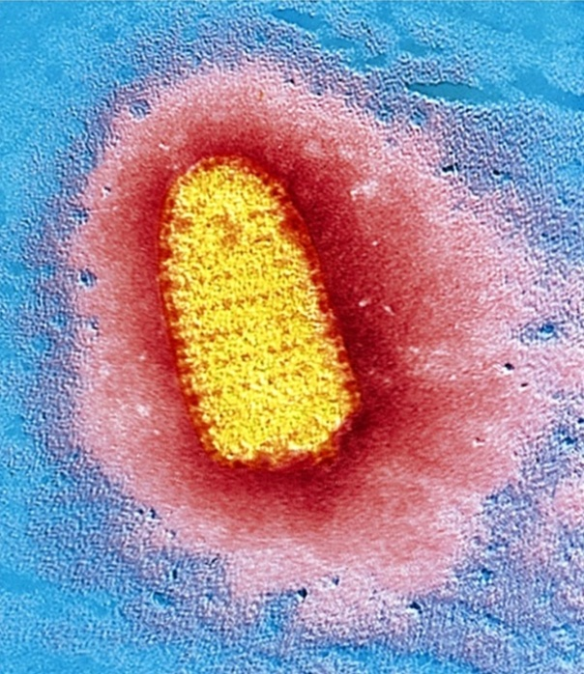
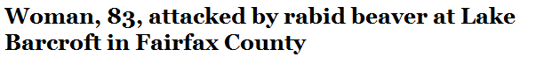
Dr. Gall’s favorite virus?
My favorite movies?
The beaver story
Transmission by?
What cells does it infect?

Slide 17
“All of a sudden, the beaver flips over and comes back to life”
http://www.washingtonpost.com/local/crime/woman-83-attacked-by-rabid-beaver-at-lake-barcroft-in-fairfax-county/2012/09/05/e778ec02-f794-11e1-8253-3f495ae70650_story.html

Slide 18
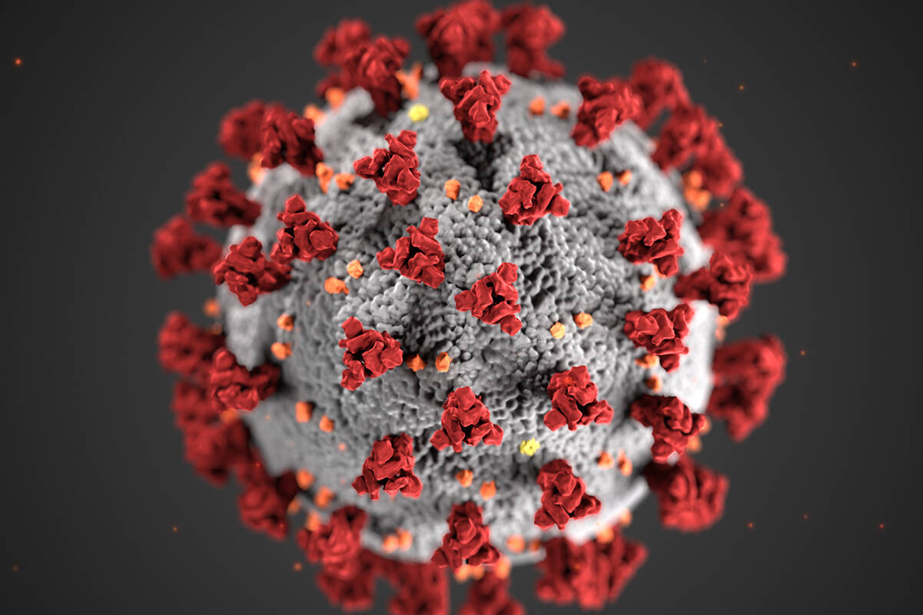
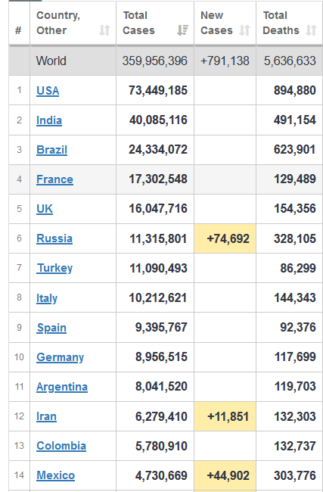
COVID-19
Respiratory virus
Stages of infection:
  Early replication
  Pulmonary (pneumonia)
  Inflammatory phase
Global death toll?
USA death toll?
Risk by age group?
Treatment?

Slide 19
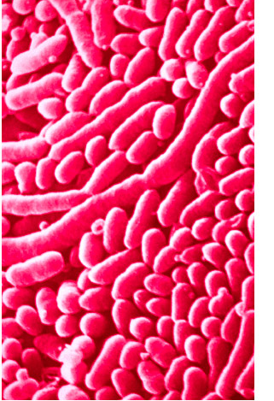
Prokaryotes
Bacteria
Who are we talking about?
How many cells in your body?
How many prokaryotes in you?
“There are more individual prokaryotes in your large intestine than there are cells in your body”

Slide 20
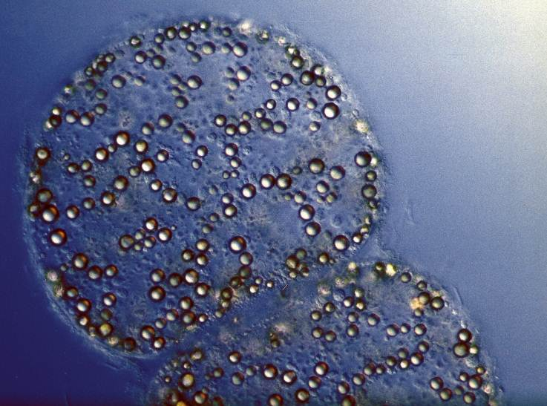
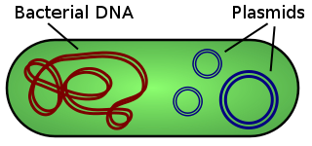
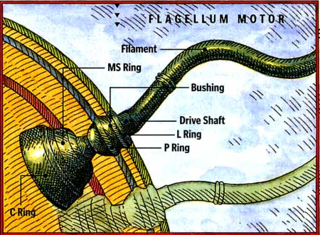
Prokaryotes
Small
Unicellular
Circular chromosome, no nucleus
Asexual reproduction
Modes of gene transfer
Lack organelles
Little morphologial diversity
Simple flagella
High metabolic diversity
High ecological diversity
Oldest DNA-based life

Slide 21
Prokaryotes vs. Eukaryotes
No nucleus
DNA ring
Small size
Lack of specialized organelles
Bacterial flagella
No true multicellularity
Genetic recombination by transduction, conjugation, transformation
Nucleus present
Complex chromosomes
Large Size
Specialized organelles present
9 + 2 cilia and flagella
Multicellularity common
Genetic recombination by meiosis and fertilization

Slide 22
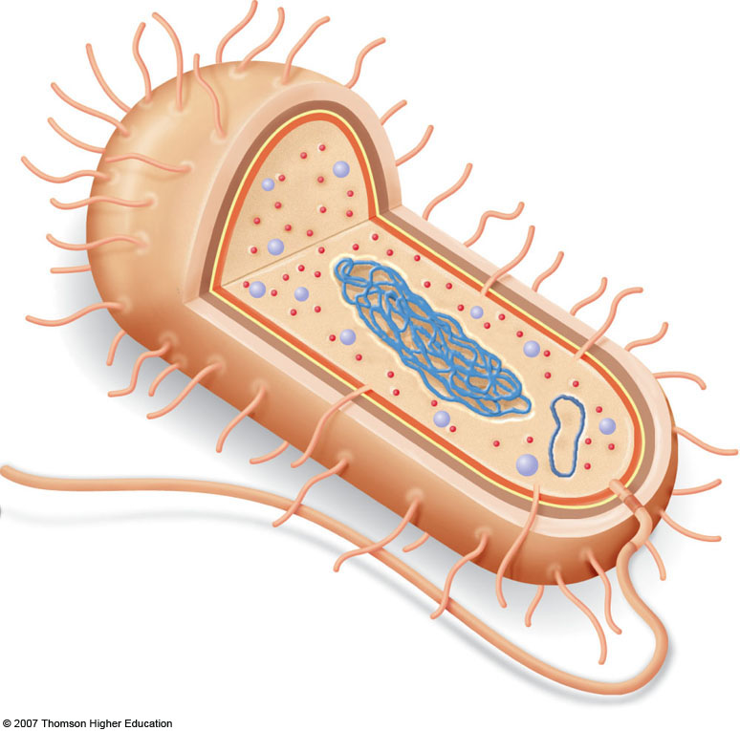
Bacteria and Archaea Cell Structure
Outer membrane
Pili (structures used for attachment)
Cell wall
Peptidoglycan layer
Nuclear area (nucleoid)
Storage granule
Plasmid (DNA)
Flagellum
Ribosomes
Bacterial chromosome
(DNA)
Capsule
Plasma membrane
Notes:
Figure 24.9: Structure of a prokaryotic cell.
This bacillus is a gram-negative bacterium (discussed in text). Note the absence of a nuclear envelope surrounding the bacterial DNA.

Slide 23
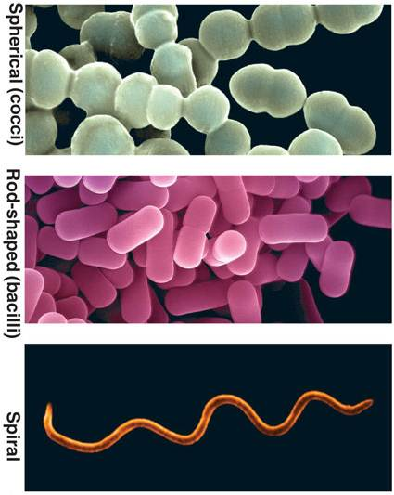
Prokaryote
Diversity

Slide 24
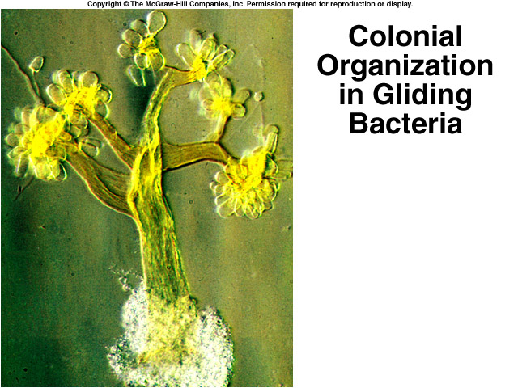


Slide 25
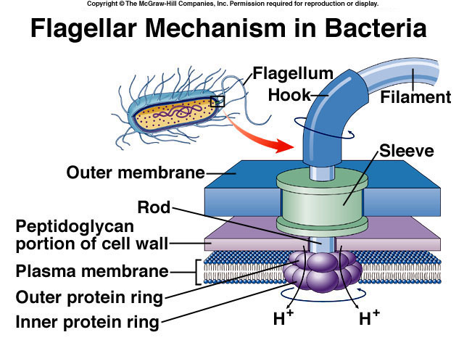
https://www.youtube.com/watch?v=a_5FToP_mMY

Slide 26
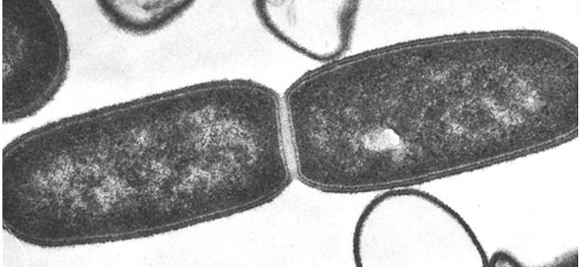
Reproduction
What’s the problem with cloning yourself over and over for eternity?
Under optimal conditions, one bacterium can divide every 20 minutes

Slide 27
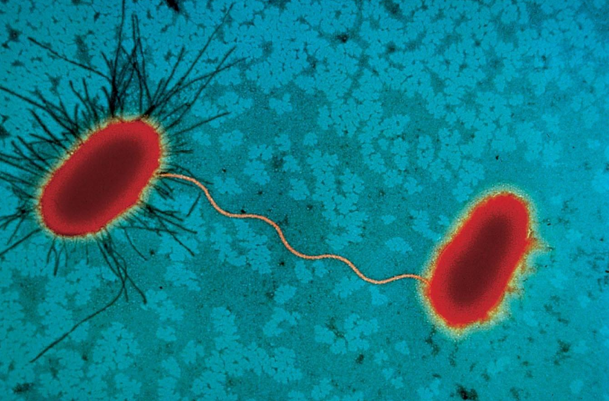
Gene Transfer Between Prokaryotes

Slide 28
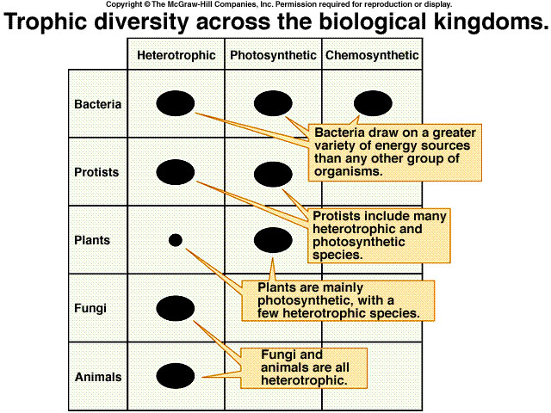
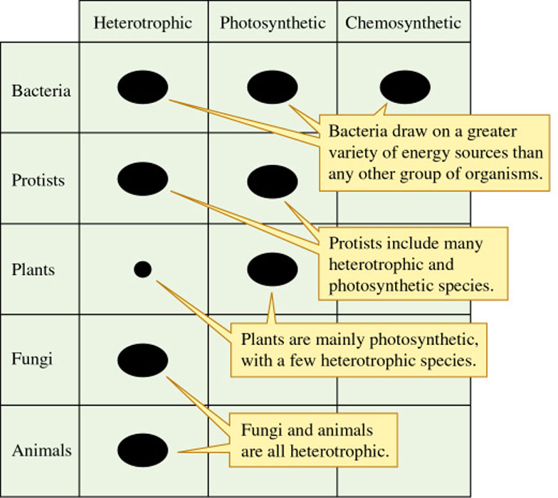
Metabolic Diversity Among the Kingdoms
Figure 6.2
6-1

Slide 29
Archaea
Bacteria
Cell walls contain?
Plasma membrane?
Antibiotics do?
Cell walls contain?
Plasma membrane?
Antibiotics do?
Several other differences associated with DNA replication and gene expression
  Simple RNA polymerase enzyme
  Unique translation initiation
Multiple RNA polymerases (Like Eukaryotes)
Translation is similar to Eukaryotes

Slide 30
Using this information, draw a cladogram depicting the evolutionary relationships between the 3 domains

Slide 31
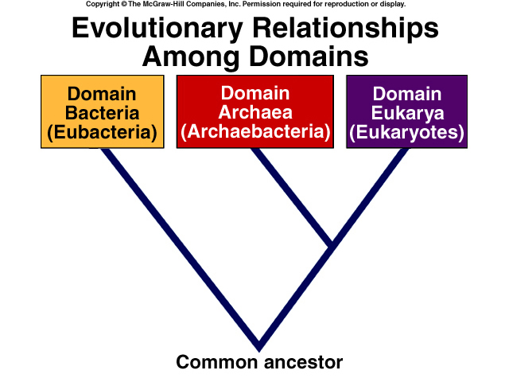
1987 – 12 phyla
2003 – 29 phyla
2012 – 52 phyla
2020 – 1300 phyla

Slide 32
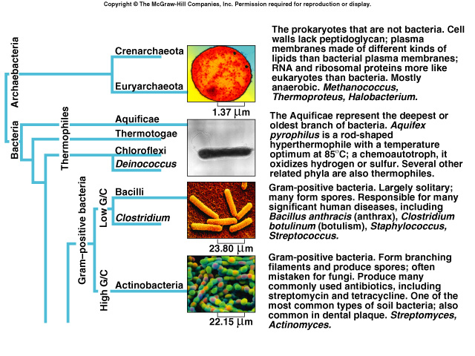

Slide 33
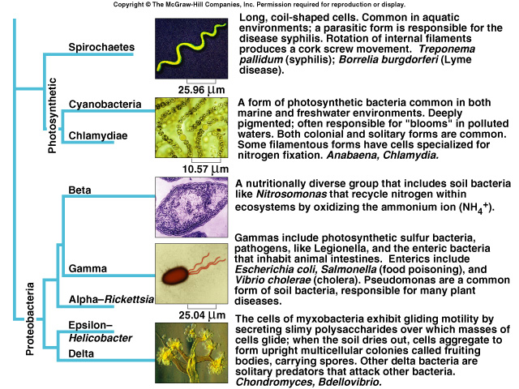

Slide 34
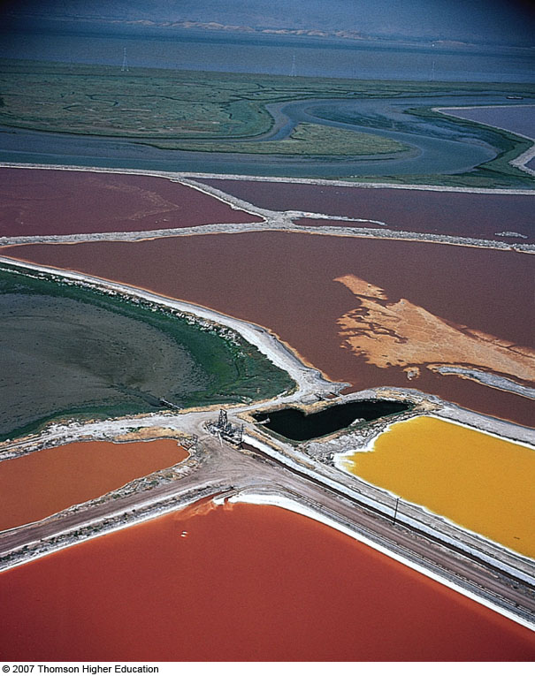
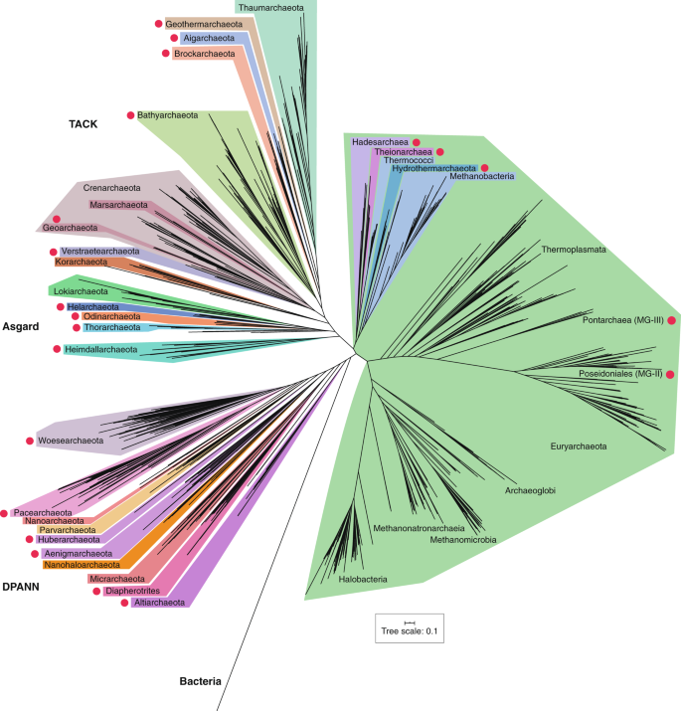
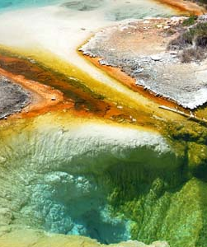
Archaea Diversity
27 Phyla
4 major lineages

