Slide 1
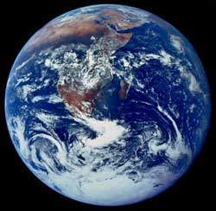
AND NOW FOR A BRIEF INTRODUCTION TO:
THE HISTORY OF LIFE…

Slide 2
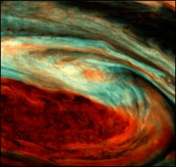
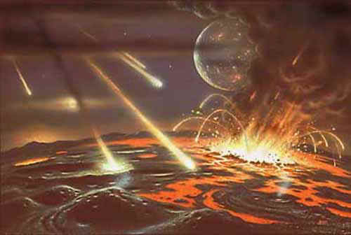
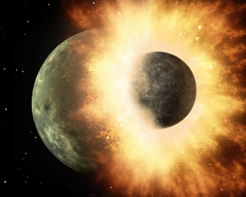
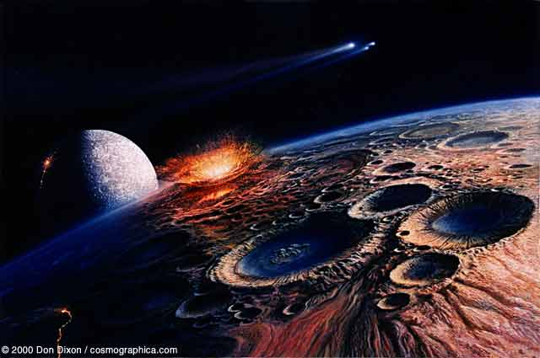
Formation of the Earth

Slide 3
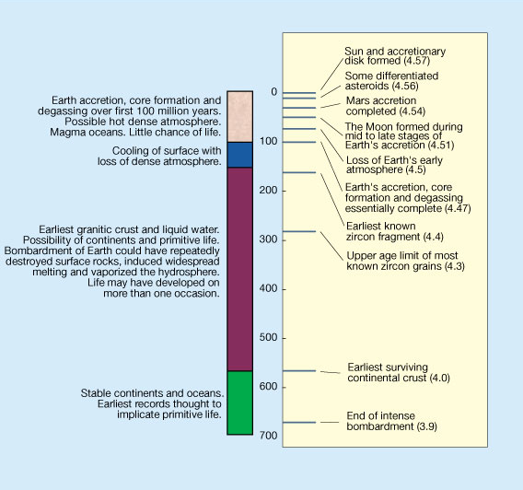
Deciphering the Earliest History of the Earth
Hadean
Eon
From: Halliday 2001 Nature 409:144-145

Slide 4
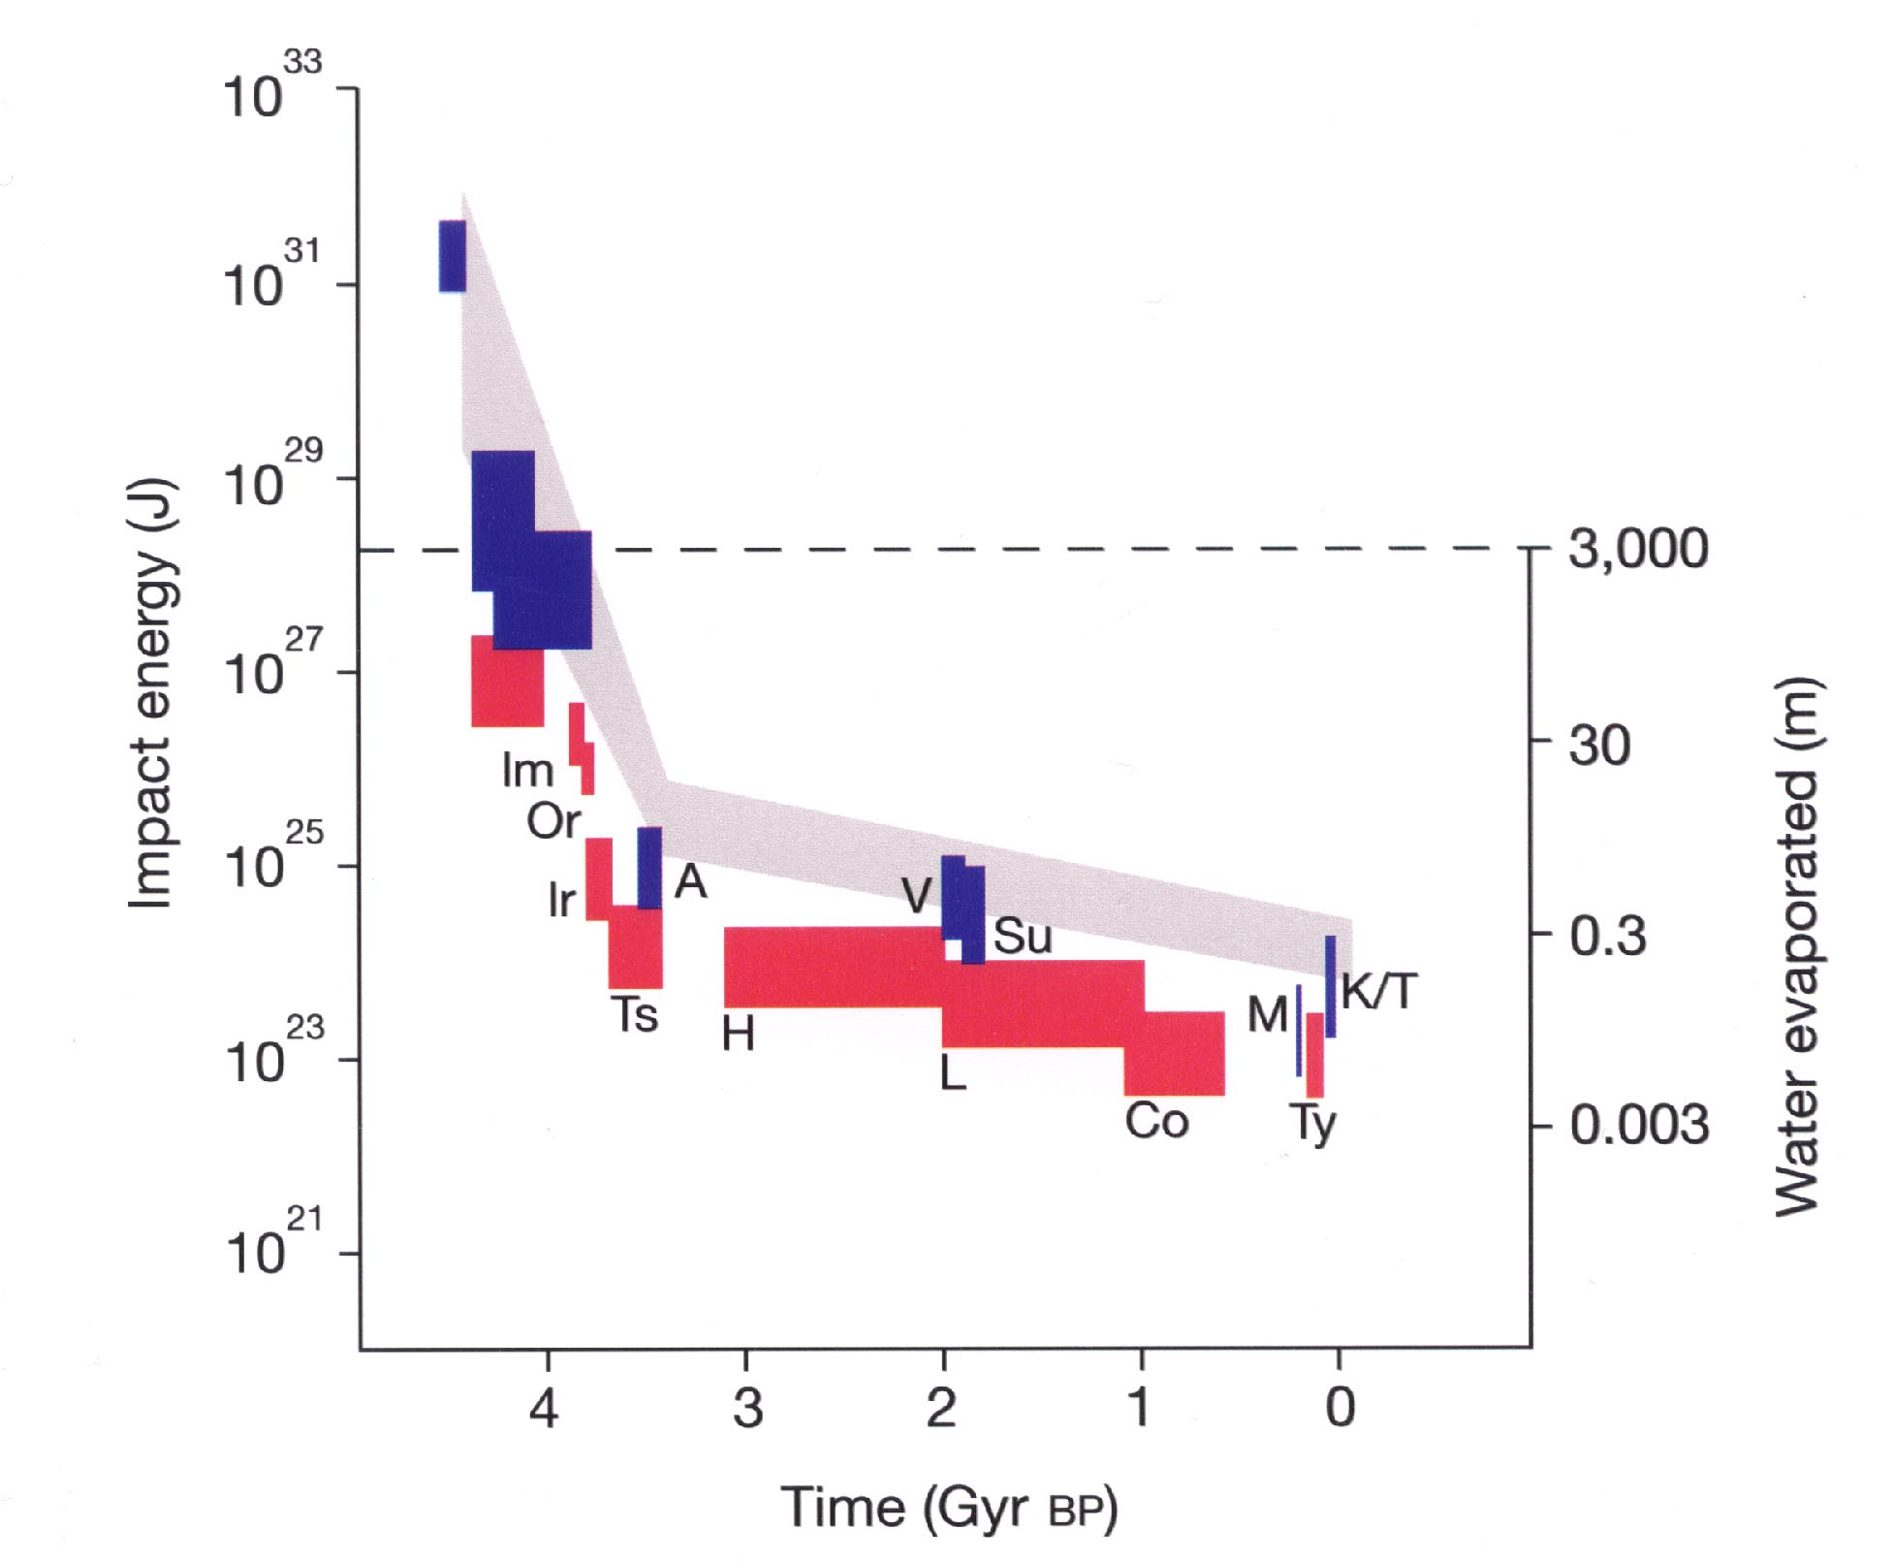
ORIGIN OF THE MOON
No Life
Period of Intense Bombardment
Life
Possible

Slide 5
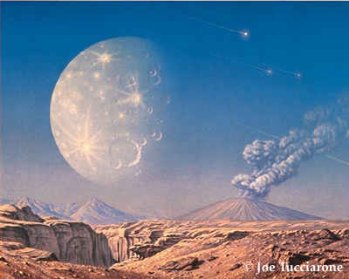
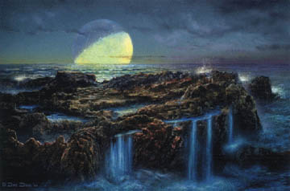
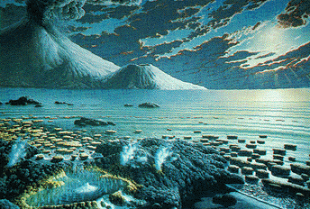
Earth cools
Liquid water forms (oceans)
Reducing atmosphere
Life appears

Slide 6
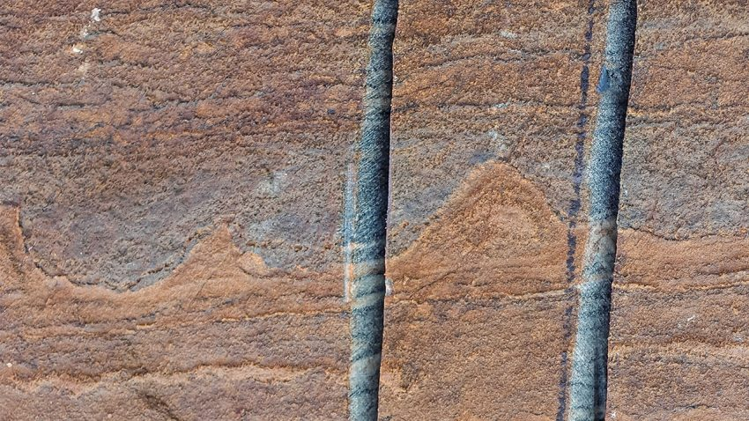
When did life originate?
Earliest Fossils – 3.7 BYA
Nutman et al. 2016. Nature.

Slide 7
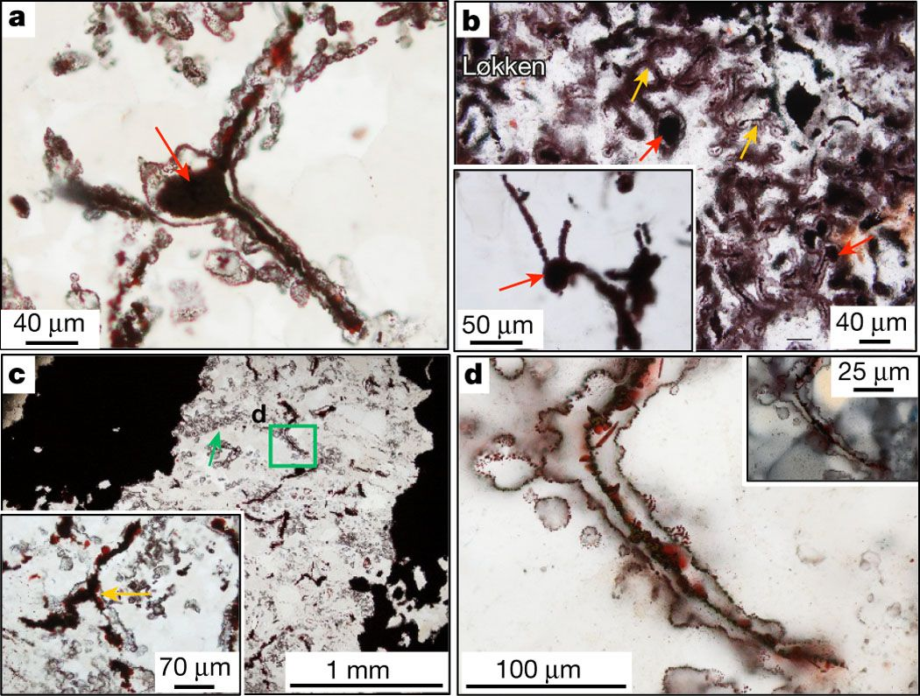
Oldest Fossil Evidence
3.7 BYA
“filaments with morphologies and mineral assemblages similar to filamentous microorganisms”
Common around hydrothermal vent
Dodd et al. 2017. Nature

Slide 8
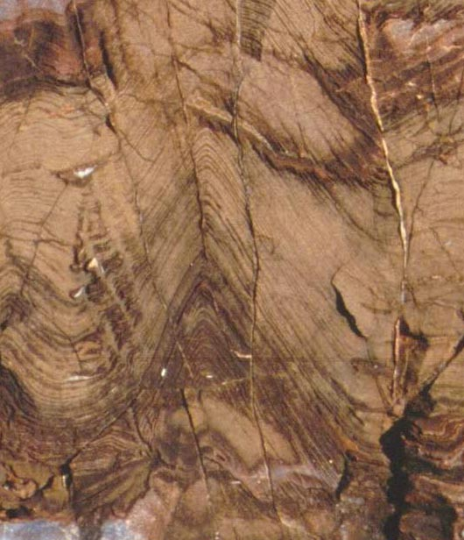
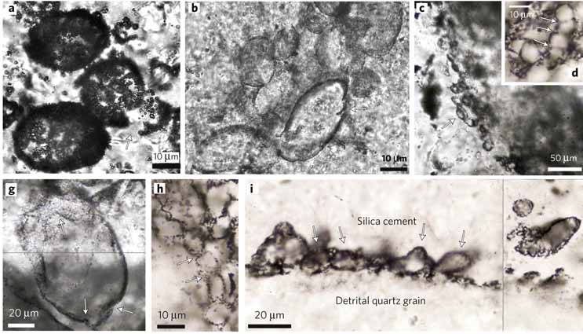
Microfossils - 3.4 BYA
Stromatolites from Western Australia
Wacey et al. 2011. Nature Geoscience 4:698–702.

Slide 9
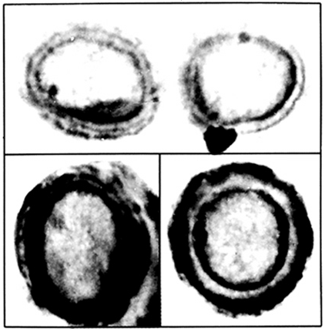
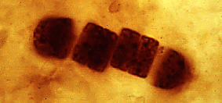
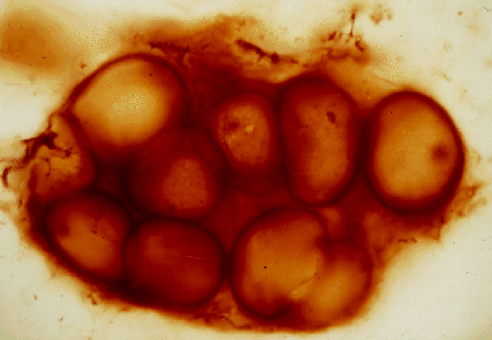
2.5 BYA
Fossil bacteria – 2.5 BYA

Slide 10
What do you think about the timing between the end of the intense bombardment and the origin of life?

Slide 11
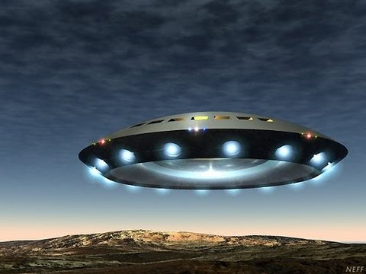
Hypotheses for the Origin of Life

Slide 12
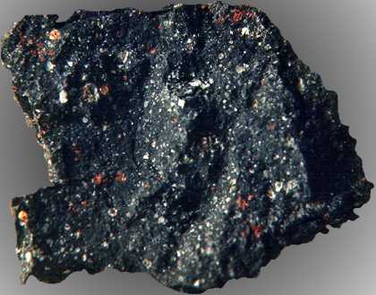
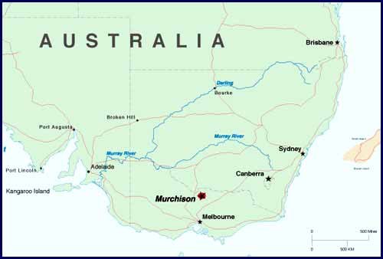
Panspermia
Murchison Meteorite
Sugars (glycerol) & acids
Shifts the problem – where?
Cooper et al. 2001 Nature 414:897-883

Slide 13
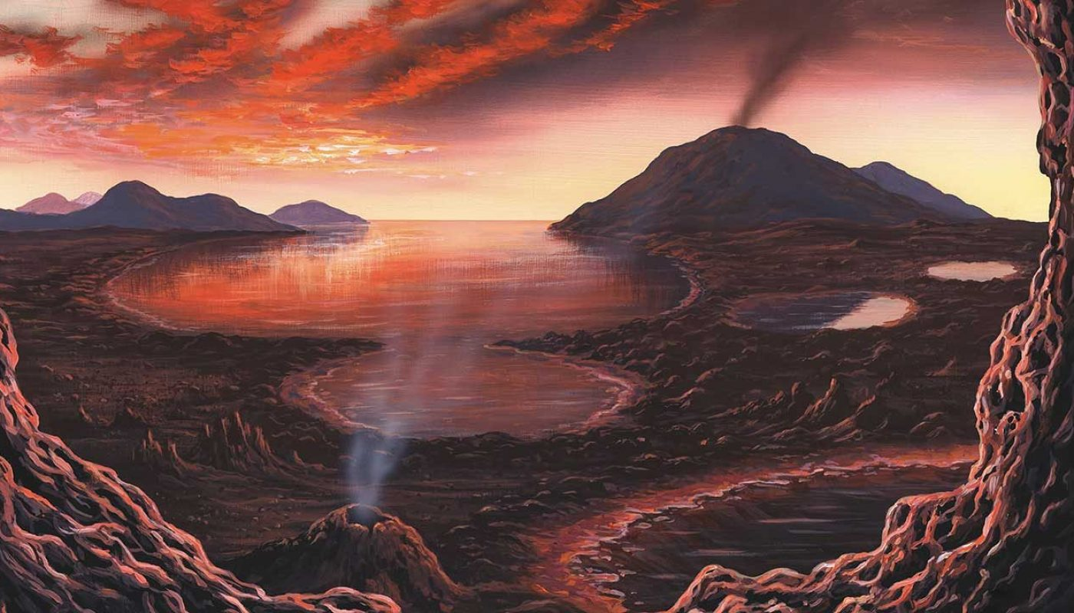
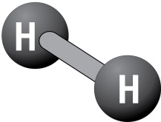
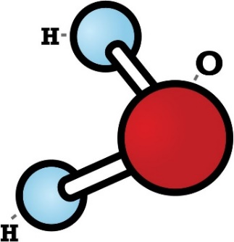
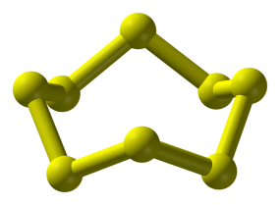

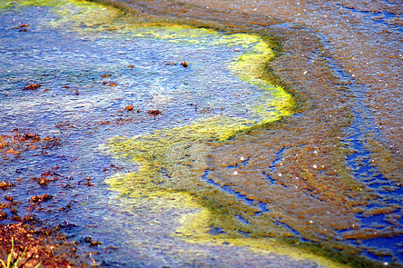
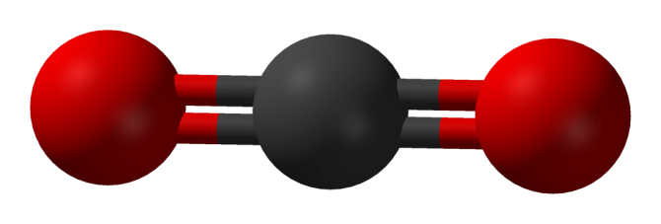
Primordial Soup Hypothesis
+
ENERGY
=
Parker et al. 2011. PNAS 108: 5526–5531

Slide 14
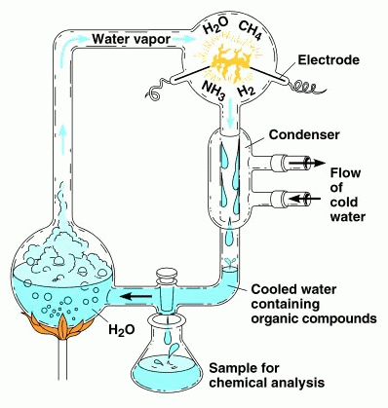
How could we test the primordial soup hypothesis?
H₂CO - Formaldehyde
HCN – Hydrogen Cyanide
Urea
Amino Acids
Nucleotides
NOT LIFE
Parker et al. 2011. PNAS 108: 5526–5531

Slide 15
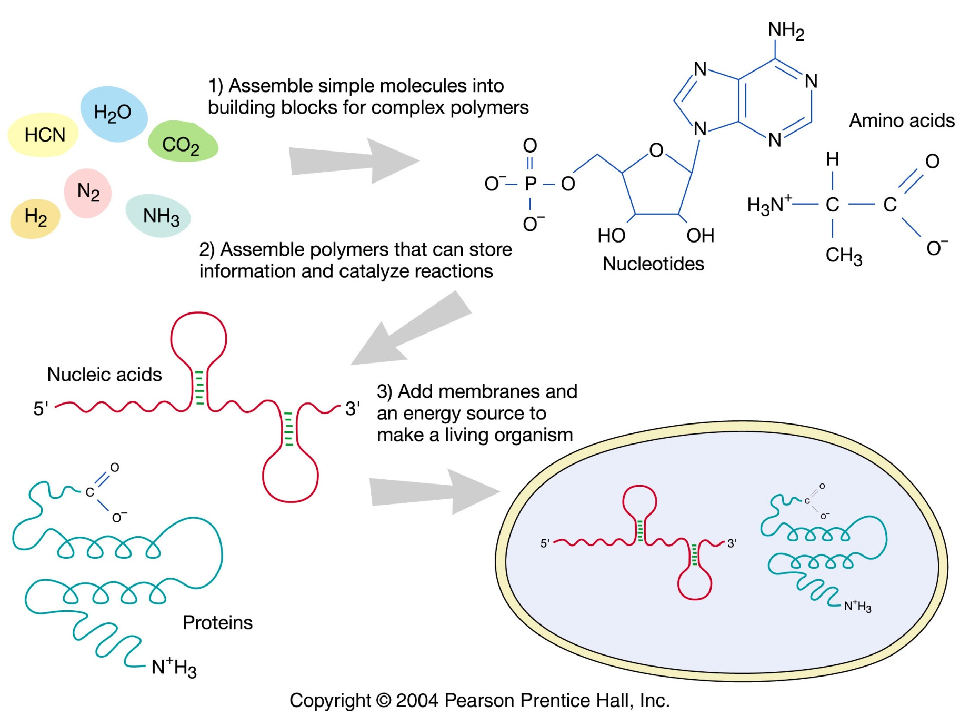
1920’s – theoretical advances

Slide 16
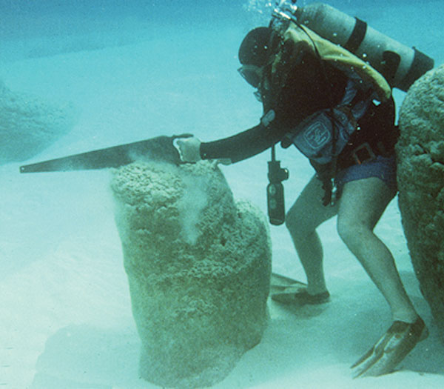
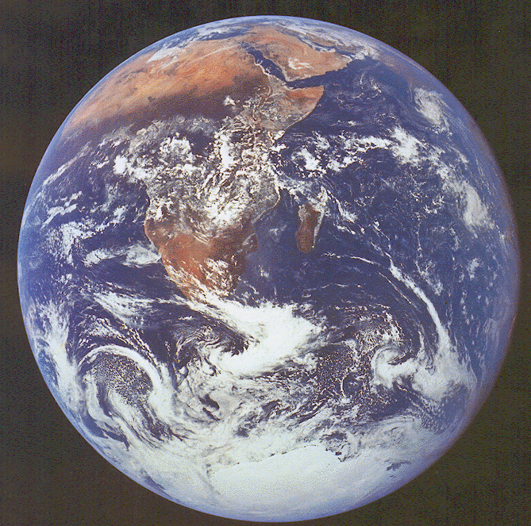
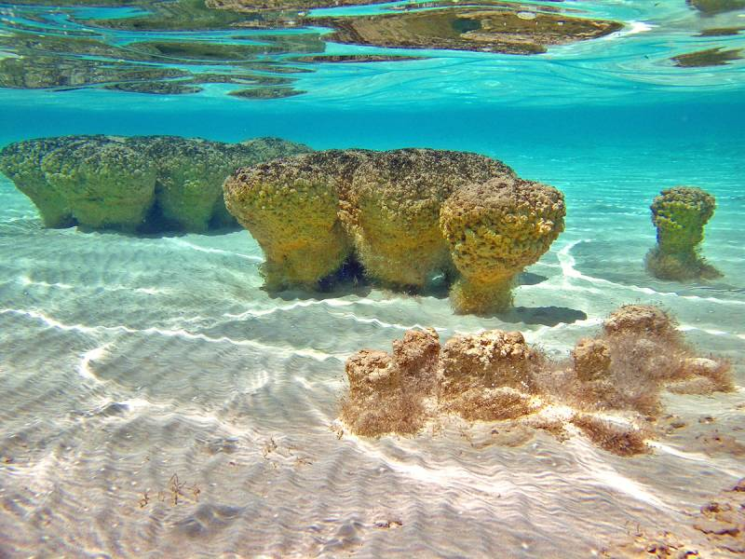
What does increasing O2 conc indicate?
Oxygen Revolution (and a new Eon) Begins
Why so important?

Slide 17
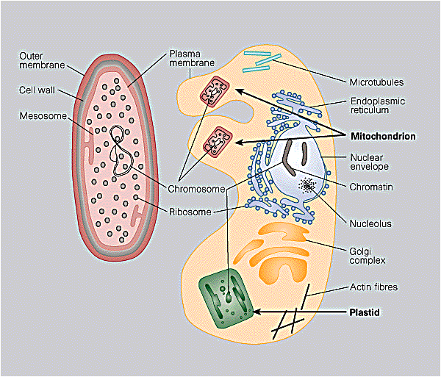
Relative to what’s alive today, what was the first life-form?
EUKARYOTE
1.5 BYA – something strange happens
What’s interesting about the timing of origin of life compared to this event?

Slide 18
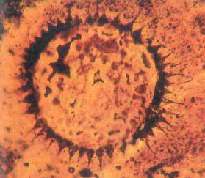
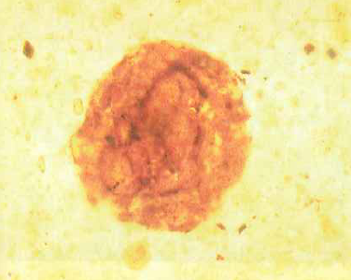
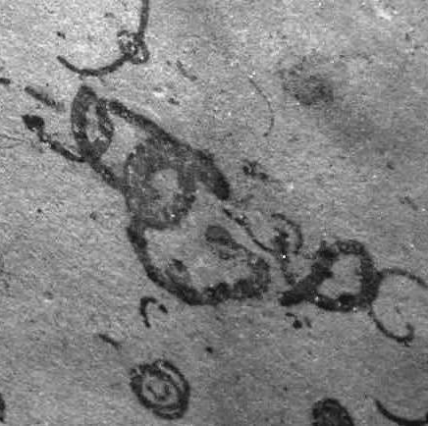
Origin of Eukaryotic cells from prokaryotic ancestors: 1.5 BYA

Slide 19
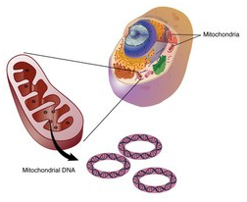
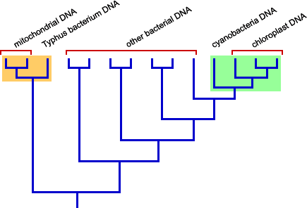
Evidence of this transition
Mitochondria and chloroplasts have circular DNA
Sequence genes = bacteria
Expose to antibiotics, stops protein synthesis
DNA replicates via binary fission

Slide 20
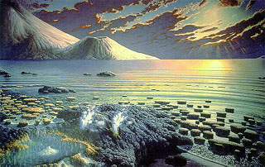
THE PROTEROZOIC Eon: 2.5 BYA TO 600 MYA
What types of organisms are alive at this time?
~600MYA – another something strange

Slide 21
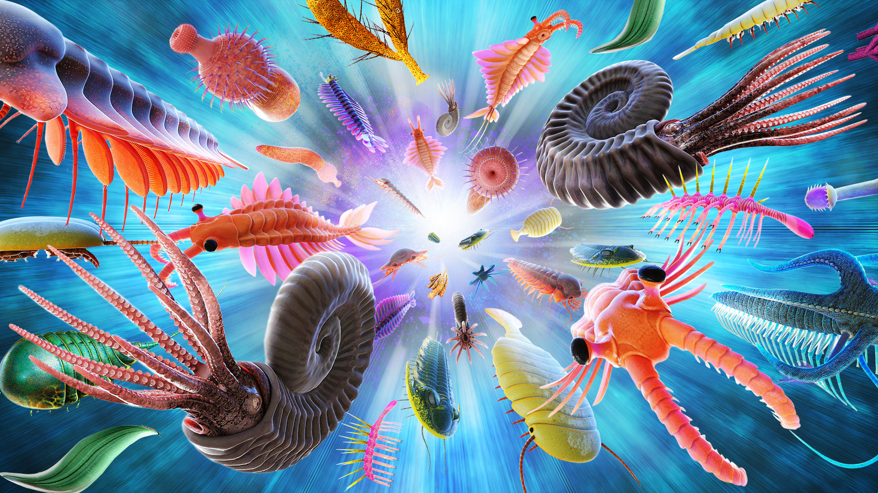

Slide 22
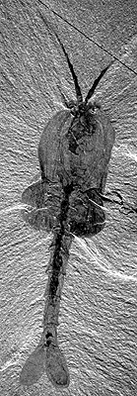
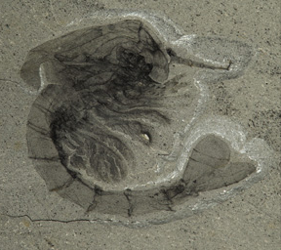
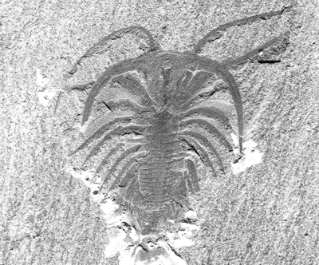
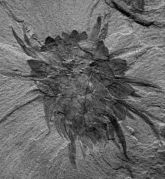
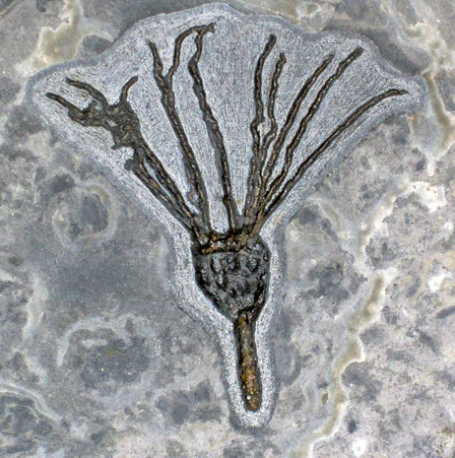
Arthropods
Waptia
Marrella splendens
Crustaceans
Annelids
+
Sponges
Jellies
Flatworms
Cephalopods
Echinoderms
Wiwaxia

Slide 23
What Precipitated the Explosion?

Slide 24
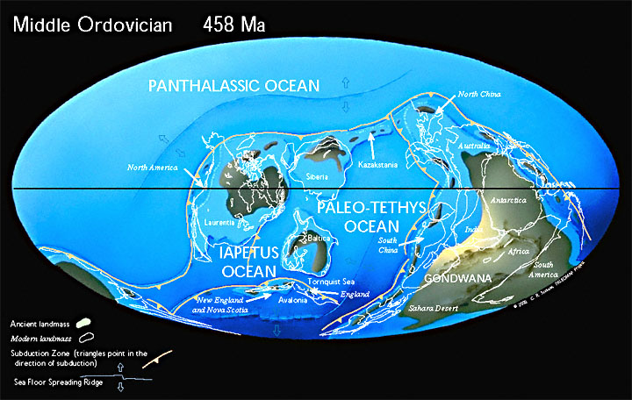
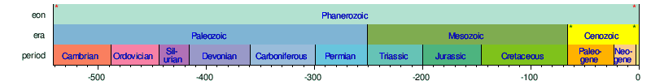
(500 to 450 MYA)
What do we not see in the Cambrian explosion?

Slide 25
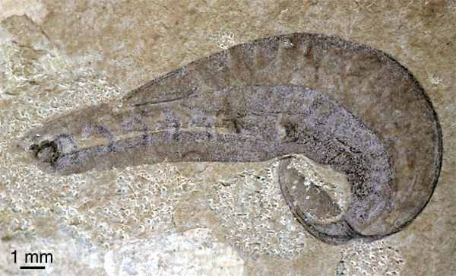
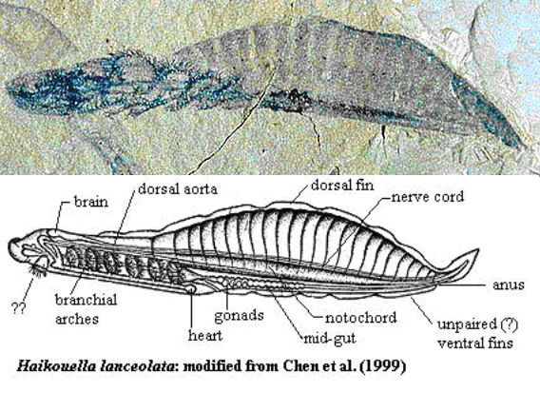
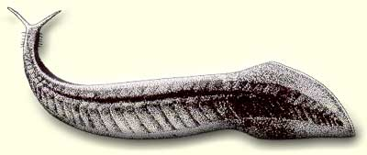
Yunnanozoon lividum
Notochord
Myomeres
Pikaia gracilens

Slide 26
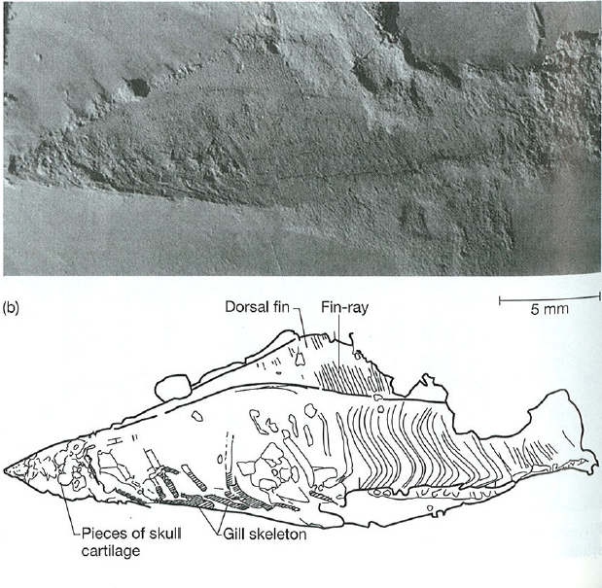

Haikouichthys
First vertebrates
Notes:
Ostracoderms are dominant in marine environments

Slide 27

What does “land” look like at this time?

Slide 28


First Terrestrial Fungus and Lichens
*SUPER IMPORTANT* - Why?
Lobaria pulmonaria
Notes:
Figure 1 (A to C and E toG) Fossil hyphae and spores from the Ordovician and (D and H) spores formed by extant glomalean fungi. (A and B) Overviews of the fossilized material. (C, E, F, and G) Fossil spore details. (C) Detail of (B). (D) A spore of present-dayGlomus sp. S328 with layered wall structure. In (G), the arrow shows walls of a subtending hypha in connection with the spore wall. (H) A spore of present-day Glomus leptotichum, a member of the deeply divergent glomalean lineages. Images were obtained by light microscopy (28) of the specimens in air (A, C, F, and G), differential interference contrast microscopy of the specimens in polyvinylalcohol-lactoglycerol (D, E, and H), and confocal laser scanning microscopy with the autofluorescence of the material (B). All scale bars are 50 μm.
Glomalean Fungi from the Ordovician
Dirk Redecker1,*,
Robin Kodner2 and
Linda E. Graham2

Slide 29




(450 to 400 MYA)
Climate warming

Slide 30


Dunkleosteus
Teeth?

Slide 31

400 to 350 MYA
Climate mild
Gondwana splitting apart

Slide 32





Slide 33



“Age of Fishes”

Slide 34



Slide 35

Plants and insects diversifying on land
Continents near equator
Set the stage for?
Flat head
Fins fleshy
Wrist bendy
Daeschler et al., 2006. Nature

Slide 36


Slide 37

Why the transition to land?
Notes:
Escape predation from aquatic predators
Provided a nursery that was relatively free from predators (giant lobe-fin predators)
Take advantage of terrestrial prey (e.g., insects)
Move between pools in seasonally dry environment

Slide 38

1st Amphibians

Slide 39


Another
“Stem Tetrapod”

Slide 40

Paleozoic Era: Carboniferous Period
350 to 300 MYA
What’s the average global temp today?

Slide 41

Gymnosperms dominant
No flowering plants
Notes:
Figure 21.11: Reconstruction of a Carboniferous forest.
Plants of this period included giant ferns, horsetails, club mosses, seed ferns, and early gymnosperms.

Slide 42

Carboniferous coal beds

Slide 43


Abundant terrestrial animal life
Insect diversity explodes
lots of plants = high O₂ = GIGANTISM
Meganeura
Arthropleura

Slide 44





Amphibians Diversify
First Amniotes

Slide 45

300 to 250 MYA

Slide 46


Reptiles appear
Ancestral mammal appear and dominate

Slide 47

Permian Extinction Event: Largest extinction event in the history of life on Earth
https://www.youtube.com/watch?v=xXMoBnuFZ5k

Slide 48


Slide 49



Jeholodens jenkinsi
Lau et al. 2007. Nature

Slide 50

250-65 MYA
“Age of Reptiles”
Mammals?
I thought mammals were dominant?

Slide 51




Baby dinosaur

Slide 52


Slide 53


~100 MYA
Birds descended from dinosaurs

Slide 54



Flowering plants – the Angiosperms
~100 MYA

Slide 55



Cretaceous
Asteroid Impact (65 mya)
Mass extinction
Who?

Slide 56





Slide 57






Survivors?

Slide 58


65 MYA - Present
“Age of Mammals”
66 MYA

Slide 59


Eobasileus
Diatrymiformes
Climate very warm
Many open niches
65-55 MYA

Slide 60




55-30 MYA
Climate cooling
Transitioning from forest to plains
All modern mammal orders appear
Modern birds appear
Indricotherium

Slide 61



30-20 MYA
Much cooler/drier
Ice forming at poles
Grazing mammals dominant

Slide 62

20 MYA – present
Modern climate patterns
Land bridges connect all major continents
Major extinction events
First modern humans (~200,000 yrs ago)

Slide 63
History of Life Homework
Break into 3 groups
Obtain a meter tape and a pack of pictures
Grab an instruction sheet
Review the assignment
Ask questions

