Slide 1
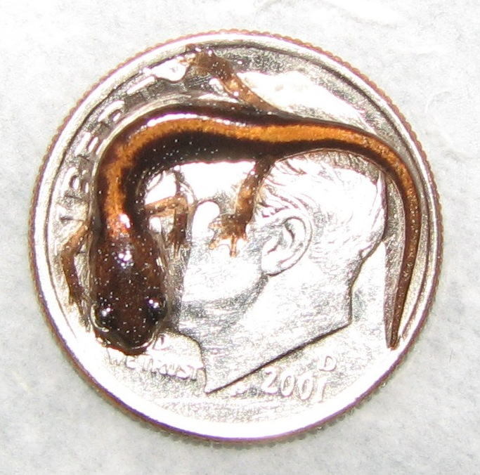
Intro to Herp Photography

Slide 2
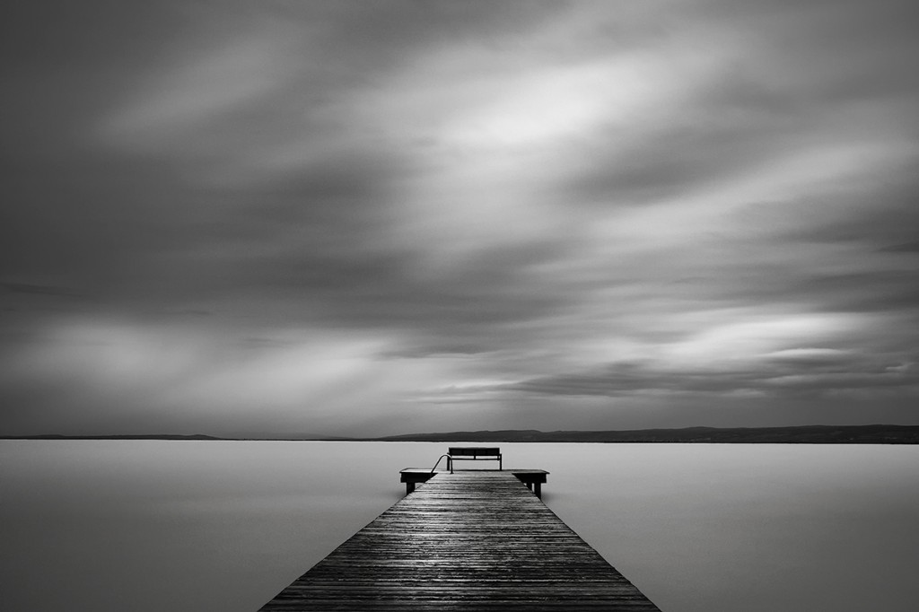
Notes:
Like all other forms of photography – taking pictures of herps (or any living animals) is an art
Takes years of practice

Slide 3
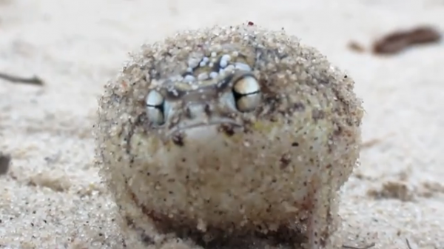
Notes:
Also requires a TON of knowledge about your subject
Have to know what they like and don’t like, how they act normally, to get them to do what you want
A lot like taking pictures of children – gotta keep them happy!

Slide 4


Slide 5
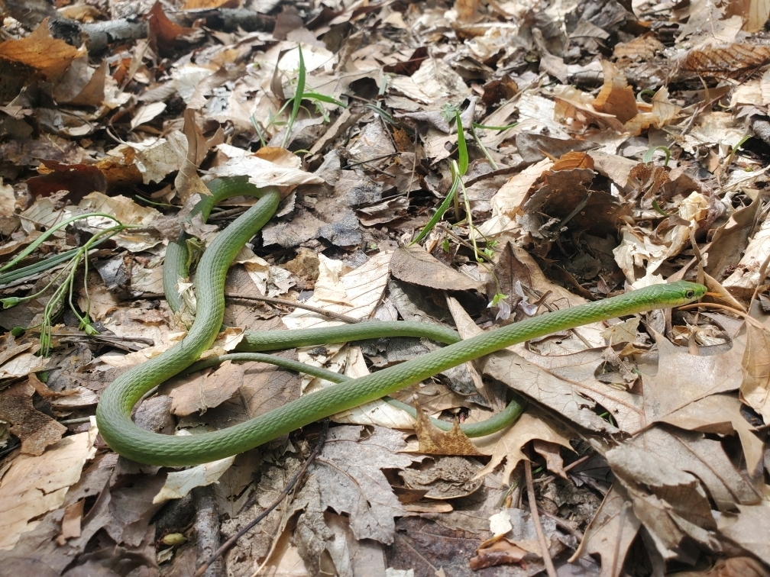
Things to Consider
Get the whole animal
Facing you
Background!

Slide 6
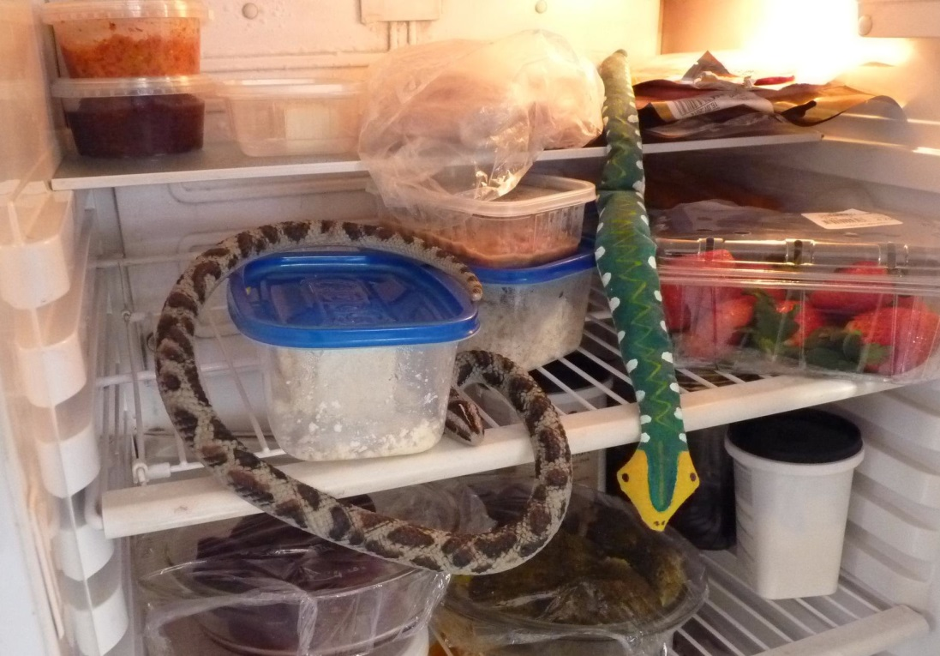
Additional Tips
Get them cold
Keep them moist
Touch them, but don’t touch them
Make them feel “safe”

Slide 7
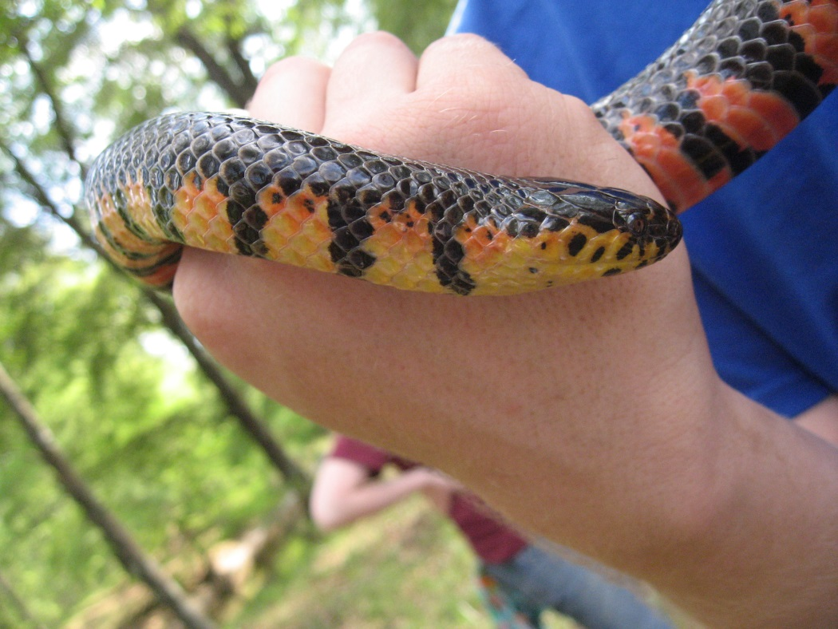
Let’s Play, FIND THE PROBLEM!

Slide 8
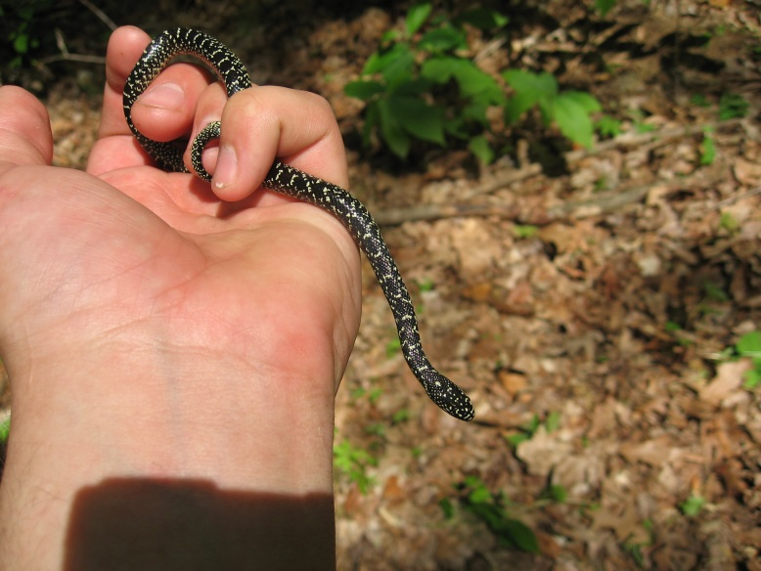

Slide 9
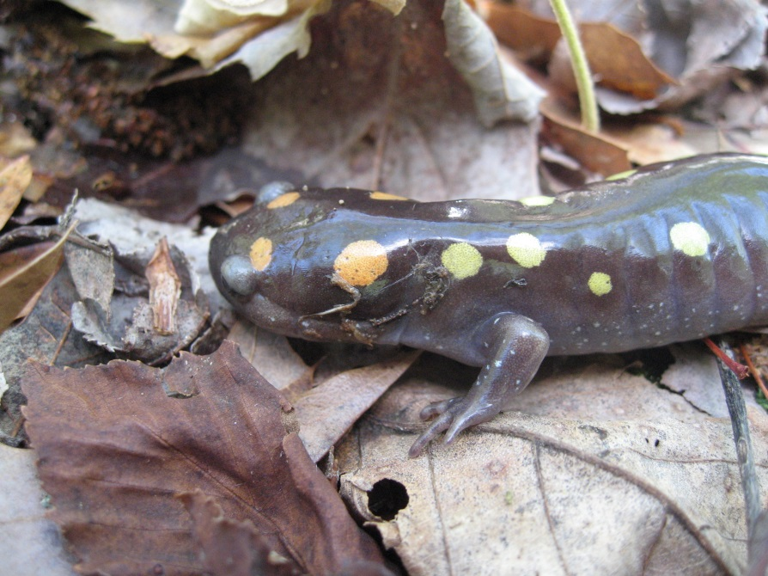

Slide 10
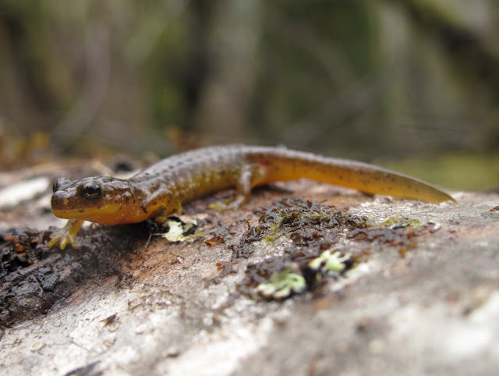

Slide 11
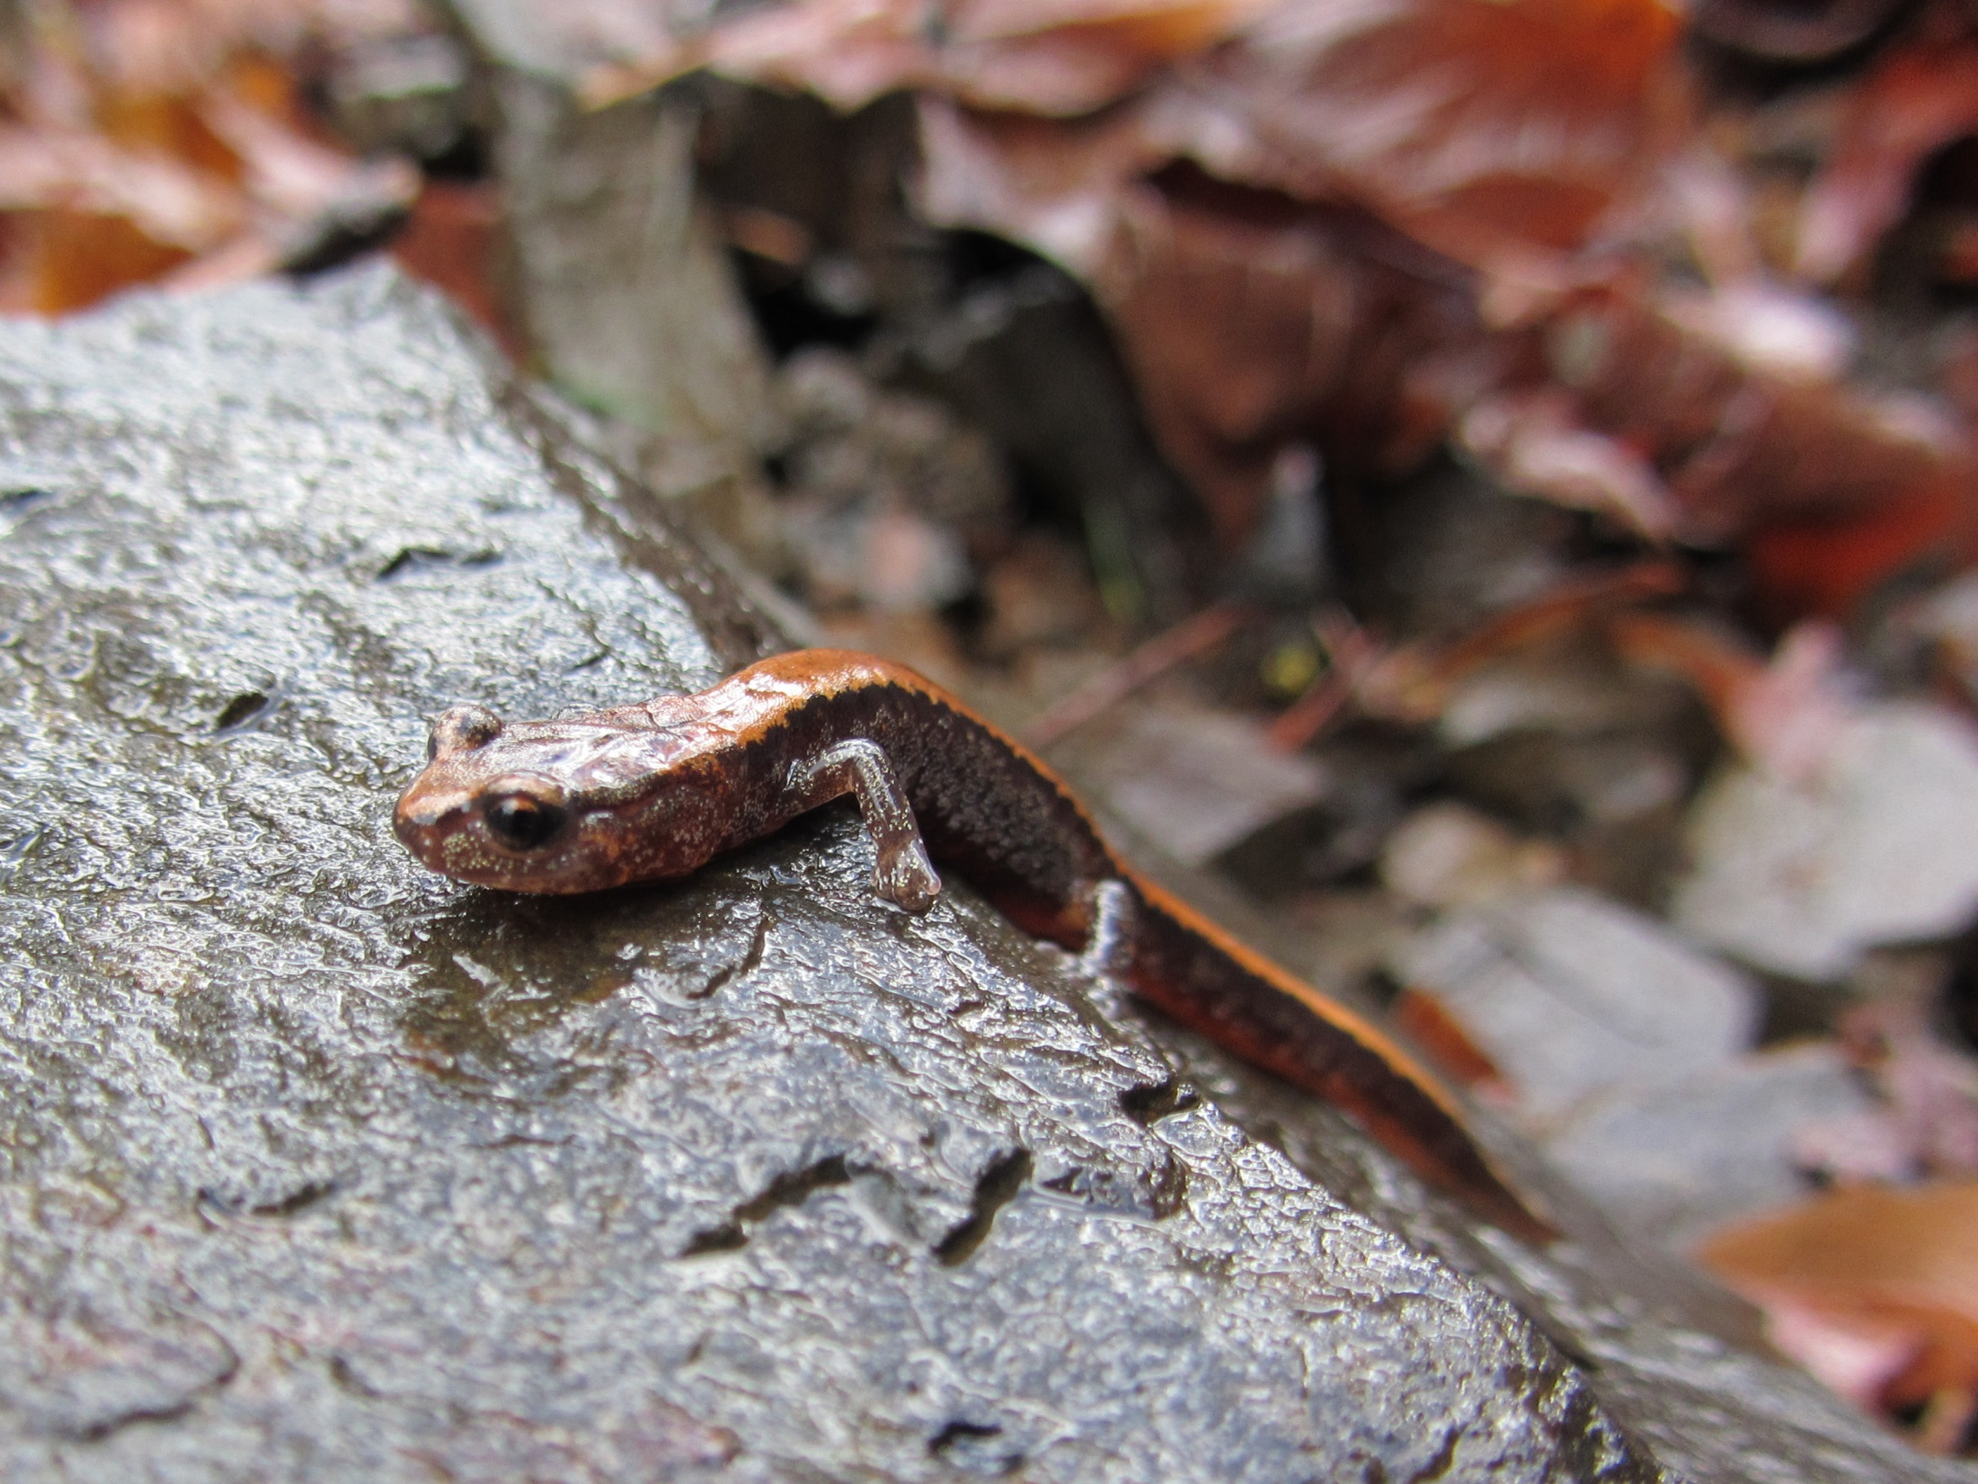

Slide 12
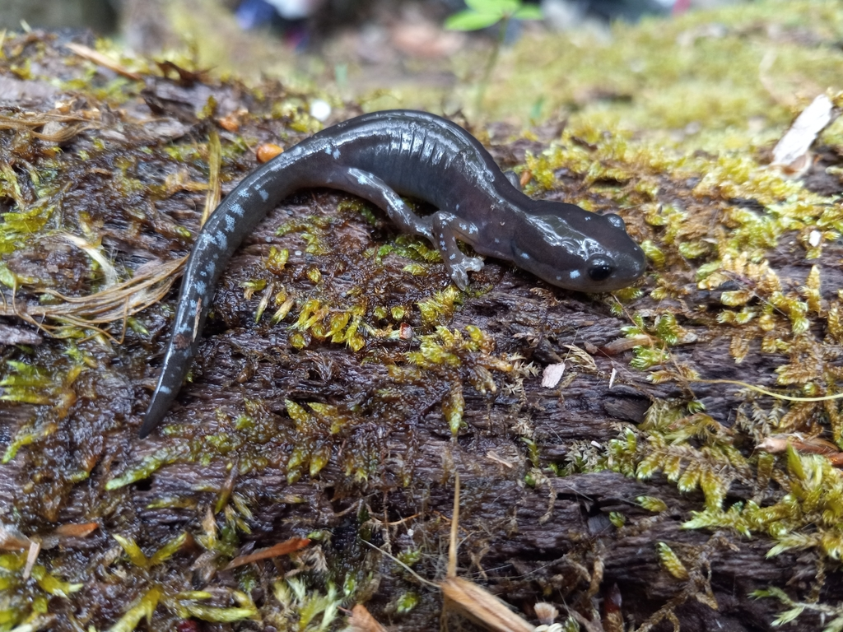

Slide 13
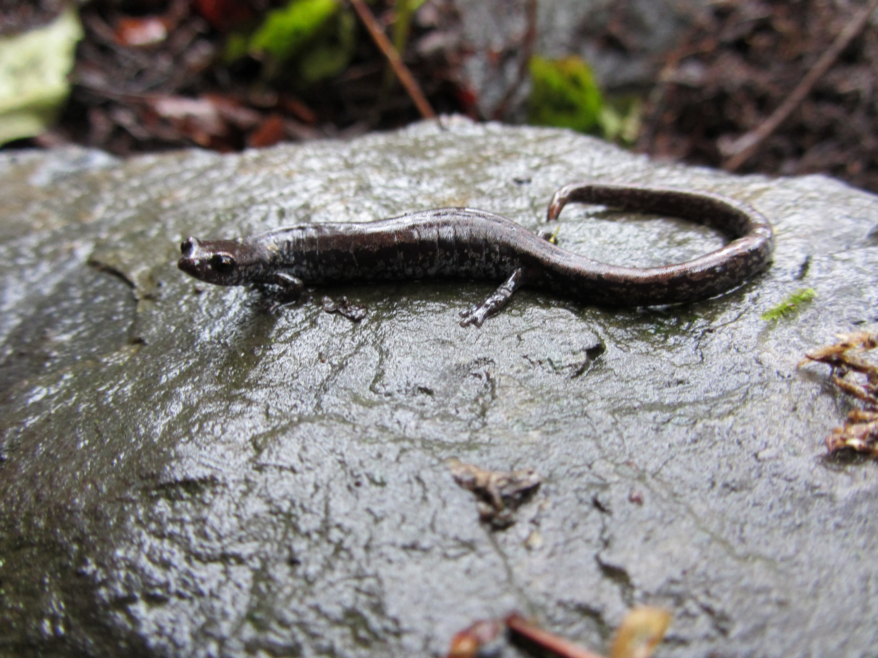

Slide 14
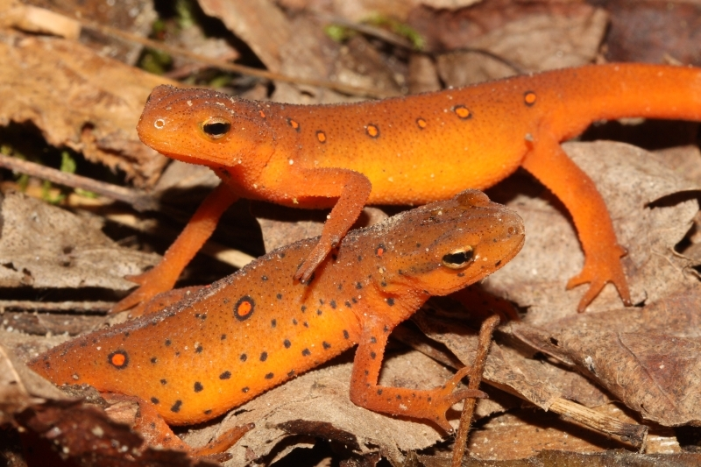

Slide 15
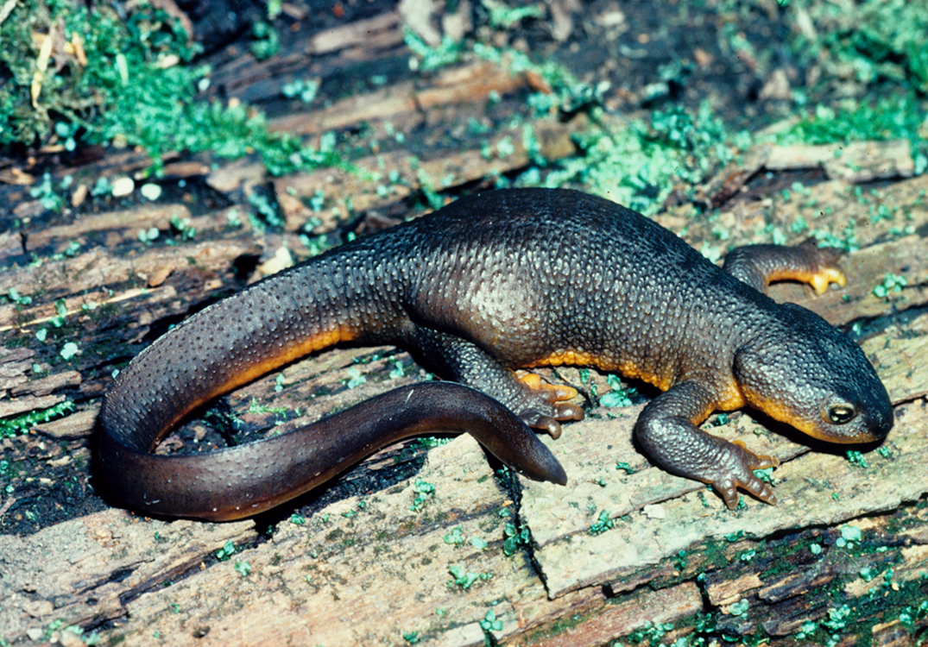

Slide 16
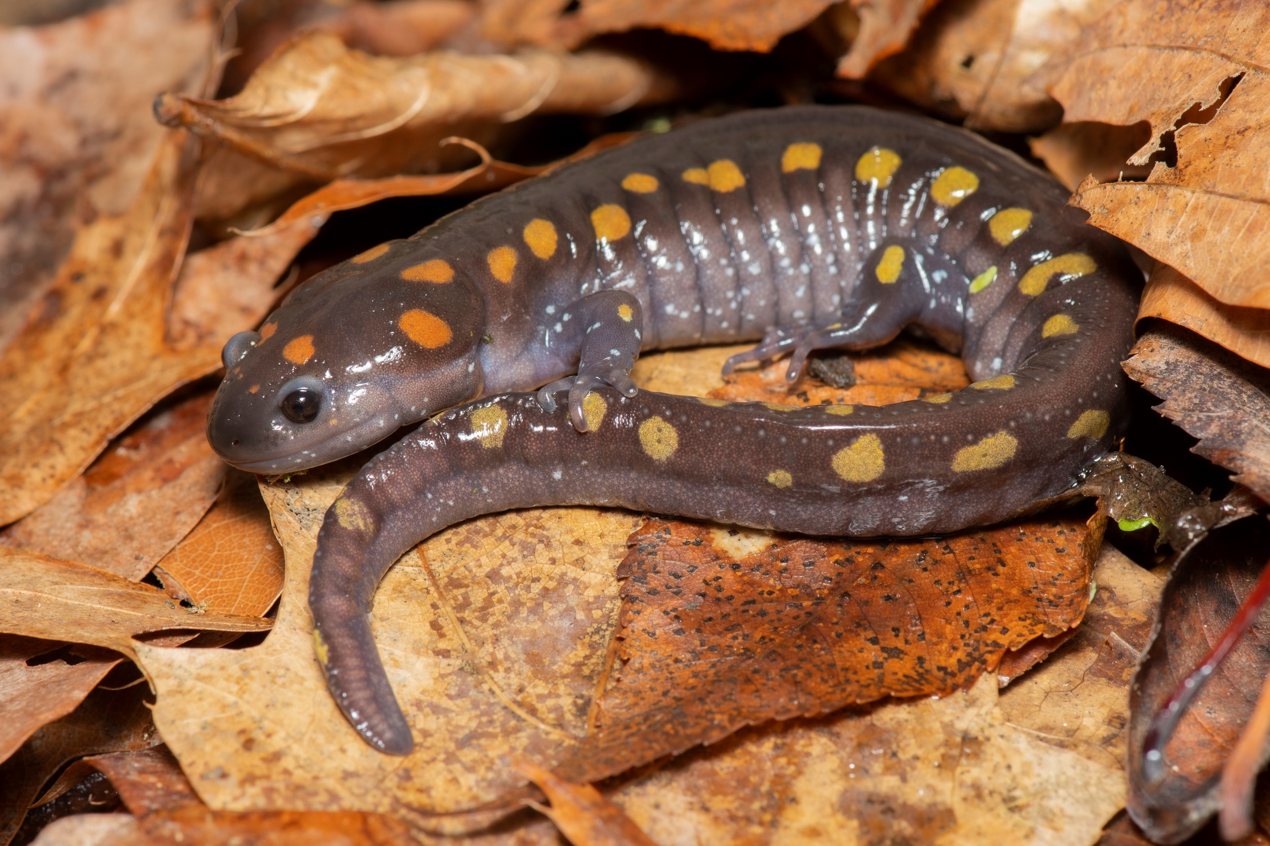
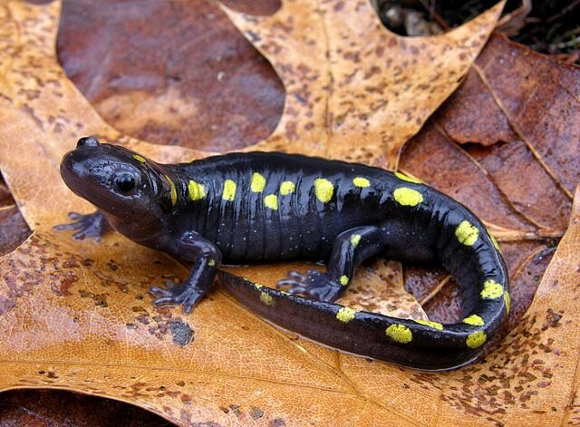

Slide 17
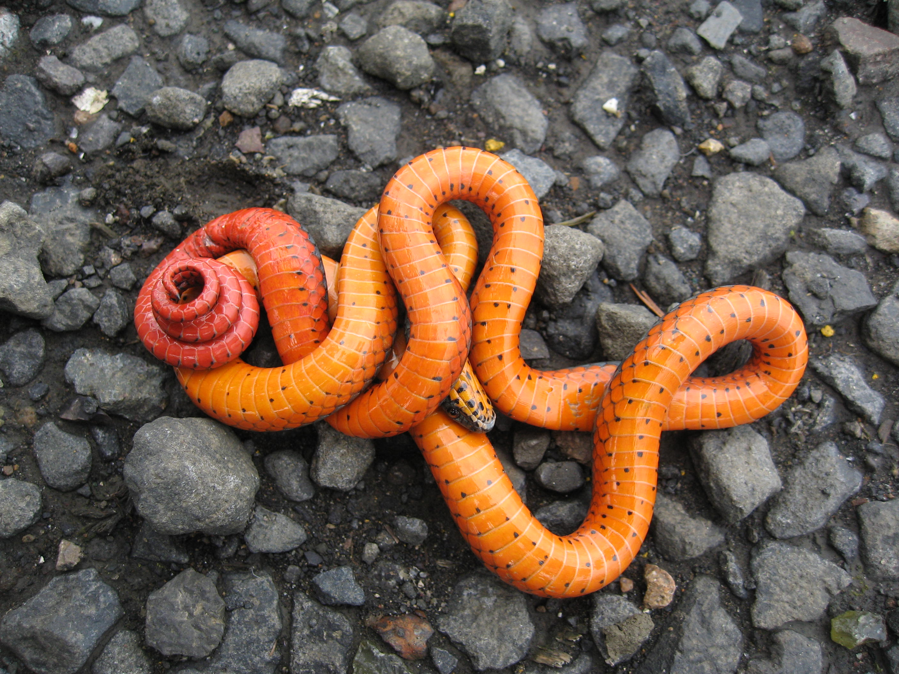

Slide 18
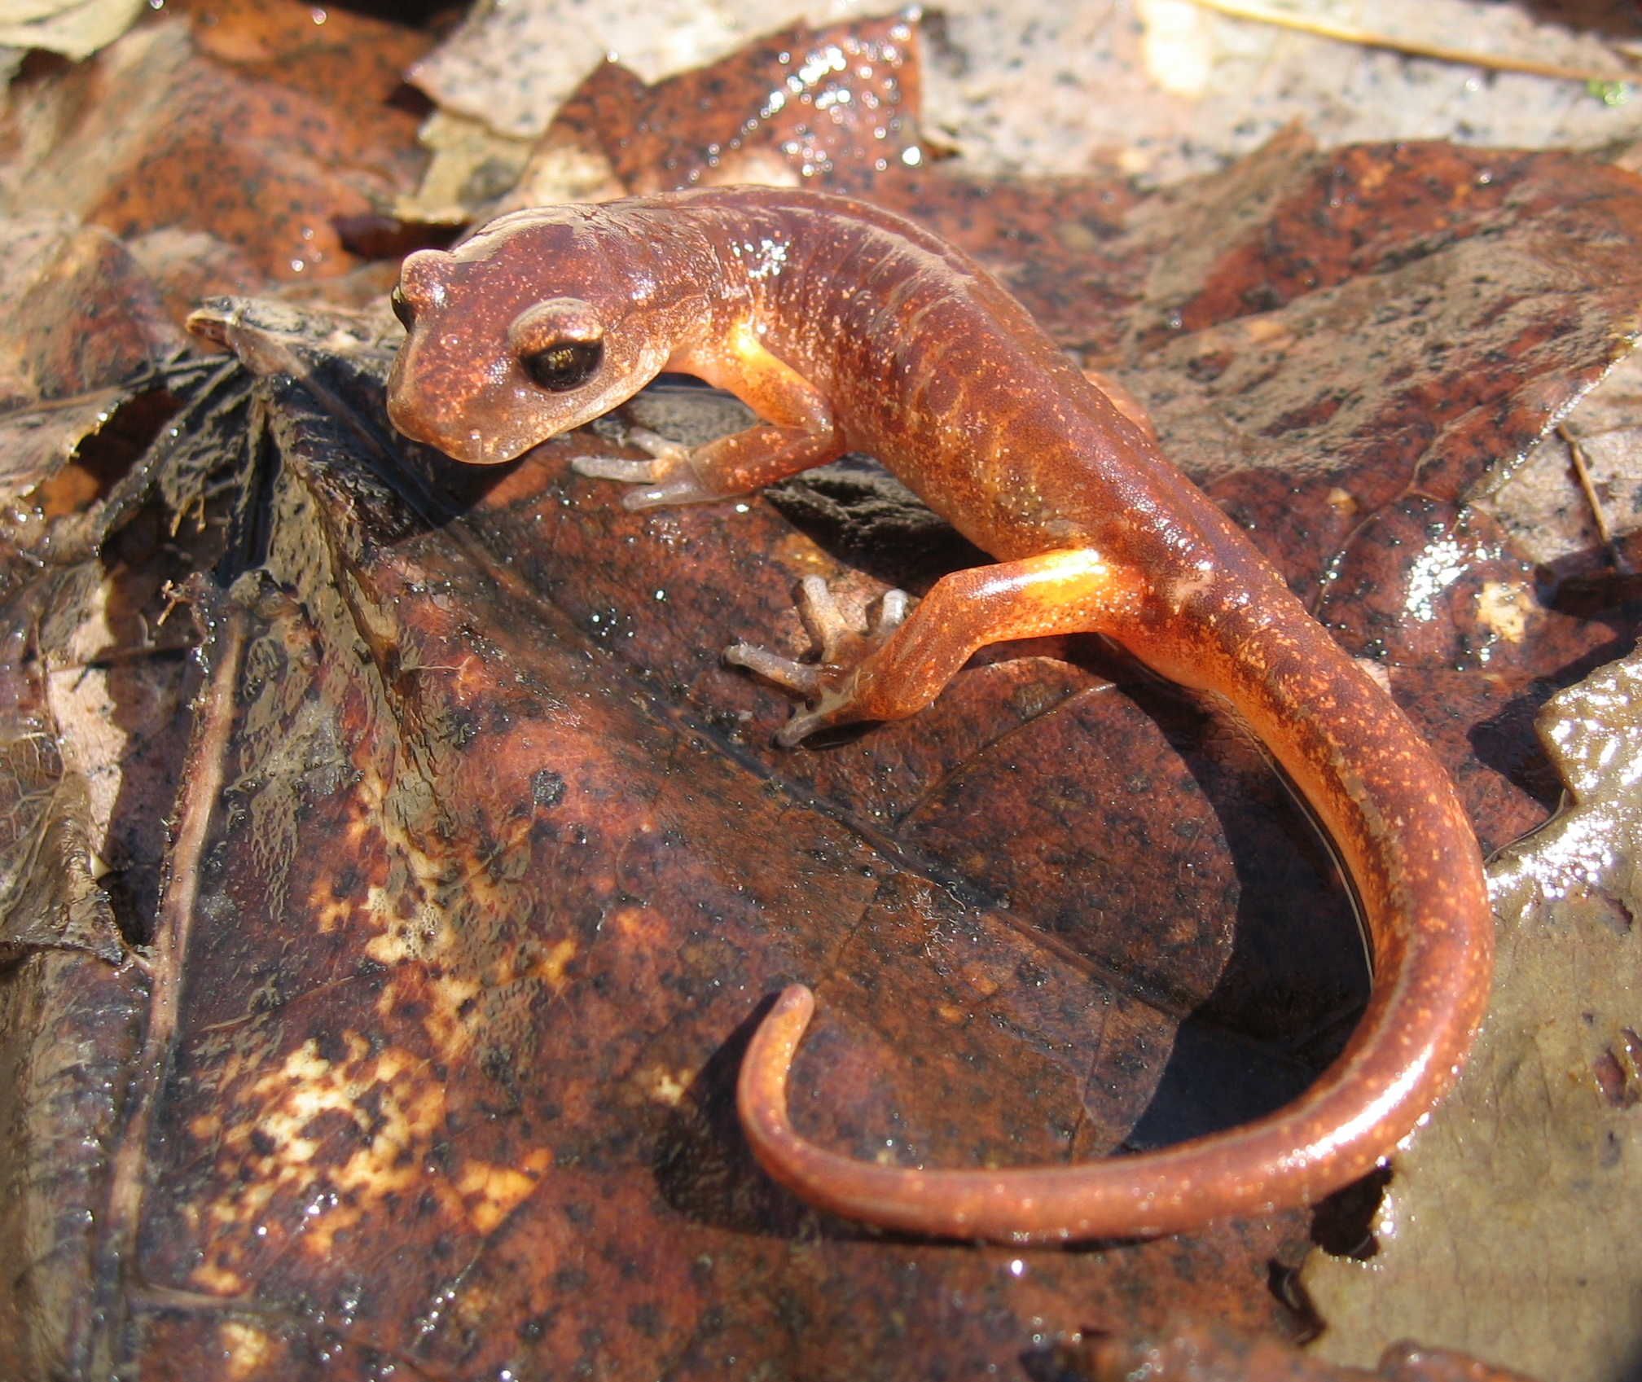

Slide 19
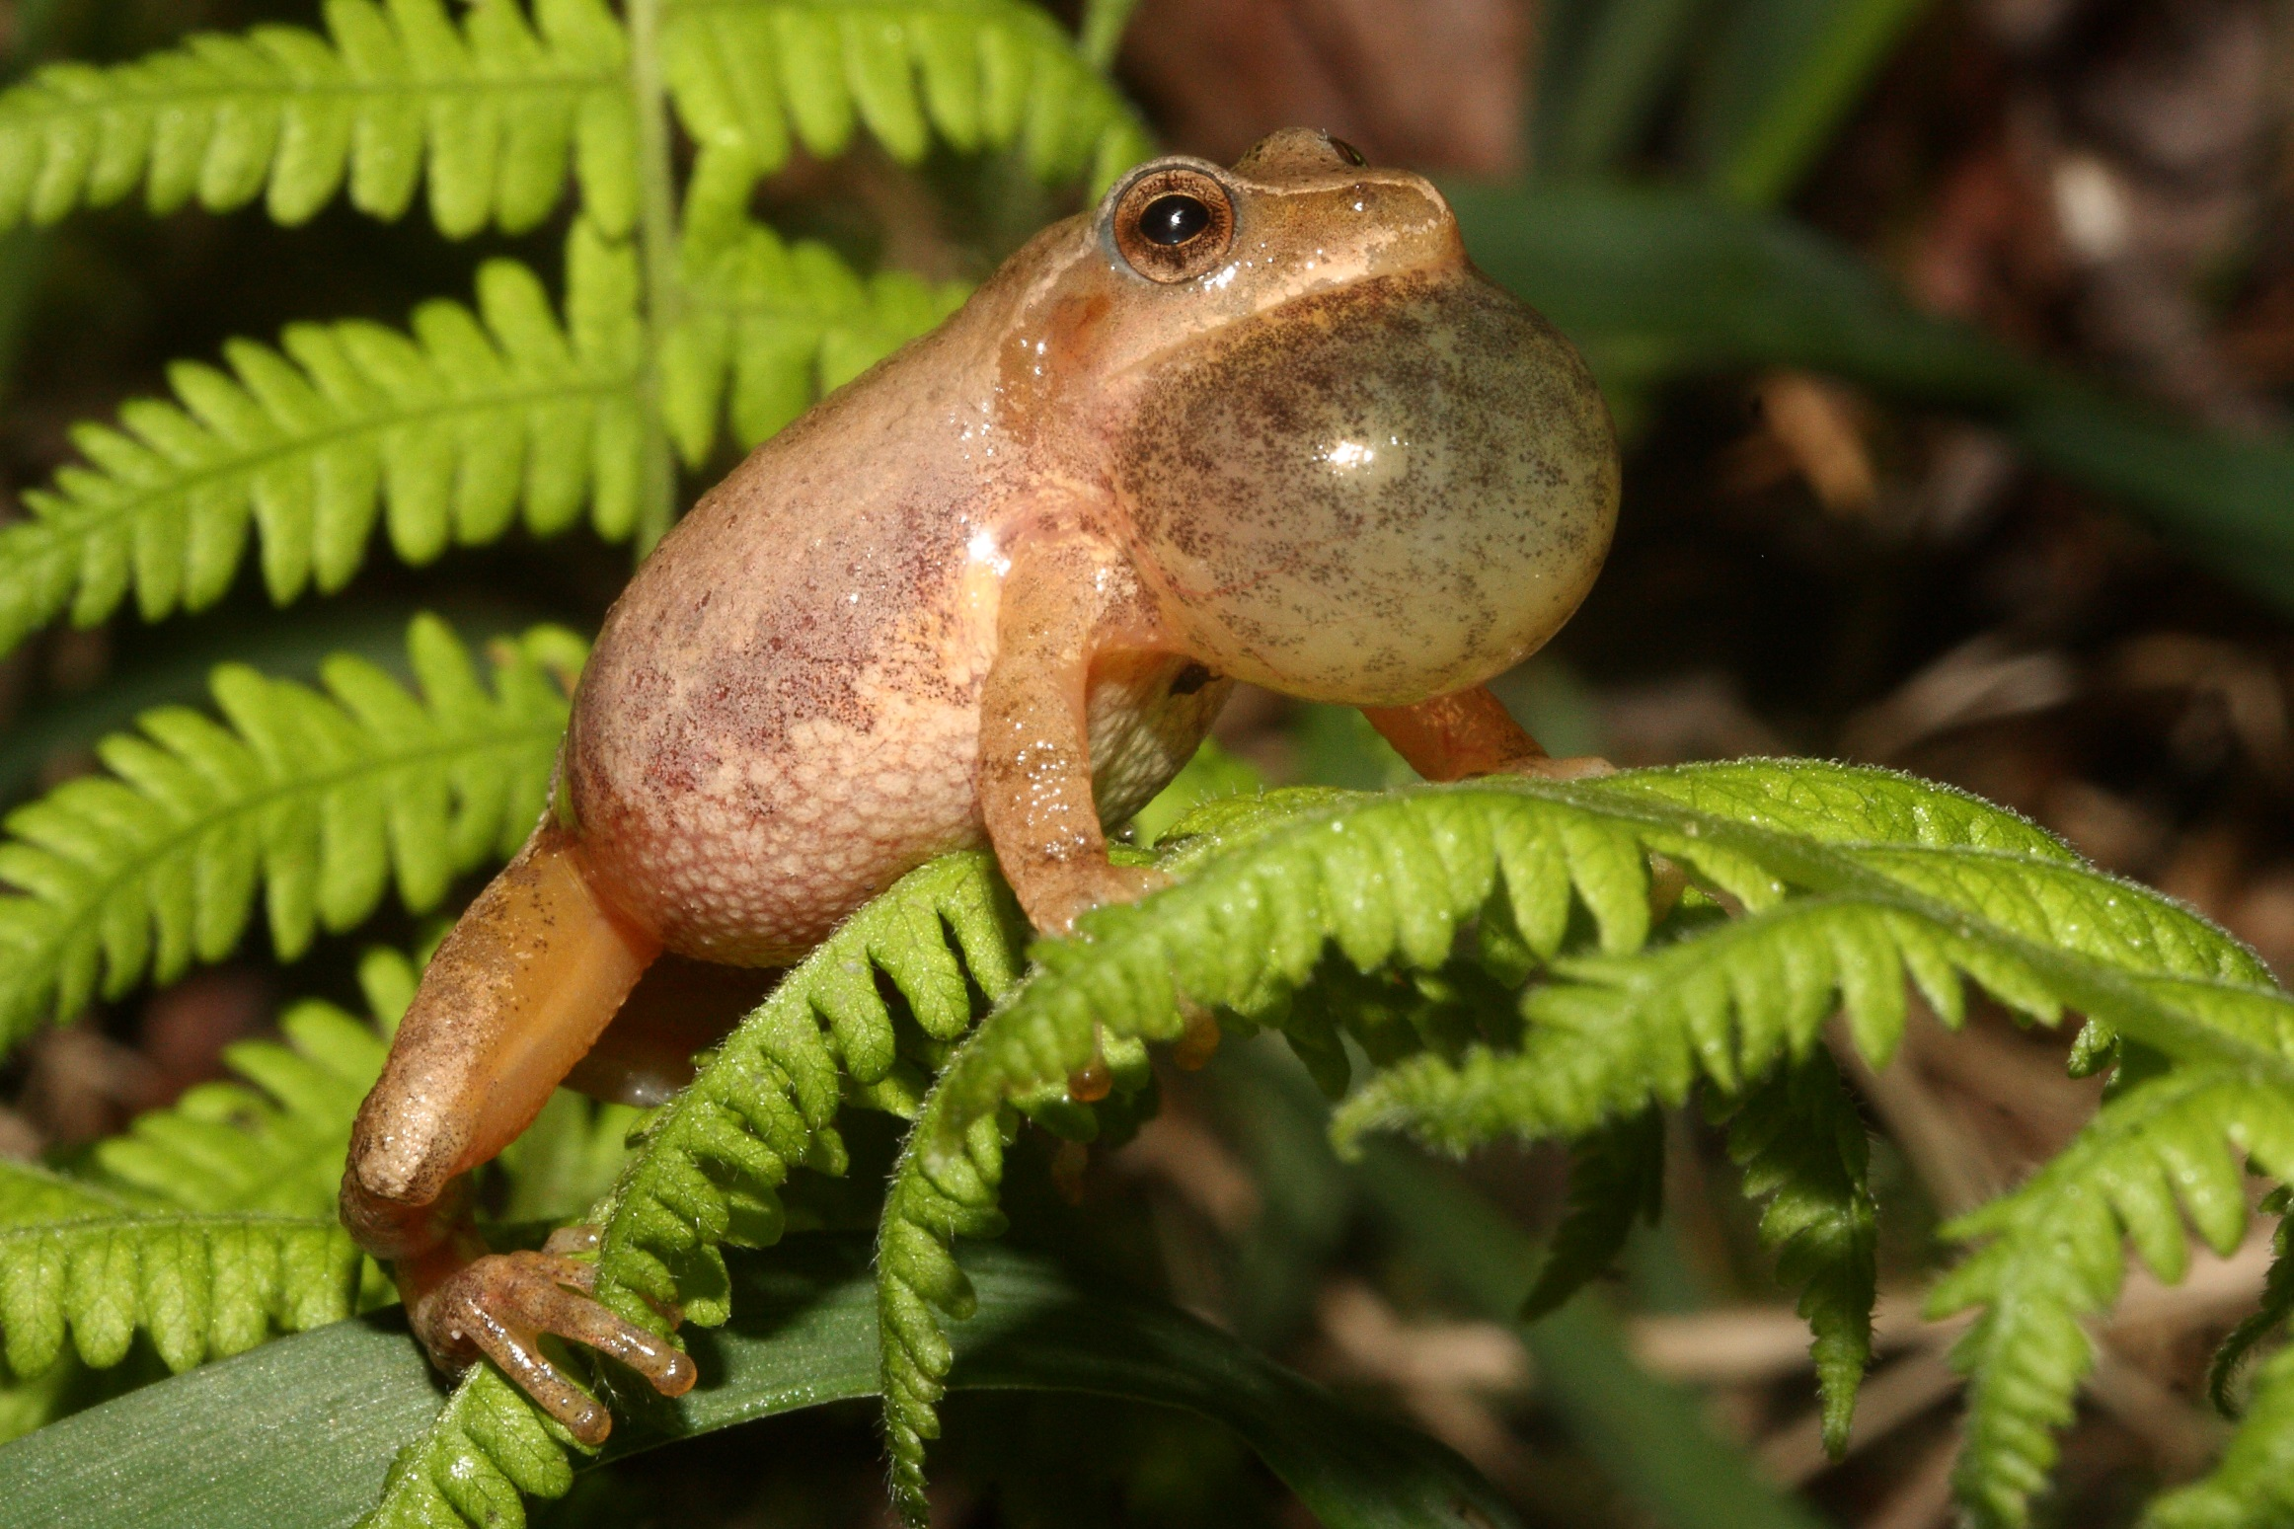

Slide 20
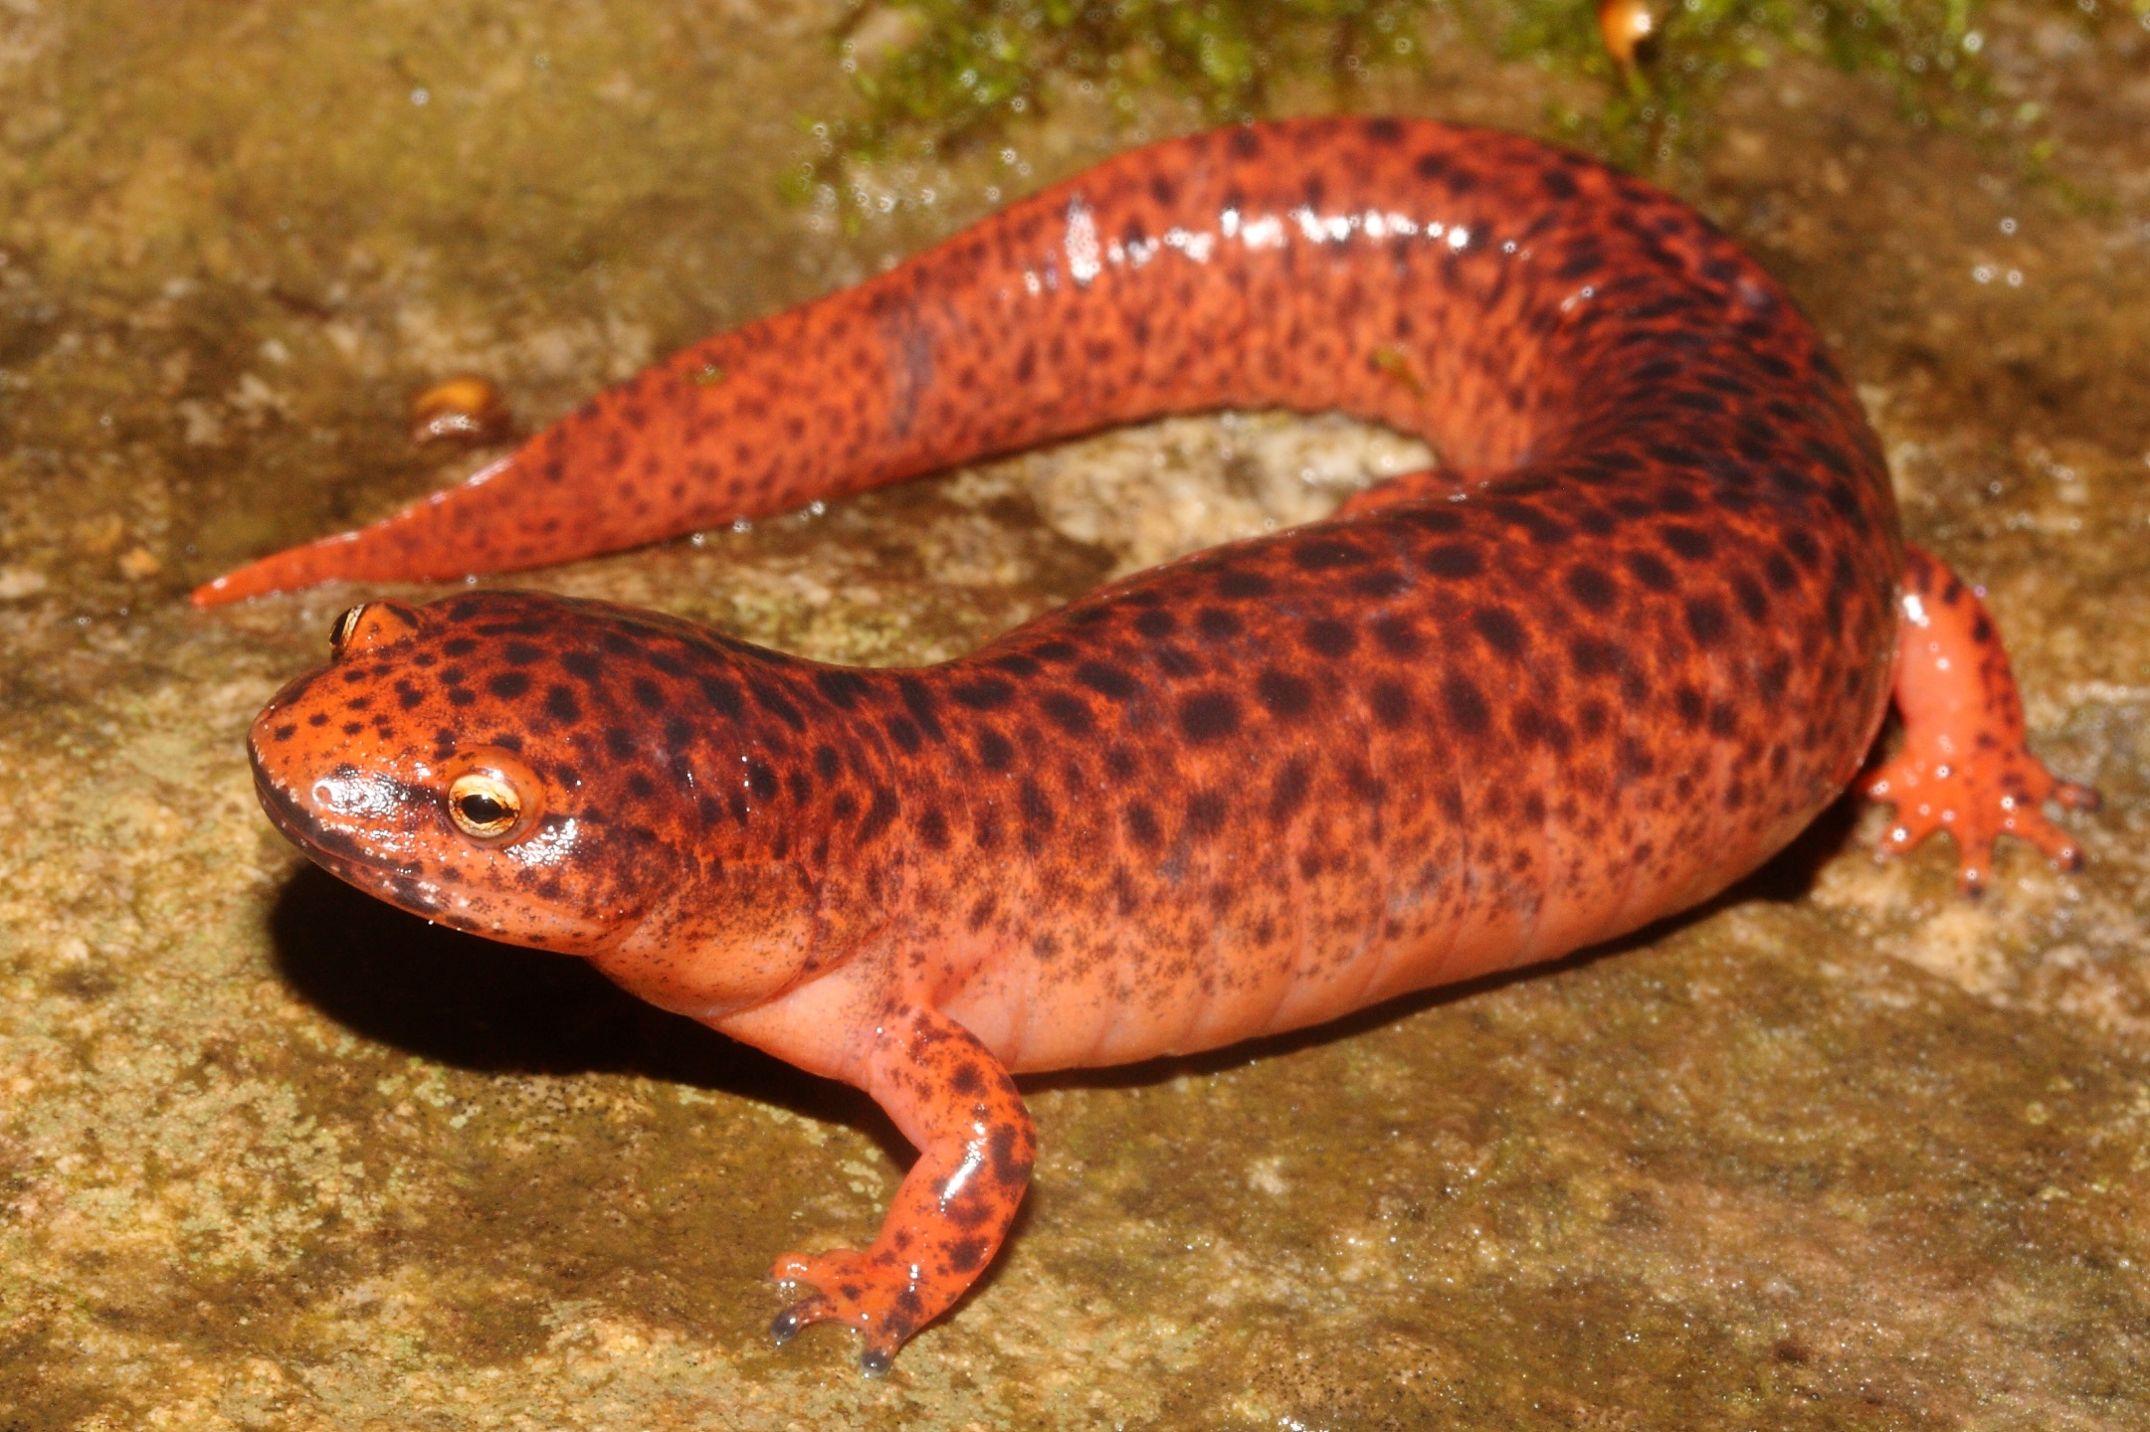

Slide 21
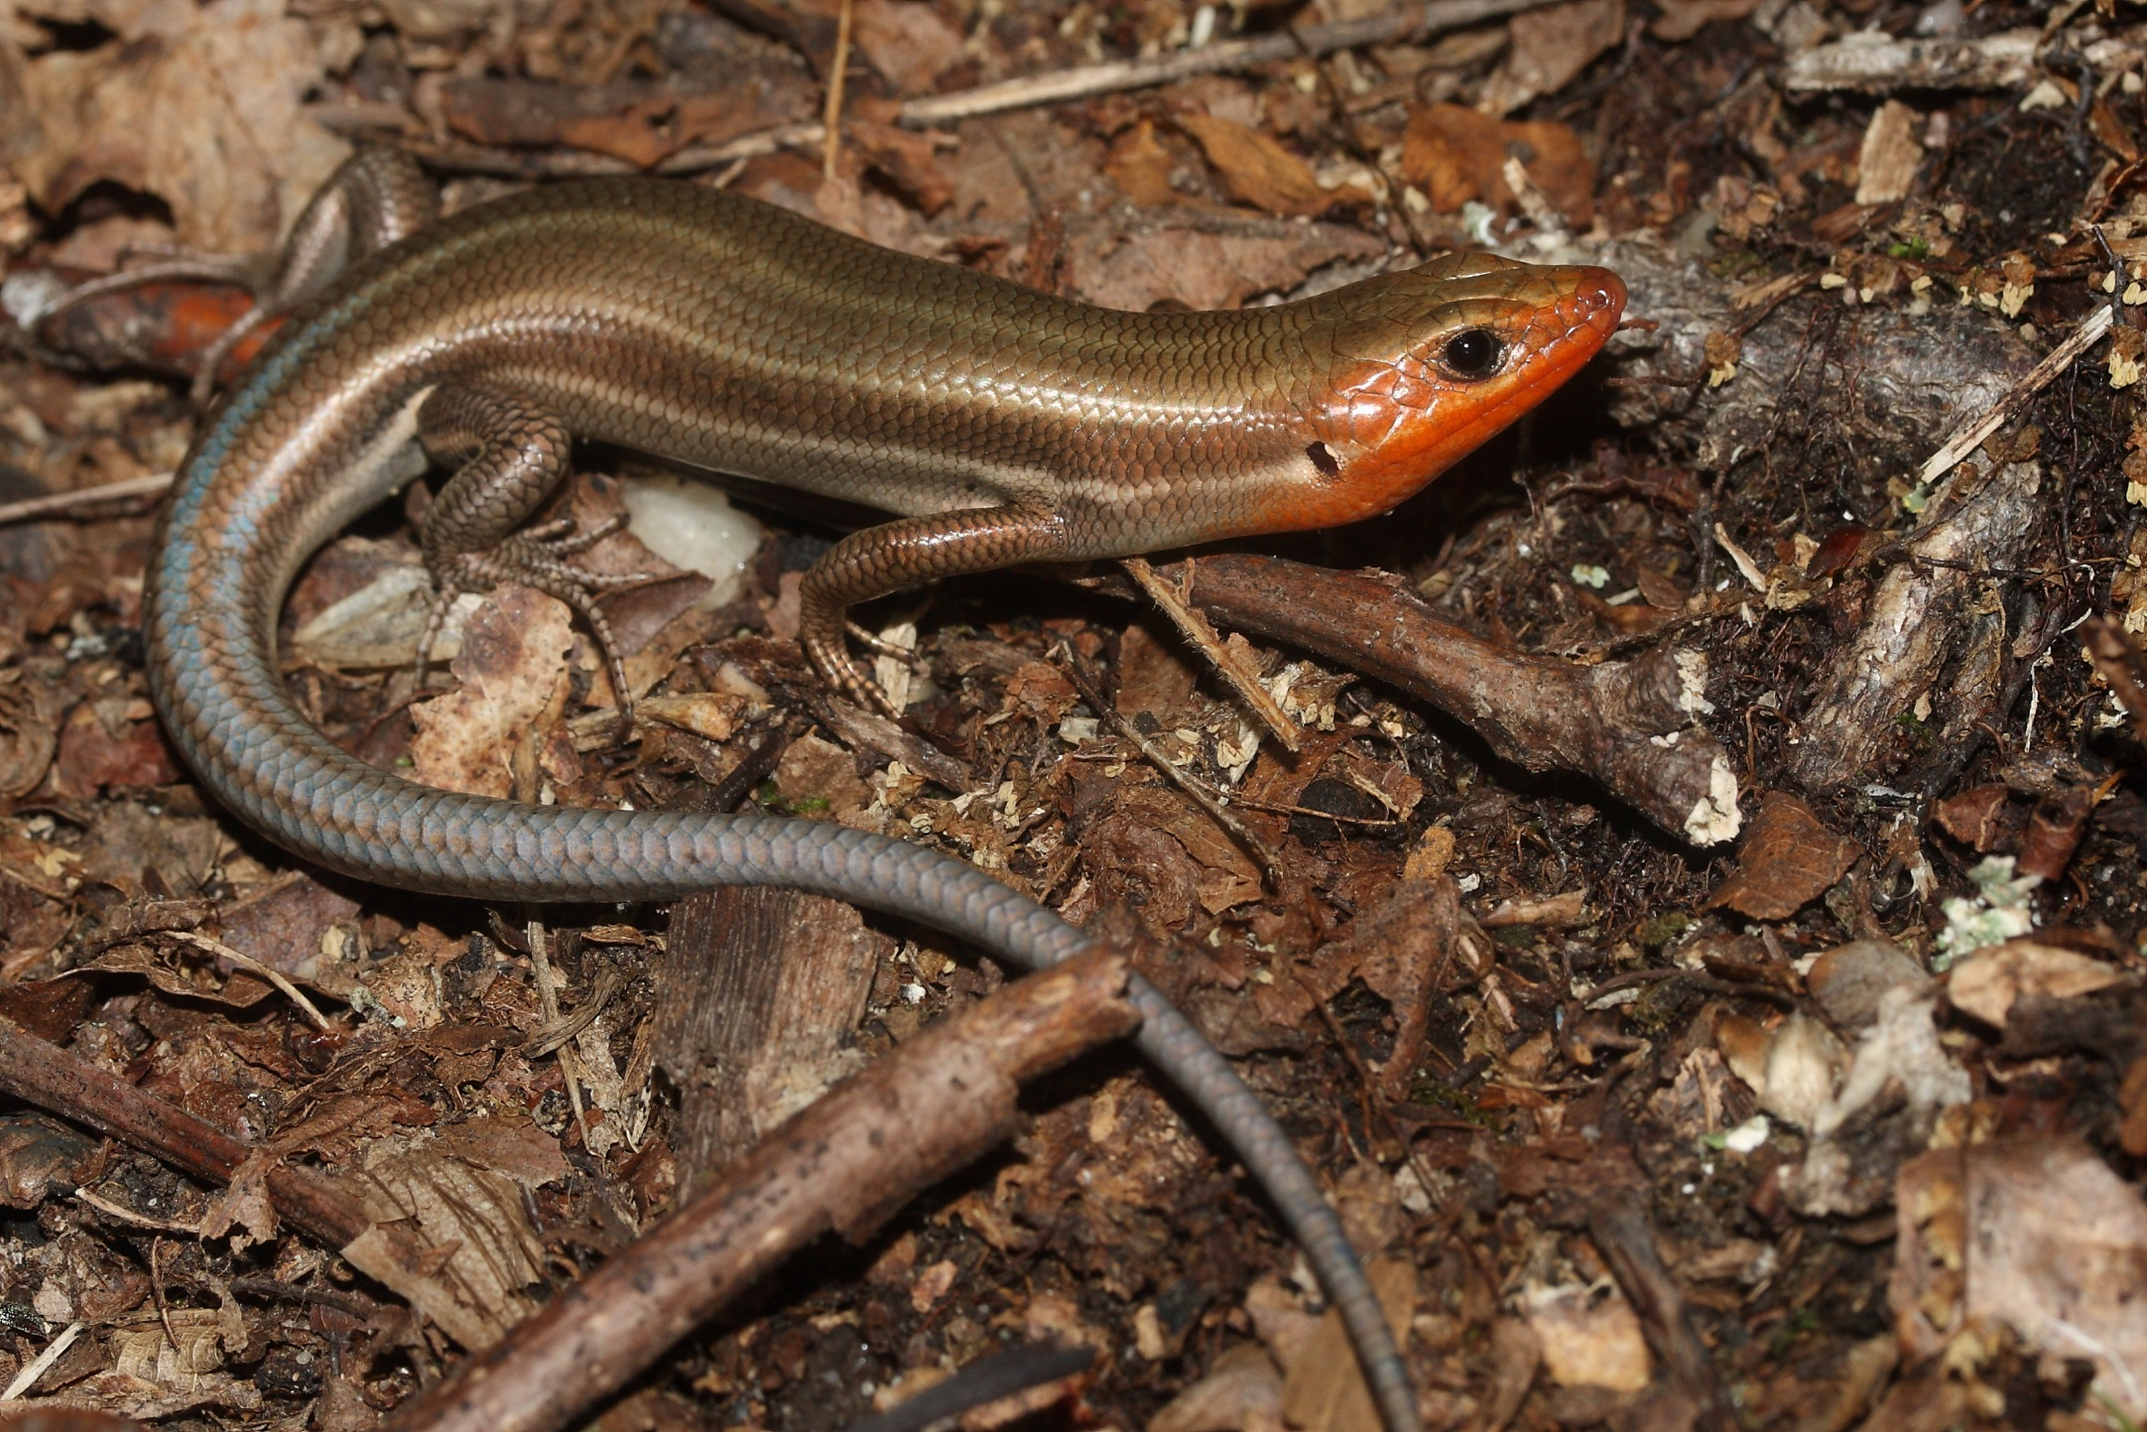

Slide 22
