Slide 1
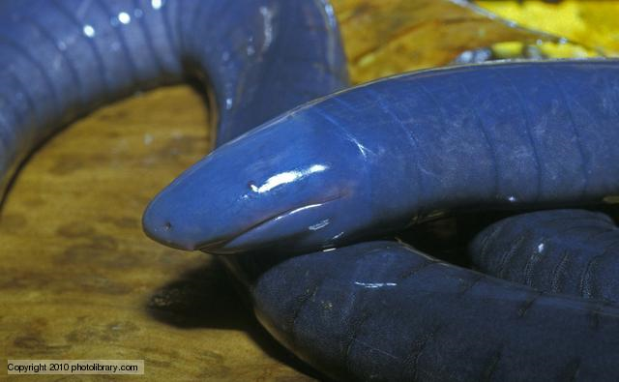
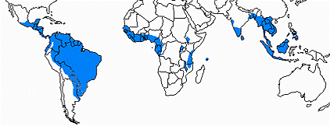
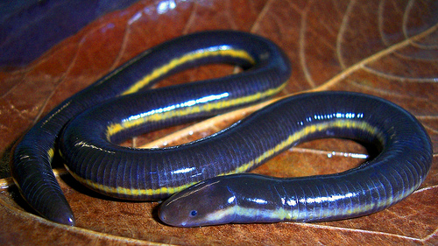
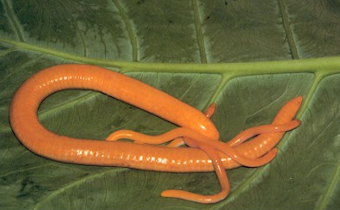
Caecilians
Gymnophiona
Split ~200MYA
Fossorial or aquatic
Pantropical distribution
Body size varies
Diverse reproductive modes

Slide 2
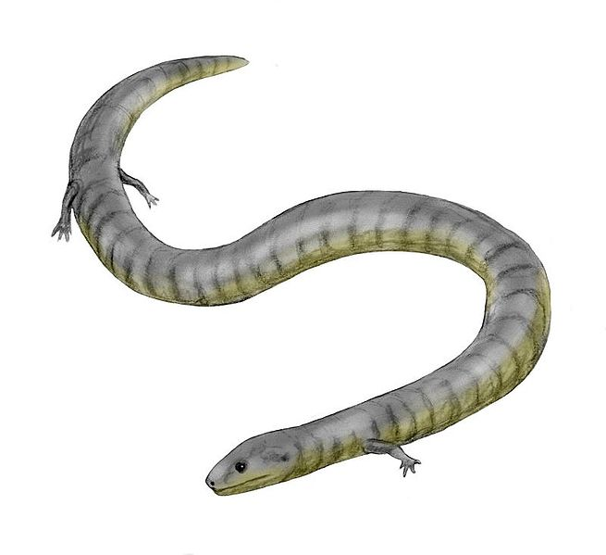
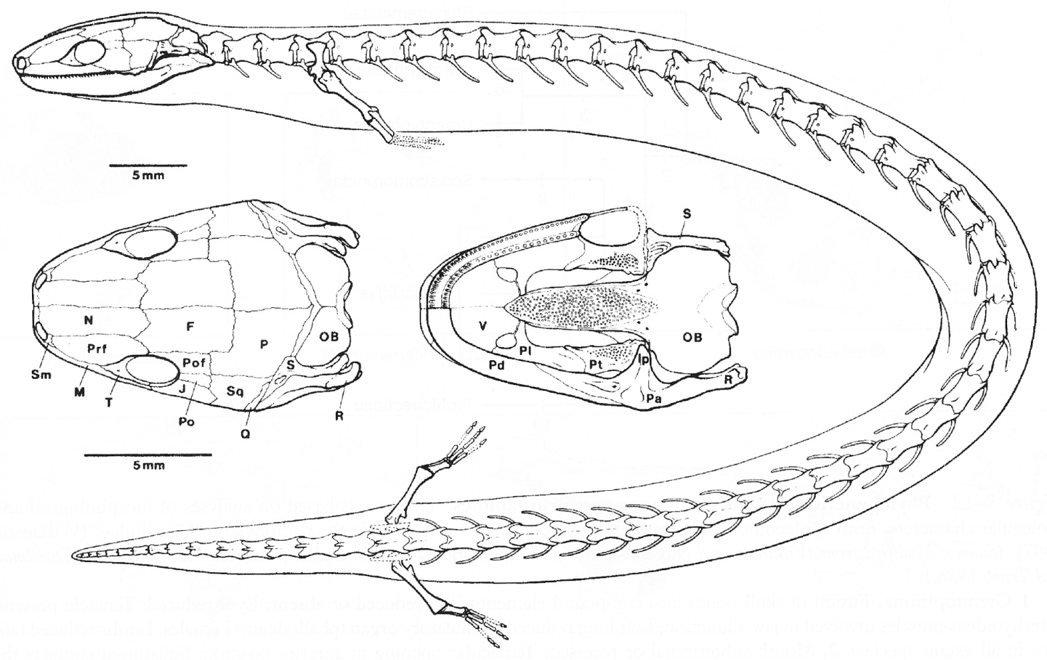
Fossil Evidence
From ~190 MYA
Skull identifies it as caecilian
Girdles and limbs present
Jenkins and Walsh, 1993. Nature
Eocaecilia micropoda

Slide 3
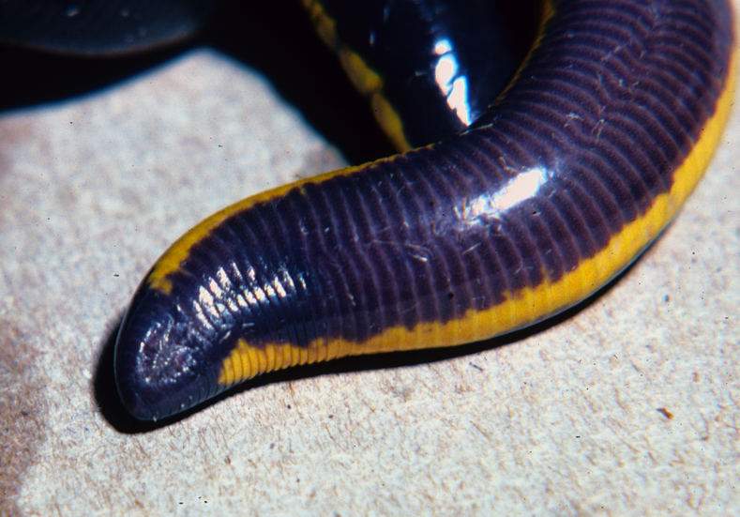
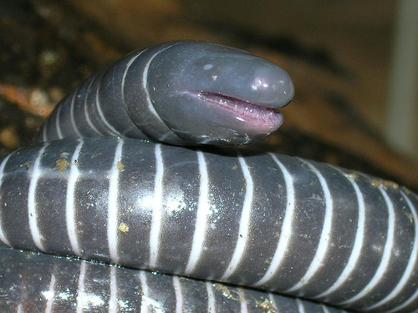
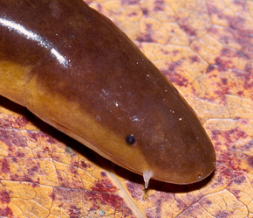
Gymnophiona Synapomorphies
Long annulated body – why?
Reduced/absent tail – define tail?
Limbless (no girdles)
Left lung reduced
Eyes reduced
Dermal scales
Phallodeum
Tentacle

Slide 4
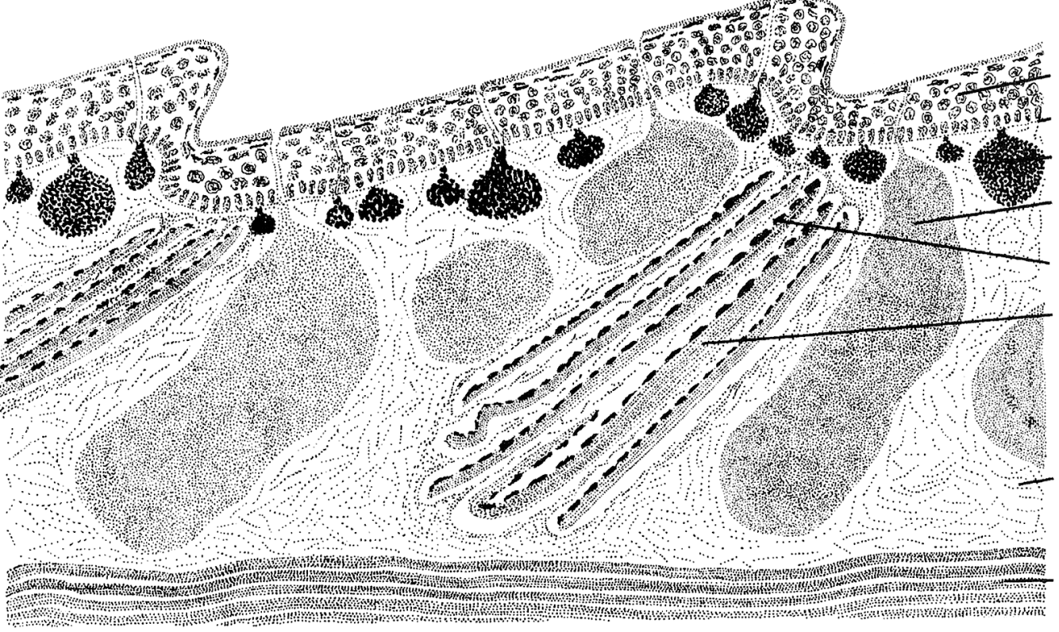
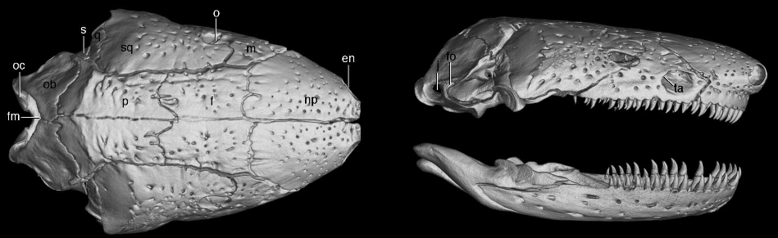
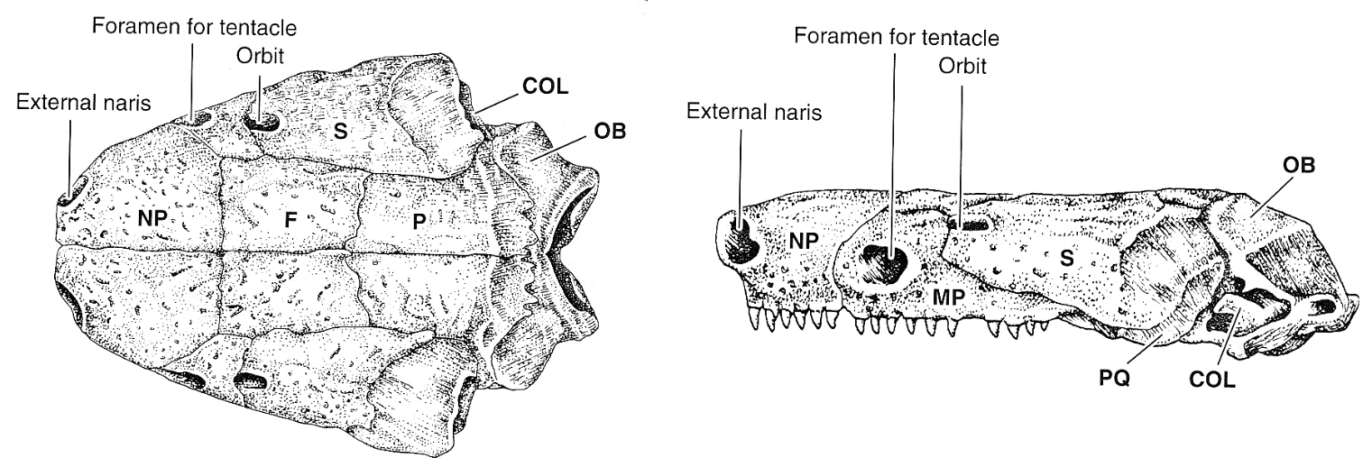
Caecilian
Traits
Skin, longitudinal section
Dermophis skull

Slide 5
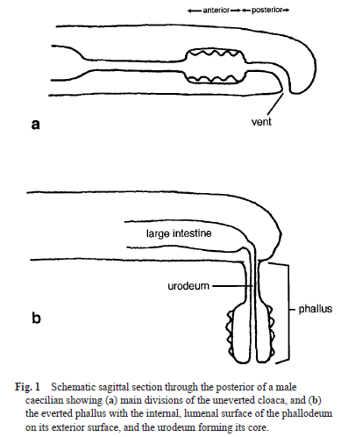
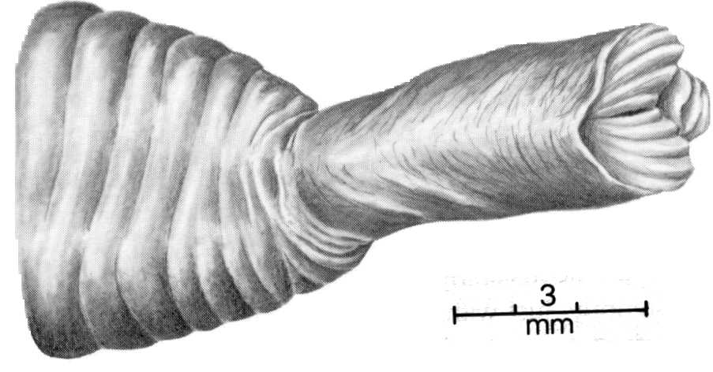
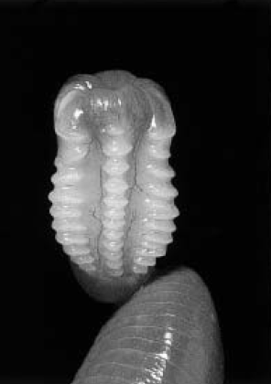
Phallodeum of a Geotrypetes seraphini
From: Gower and Wilkinson 2002.
(from Duellman & Trueb, 1986)
Notes:
Geotrypetes is found in western Africa

Slide 6
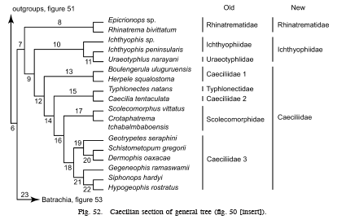
Caecilian Phylogeny
Family assignments based on genetic data
From: Frost et al. 2006. The Amphibian Tree of Life

Slide 7
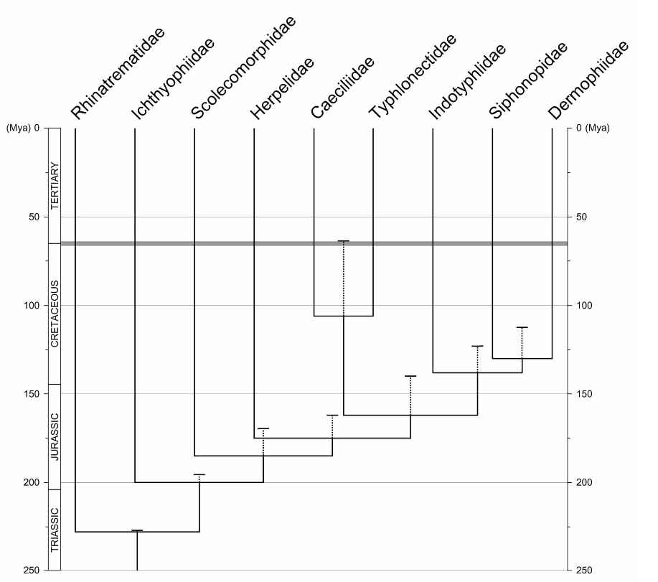
Caecilian Phylogeny
Family assignments based on genetic data
Wilkinson et al. 2011. Zootaxa

Slide 8
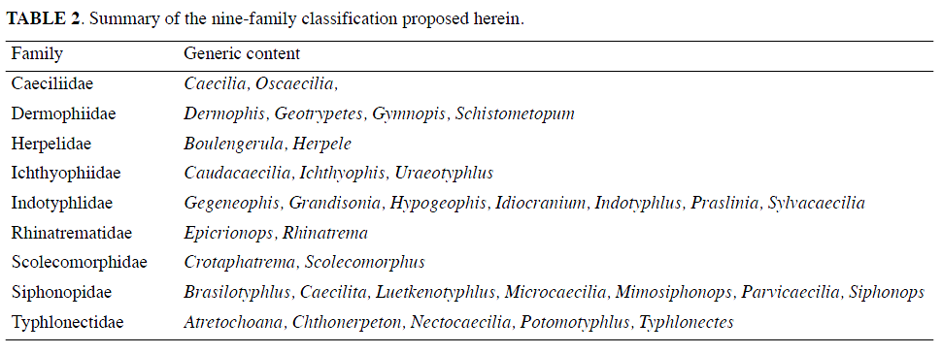
Summary of caecilian families and associated genera

Slide 9
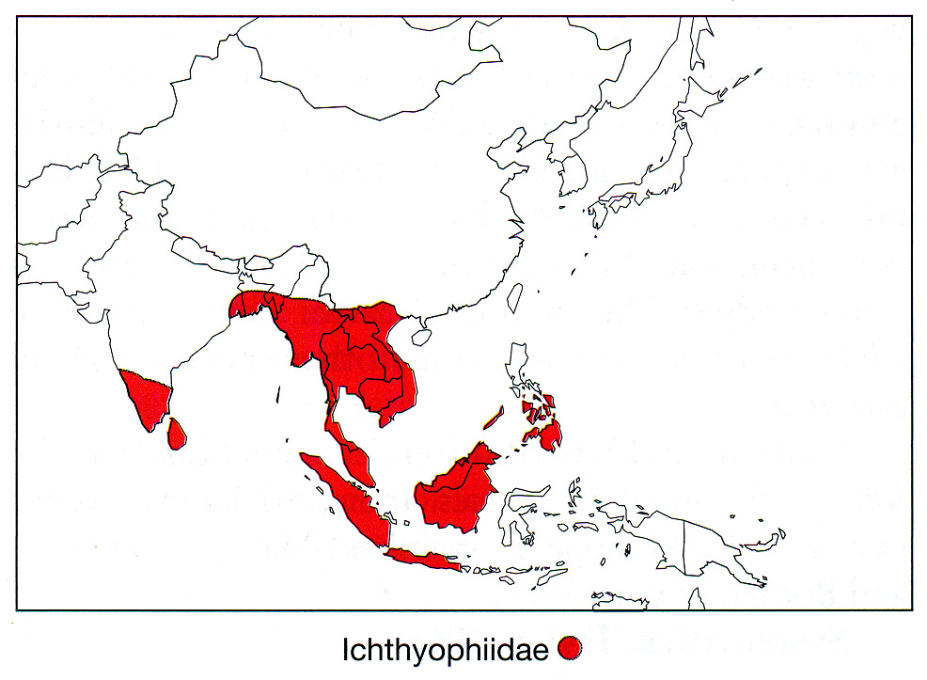
Distribution of Ichthyophiidae
(from Pough, et al., 2004)

Slide 10
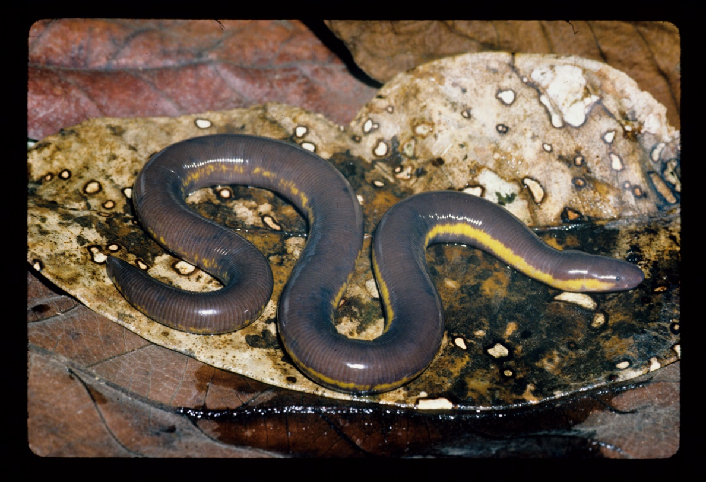
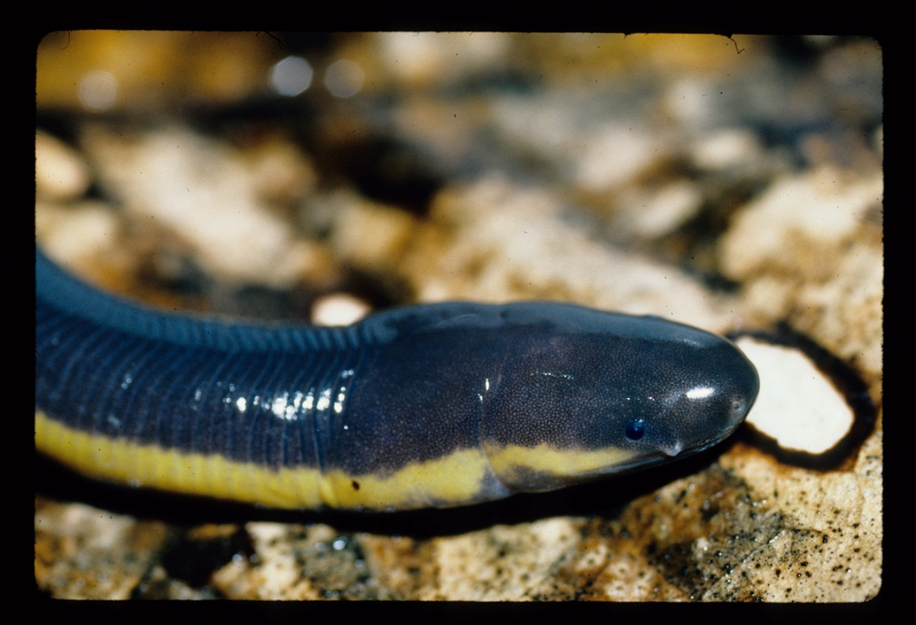
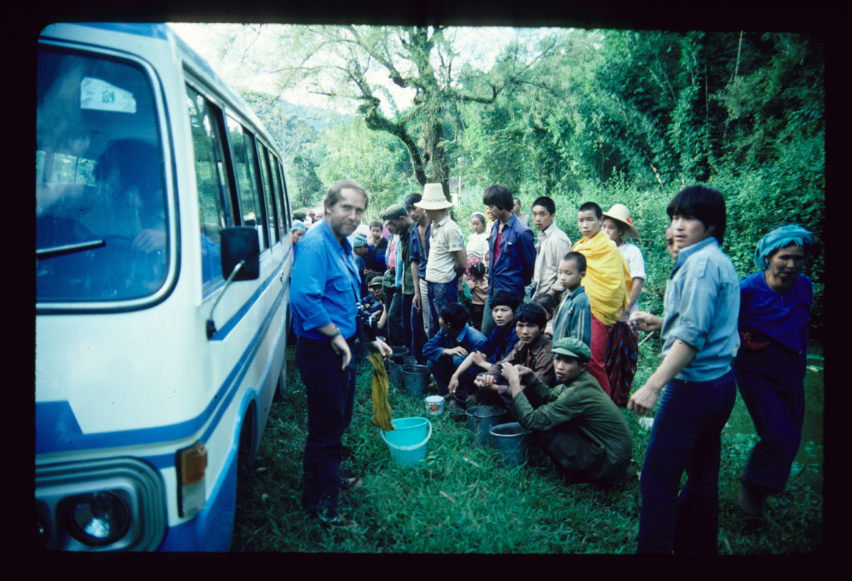
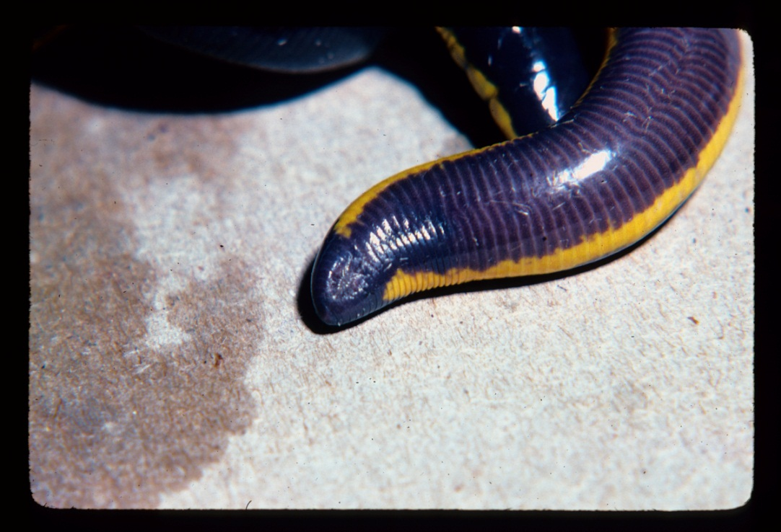
Ichthyophiidea
Ichthyophis bannanicus

Slide 11
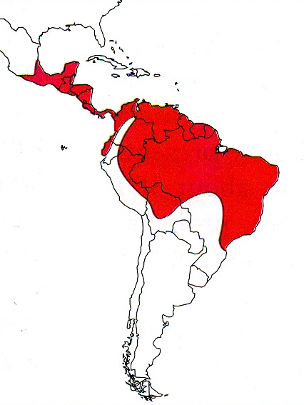
Distribution of Caeciliidae
(from Pough, et al., 2004)

Slide 12
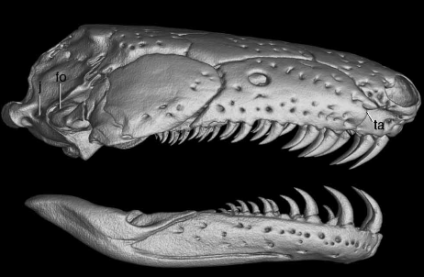
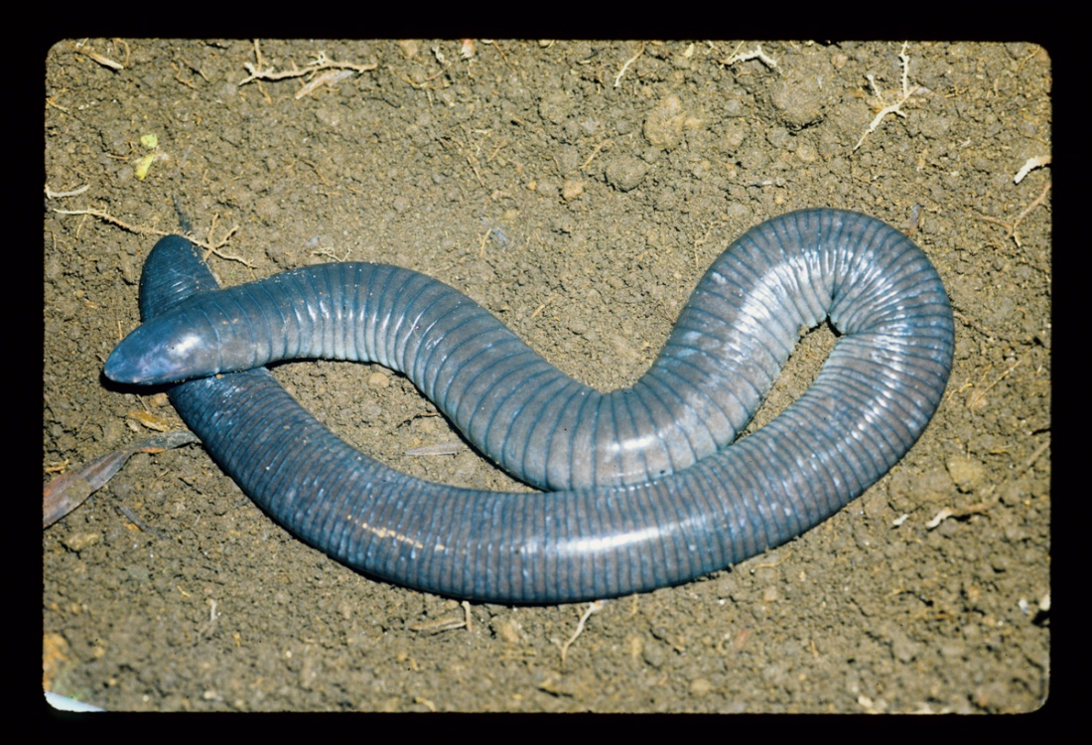
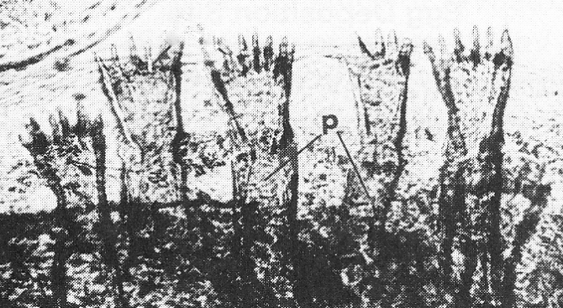
Caeciliidae
Dermophis mexicana
Fetal Teeth

Slide 13
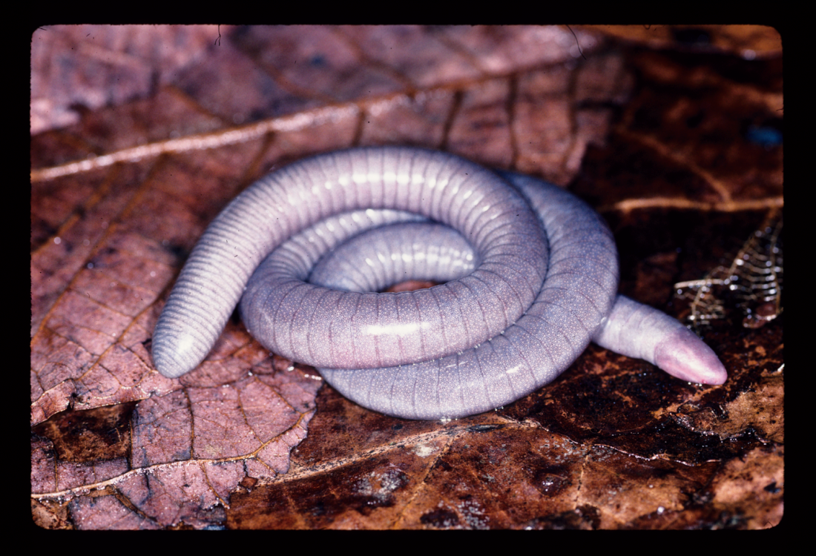
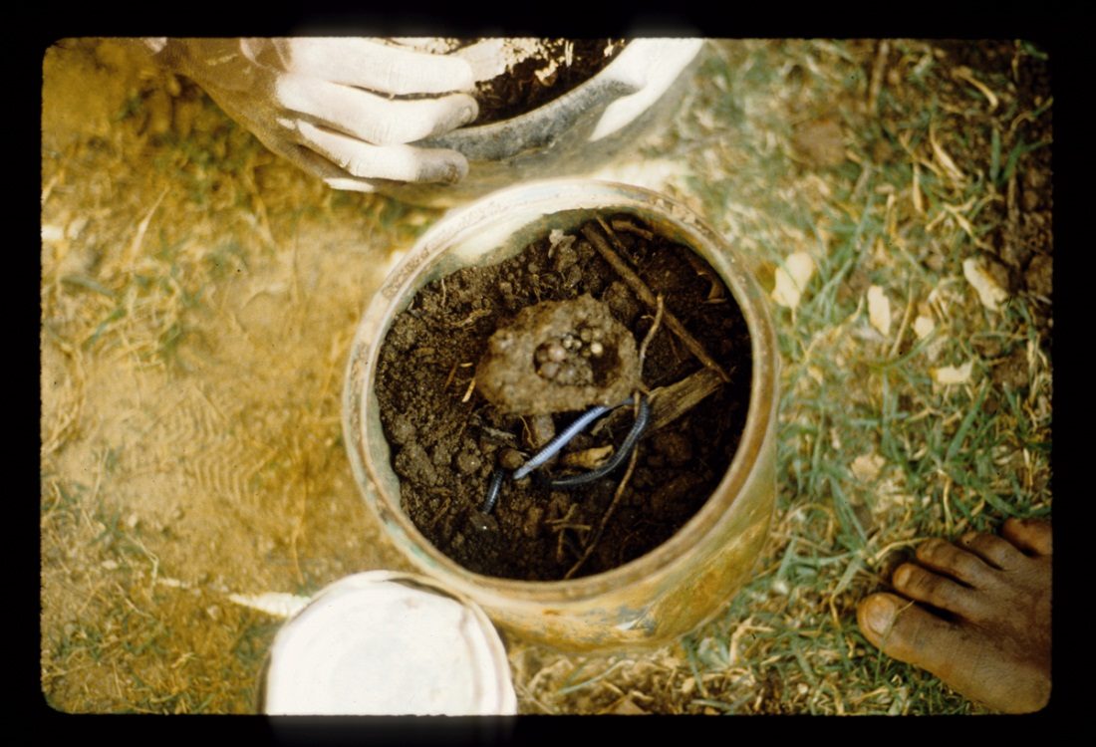
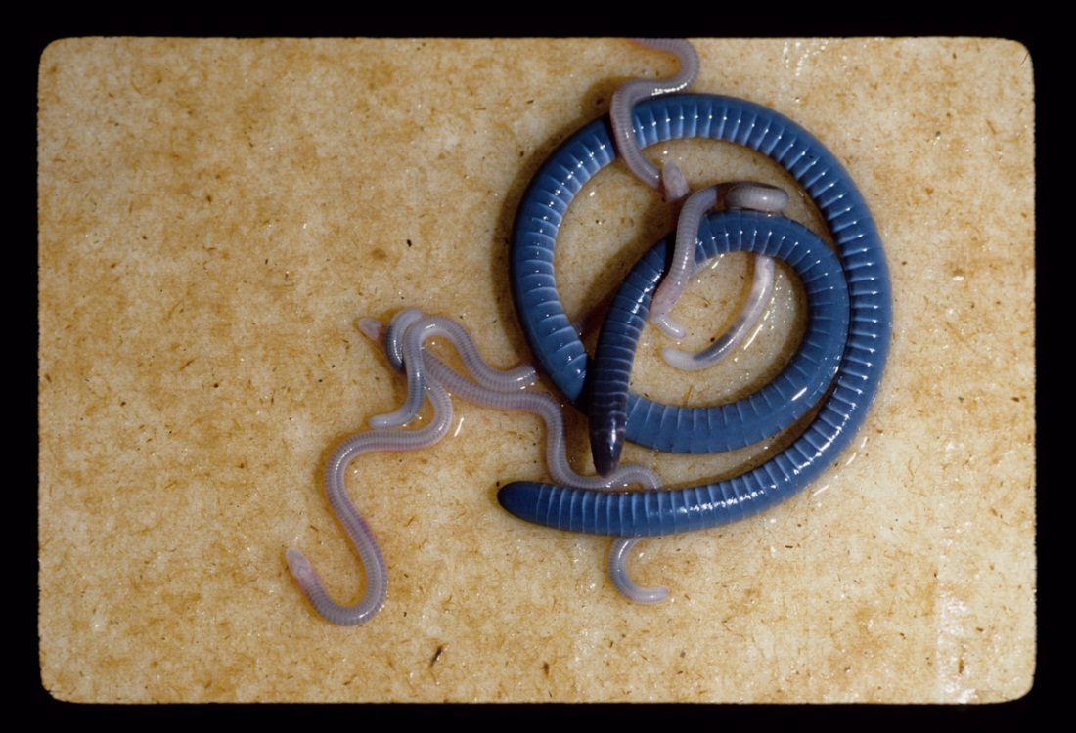
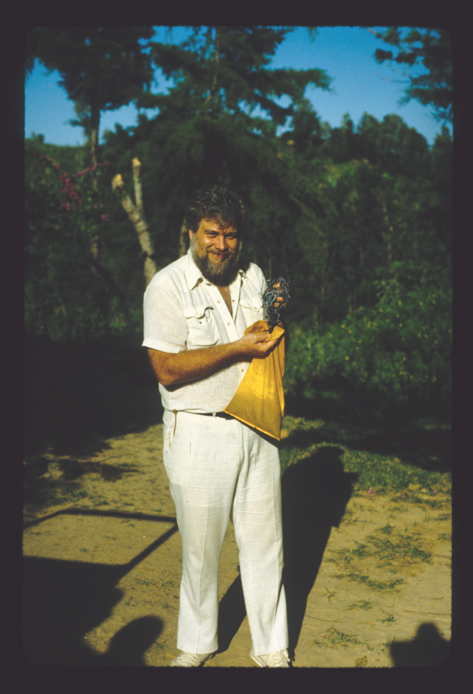
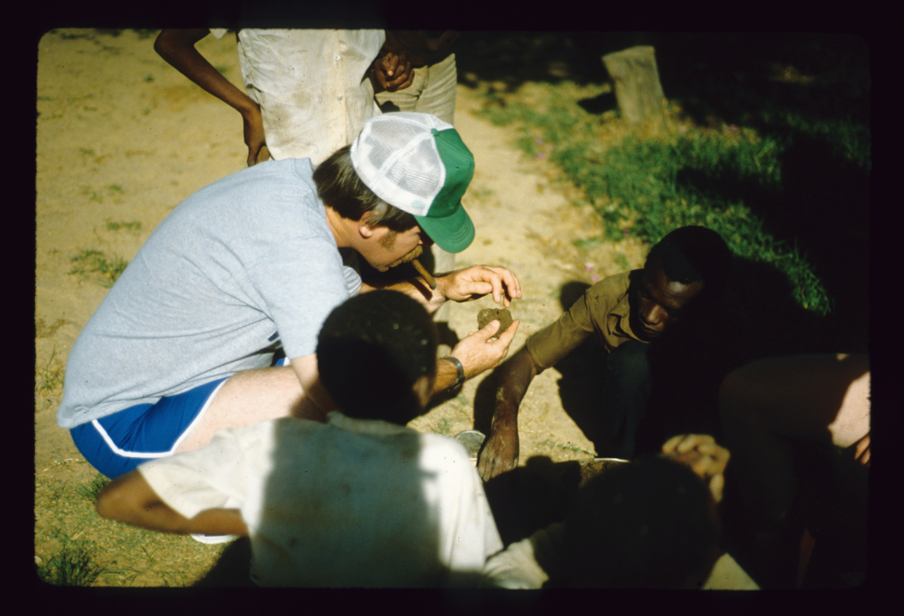
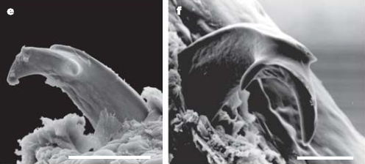
Herpelidae
http://www.youtube.com/watch?v=DMvL4zOLSeM
Kupfer et al. 2006. Nature
Boulengerula taitana
Herpele
Boulengerula boulengerula

Slide 14
Herpele

Slide 15
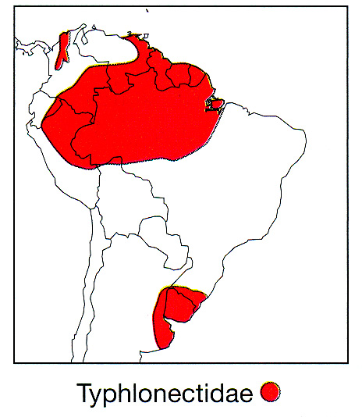
Typhlonectidae
(from Pough, et al., 2004)

Slide 16
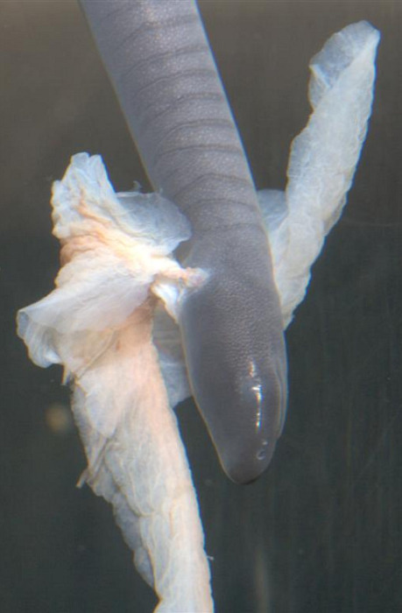
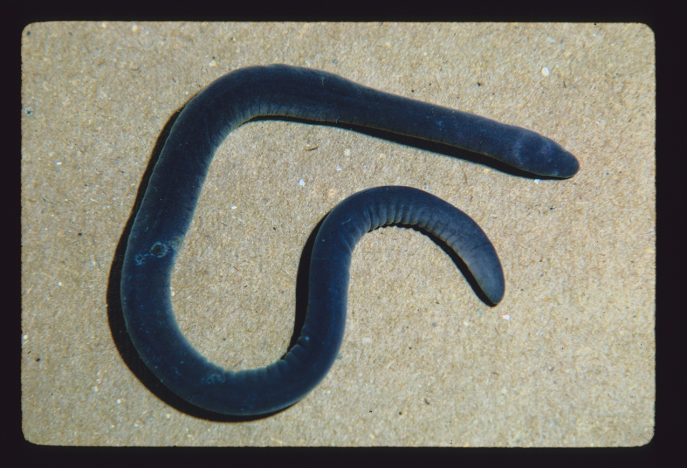
Typhlonectidae
http://www.youtube.com/watch?v=1lAfOTR9tY4
Typhlonectes compressicauda

Slide 17
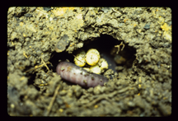
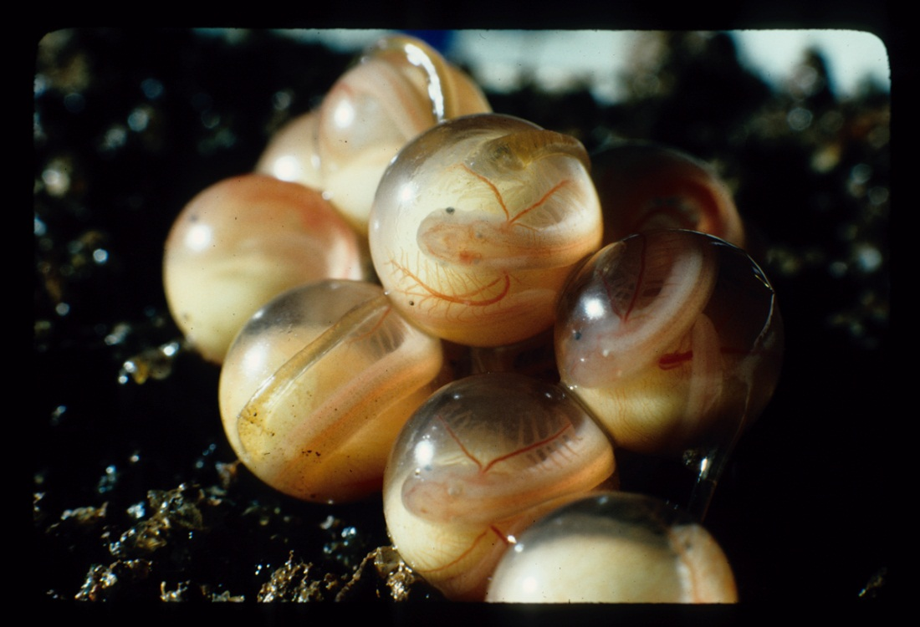
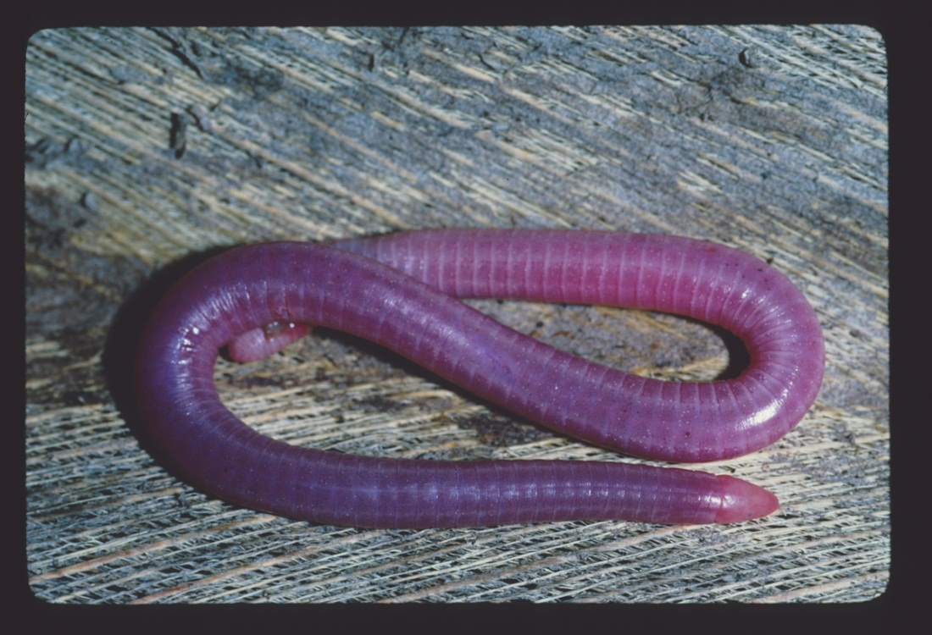
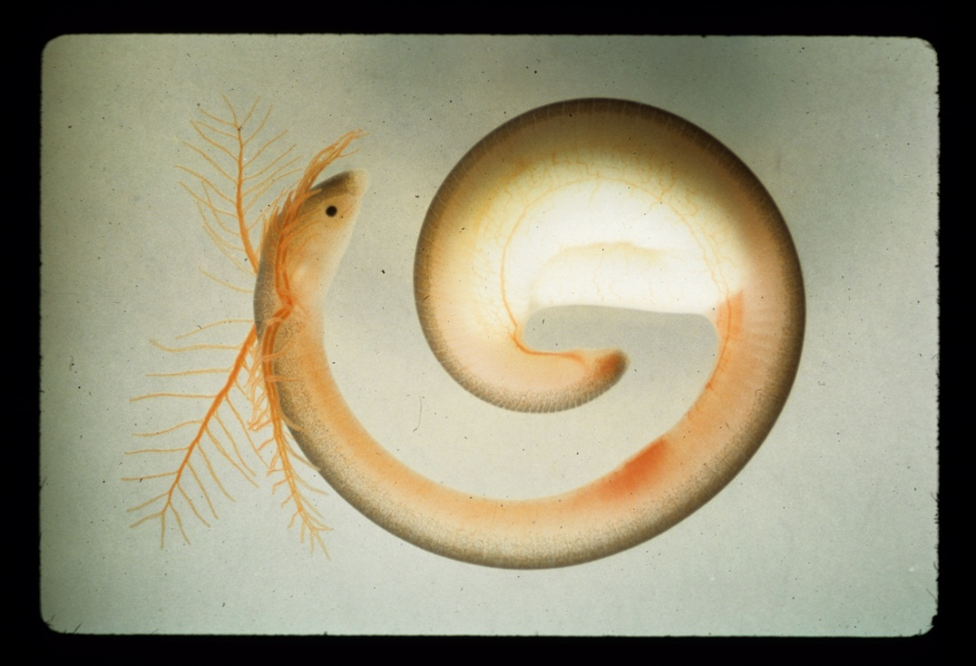
Indotyphlidae
Hypogeophis rostratus

Slide 18
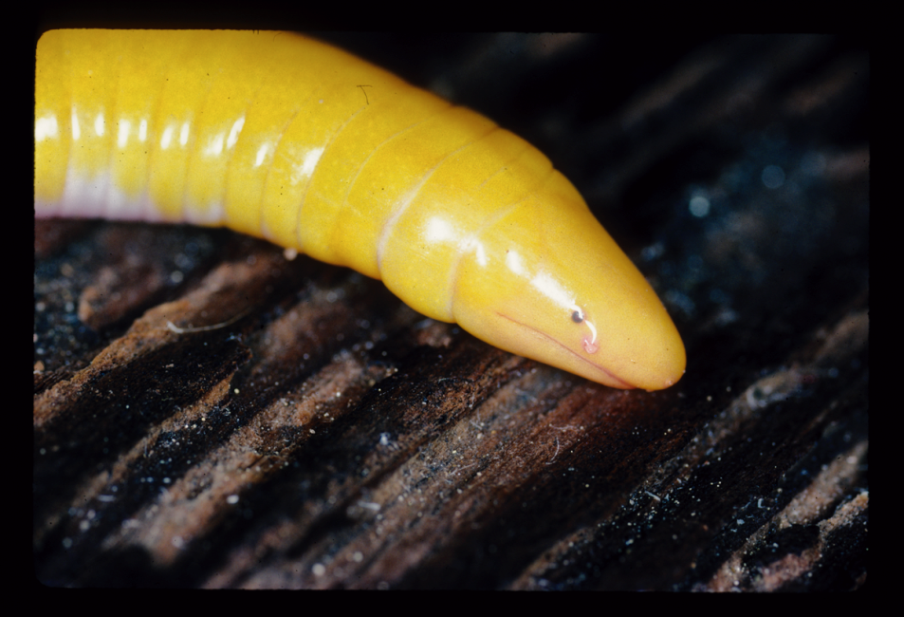
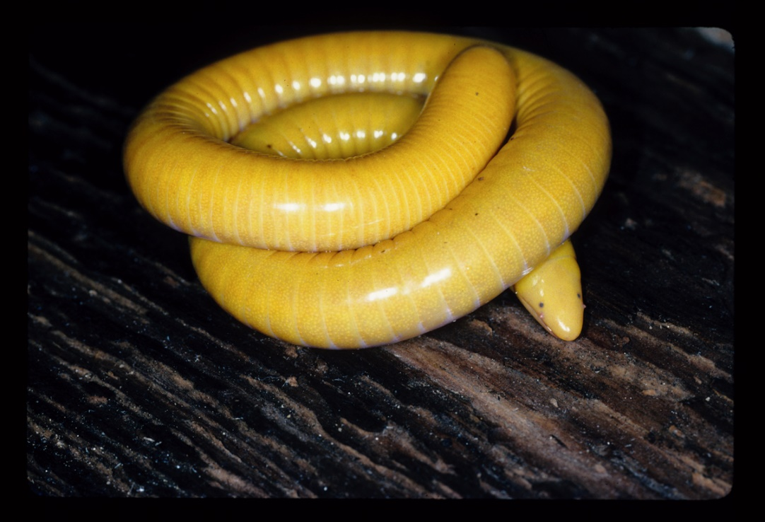
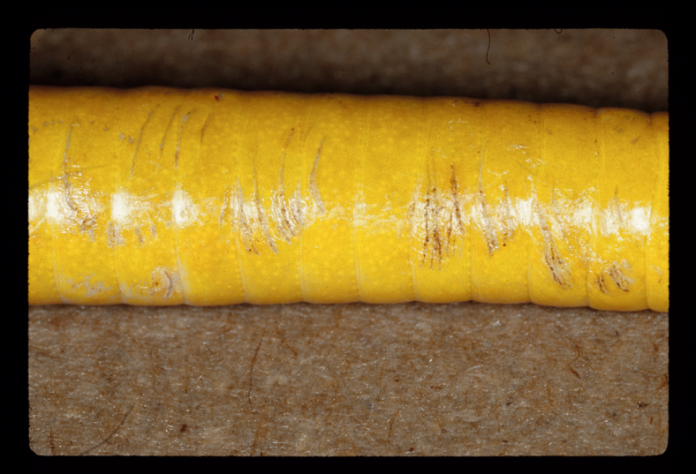
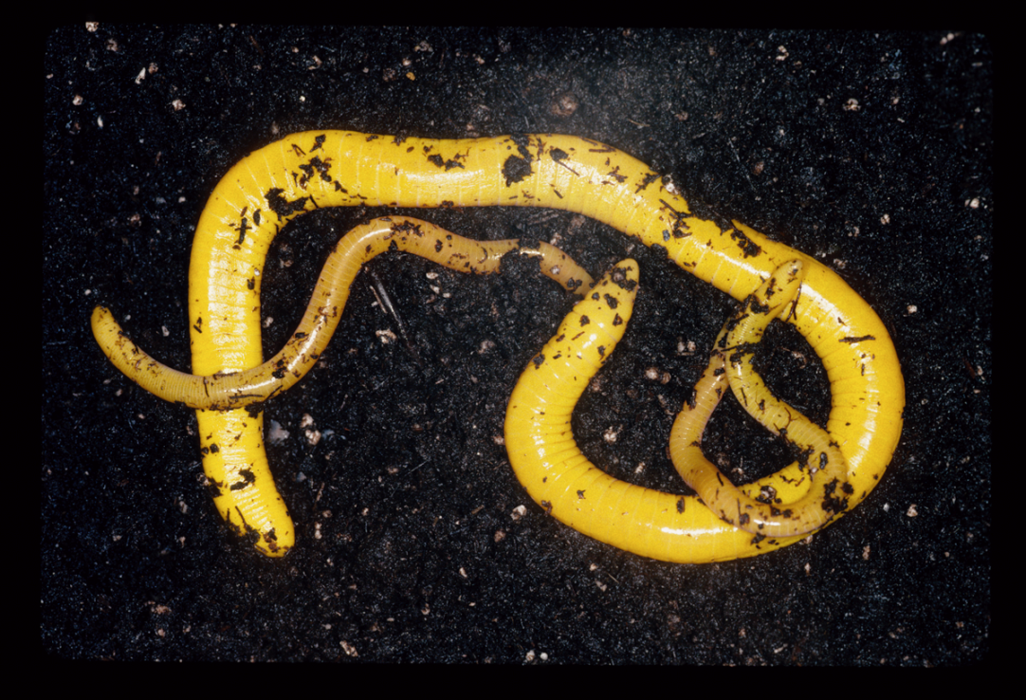
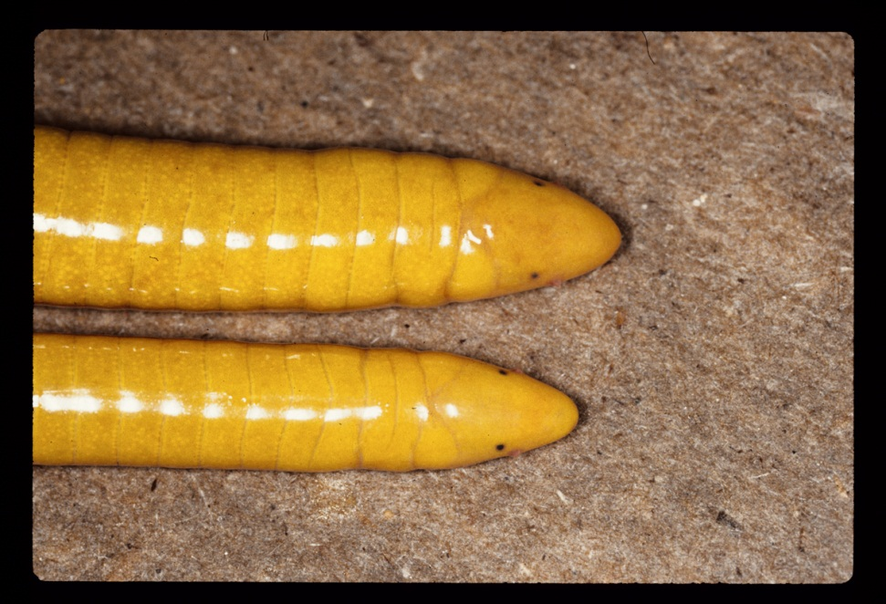
Dermophiidae
Shistometopum thomense
Male
Female

Slide 19
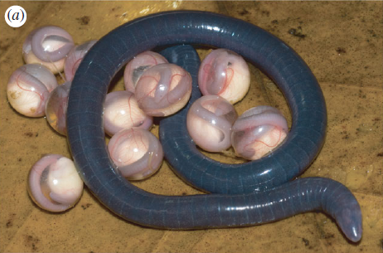
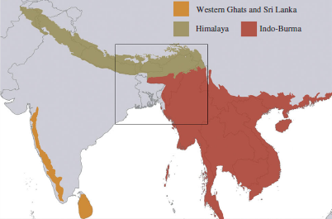
A new family of Caecilians from India
Chikilidae
Kamei et al. 2012. Proceedings of the Royal Society B

Slide 20
