Slide 1
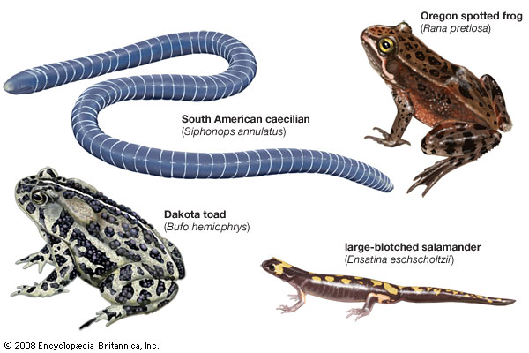
Monophyletic Amphibia
Three Orders of Living Amphibians

Slide 2
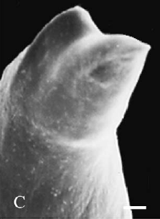
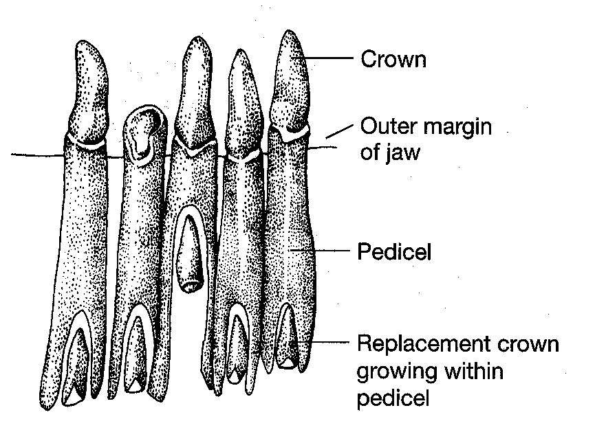
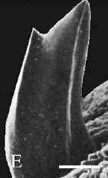
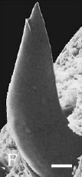
Lissamphibia Synapomorphies
1.
Teeth pedicellate and bicuspid

Slide 3
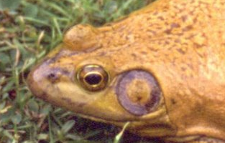
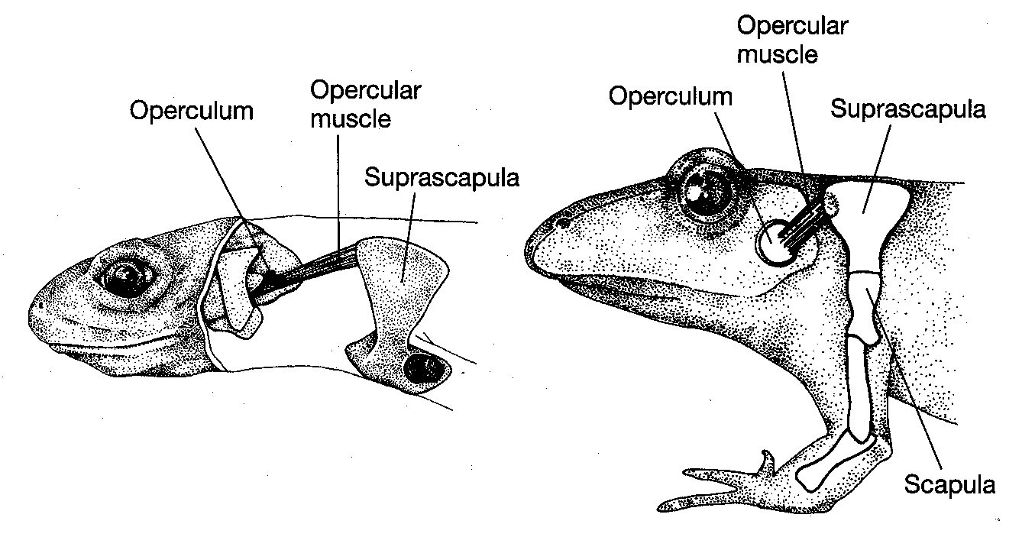
2.
Unique middle ear structure

Slide 4
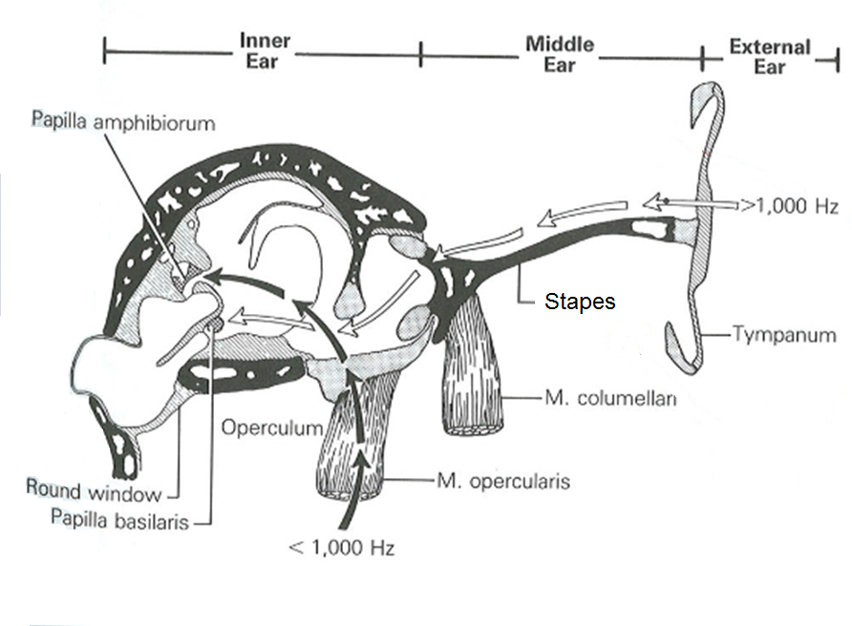

Slide 5
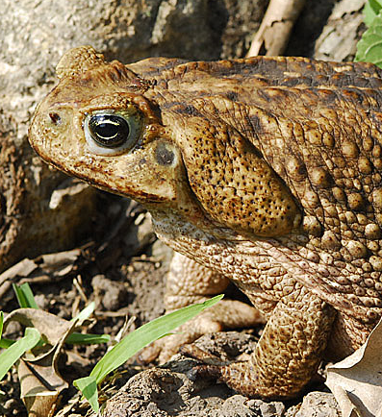
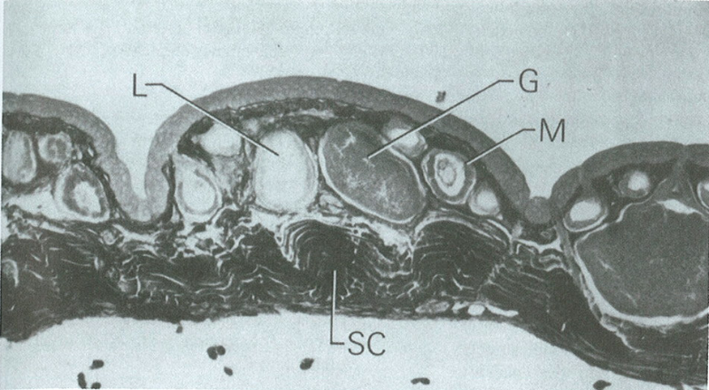
Lissamphibia Synapomorphies
3.
Fat bodies develop from germinal ridge (gonad cells)
4.
Two types of glands

Slide 6
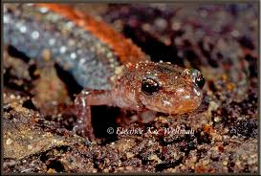
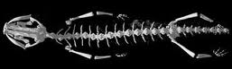
Lissamphibia Synapomorphies
5.
Green rods in the retina
6.
Levator bulbi muscle
7.
Unique respiration
8.
Short straight ribs

Slide 7
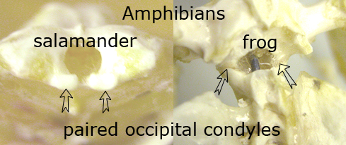
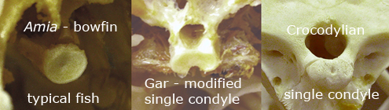
Lissamphibia Synapomorphies
9.
Two occipital condyles

Slide 8
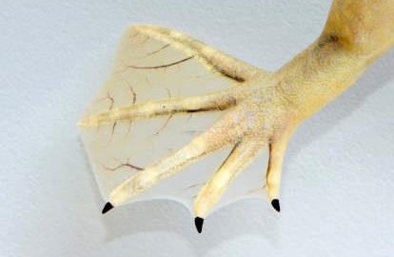
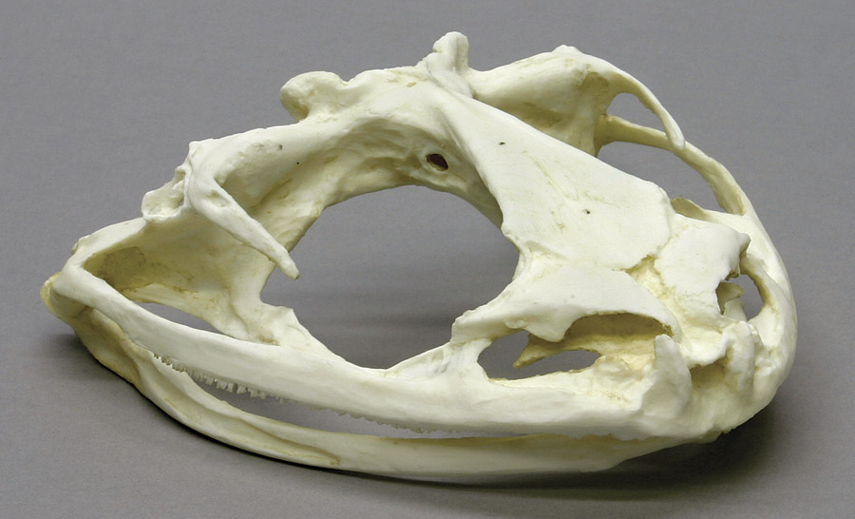
Lissamphibia Synapomorphies
10.
Reduction in skull bones
11.
No true nails or claws

