Slide 1
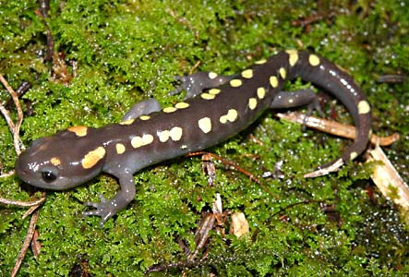
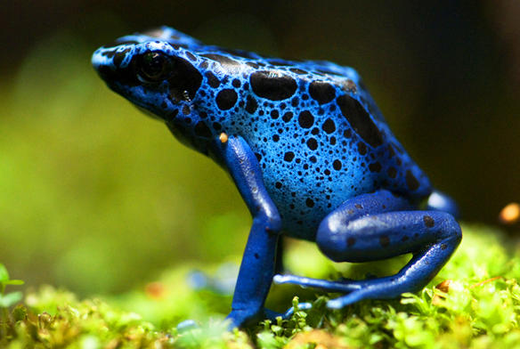
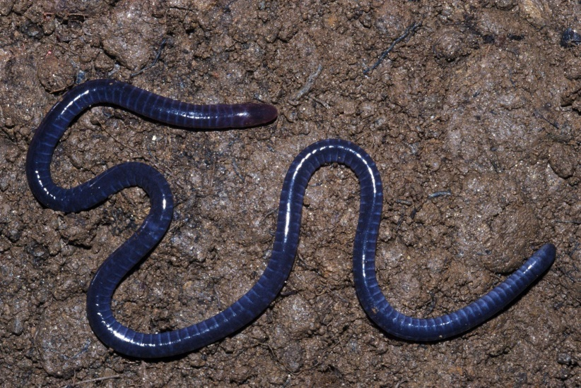
External Morphology of Amphibians and Reptiles

Slide 2
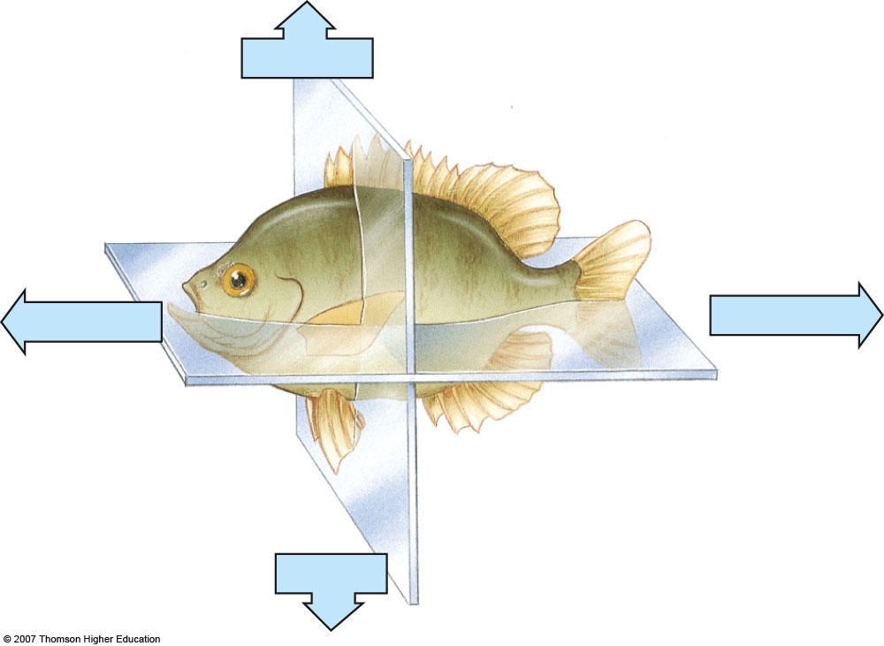
Bilateral symmetry (lateral view)
Notes:
Figure 29.3: Radial and bilateral symmetry.
(c, d) In bilateral symmetry, the head end of the animal is its anterior end, and the opposite end is its posterior end. The back of the animal is its dorsal surface, and the belly is its ventral surface. The diagrams also illustrate various ways the body can be sectioned (cut) to study its internal structure. A sagittal section (lengthwise vertical cut) divides the animal into right and left parts. A frontal, or longitudinal, cut (lengthwise horizontal) divides the body into dorsal and ventral parts. Sections are used in illustrations throughout this book to show the structure and arrangement of tissues and organs.

Slide 3
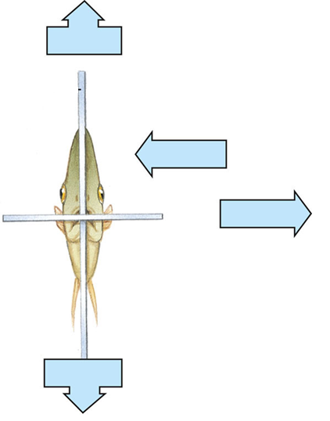
Bilateral symmetry
(front view)
Notes:
Figure 29.3: Radial and bilateral symmetry.
(c, d) In bilateral symmetry, the head end of the animal is its anterior end, and the opposite end is its posterior end. The back of the animal is its dorsal surface, and the belly is its ventral surface. The diagrams also illustrate various ways the body can be sectioned (cut) to study its internal structure. A sagittal section (lengthwise vertical cut) divides the animal into right and left parts. A frontal, or longitudinal, cut (lengthwise horizontal) divides the body into dorsal and ventral parts. Sections are used in illustrations throughout this book to show the structure and arrangement of tissues and organs.

Slide 4
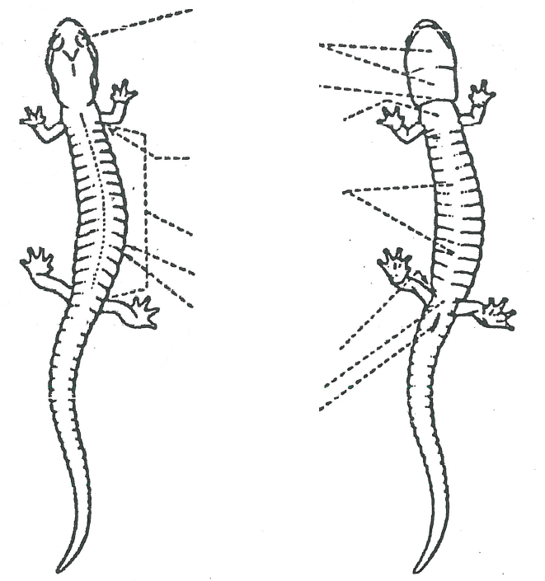
Dorsal
Ventral

Slide 5


Slide 6
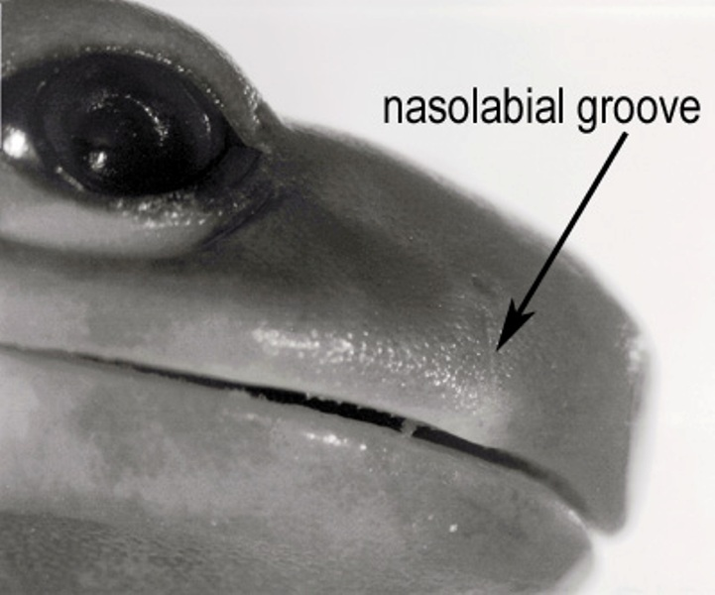

Slide 7
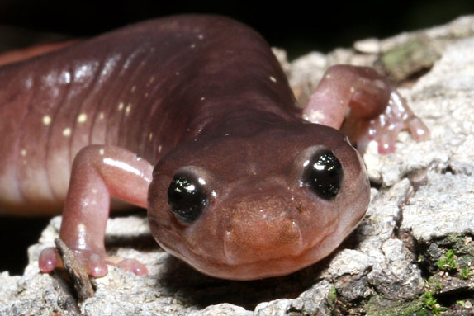

Slide 8
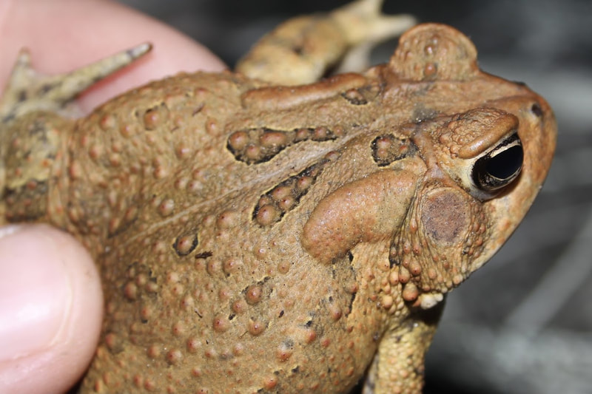

Slide 9
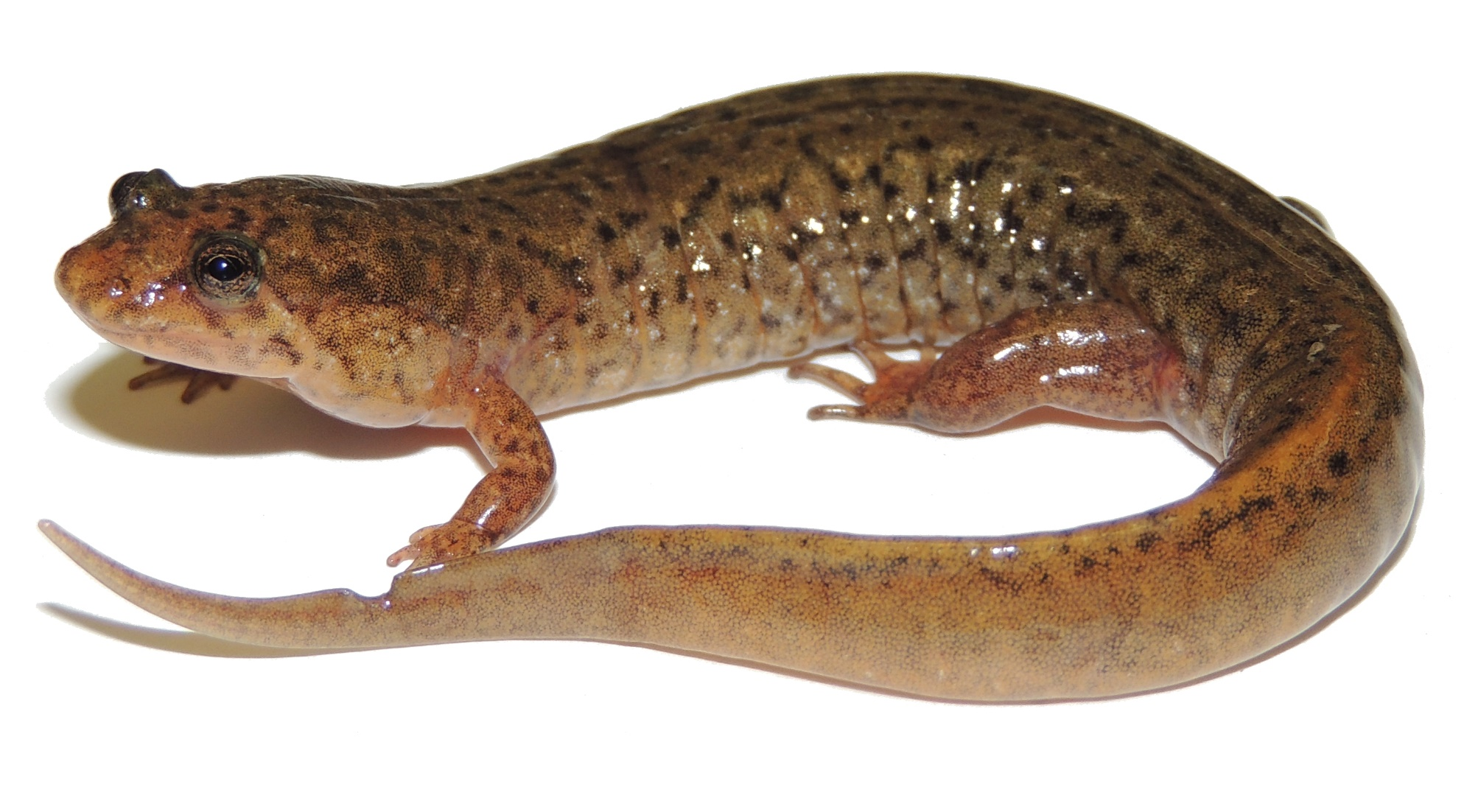

Slide 10
First Identification

Slide 11
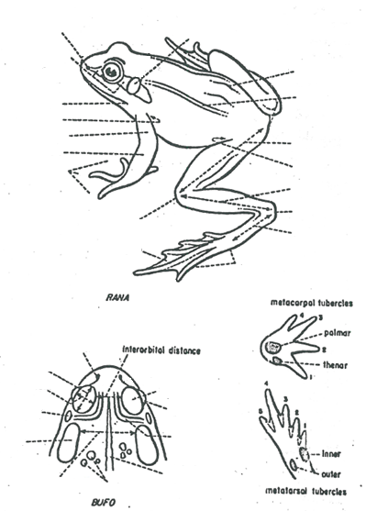
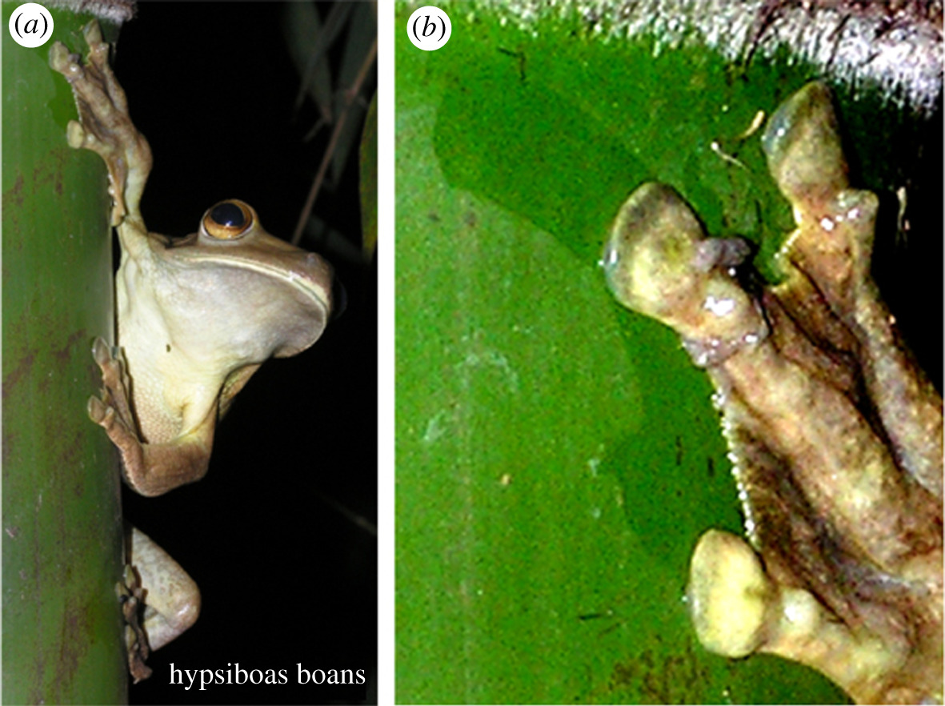

Slide 12
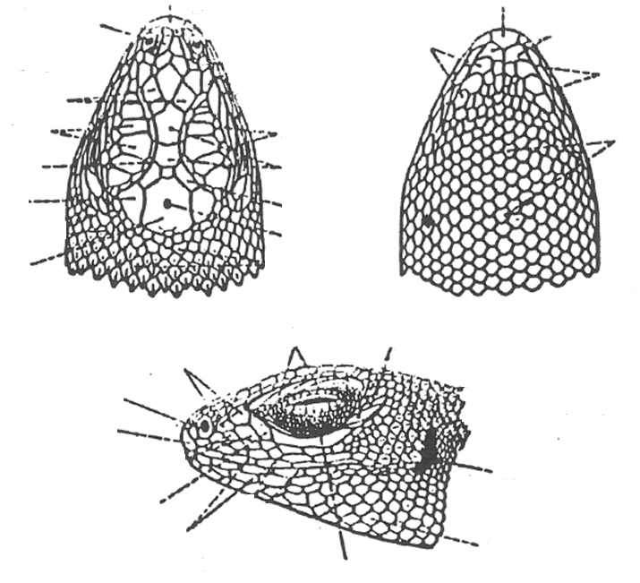

Slide 13
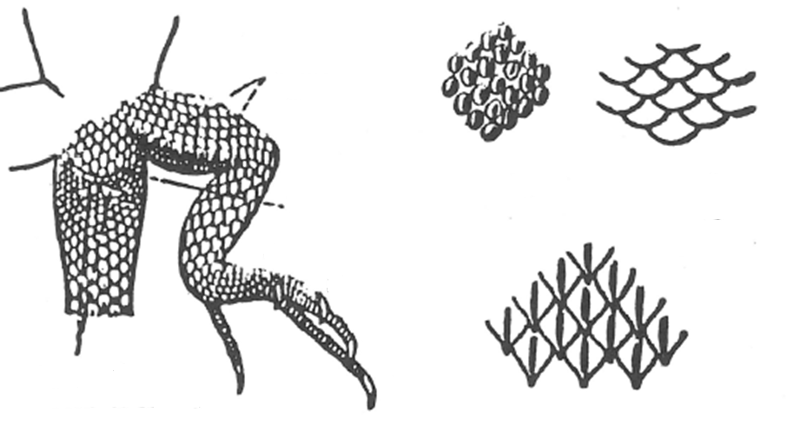

Slide 14
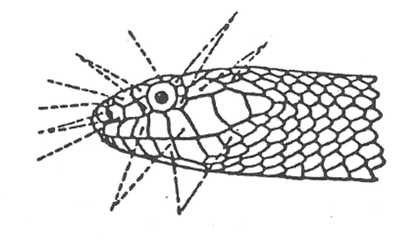
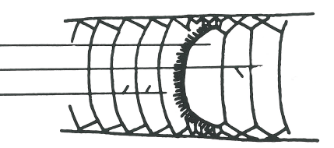
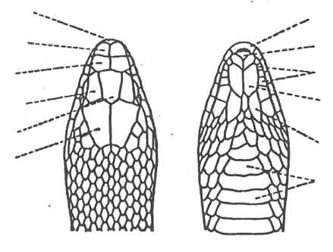

Slide 15
