Slide 1
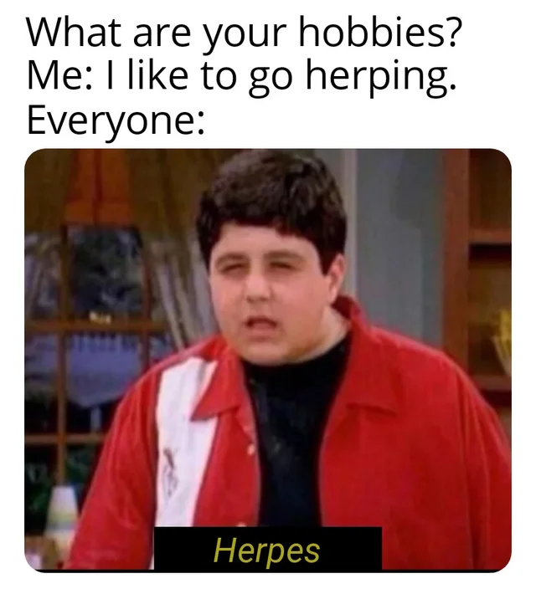

Welcome to
Herpetology
Bio227

Slide 2
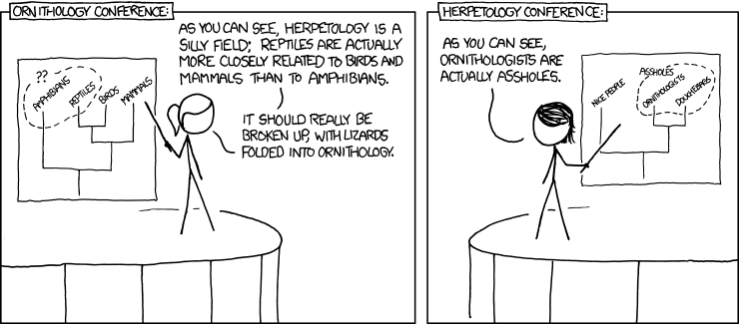

Slide 3
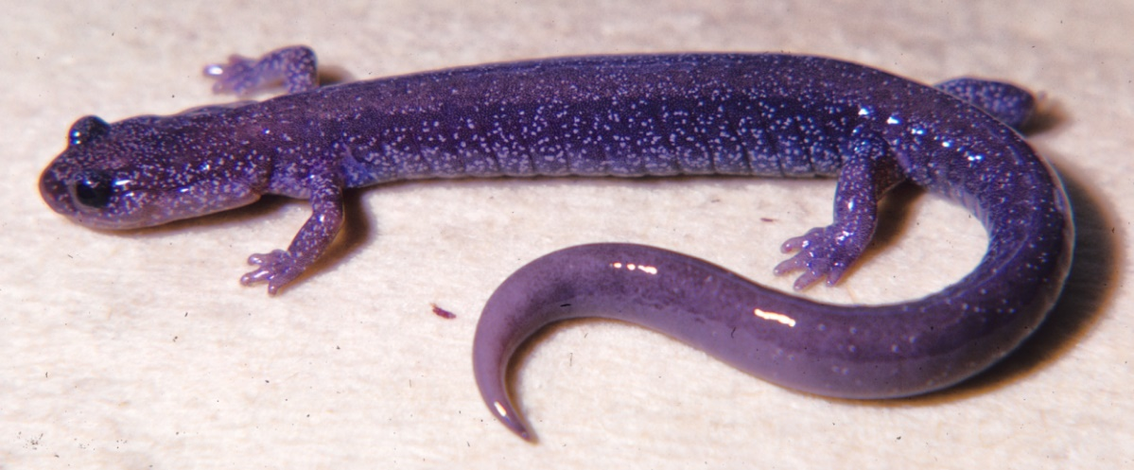
Background
Fishes
Amphibia
Roots of “Herpetology”
What major groups?
Classification review:
What domain?
What kingdom?
What phylum?
What classes?
Why?
Mammalia
Systematics:
Domain: Eukaryota
Kingdom: Animalia
Phylum: Chordata
Class: Amphibia
Order: Caudata
Family: Plethodontidae
Genus: Plethodon
Species: stormi
Aves
Reptilia

Slide 4
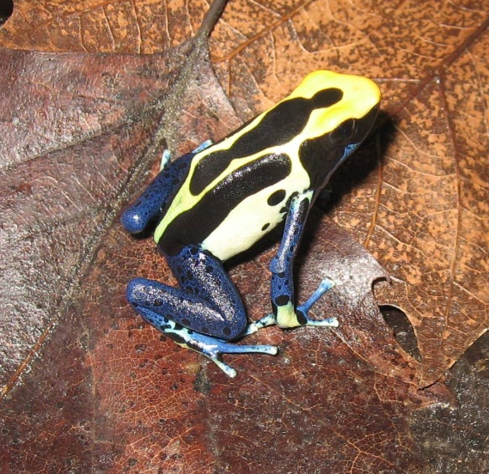
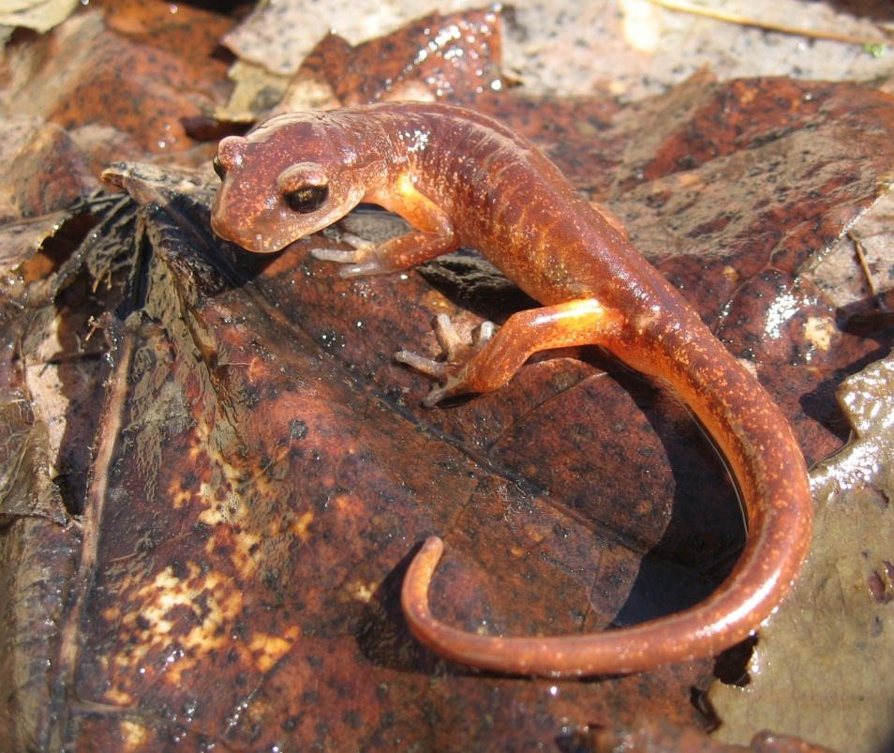
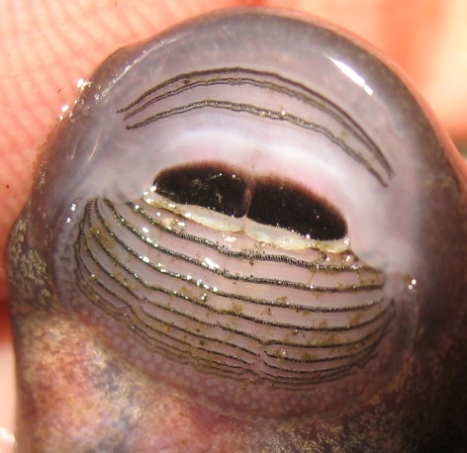
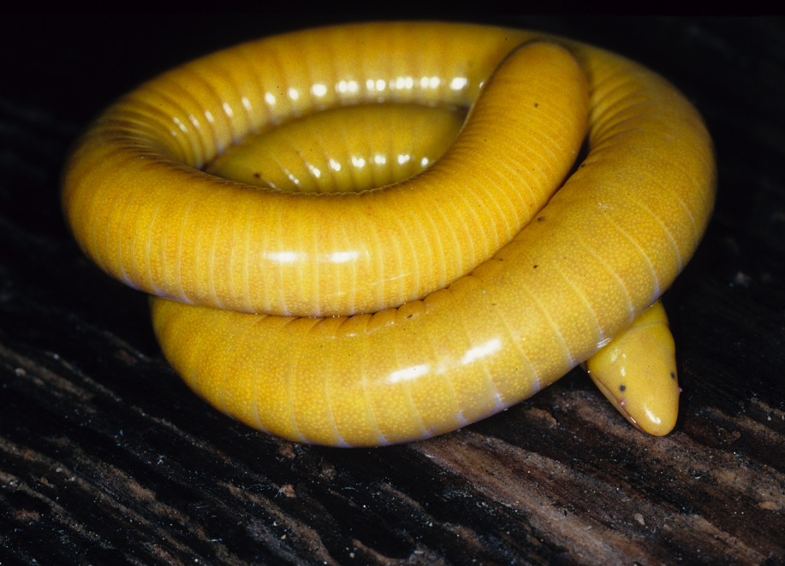
What will we cover?
Dendrobates
Ensatina
What is an amphibian?
Caecilian

Slide 5
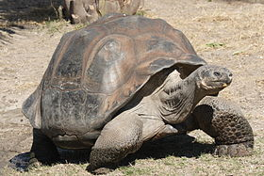
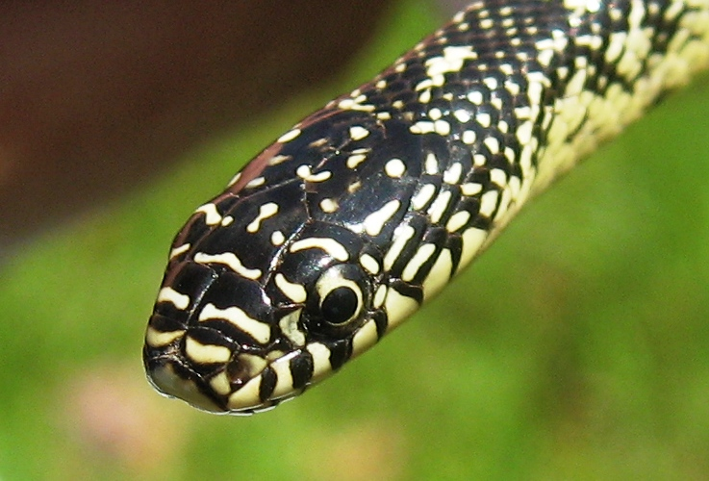
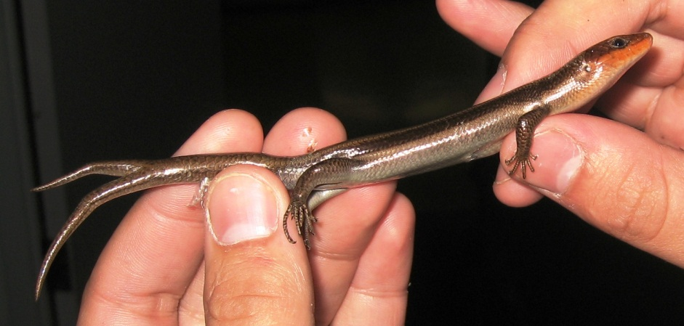
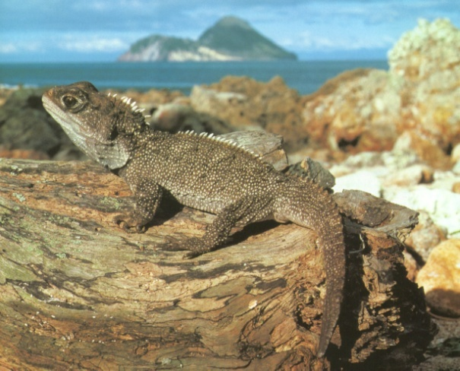
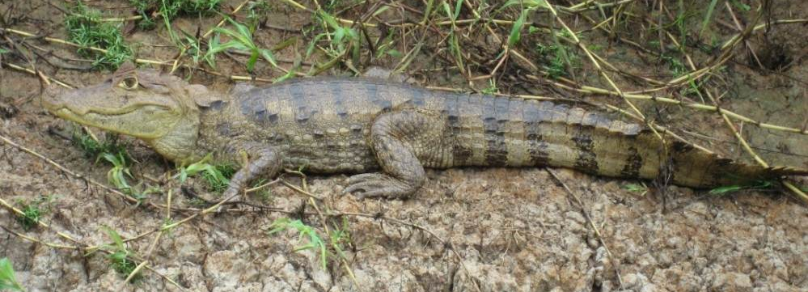
What will we cover?
Galapagos tortoise
What is a reptile?
Skink (Eumeces)
Kingsnake (Lampropeltis)
Tuatara (Spenodon)
Caiman

Slide 6
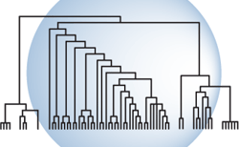
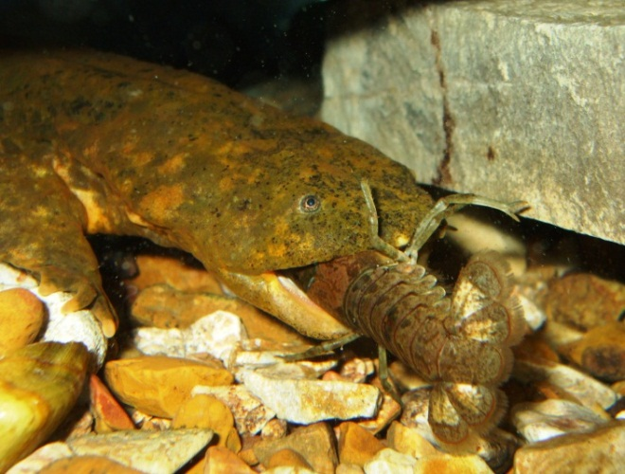
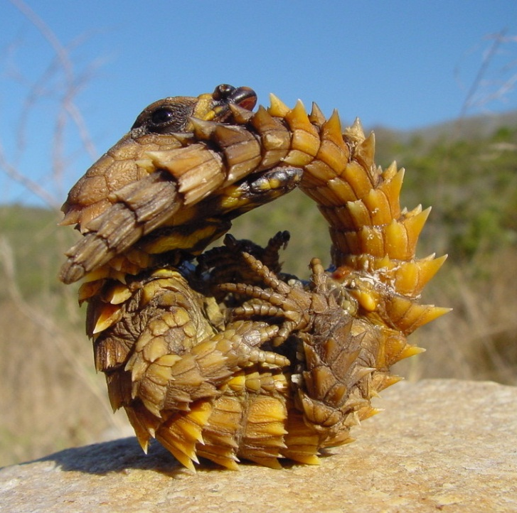
The study of amphibians and reptiles
  Evolution
  Systematics
  Morphology
  Physiology
  Antipredator Behavior
  Foraging
  Ecology
  Conservation
Cryptobranchus alleganiensis
Giant Girdled Lizard (Cordylas)
Notes:
What will we cover during this class?

Slide 7
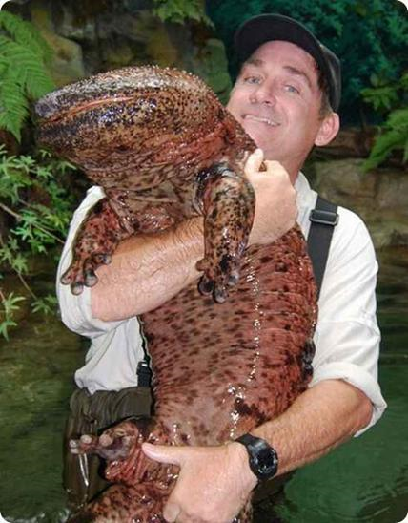
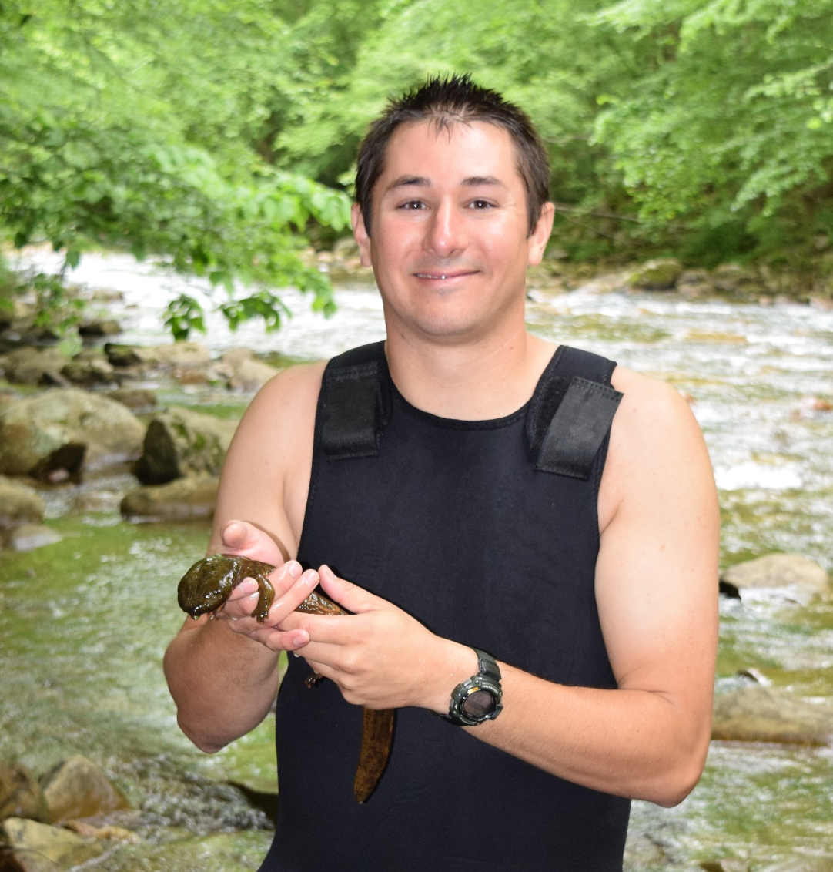
How do I use Herpetology?
Cryptobranchus alleganiensis
Andrias sp.

Slide 8
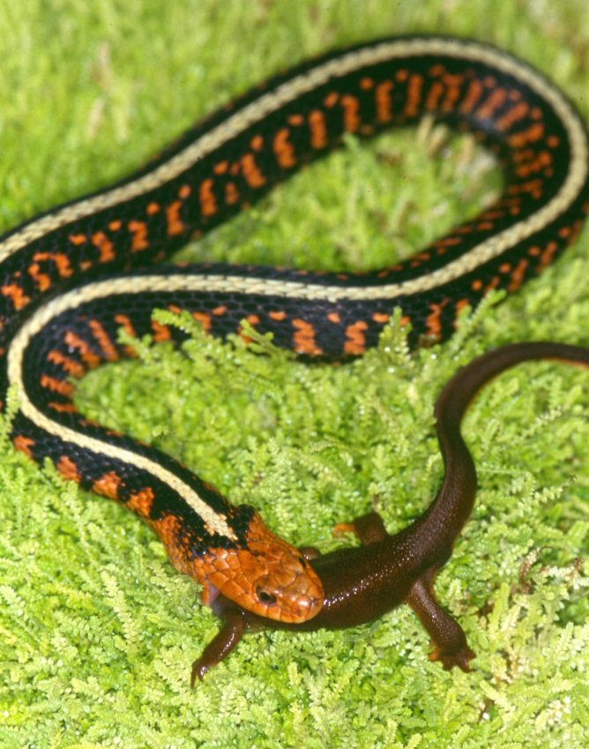
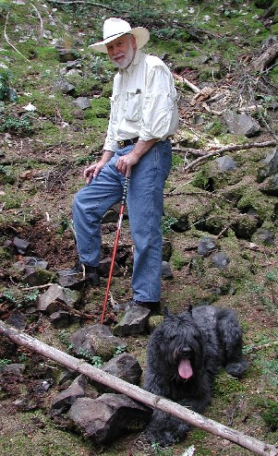
Evolution and Herpetology
Notes:
Would not say herpetology has a historically strong tradition here at USU
Over the past 20 years it has been growing tremendously (especially last 3 years)
We now have a group of people that are very strong in herpetology
Edmund D. Brodie Jr. – Prominent herp behavior and evolutionary biologist. Started the trend toward a strong herp representation at USU

Slide 9
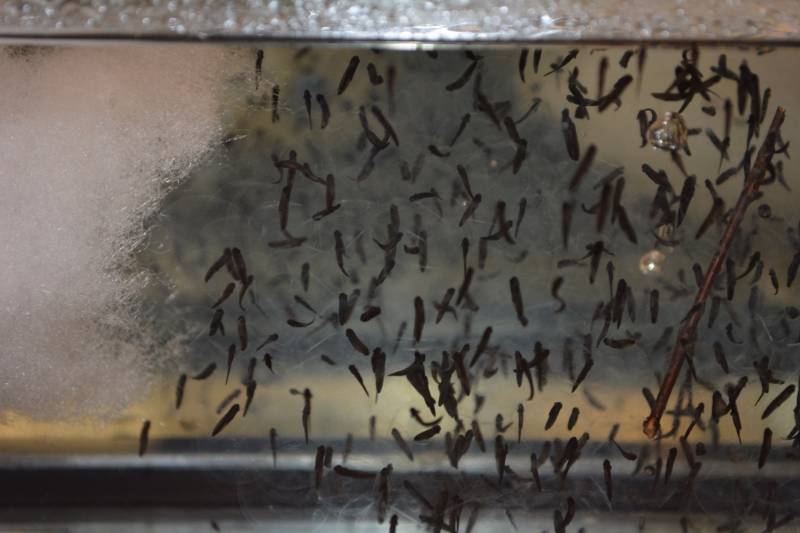
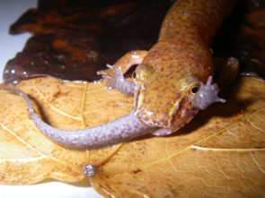
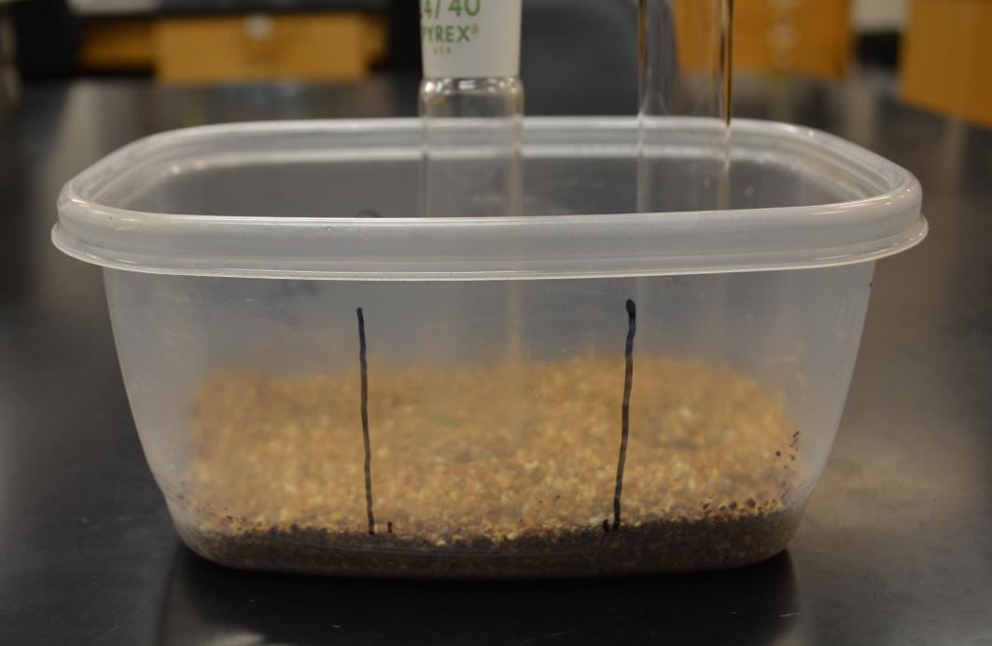
Behavior
Notes:
Would not say herpetology has a historically strong tradition here at USU
Over the past 20 years it has been growing tremendously (especially last 3 years)
We now have a group of people that are very strong in herpetology
Edmund D. Brodie Jr. – Prominent herp behavior and evolutionary biologist. Started the trend toward a strong herp representation at USU

Slide 10
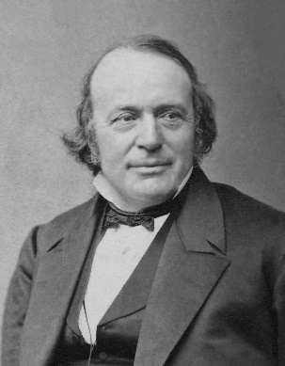
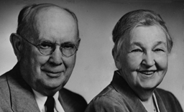
History of Herpetology
Oken & Wagler
Munich
Cuvier & von Humboldt
Paris
AGASSIZ
Harvard
JORDAN
Stanford
Whitman
Chicago
Wilder
Cornell
Grinnell
UC Berkeley
Myers
Stanford
REED
Cornell
Adams
Michigan
Ruthven
Michigan schools
GAGE
USNM
Cornell, Duke, Florida, Kansas,
Oklahoma & Tulane schools
Albert & Anna WRIGHT
BISHOP
Rochester
GORDON
Oregon State
HECHT
CUNY
LIU
China
SCHMIDT
Chicago
COWLES
UCLA
HAMILTON
Cornell
STORM
Oregon State
STEWART
SUNY-Albany
Arizona, Cornell
& UC Berkeley
BARBOUR
Kentucky
Michigan, Mississippi State,
Utah State
Notes:
Herpetology History
Agassiz: Considered the father of American herpetology
Born in Switzerland and got his degrees in Europe
studied briefly under Georges Cuvier
published many books, fossil fishes, prehistoric ice age, book with all genera and subgenera of animals (including herps)
bankrupt from all the publishing so left Europe and went to America to give lectures.
resulted in professorship role at Harvard – stayed here rest of career
co-founded US National Academy of Sciences
rejected evolution and believed in special creation – this led to him being lost much respect in academia and ultimately became isolated, even at Harvard.
Massive work, Contributions to the Natural History of the United States of America had huge sections on herps, especially turtles
Wrights – general naturalists, worked at cornell
published Life-Histories of the anura of new york, Synopsis and description of north american tadpoles, and life-histories of the frogs of okefinokee swamp, georgia
12,000 photos of reptiles and amphibians
most important contribution however was in mentoring students.

Slide 11
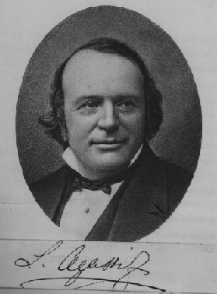
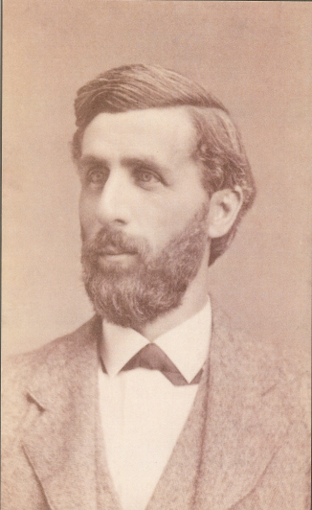
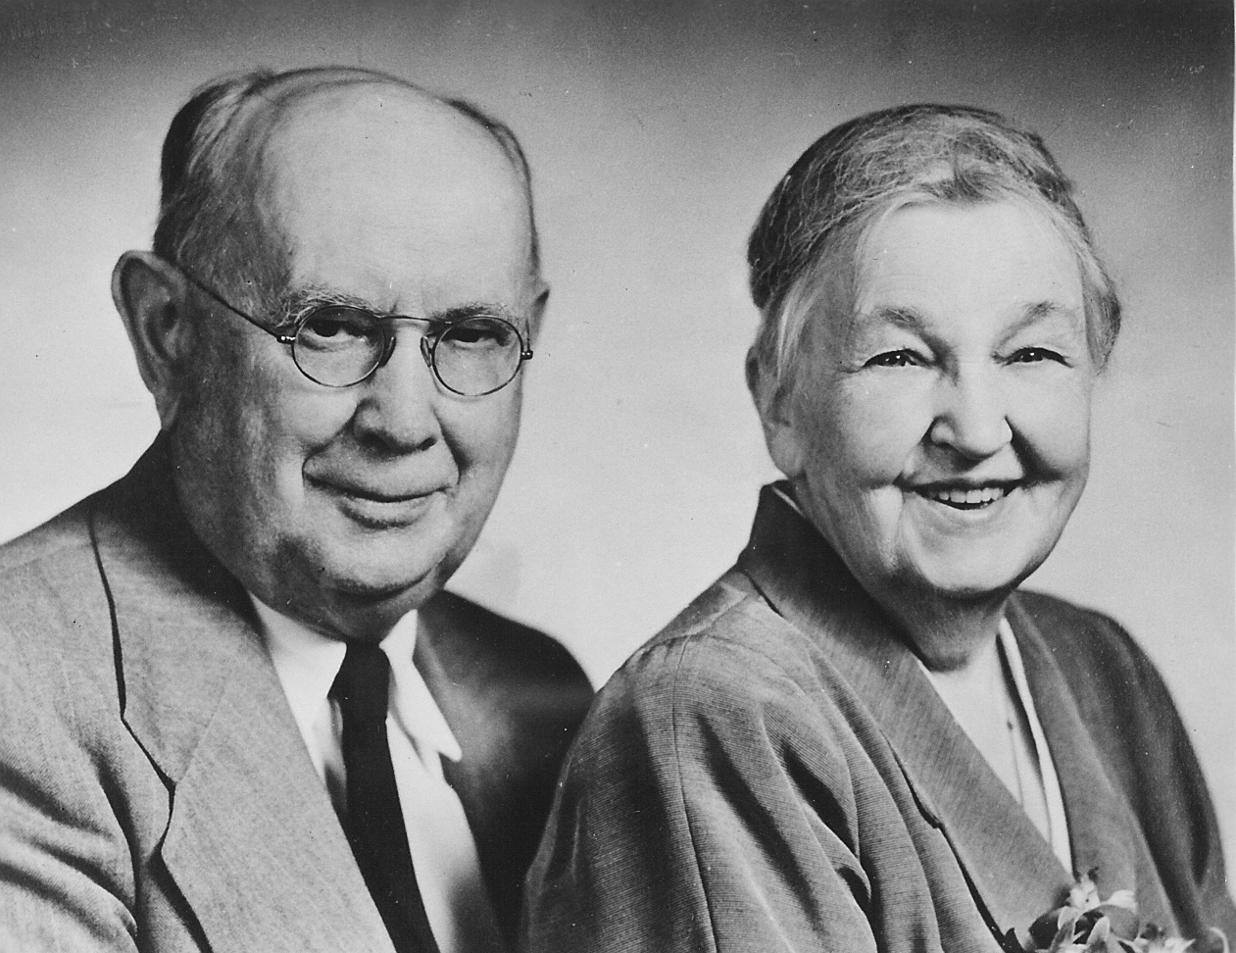
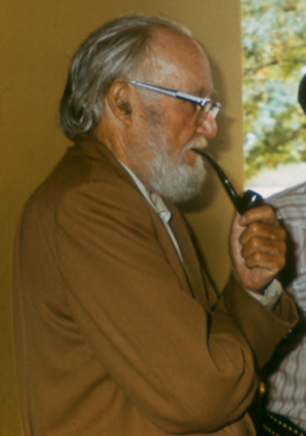
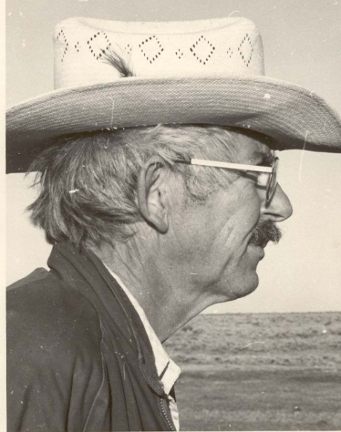
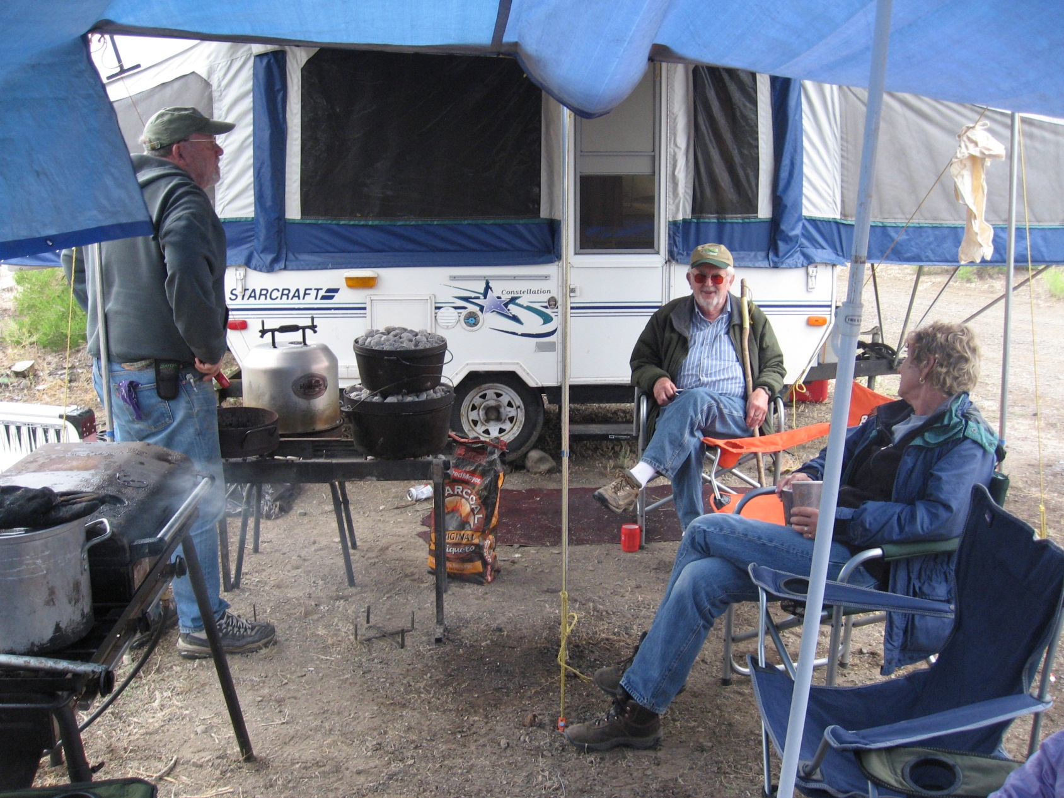
ACADEMIC LINEAGE
L. Agassiz
1807-1873
Burt G. Wilder
1841-1925
Albert H. Wright
1879-1970
Kenneth L. Gordon
Robert M. Storm
1918 - 2017
Notes:
Contribution:
E. D. Brodie Jr.
Over 175 publications on reptiles and amphibians from all over the world
Author of 5 books, including: Reptiles of North America with Hobart Smith; Amphibians and reptiles of the pacific northwest; venomous animals; biology of pitvipers; and Venomous animals
Extensive contributions to understanding evolution through the arms-race between newts and snakes

Slide 12
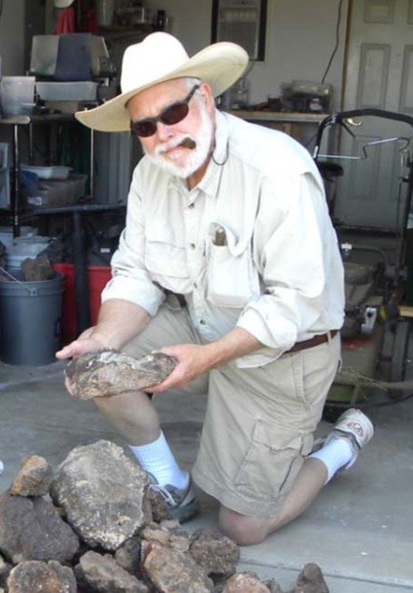
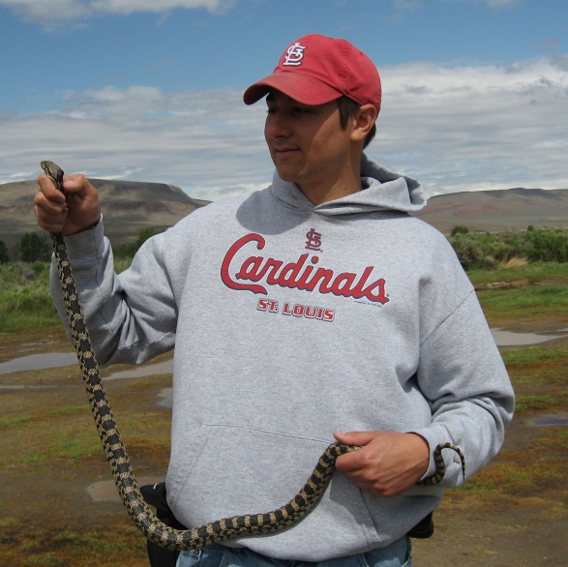
E. D. Brodie, Jr.
1941 -
Brian G. Gall

Slide 13
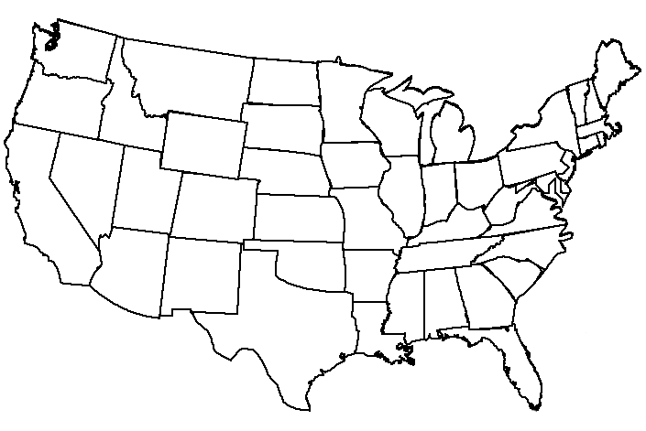
Distribution of STORM students and their students
HAWAII
TIAWAN
U.K.
AUSTRALIA
Notes:
Map of the current locations of all of storm’s students + their students that work at the college level
I received a job offer at a small school in southern Indiana and am the first in the lineage to work in that state

