Slide 1
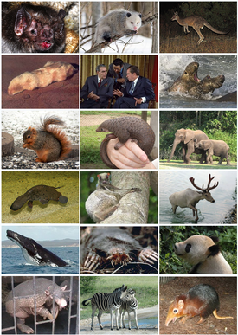
What are you?
What does that mean?

Slide 2
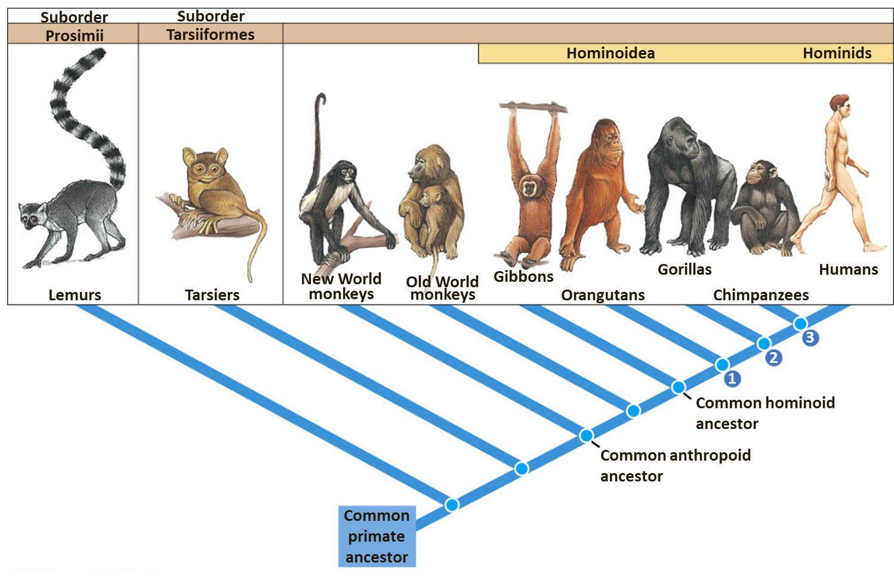
Notes:
Figure 22.2: Primate evolution.
This branching diagram, called a cladogram, shows evolutionary relationships among living primates, based on current scientific evidence. The nodes (circles) represent branch points where a species splits into two or more lineages. ●1 The divergence of orangutans from the ape/hominid line occurred some 12 mya to 16 mya. ●2 Gorillas separated from the chimpanzee/hominid line an estimated 8 mya, and ●3 the hominid (human) lineage diverged from that of chimpanzees about 6 mya. (Figures not drawn to scale.)

Slide 3
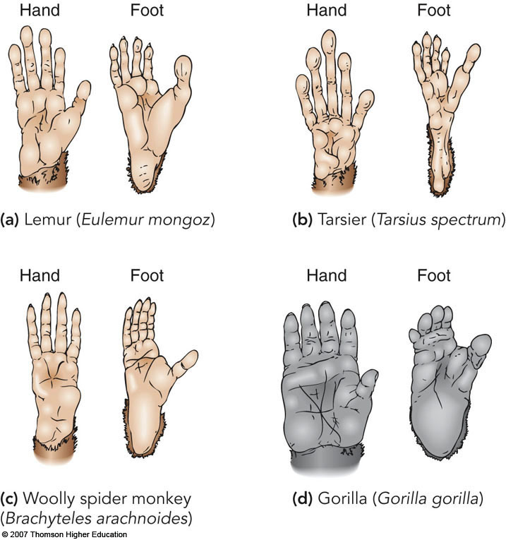
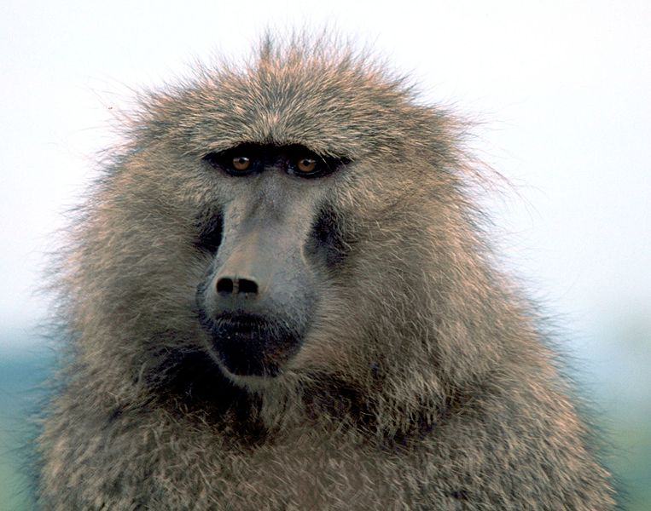
Adaptations to what type of life-style?

Slide 4
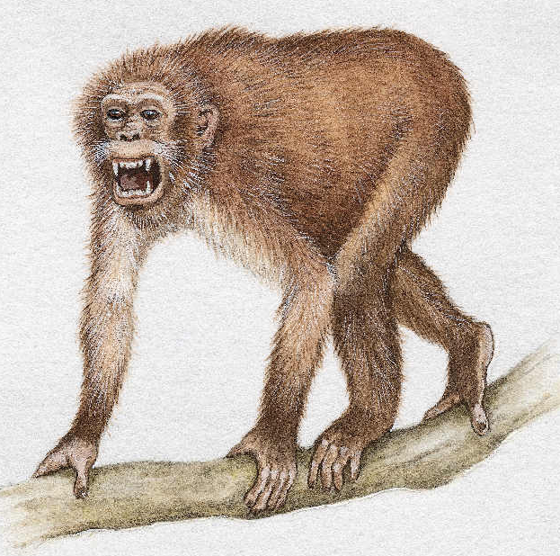
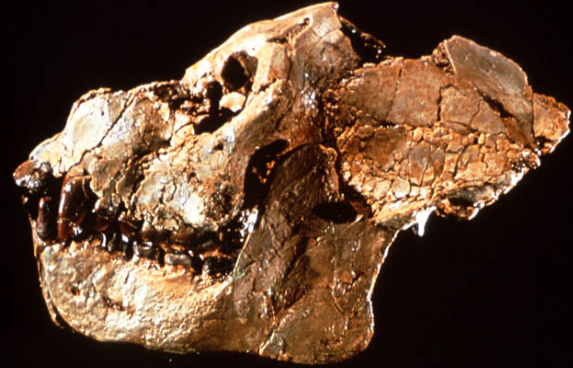
Ape evolution: Fossil record
Earliest ape-primate transition fossil 34 MYA
Aegyptopithecus was unearthed in Egypt
Appears to be the common ancestor between monkeys and apes

Slide 5
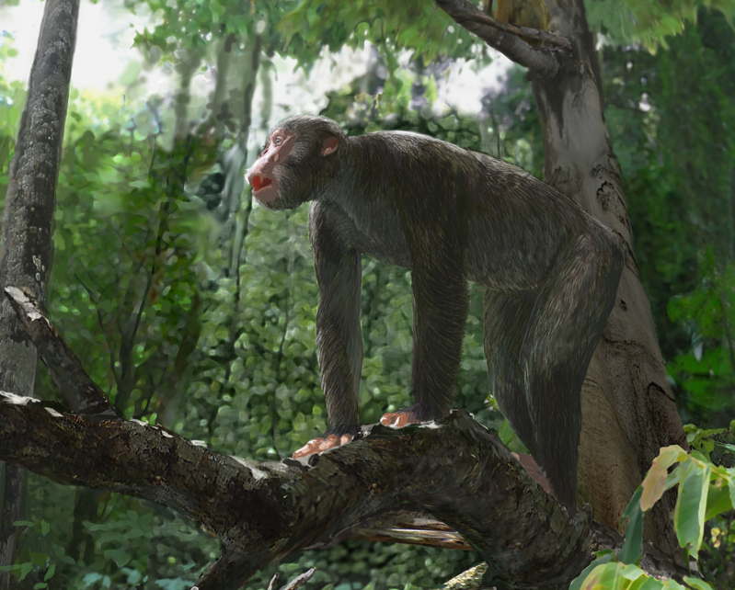
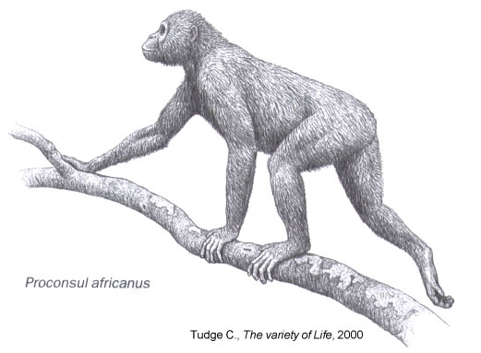
Proconsul
E. Africa, 20 MYA
Limbs and body proportions of a monkey but lacked a tail
Ape-like teeth and head

Slide 6
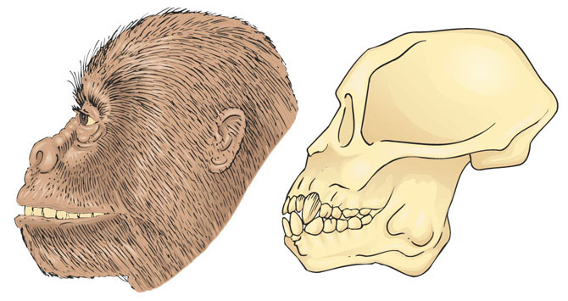
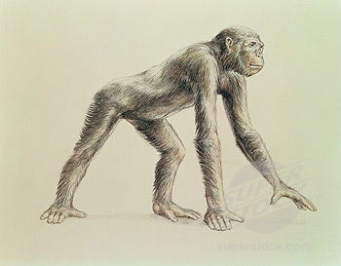
Dryopithocines
Organisms from Africa, Asia and Europe
  ~ 17 MYA
More ape-like
  Terrestrial life style
  Same dentition as modern apes (including humans)
Likely ancestors of all modern homonoids
Notes:
Dryopithocines
A large number of fossil species have been found from approximately 15 MYA
Much more ape-like than previous examples
Skeletons suggest shift to terrestrial life style
Same dentition as modern apes (including humans)
2:1:2:3 on both jaws (incisors, canines, premolars, molars)
Likely the ancestor of all modern hominoids

Slide 7
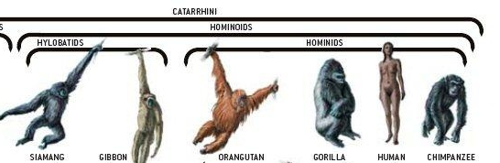
From here on out, looking exclusively at ancestors of humans

Slide 8
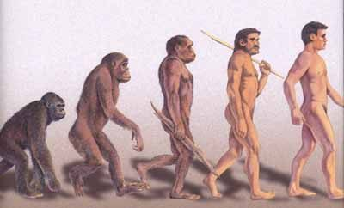
Hominid Evolution
Human evolution is not a record of ‘simple’, directional change over time…more like a bush!

Slide 9
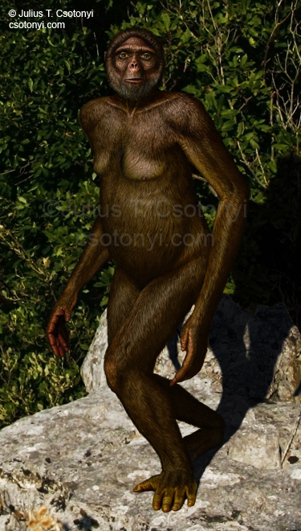
Ardipithecus ramidus
“Ardi”
4.4 MYA
Brain size ≈ chimpanzee
Facultative upright walker
Unique hand
Grasping big toe
Woodland-to-forest
Omnivore and fruit eater
Canines small and comparable to human

Slide 10
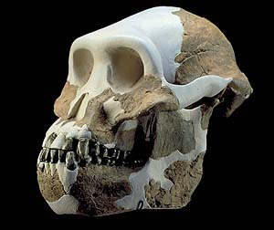
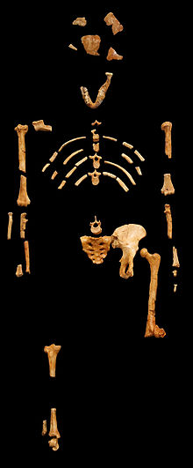
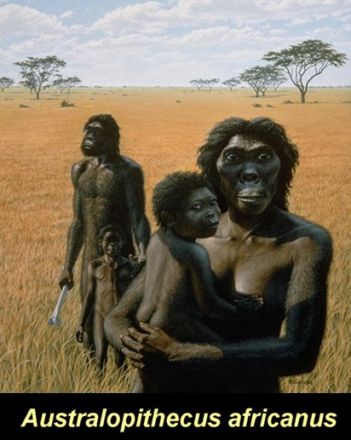
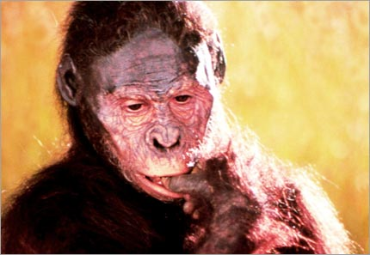
Australopithecus
4.0-1.2 MYA, Africa
Morphology:
  Small body
  small brains 500 cc
‘Lucy’, famous fossil
Sexually dimorphic - ?

Slide 11
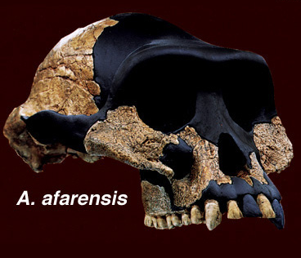
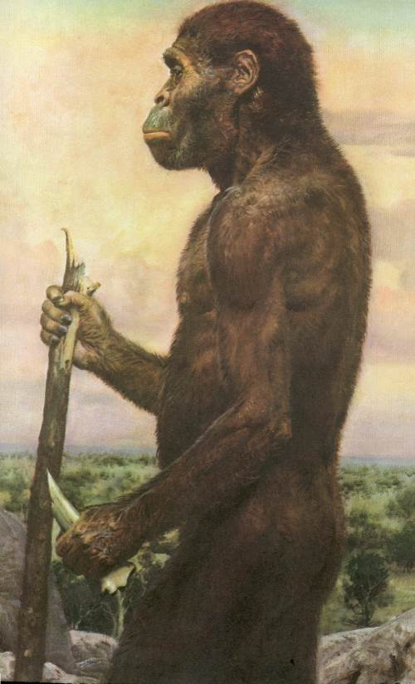
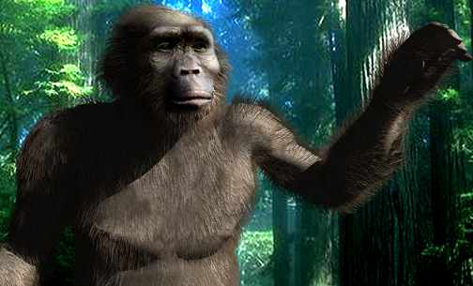
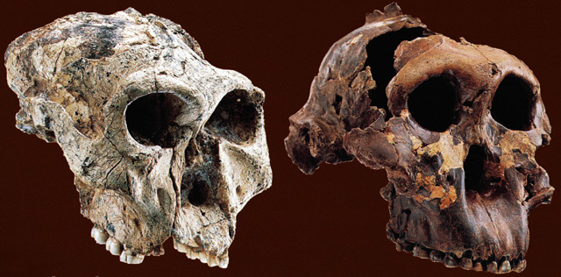
Australopithicus derivatives
Two major lineages
  Small and thin lineage
  Large and robust group
Evolutionary “off-shoots”
P. robustus
P. boisei

Slide 12
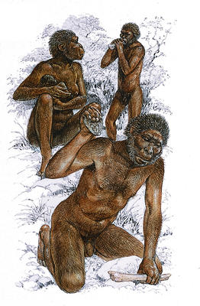
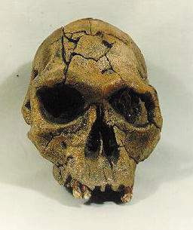
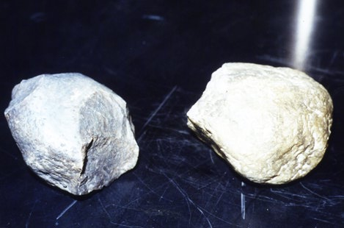
Homo habilis
2.5-0.9 MYA, Africa
Why the change in genus?
  Slightly larger brain (600cc)
  Different molar / premolar structure
Fashioned crude tools from stone

Slide 13
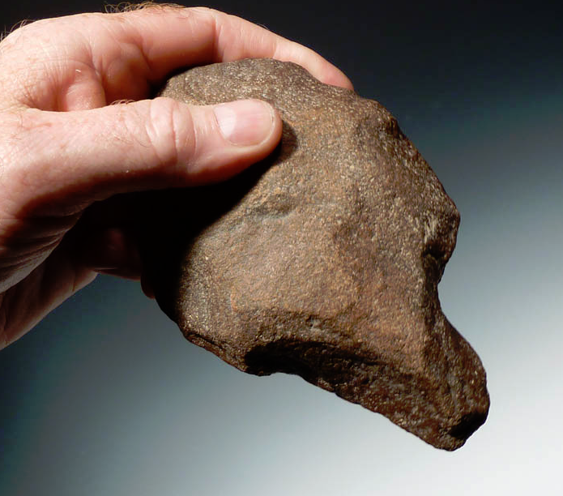
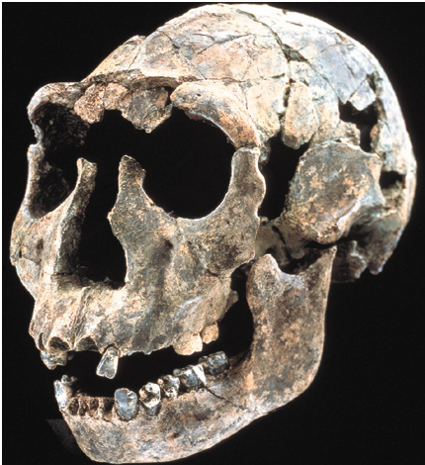
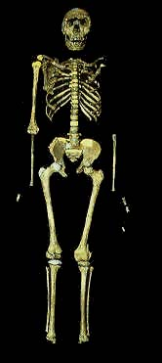
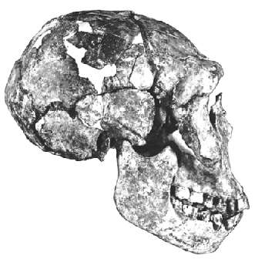
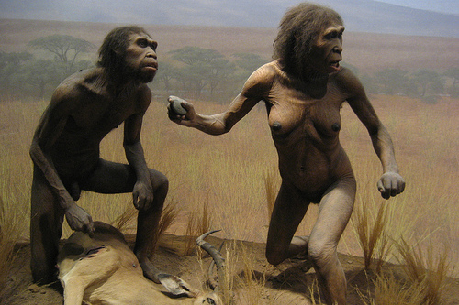
Homo ergaster
Possible ancestor to Homo sapiens
Turkana boy (Kenya)
  11 – 12 years old, fossil dates to 1.6 MYA
Larger brain size (880 cc)
More advanced tools
Social structure?
Language skills?

Slide 14
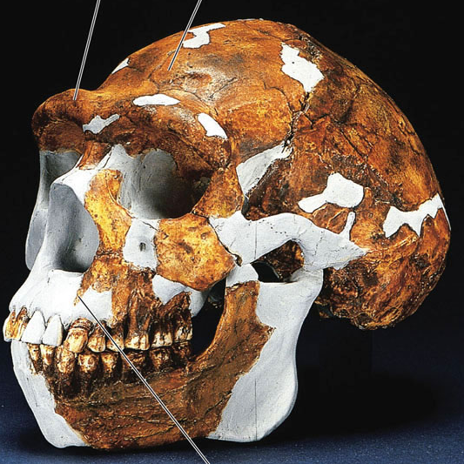
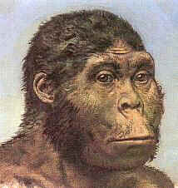
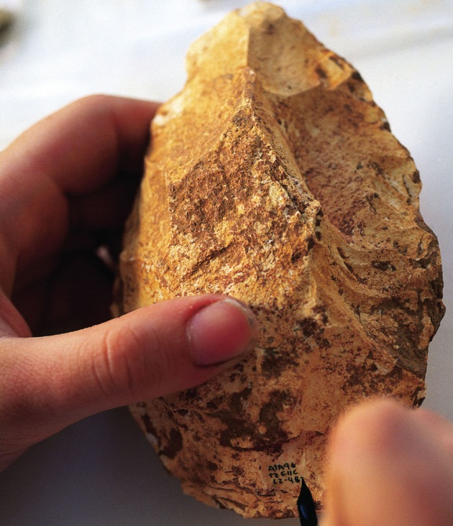
Homo erectus
Offshoot from H. ergaster
1.5 – 0.3 MYA
Larger brain & body:
  ~5ft
  1000 cc
Left Africa and migrated to Europe & Asia
More sophisticated tools (Acheulean)
May have worn clothing, built fires, lived in caves or shelters

Slide 15
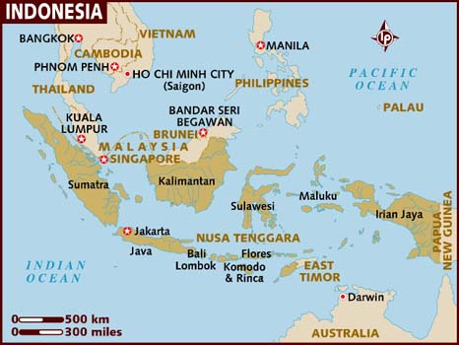

Slide 16
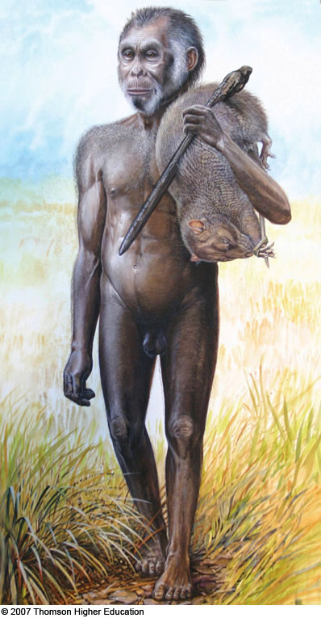
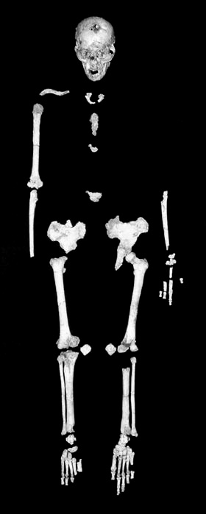
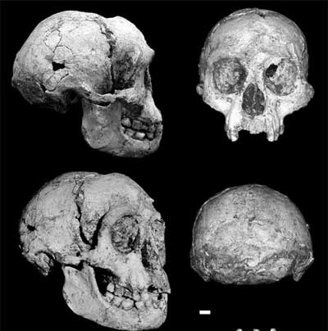
The hobbits
Homo floresiensis
Adult measured 3 ft tall
  A dwarf hominid species?
~40,000 - 12,000 YA
Capable of both fire and tool use
Size may be attributable to phenomenon known as ‘island dwarfism’
Notes:
Homo floresiensis
One interesting evolutionary offshoot from homo erectus - 2004
Homo floresiensis
Found on the island of Flores in Indonesia in 2004
Adult measures only 3 ft tall
May be a dwarf species of hominid that lived as recently as 12,000 yrs ago
Capable of making tools and using fire
Size may be the result of:
Island dwarfism – large mammals evolve smaller
Hunted pigmy elephants
Genetic defect causes microcephaly – small brain and body
Current evidence does not support this hypothesis

Slide 17
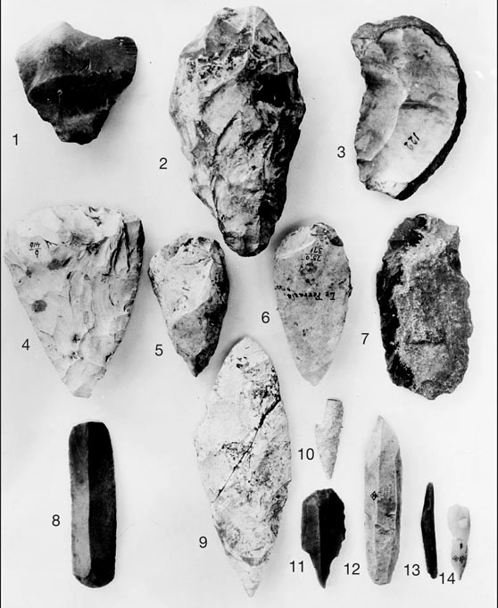
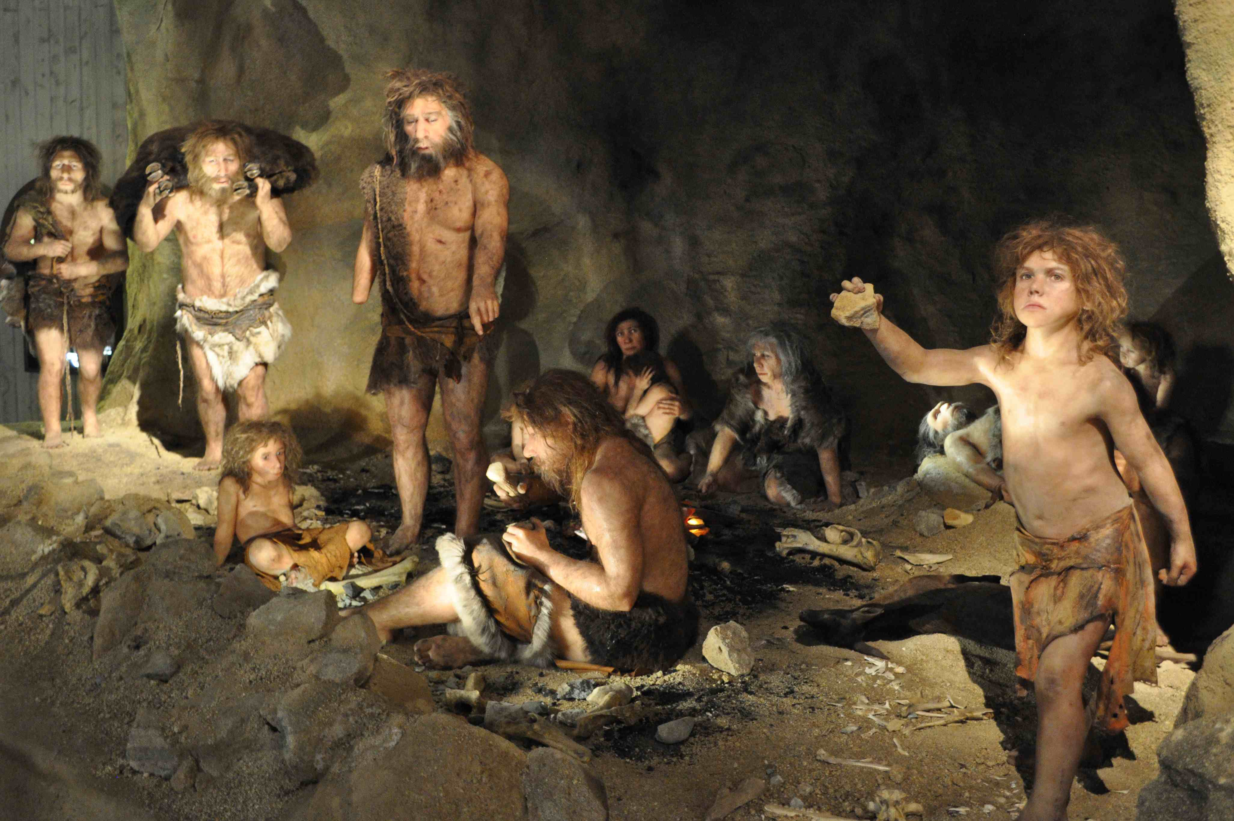
Neanderthals
250,000 – 28,000 yrs ago
Huge skull
Short & stout
Abrupt disappearance
Some interbreeding with humans

Slide 18
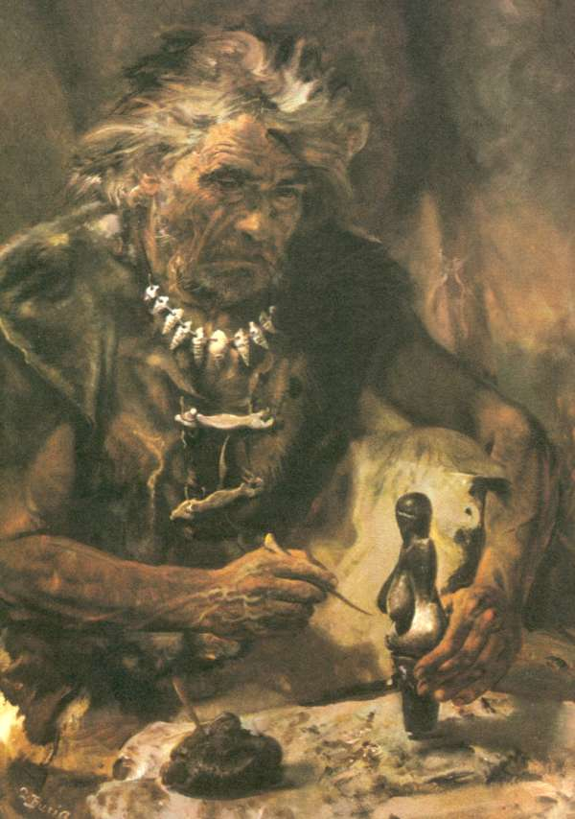
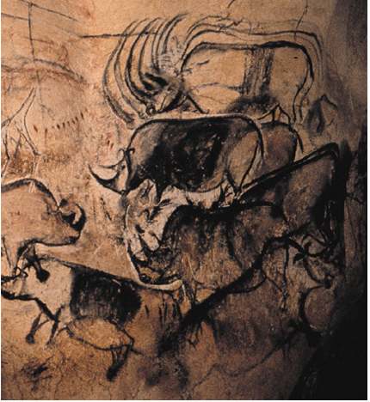
Homo sapiens
Arose in Africa
  195,000
Left Africa – 100,000 yrs ago
Europe - 45,000 yrs ago
Social organization
Language
Complex tools

Slide 19
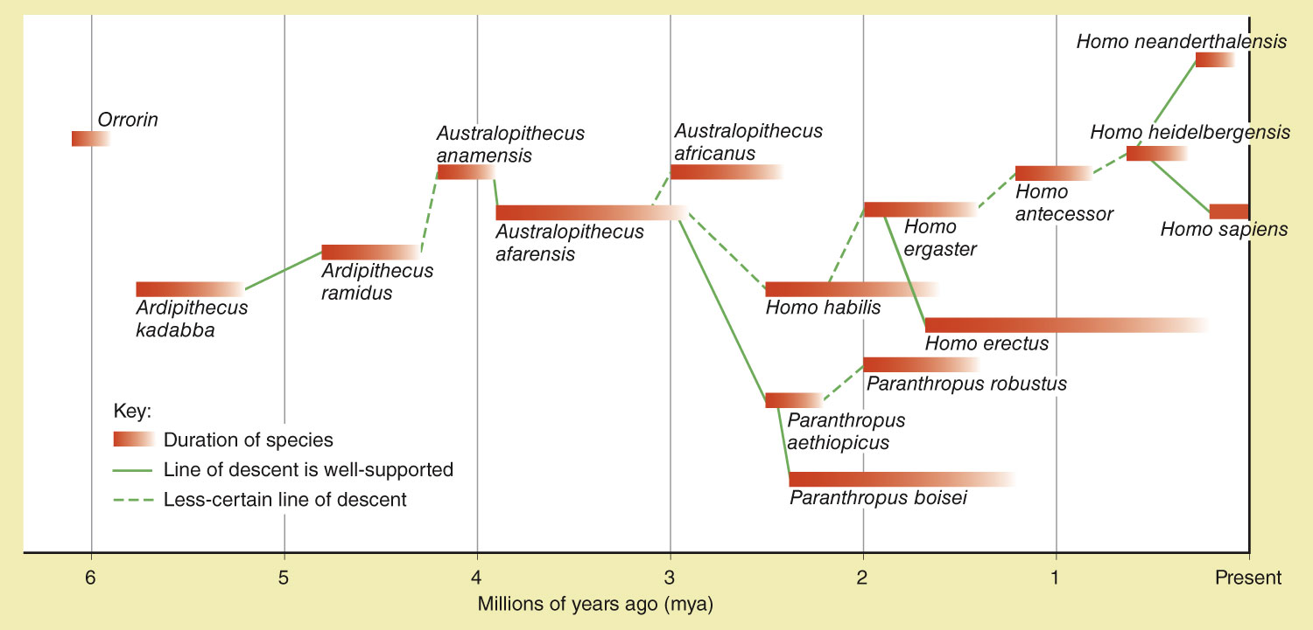
Picking up along the Human evolutionary bush!
Notes:
Figure 22.9: One interpretation of human evolution.
This interpretation, compiled by the author from multiple sources, will likely change as new evidence comes to light.

Slide 20
Other adaptations?
Many adaptations used to differentiate humans and their early ancestors
Include:
  Sagittal crest – prominent or reduced
  Position of the thumb and big toe
  Brow ridge – prominent or reduced
  Foramen magnum – general position (back or under)
  Prognathism (snout) – prominent? Over or underbite?
  Canines – large, medium, small?
  Canine diastema – gap between canines and incisors
  Incisors – present or not, prominent? angle?
  Chin – protruding chin
  Teeth arrangement – U-shaped or rounded

Slide 21
Part 1: build a timeline
Using your notes and working as a table, build a family tree showing the transition and branching of the various human ancestors leading up to modern humans (use the back of your 11x17 paper).
Start with Ardipithecus

Slide 22
Part 2: Character assessment
In groups of two, use the handouts and visit each station to fill in what characteristics each species had (or likely had). You will likely have to make comparisons between species to generate your answers.
Example: does proconsul have a small, medium, large, or very large sagittal crest?

Slide 23
Part 3: Evaluation (homework)
Between the ancestor of gorilla/chimps and modern humans, what characteristics disappear? What characteristics change and how so?
Who would you put in a zoo (i.e. where would you make the cut off) and why?
Who would you take to dinner and why?
  Can’t take Homo sapiens

Slide 24
Picking up along the Human evolutionary bush!
Notes:
Figure 22.9: One interpretation of human evolution.
This interpretation, compiled by the author from multiple sources, will likely change as new evidence comes to light.

Slide 25
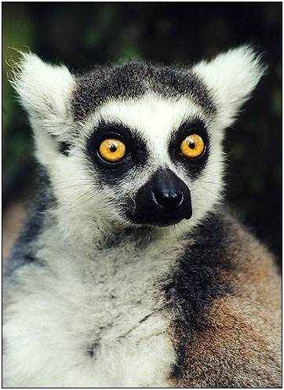
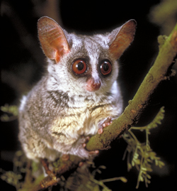
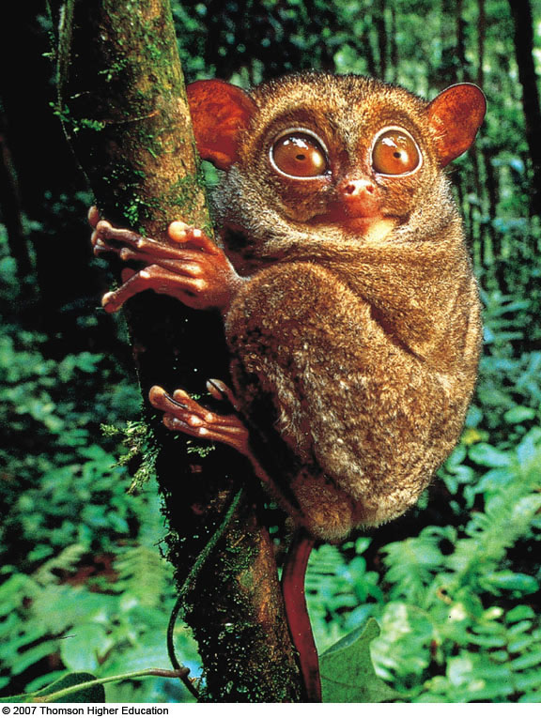
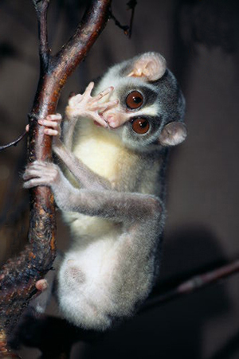
Suborders of Primates
Prosimii
Tarsiiformes
Anthropoidea
http://www.youtube.com/watch?v=6Jz0JcQYtqo

Slide 26
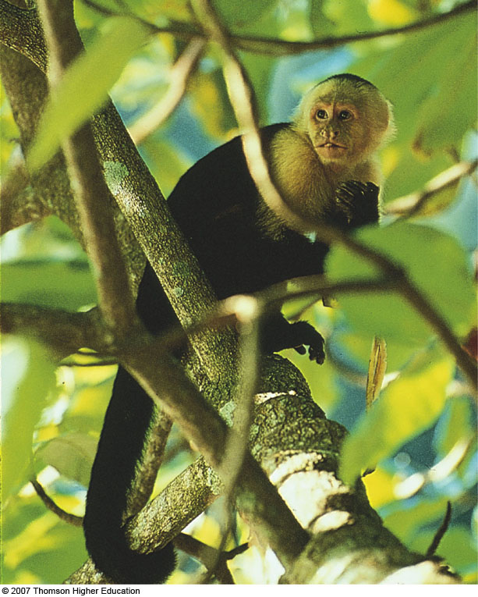
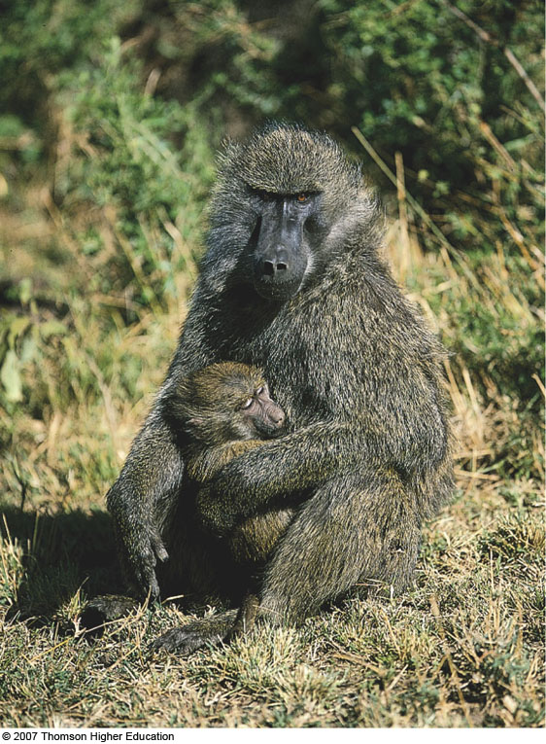
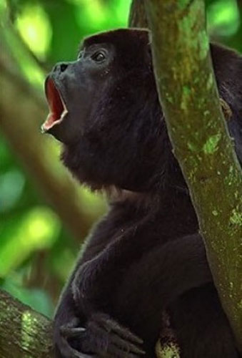
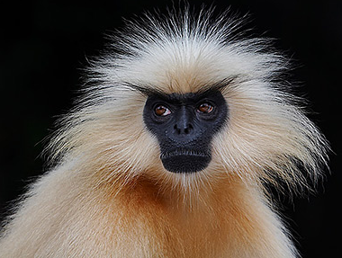
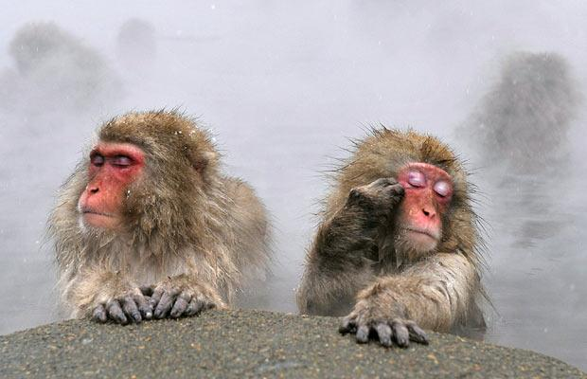

New World and Old World Monkeys
Langur
Marmoset
Macaque

Slide 27

The Living Apes
Fossil evidence indicates old world monkeys and apes diverged ~25 MYA
Closest living relatives to humans are the apes
Five major groups of apes

Slide 28




Human Evolution
Phylum Chordata
Subphylum Vertebrata
Class Mammalia
Order Primates
Family Hominidae
Genus Homo
Species sapiens

Slide 29

Genetic divergence
DNA sequence that produce hemoglobin is EXACTLY the same in humans and chimps
  2 amino acid changes from gorilla
  15 changes in rhesus monkey
Order of divergence:
  Gibbons = 15 MYA
  Orangs = 12 MYA
  Gorillas = 8 MYA
  Chimps = 6 MYA
The genetic difference between chimps and humans is 1.8%

Slide 30

So what does that mean?
The human genome is 3 billion base pairs
  1% is quite significant if you stop to think about it
Examples:
  HAR1: involved in cortex development
  HAR2: wrist and thumb development
  FOXP2: speech
  AMY1: starch digestion

Slide 31


Slide 32

These are referred to as the
Laetoli footprints.
They were made in ash.
The fossils stretch over 80 ft.
They are dated to 3.6 MYA

Slide 33
Hominid Evolution
Hominids - group of human-like ancestors gave rise to modern humans
After this lineage diverged from other apes
Went through large diversification of species
Human evolution is not a record of ‘simple’, directional change over time…more like a bush!

Slide 34

Notes:
Studying human evolution.
The late Drs. Mary and Louis Leakey studied fossil teeth from Australopithecus boisei, an early hominid (human) that lived in Africa. This photo was taken in Olduvai Gorge in Tanzania. The Leakey family has contributed much of what we know about human evolution. Son Richard, daughter-in-law Meave, and granddaughter Louise have followed in the footsteps of Mary and Louis.

Slide 35


Sahelanthropus tchadensis
6-7 MYA
Discovered in Chad
  2002
Demonstrated greater dispersion and a wider variety
Small brain case, similar to a chimp
Face and teeth had many characteristics of larger brained human ancestors
Mechanism of locomotion is unknown
  Foramen magnum is in the right place

Slide 36



Orrorin
6 MYA
Discovered in Kenya
  2001
Probably bipedal
The notion is
based on fossil leg
bones

Slide 37

Why ?
It is more energy efficient than quadrapedalism
Enables an individual to see over tall grasses
Pick fruit from trees
Exposes less body surface area to the sun’s rays
Enabled wading across bodies of water
Frees the forelimbs to carry food…pair bonding

Slide 38

Simply curved spine
Foramen magnum at the center base of skull
Complex curvature of human spine
Foramen magnum at the center rear of skull
Tall, narrow pelvis (front view)
Shorter, broader pelvis (front view)
First toe not aligned with others
First toe not opposable, and all toes aligned
Gorilla skeleton
Human skeleton
Notes:
Figure 22.7: Gorilla and human skeletons.
When gorilla and human skeletons are compared, the skeletal adaptations for bipedalism in humans become apparent.

Slide 39



Hominids!
Found in 1994 in Afar, in the Great Rift Valley of Ethiopia
Took about 3 yrs to trawl the volcanic ash
  125 fragments together

Slide 40
“Imagine that paleontologists from the distant future learned everything they knew about our entire species from the skeleton of a single NBA player. If they then uncovered the skeleton of a five-foot gymnast, they would be right to wonder whether they had found a separate species.”
--- Carl Zimmer

Slide 41



Lordkipanidze et al. 2013. Science

Slide 42

Origins of Modern Humans

Slide 43

But wait there’s more…
May of 2010 - Neandertal genome was published
Unexpected findings:
  1 - 4% shared nuclear DNA
  Absent in Africans
Better to say Out of Africa (with leakage)?
  Overlap
  Interbreeding
  Middle East

Slide 44
Picking up along the Human evolutionary bush!
Notes:
Figure 22.9: One interpretation of human evolution.
This interpretation, compiled by the author from multiple sources, will likely change as new evidence comes to light.

